Slide 1


Occupancy and Motion Detectors
Lucas Kechouri – 6218000236
Arnaud Guénard - 6218000232

Slide 2
Definitions
Occupancy :
The action or fact of occupying a place.
Motion:
The action or process of moving or being moved.
Detector:
A device or instrument designed to detect the presence of a particular object or substance.

Slide 3
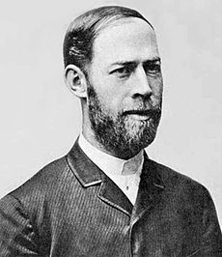
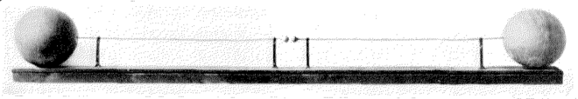
A Brief History of motion detection
1879 :
Heinrich Hertz prove the existance of electromagnetic waves.
Hertz’s first radio transmitter (50MHz).
Heinrich Hertz

Slide 4
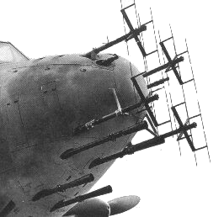
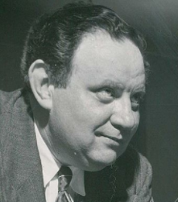
1940s:
Radar (Radio Detection and Ranging) are used to guide aircraft and detect enemy movements.
A ww2 aircraft’s radar
1950:
The first ‘’true’’ Motion Detector, the « Burglar alarm system» is invented by
Samuel Bagno.
Samuel Bagno

Slide 5

Bagno’s Idea:
Bagno applied the fundamentals of radar to ultrasonic waves, a frequency that humans cannot hear, to detect a thief or a fire. His system also made use of the Doppler effect, the difference in the frequency of waves of a moving object

Slide 6
Nowadays:
A lots of modern motion detection systems still follows bagno’s concept but new ways to detect movement or presence exists, such as the microwave motion detector. Like a lot of other sensors they play a crucial part of our everyday life.
Microwave sensors are used for example on automatic doors.

Slide 7
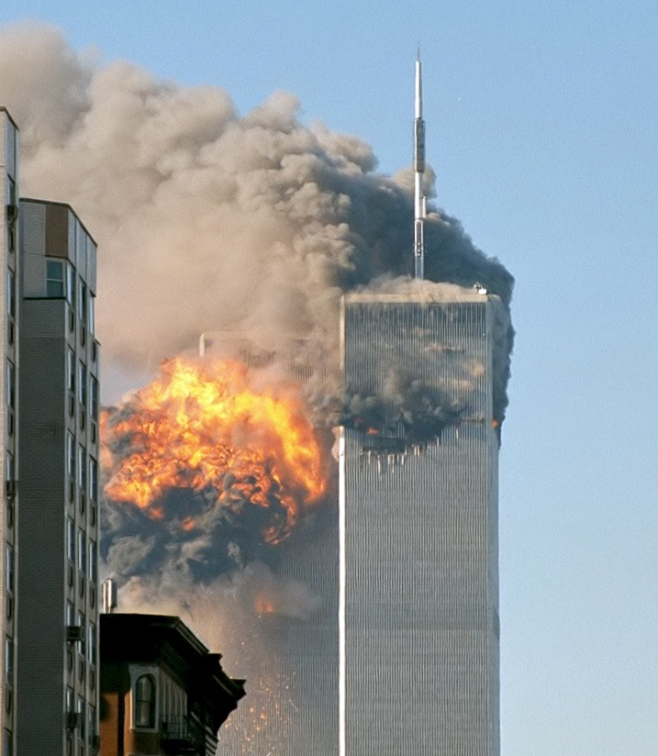
Motion detectors fields of use
The september 11 attacks are one of the events that have changed the ways people think about security and an expanding interest in developping more reliable detection and monitoring systems.
Nevertheless motion detection isn’t only used in security and surveillance but in other fields such as : Energy management, Domotic, Gaming, Advertisement, etc…

Slide 8
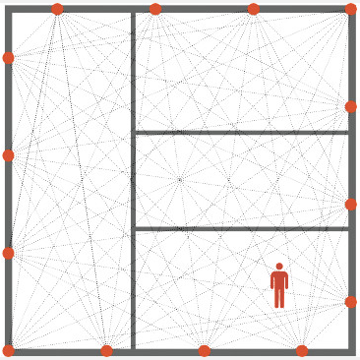
Technology
Passive Infrared (PIR)
Microwave
Ultrasonic
Tomographic
Video caméra software
Gesture detector
Etc...

Slide 9
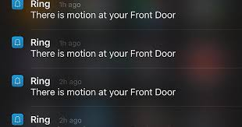
A Risk, the ‘’False-positive’’
Or when the sensor detects a presence when the is none.
In noncritical application it can become a bit annoying...

Slide 10
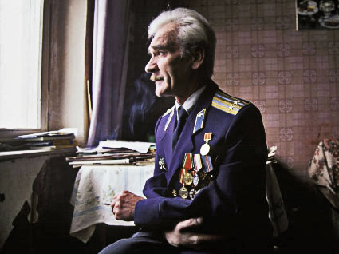
…but in other system, specifically in security, it can represent a major risk to safety :
In 1983, during the cold war, the soviet satellite network detect 5 nuclear missile approaching russia.
Stanislav petrov (on the left) decides to wait for confirmation before ordering an attack over the usa.
It appeared later that those missiles were in fact sunrays reflected on clouds.

Slide 11
A solution to the false positive is for example to use sensors operating on an other physical principle (ex: combining capacitive and infrared detectors)
Also when choosing a sensor for critical application a reflexion should be made about its reliability, its suitability and its noise immunity.
Next, the Occupancy sensors…

Slide 12
Occupancy Sensor

Slide 13
What is it ?
It is a device that can according to its type, detect a change of state around him. Ex : a door that opens or a baby crying.
When the device detects something, it turns on and do what it was programmed for.

Slide 14
Main Occupancy Sensor Type

Slide 15
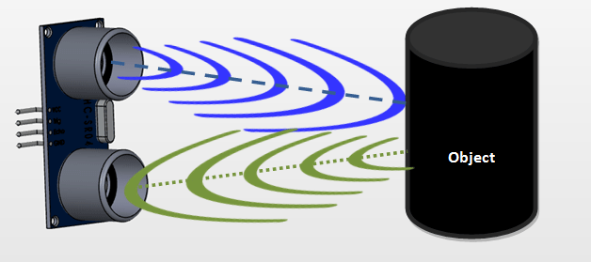
Ultrasonic Sensor
Sensor that send ultrasonic waves (16kH -> 10.000kH) in order to know its close environment

Slide 16
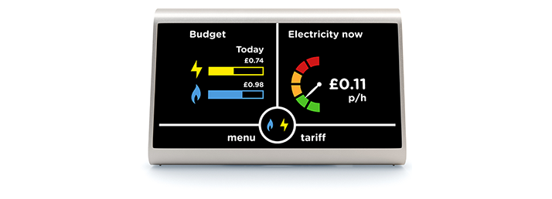
Smart Meter
Sensor that can detect changes in electricity consumption

Slide 17
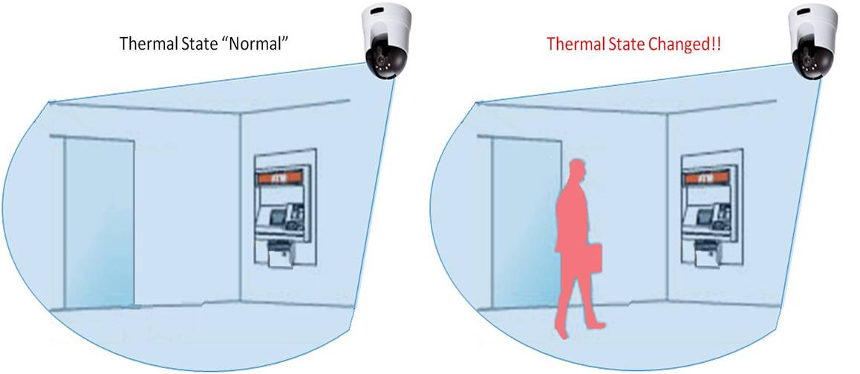
PIR (Passive Infrared Sensor)
Sensor working with the temperature change by measuring the variations of infrared waves

Slide 18
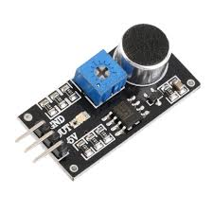
Audio Sensor
Sensor that activates when it detects sound

Slide 19
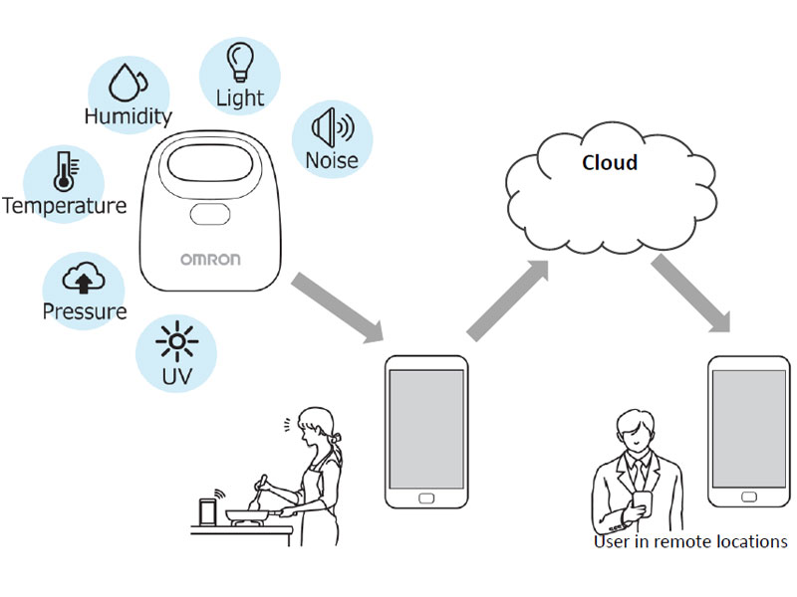
Environmental Sensor
Sensors measuring different data (temperature, humidity, CO²) that detect environemental changes

Slide 20
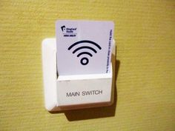
Keycard Slight Slot
Sensor that detect if a hotel card is present to activate electricity and thermostat

Slide 21
Main utility of these sensor :
Control your energy consumption to save energy
Provide automatic control

Slide 22
Occupancy and Motion Detectors
Lucas Kechouri – 6218000236
Arnaud Guénard - 6218000232

