Slide 1
Natural Language Understanding
Will Kearns
BIME 591: Artificial Intelligence Methods for Conversational Agents in Healthcare
2019-10-08

Slide 2
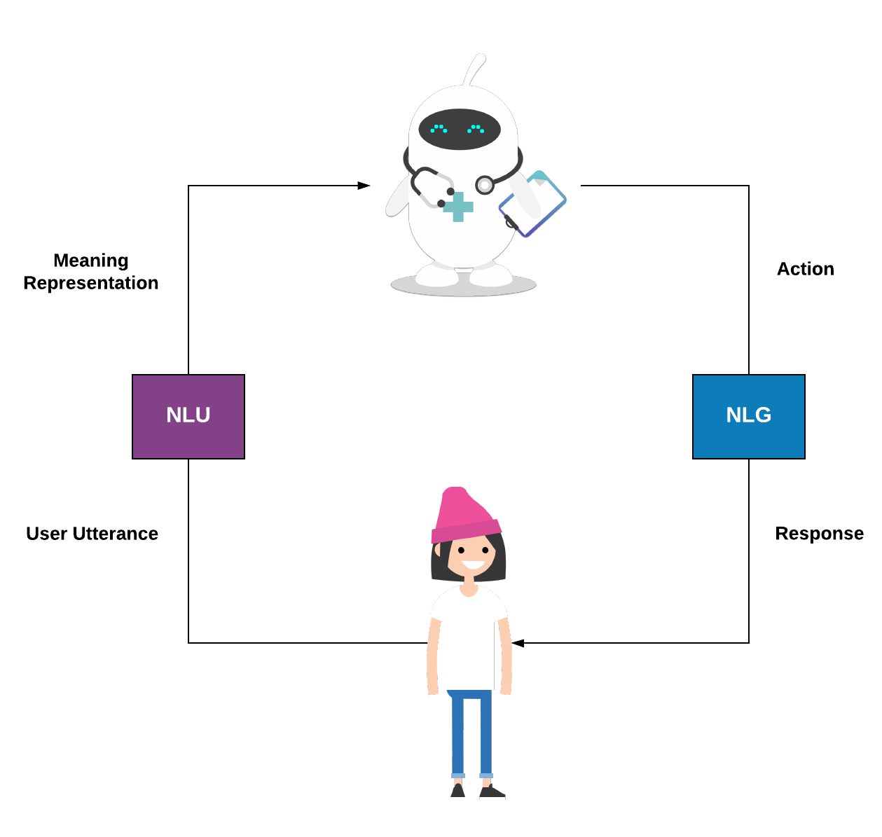
Task
Given a user utterance construct a computable meaning representation.

Slide 3
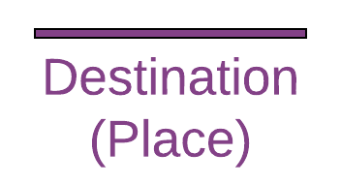

Intent/Slot Schema
Intent: The purpose behind the user utterance.
Each intent can define slots required to fulfill that intent.
I need transportation to the hospital.
Alternatives:
Grammars
Propositional Logic
Example: Head-drive Phrase Structure Grammar and Minimal Recursion Semantics

Slide 4
Intent/Slot Schema
Intent: The purpose behind the user utterance.
Each intent can define slots required to fulfill that intent.
I need transportation to the hospital.
Alternatives:
Grammars
Propositional Logic
Example: Head-drive Phrase Structure Grammar and Minimal Recursion Semantics

Slide 5
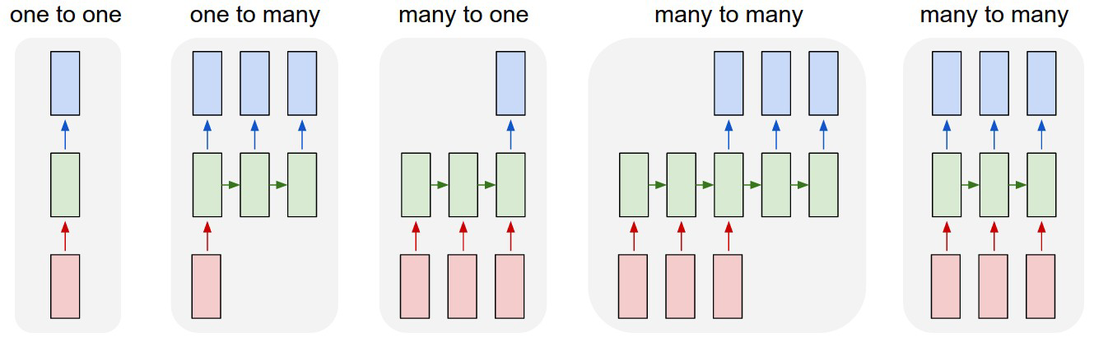
Intent Classification Methods
Input: Word Sequence Output: Intent Class
Index all words to numerical representation, i.e. hospital → 324
Represent each word as a vector using a randomly initialized embedding matrix.
Use favorite classification model LR, CNN, LSTM, Transformer.
Learn weights using backpropagation of loss.

Slide 6

Intent Classification Methods
Input: Word Sequence Output: Intent Class
Index all words to numerical representation, i.e. hospital → 324
Represent each word as a vector using a randomly initialized embedding matrix.
Use favorite classification model LR, CNN, LSTM, Transformer
Overcome small in-domain data using pre-trained embeddings.
Freeze embedding layer.

Slide 7


Slide 8
Slot Tagging
Locate span of text corresponding to a slot in semantic frame of intent.
Regular expression matching, e.g. ^\([0-9]{3}\)[0-9]{3}-[0-9]{4}$
Thesaurus based methods, e.g. Metamap.
Pros:
High recall
Easy to implement
Require no training data
Cons:
Poor scaling
Error prone
Difficult to manage

Slide 9
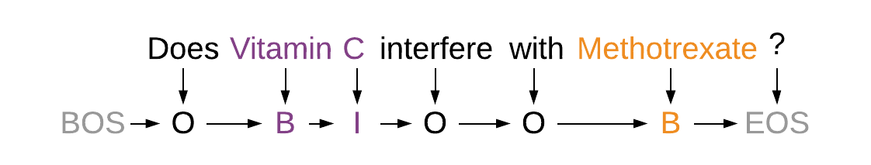
Slot Tagging
Input: Word Sequence Output: BIO Tags
Choose favorite sequence model: CRF, LSTM, Transformer.
Note: x-CRF Conditional Random Field (CRF) decoder with external knowledge.

Slide 10
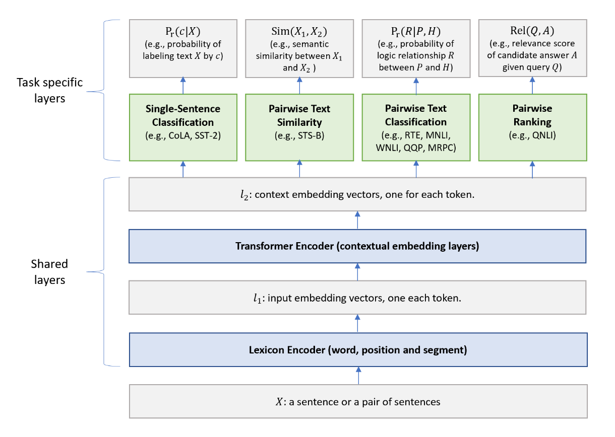
Multi-Task Learning
Liu X, He P, Chen W, Gao J. Multi-Task Deep Neural Networks for Natural Language Understanding. In Proc. ACL 2019.
Notes:
Many of you are probably familiar with these methods. We’ll be providing an overview as a foundation.
If you don’t follow exactly, that’s okay too. I’ll star the most important slides.

Slide 11
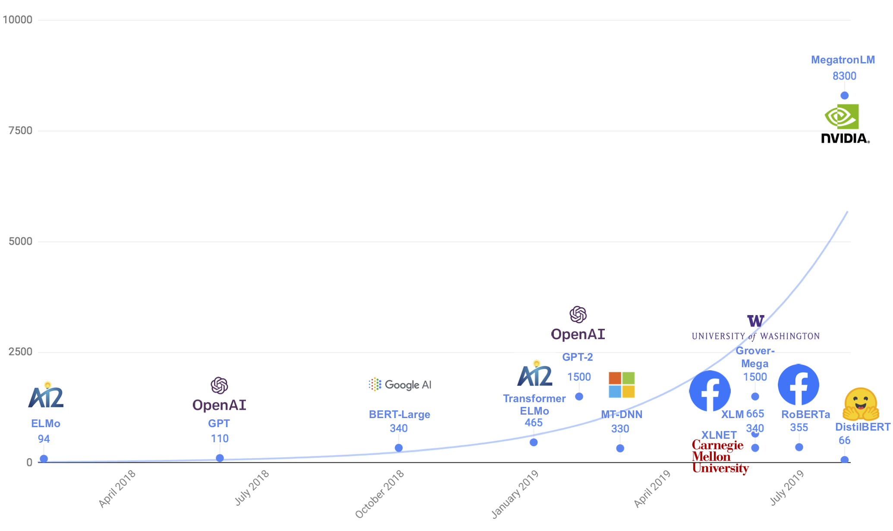
Article by Hugging Face on Distillation methods
Notes:
Expensive
Slower inference

Slide 12
Spoken Language Understanding
* Requires additional considerations
Disfluencies: I need to uhh… go to the … uhh hospital
Correction: I need directions to the clinic… I mean hospital.
Error Propagation: Does Vitamin C interact with Methorphan (sic) ?
Etc.

Slide 13
Interactive Coding Lab
Join a group.
Each group should select a domain to address.
Design an intent/slot schema.
Train NLU model.
Medical Education
Clinical Processes
Mental Health
Personal Health
Patient Education

Slide 14
Additional Resources:
LSTM - https://colah.github.io/posts/2015-08-Understanding-LSTMs/
BERT - https://jalammar.github.io/illustrated-bert/
Regex - https://regex101.com/
Green AI - https://arxiv.org/abs/1907.10597

