Slide 1


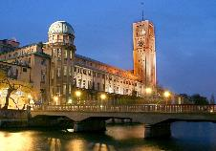
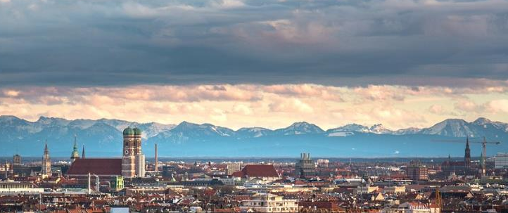






Forum on specification & Design Languages
10-12 September 2018 | Munich, Germany
FDL is an international forum to exchange experiences and promote new trends in the application of languages, their associated design methods, and tools for the design of electronic systems. FDL stimulates scientific and controversial discussions within and in-between scientific topics as described below. The program structure includes original research sessions, tutorials, panels, and technical discussions, as well as standardization meetings. Furthermore, “Wild and Crazy Ideas” are welcome.
For all of these tracks, electronic systems of interest to FDL include (but once again are not limited to) those that are used in Internet of Things (IoT), Cyber-Physical Systems (CPS), mixed criticality embedded systems, automated driving and driver assistance, real-time systems, reconfigurable and secure computing.
We welcome authors to submit manuscripts on topics including, but not limited to:
https://commons.wikimedia.org/wiki/File:Museumsinsel_M%C3%BCnchen.jpg
by Max-k muc
Language- and Formalism-Based Design Methodologies
This track seeks novel research contributions that employ languages and formalisms in the design, test, verification, and simulation of modern day electronic systems. These contributions may consist of (but are not limited to) the use of requirements and property specifications, models of computations, automata, networks, model and component-based design, platform modeling and abstraction, and system-level design languages, including synchronous languages and formalisms for the emerging quantum computing. Moreover, we encourage contributions on the design of new and disruptive languages.
Source: CC0 No attribution https://pixabay.com/en/munich-olympia-mountain-1558682/
Techniques for Modern Architectures and Applications
This track seeks research contributions demonstrating effective techniques for system design involving modern approaches such as machine learning and its verification, as well as modern computing architectures such as energy-efficient computing, accelerators including GPUs and FPGAs, and IoT applications for the design and verification of electronic systems. Examples may include (but are not limited to) parallel simulation, compilers with support for multi/many-core and heterogeneous architectures, high-level hardware and software synthesis, virtual prototyping, and design space exploration.
Tools, Flows and Industry-Relevant Applications
This track solicits contributions that present authors' experiences in designing applications that are relevant to electronic systems industries. The contributions should focus on applications that identify valuable design, test, simulation and verification practices for applications of the future. The contributions may also demonstrate effective use of tools for successfully developing industry-relevant applications.
Important Deadlines:
Special Sessions: Mar 24, 2018
Abstract Deadline: Apr 21, 2018
Paper Deadline: Apr 28, 2018
Other Contributions: May 26, 2018
Author Notification: Jun 26, 2018
Final Version: Jul 21, 2018
Submissions:
Authors should submit papers in double column, IEEE format as PDF through the submission system. A full research paper must be a minimum of 6 pages and a maximum of 8 pages. Other contributions shall not exceed 2-4 pages. Submitted papers must be anonymous (double blind), must describe original unpublished work, and must not be under consideration for publication elsewhere.
Publications:
Conference proceedings will be published in electronic form with an ISSN and an ISBN number and made available on IEEE Xplore. In addition, an edited collection of extended versions of selected best papers will be published as a book by Springer. Accepted papers must be presented by one of the authors. A full registration for each paper is required prior to the camera ready papers deadline.
Call for Special Sessions:
Special Sessions should focus on a topic which is of particular interest to the FDL audience. Papers of Special Sessions may be included in IEEE Xplore depending on their quality. People interested in organizing a Special Session must submit a brief proposal (no more than two pages) which describes the topic, the intended audience, as well as a list of possible speakers to fdl2018@easychair.org.
General Chair: Hiren Patel | Univ. of Waterloo
Program Chair: Tom J Kazmierski | Univ. of Southampton
Program Co-Chair and Local Chair: Sebastian Steinhorst | TU Munich
Special Session Chair: Daniel Grosse | Univ. of Bremen
Panel/Tutorial Chair: Sara Vinco | Politecnico di Torino
Finance Chair: Graziano Pravadelli | Univ. of Verona
Publication Chair: Akramul Azim | Univ. of Ontario Inst. of Technology
Website: www.fdl-conference.org | Contact: fdl2018@easychair.org

