Slide 1
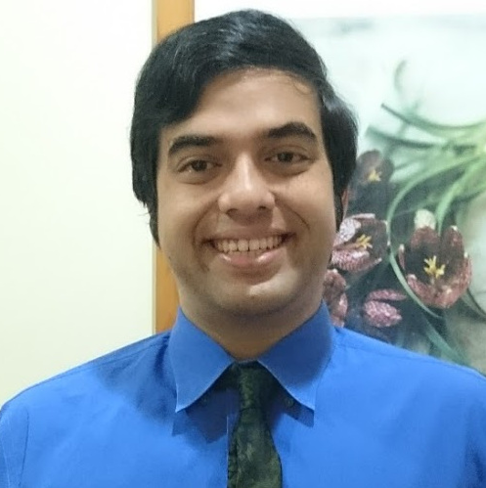
Generative Artificial Intelligence
Bishmer Sekaran
Senior Machine Learning Engineer at Xaltius

Slide 2

PLEASE DOWNLOAD YOUR OWN COPY
Github

Slide 3
Principles and Concepts

Slide 4

Discrimination vs Generation
Categorizes or answers
* “Will it rain tomorrow?”
* “Is this cat or dog?”
* “What is next year’s GDP?”
* “Draw red boxes around the faces without masks”
Creates and produces
* “Draw an apple tree”
* “Write me a K-pop song”
* “Recreate the first chapter of Dracula, but change the tone to Jane Austen’s writing style”
* “Animate the Smurfs going to space in a giant mushroom
rocket”

Slide 5
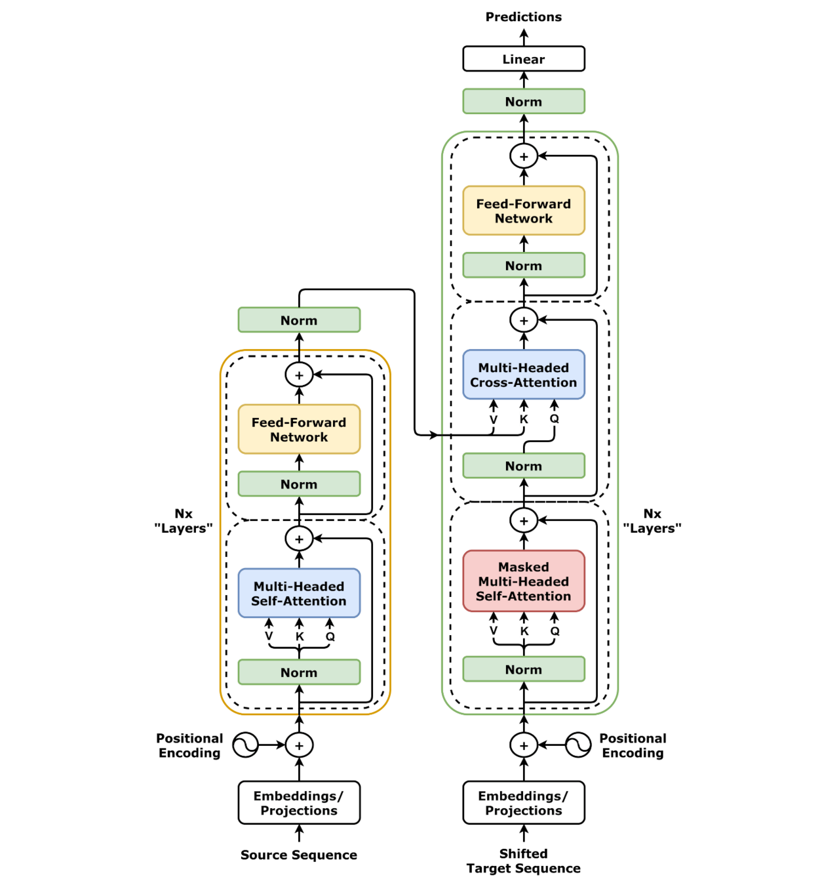
The common internals
Transformers use "self-attention heads"
to weigh data relationships, "attending"
to the most important data for meaning.
This allows the understanding of context.
Importance is established by statistical
patterns
Vaswani, et al
“Attention is all you need”
2017, Google Brain

Slide 6
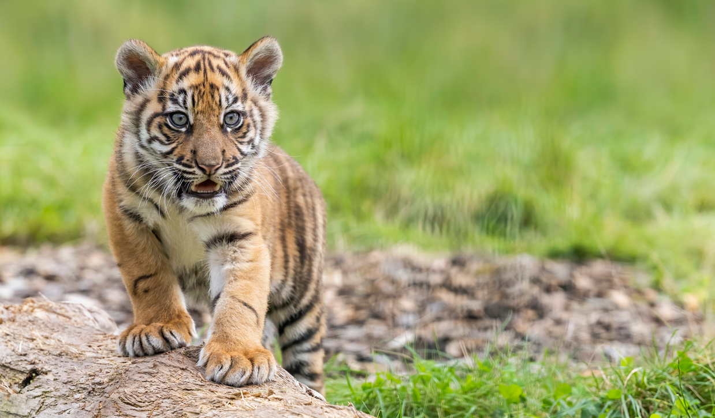
Model’s eye view
Mostly green/brown -> background
Orange thing -> Foreground
Round and triangular bits of orange thing -> Region of interest

Slide 7
GenAI across Industry 1 to 4.0

Slide 8
All Industries
Content creation – marketing copy, routine correspondence, social media posts
Brainstorming – new products, slogans, strategies, budgeting
Personalization – tailor experiences per-customer, communicating at scale
Data enhancement – synthesizing new data, extending graphs, improving internal data models

Slide 9
Individual business cases
Matrix Marketing Group – 62% cost reduction
Tokopedia – 5% increase in unique product sales
Mercedes-Benz – New online storefront with virtual agents
Samsung – deploying Gemini to new Galaxy phones

Slide 10
Using GenAI – Live!

Slide 11
Please log into gemini.google.com

Slide 12
Crime and Controversy

Slide 13
Crime-enhancing Gen AI tech
Voice-cloning
Deepfake videos (from 24 hours ago!)
Cryptocurrency manipulation
AI-assisted cracking

Slide 14
Controversies and legal issues
The Sarah Silverman lawsuit
The music studios vs Suno and Udio lawsuit
Tech layoffs 2023
GenAI limits (see: “Why is everyone LYING?”)
Timnit Gebru vs Google
Model Bias
Have and have-not hardware fairness

Slide 15
Thanks for coming!

