Slide 1
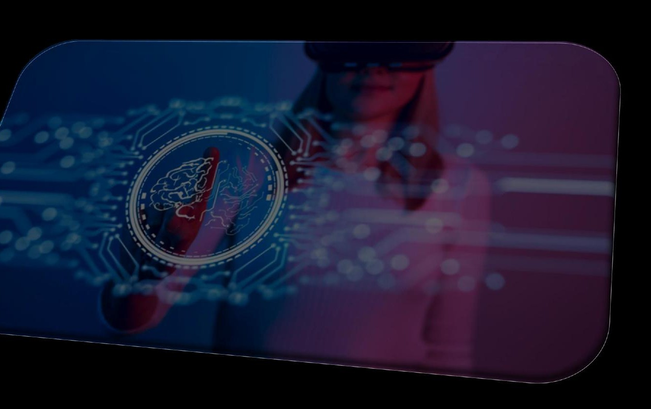
Ubiquitous XR: from healthcare to arts
Fabrizio Sulpizio - Portfolio
POLITECNICO DI TORINO · Computer Graphics & Vision Group
Notes:
Good afternoon everyone, I am Fabrizio Sulpizio and today I will bring you through my journey in Extended Reality at Politecnico di Torino

Slide 2
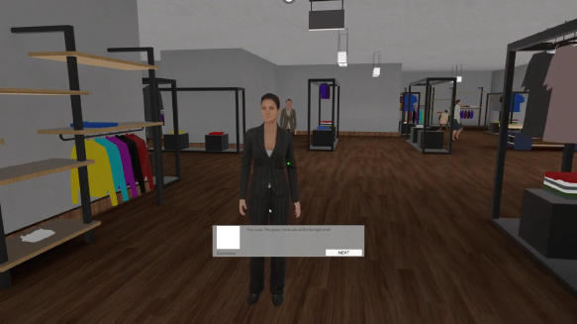
Aware: desktop VR for Social Anxiety
Desktop virtual reality application for exposure therapy targeting social anxiety disorder, featuring immersive scenarios designed for gradual desensitization.
Notes:
I began exploring immersive technologies during the Virtual Reality course in my master’s program. Aware is a virtual reality prototype application designed to help users manage social anxiety. The experience begins in a psychologist’s office, where the possible scenarios are introduced. In the first prototype, developed using the vertical slicing technique, we focused on social anxiety in a clothing store setting. Within this environment, the user is given a series of objectives communicated through a virtual smartphone display, which serves as a meta-interface. Tasks such as asking a salesperson for assistance, waiting in line, and paying at the cashier involve everyday social interactions that can trigger discomfort; the application allows users to engage with these situations in a controlled setting.
For this project, I collaborated with colleagues from design and architecture. This interdisciplinary teamwork strengthened my ability to communicate effectively across different fields and to integrate diverse perspectives into a cohesive interactive experience.

Slide 3
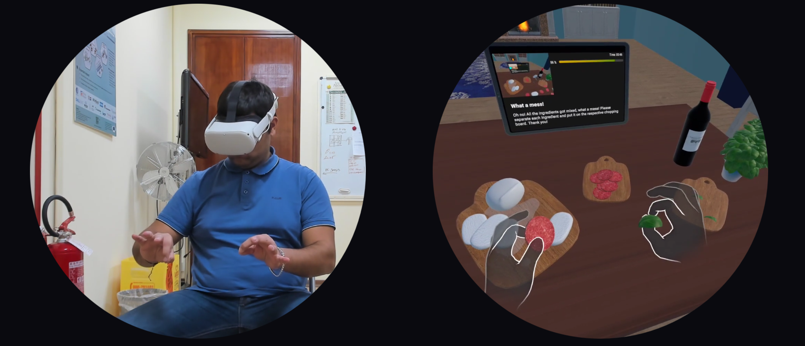
MetaRehab (IEEE GEM2024)
A self-supervising, home-based, gamified VR app for hands rehabilitation in patients with neurodegenerative syndromes
Notes:
Metarehab was my master thesis project. It is a gamified virtual reality application developed to support at-home rehabilitation for people with Parkinson's disease. The app places users inside an immersive VR environment modeled after a familiar home setting, allowing them to perform physical and cognitive rehabilitation exercises in a comfortable and recognizable context. To keep users motivated and encourage consistent daily use, the experience is built around gamification principles, turning therapeutic exercises into engaging interactive challenges. Interaction is handled through a Natural User Interface, meaning users can engage with the environment in an intuitive, gesture-based way without needing to learn complex controls, which is an important consideration for a population that may face motor difficulties. The app also incorporates multimodal feedback, combining visual, auditory, and other sensory cues to make the experience accessible to users with varying needs and abilities. It was composed of 7 scenes with increasing difficulty, featuring both hands coordination and dual task training. Overall, MetaRehab is designed to bring professional-grade rehabilitation into the home, reducing the need for repeated clinic visits while keeping patients actively engaged in their own recovery.
I loved this experience because I carried out the project as an industrial internship, which made me grow as a professional in a fast-paced environment with constraints that usually are not required in an academic setting, and with minimal supervision. Furthermore, I carried out a usability study analyzing perceived usability and workload, which I personally presented at IEEE Gaming,Entertainment and Media 2024. Per esempio che non deve essere prototipo

Slide 4
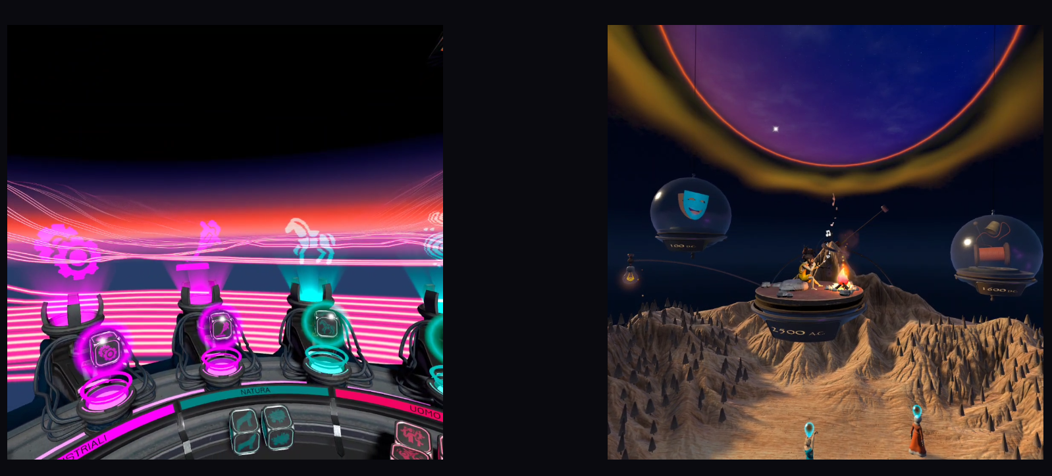
Alptech (Italian Ministry of Business)
VR experiences for a temporary exposition to promote the Italian region of Valle D’Aosta and its culture
Sense the City
Augmented Aostae
Notes:
As soon as I graduated, in 2024 I joined the Computer Graphics and Vision Group as a research fellow. The ALPTECH project was my first professional VR project, which I co-designed and developed since its concept phase. It aimed at spreading the cultural heritage of the Aosta Valley through immersive technologies. Within this project, Sense the City, focuses on auditory immersion, enabling users to explore Aosta through soundscapes, environmental audio, and interactive musical elements inspired by the territory. The user is asked to compose a melody created by summing up audio of the Aostan tradition and at the end of the experience the audio track is sent to their e-mail. Augmented Aostae, by contrast, offers an interactive, narrative-driven VR experience where users explore a symbolic world to recover and reconstruct fragments of local memory and traditions. The user can interact with several virtual characters, resembling historical figures of the region. Each character is associated to a sphere through the historic period in which they lived and color coding.
Inserting them in the associated sphere, triggers the character, who starts telling the user his story. Together, these applications reinterpret cultural heritage through multisensory and participatory digital experiences, fostering deeper engagement with the region’s identity. This experience was meaningful to me, cause it was my first professional experience in a team of several partners, in a context of strict deadlines tied to fund granting.

Slide 5
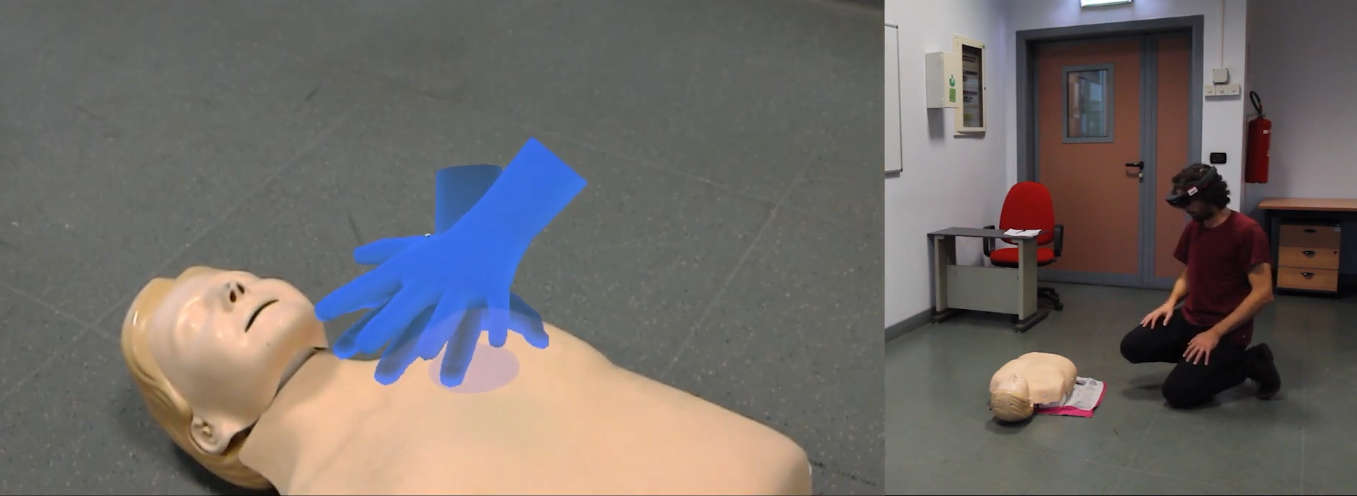
Holo-BLSD
Mixed Reality based self-training tool for emergency first responder procedures in case of cardiac arrest.
Notes:
After ALPTECH, in January 2025 I joined the Holo-BLSD project. It is a software tool for training of professional personnel in Basic Life Support and Defibrillation (BLSD) procedures, i.e., the sequence of operations required to recognize a patient in cardiac arrest and manage emergency first aid procedures. Holo-BLSD is a self-training software tool that is offered as an alternative to standard instructor-led courses. Training content is delivered through a Mixed Reality application that integrates real content and virtual elements and includes a CPR manikin for experiential training. Holo-BLSD allows adapting the procedure to be taught to different categories of learners and various emergency scenarios, helping learners monitor and evaluate their training progress automatically.
In particular, I designed and developed the airway training procedure in collaboration with Molinette Hospital, one of the most important research hospitals in Italy.
This project started in 2019, so delving into legacy code reminded me the importance of writing maintainable code. Furthermore, it was my first MR experience ever, so I learned a lot of new stuff and experienced the pros and cons of VR vs MR.

Slide 6
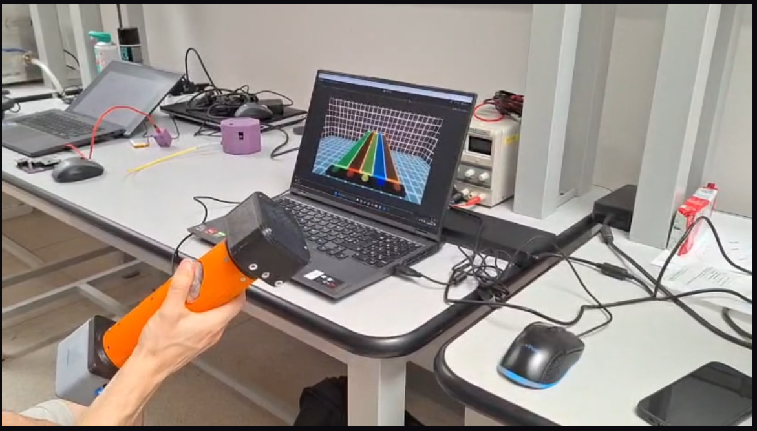
UX of PAL-HAND.Q (GRIVAPP2026)
Design of an experimental protocol, devising two games to assess device functionality as an interaction device in digital environments
Notes:
In April 2025 I started working on one of my most recent projects. A special place in my heart goes to the usability and user experience of PAL-HAND.Q, a handheld haptic device designed to provide independent haptic feedback on each finger through an integrated electro-pneumatic system. The device features five soft pneumatic membranes—one per finger—enabling vibrotactile stimulation and variable stiffness feedback. We conducted a usability study using two games that leverage the device's key features: Tile Game, which emphasizes timed actions and finger coordination, and Airplane Game, which integrates finger pressing with device orientation control. Twenty-five participants tested the system and completed questionnaires on usability, workload, game experience, haptic experience, and comfort. The results indicate good usability, moderate perceived workload, and engaging interactions. Notably, the device demonstrated better performance in continuous control tasks compared to time-pressured precision tasks, suggesting its suitability for applications requiring sustained, smooth finger-level interaction. Overall, the findings demonstrate PAL-HAND.Q's effectiveness for finger-level gaming interaction and point to its potential applicability in other domains requiring portable, independent finger-level haptic control, such as virtual and augmented reality, rehabilitation, and interactive training systems. I am particularly proud of this project cause, other then developing the games and performing the user study, I led the whole project. I had to schedule the activities and manage the tasks of the team. We finished the study in the defined timeline, we carried out estensive statistical analysis and were welcome very positively by reviewers at GRIVAPP2026, where I will present in two weeks.

Slide 7
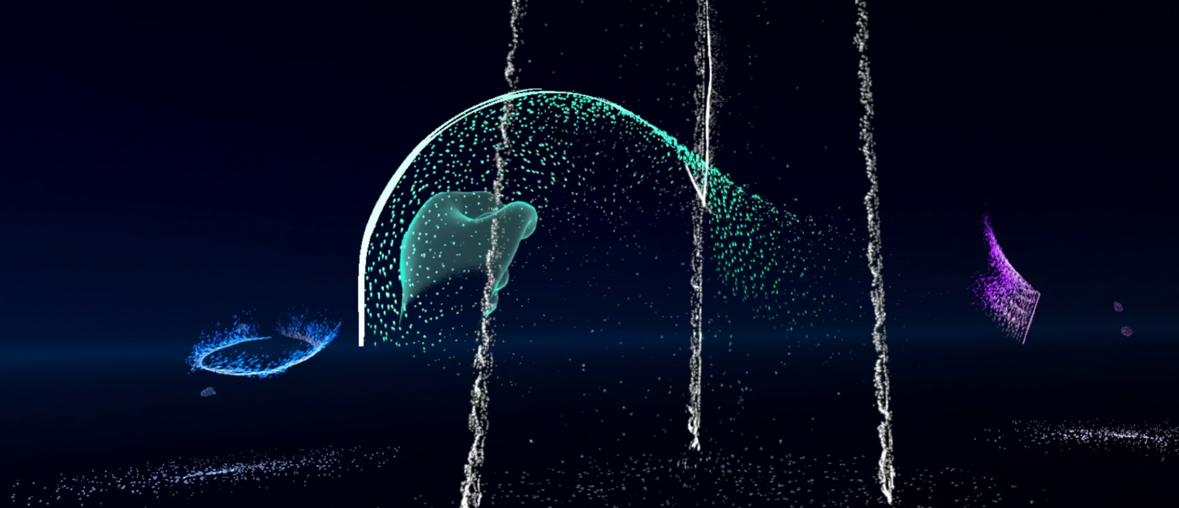
ItARTS Italy for Arts: SHARED VR
Multimedia and interactive art installation which explores new forms of co-creation
Notes:
My most recent project is the “SHARED” project, that I joined in September 2025. I worked on a multimedia and interactive installation which explores new forms of co-creation, participation and sharing. At the heart of the experience there is the transformation in real time of non-verbal gestures, performed by the audience or performers, into music and visual forms. This process is made possible by the exploitation of a virtual reality environment and the hand-tracking features of virtual reality headsets.
The work is structured to combine physical modules, by the Conservatory of Music and the Academy of Fine Arts of L’Aquila, and a virtual multi-user environment developed by our team.
In this project I led the development team and managed the technical details across the partners. My team and I showcased the project in Italy, France and China.

Slide 8
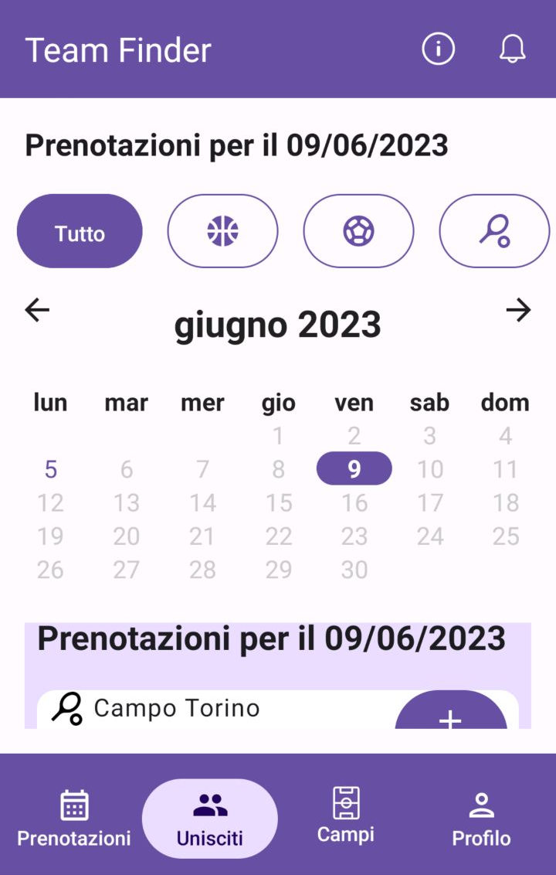
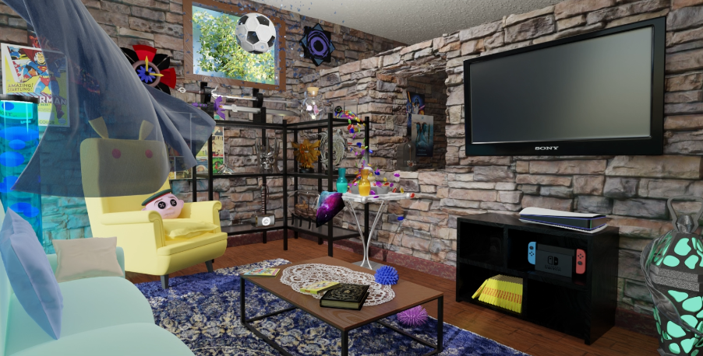
Other Projects & Accomplishments
Team Finder
Mobile app development @ Polito
Computer Graphics @ Polito

Slide 9
Other Projects & Accomplishments
ULISSES 2022 – Univ. of Lisbon: Interdisciplinary Studies on Sustainable Environment and Seas (winning project)
Myme 2021 - Make Yourself More Employable, Erasmus+ project in Poland
Science & Human Rights by the Global Campus of Human Rights
Google IT Support Professional & Cybersecurity by AcademyRapido
INSPIRED 2020 - International Project Week for Interdisciplinary Research-Oriented Digital Learning @ TU Darmstadt
Software Engineer - VR Game Design & Development Intern @ SynArea Consultants
Engineering Empathy, Machine Learning for Vision & Multimedia @ Polito
Notes:
LEGARE CON MOTIVI PER CUI NE STO PARLANDO

Slide 10
Research interests
Immersive technologies
Human-Computer Interaction: novel devices and interaction modalities
Serious Games for mental/physical wellbeing and public awareness
Eating behaviours, food perception and body perception in VR
Psychological factors in VR
VR and Neurosciences
Notes:
Well, in my near future I would like continue exploring the topics that I described in these slides. Adding to going deeper on immersive technologies and human-computer interaction through new device and interaction modalities, I would love to explore eating behaviours, food and body perception in VR, as well as psychological factors such as embodiment and agency and learn more about the neuroscience to better understand user behaviour in VR and dynamically adapt their experience. Thanks to their experience in immersive technologies, I would be happy to undertake this PhD under the supervision of Professors Schmalstieg and Fender, and I believe that the Institute for Visualization and Interactive Systems, along with the entire research environment of Stuttgart, could be a key into pursuing interdisciplinary research, which is what I would like to do in my professional career.

Slide 11
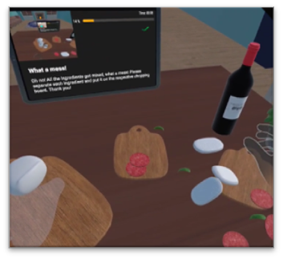
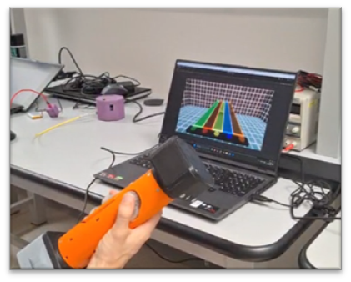
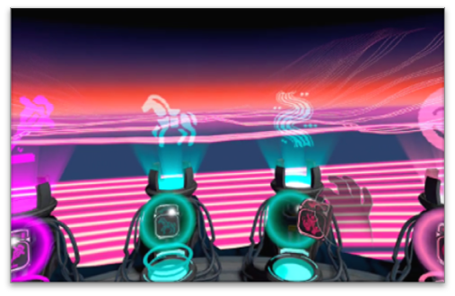
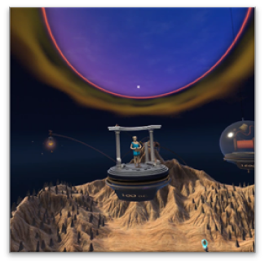
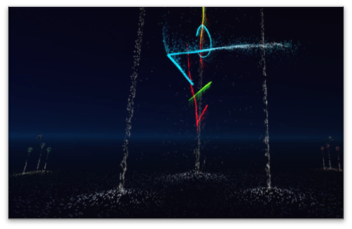
Fabrizio Sulpizio - Portfolio
Ubiquitous XR: from Healthcare to Arts
REFERENCES
Sulpizio et al. (2024). MetaRehab: Enhancing Parkinson's Disease Rehabilitation Through Gamified Virtual Reality, a Usability Study. IEEE GEM
Sulpizio et al. (2026). User Experience of PAL-HAND.Q, a Pneumatic Haptic Device for Finger-Level Gaming Interaction. 21st International Conference on Computer Graphics, Interaction and Visualization Theory and Applications
Notes:
So, these are my projects from the last 3 years. Thank you for your time and attention!

