Slide 1


Srikanth Machiraju
Build Proactive Bot using MS Bot framework
Proactive Bot
Senior Consultant | Author | Blogger
Microsoft, Hyderabad

Slide 2
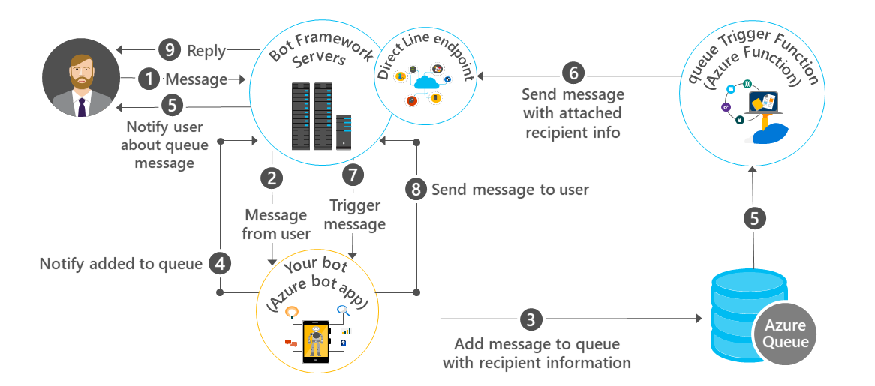
Proactive Bots

Slide 3



Proactive Bot Design
Azure Function
Azure Storage Queue
Bot framework + Direct Line API

Slide 4
DEMO
Source Code:
https://github.com/vishwanathsrikanth/mycode/tree/master/SimpleProactiveBot

Slide 5
Steps to create a proactive Bot
Create a normal Bot
1
Publish and Configure Direct Line API channel
2
Capture the state change to a Storage Queue
3
Create Azure Function with Queue Trigger and Bot framework
4
Use Trigger event to respond to the User proactively
5

