Slide 1



Srikanth Machiraju
www.linkedin.com/in/vishsrik
Build Proactive Bot using MS Bot framework
Proactive Bot
Senior Consultant | Author | Blogger
Microsoft, Hyderabad

Slide 2
Prerequisites
Visual Studio 2017 (Free Edition)
Microsoft Azure Subscription (Free Trial)
Fundamentals of Building Bot (Documentation)

Slide 3

Proactive Bot
Initiates Conversation
User
Bot
Bot Responds
Bot Notifies

Slide 4



Proactive Bot Design
Azure Function
Azure Storage Queue
Bot framework + Direct Line API

Slide 5
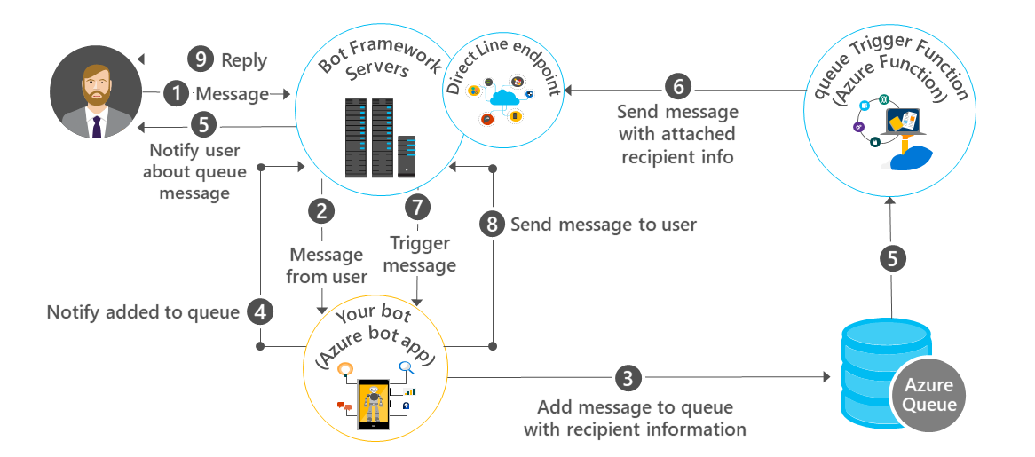
Proactive Bot Design

Slide 6
DEMO
Source Code:
https://github.com/vishwanathsrikanth/mycode/tree/master/SimpleProactiveBot

Slide 7
DEBUG
https://ngrok.com/download

Slide 8
Steps to create a proactive Bot
Create a normal Bot
1
Publish and Configure Direct Line API channel
2
Capture the state change to a Storage Queue
3
Create Azure Function with Queue Trigger and Bot framework
4
Use Trigger event to respond to the User proactively
5

Slide 9
Q & A
vism@microsoft.com

