Slide 1
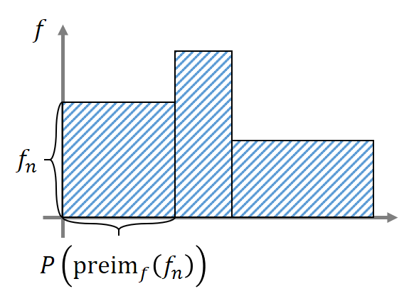



$$f$$
$$f_{n}$$
$$P\left({preim}_{f}\left(f_{n}\right)\right)$$

