Slide 1
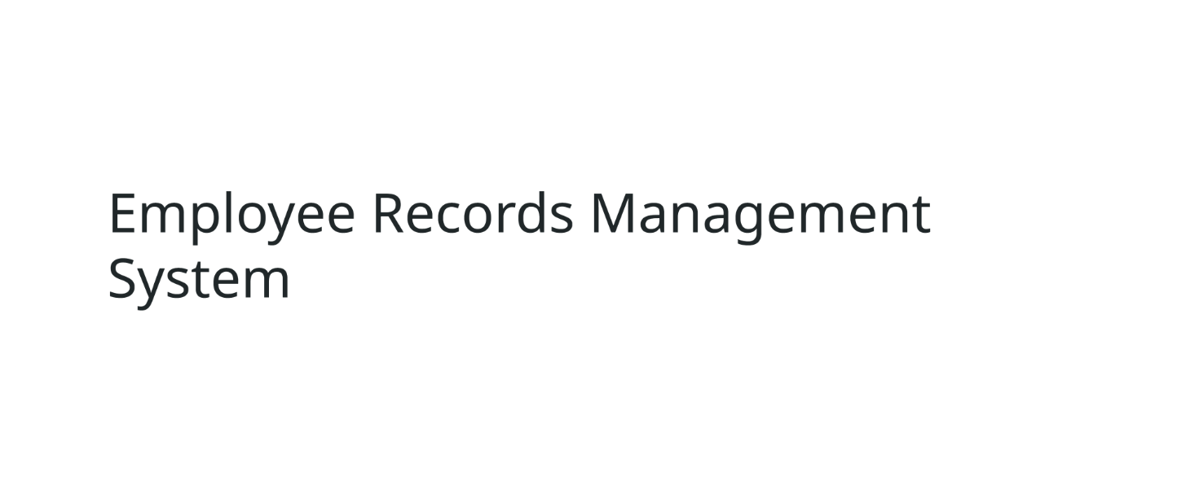

Slide 2
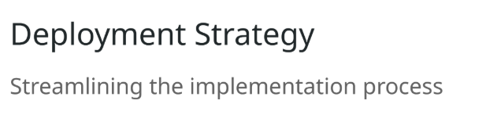
Packaging project: Mvn clean Install
Run Spring-App and DB: docker compose up
Run Tests: Mvn clean Test

Slide 3
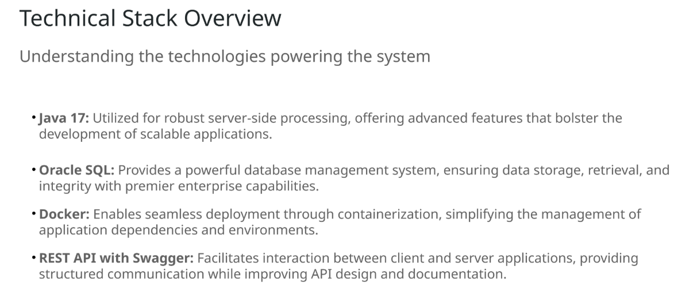

Slide 4
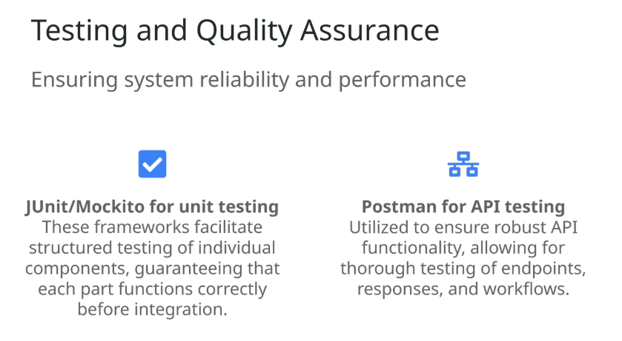

Slide 5
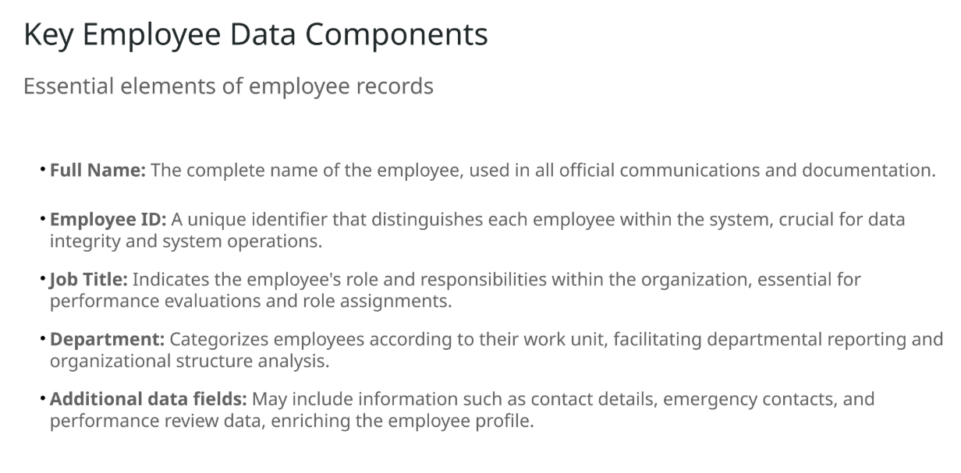

Slide 6
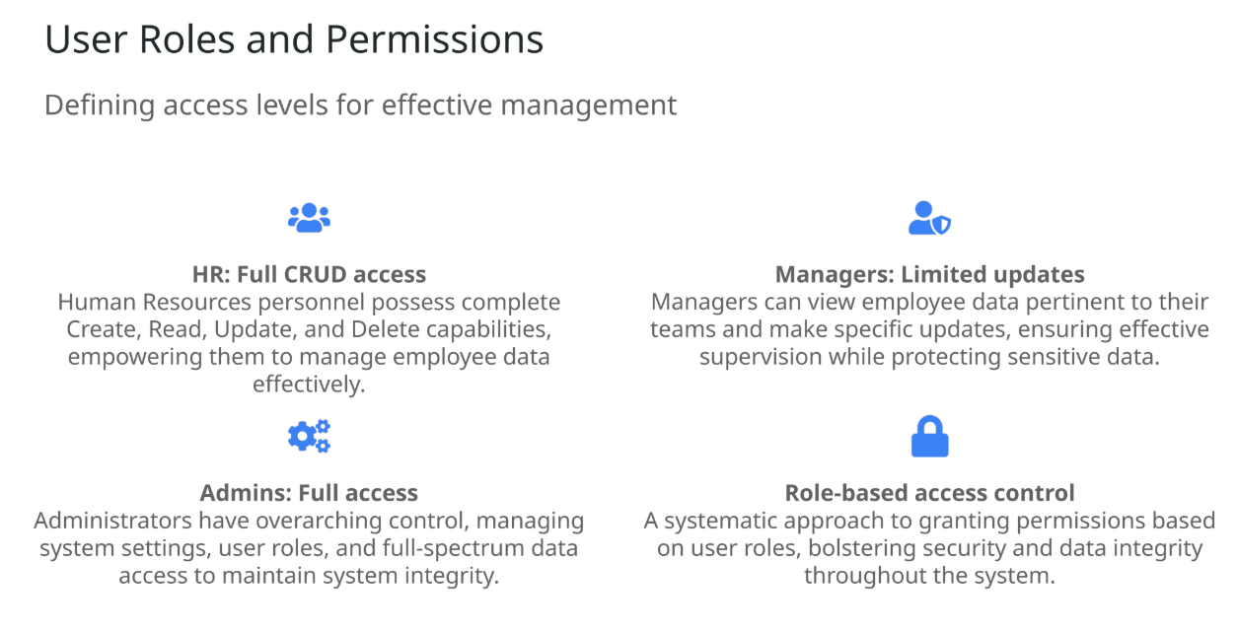

Slide 7
Manager Permissions:
HR Permissions:
View Employee Data:
Managers can access detailed employee records for individuals within their specific department.
This includes basic information like name, job title, and department.
Limited Updates:
Managers can update specific fields for employees under their supervision, such as:
Job Title
Department
Employment Status (e.g., Active, On Leave, or Terminated)
- Full CRUD (Create, Read, Update, Delete) access to all employee records.
- Ability to manage sensitive information such as Full Name, Employee ID, Contact Information, etc.
- Cannot modify system settings or manage user roles and permissions.

Slide 8
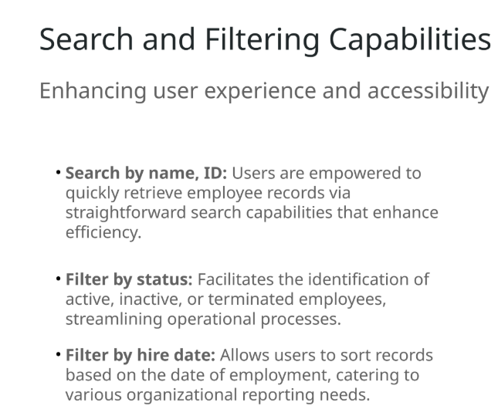

Slide 9
