Slide 1
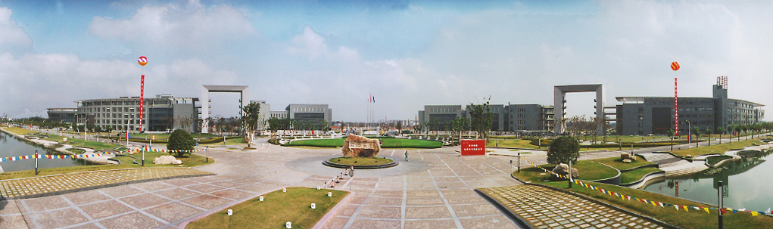
（信息与）通信技术（基础）
Module 4: Analog Modulation
王超
电子与信息工程学院 - 信息与通信工程系
教授/博士生导师
Email: chaowang@tongji.edu.cn

Slide 2


Modulation
Amplitude Modulation (AM)
Double-sideband Modulation (DSB)
Single-sideband Modulation (SSB)
Vestigial Sideband Modulation (VSB)
Angle Modulation
CONTENTS
目录

Slide 3
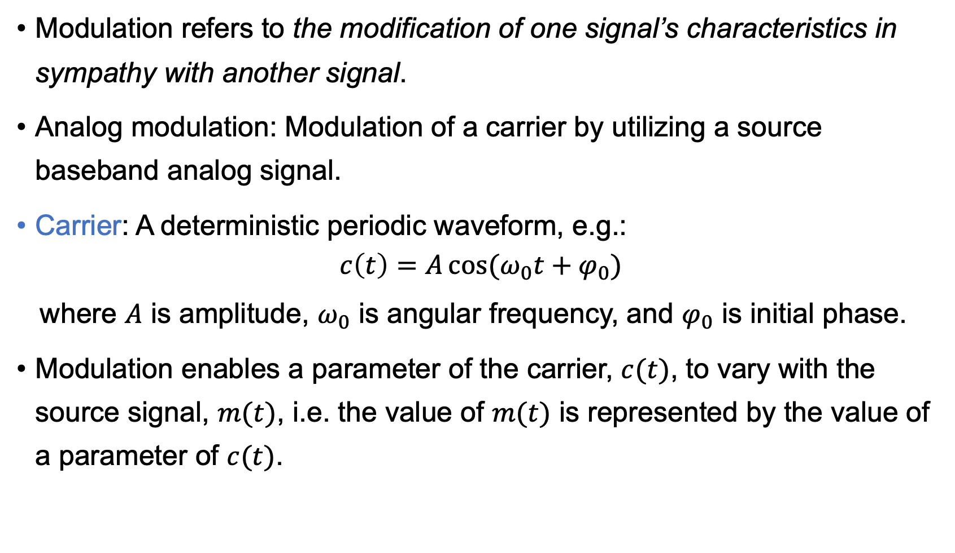
Modulation
Modulation refers to the modification of one signal’s characteristics in sympathy with another signal.
Analog modulation: Modulation of a carrier by utilizing a source baseband analog signal.
Carrier: A deterministic periodic waveform, e.g.:
$$c\left(t\right)=A\cos{(ω_{0}t+φ_{0})}$$
where $A$ is amplitude, $ω_{0}$ is angular frequency, and $φ_{0}$ is initial phase.
Modulation enables a parameter of the carrier, $c(t)$, to vary with the source signal, $m(t)$, i.e. the value of $m(t)$ is represented by the value of a parameter of $c(t)$.
Modulating
signal m(t)
Modulator
Modulated
signal s(t)

Slide 4
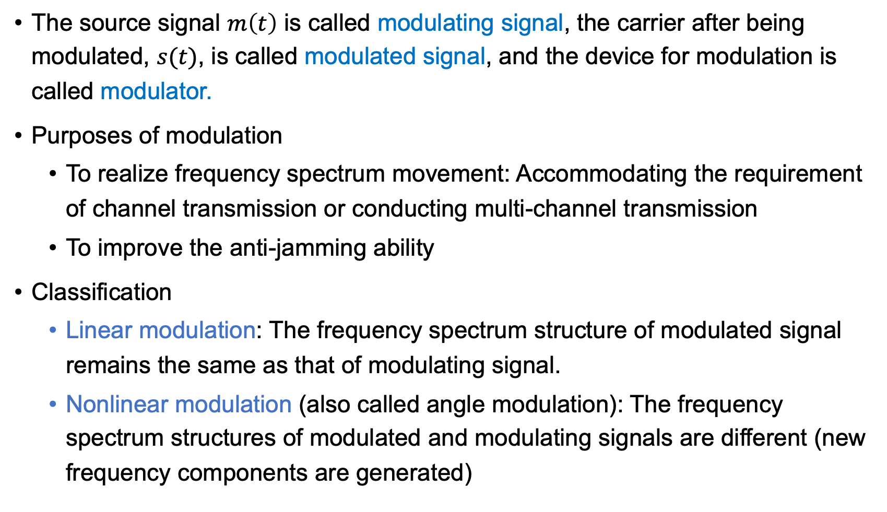
Modulation
The source signal $m\left(t\right)$ is called modulating signal, the carrier after being modulated, $s(t)$, is called modulated signal, and the device for modulation is called modulator.
Purposes of modulation
To realize frequency spectrum movement: Accommodating the requirement of channel transmission or conducting multi-channel transmission
To improve the anti-jamming ability
Classification
Linear modulation: The frequency spectrum structure of modulated signal remains the same as that of modulating signal.
Nonlinear modulation (also called angle modulation): The frequency spectrum structures of modulated and modulating signals are different (new frequency components are generated)

Slide 5
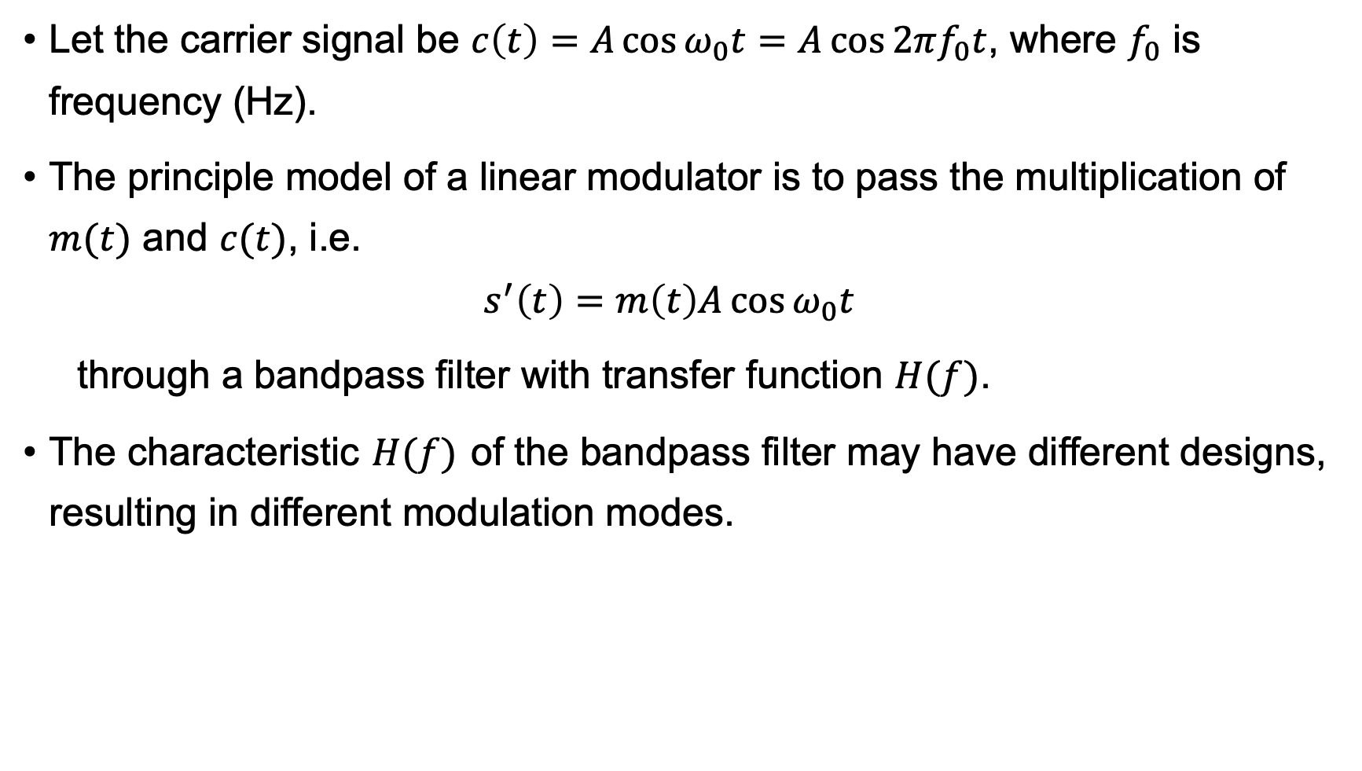
Linear Modulation
Let the carrier signal be $c\left(t\right)=A\cos{ω_{0}t}=A\cos{2πf_{0}t}$, where $f_{0}$ is frequency (Hz).
The principle model of a linear modulator is to pass the multiplication of $m(t)$ and $c(t)$, i.e.
$$s^{′}\left(t\right)=m\left(t\right)A\cos{ω_{0}t}$$
through a bandpass filter with transfer function $H(f)$.
The characteristic $H(f)$ of the bandpass filter may have different designs, resulting in different modulation modes.
s′(t)
Modulating
signal
m(t)
×
H(f)
Modulated signal
s(t)
Acosω₀t

Slide 6
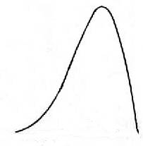
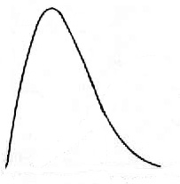


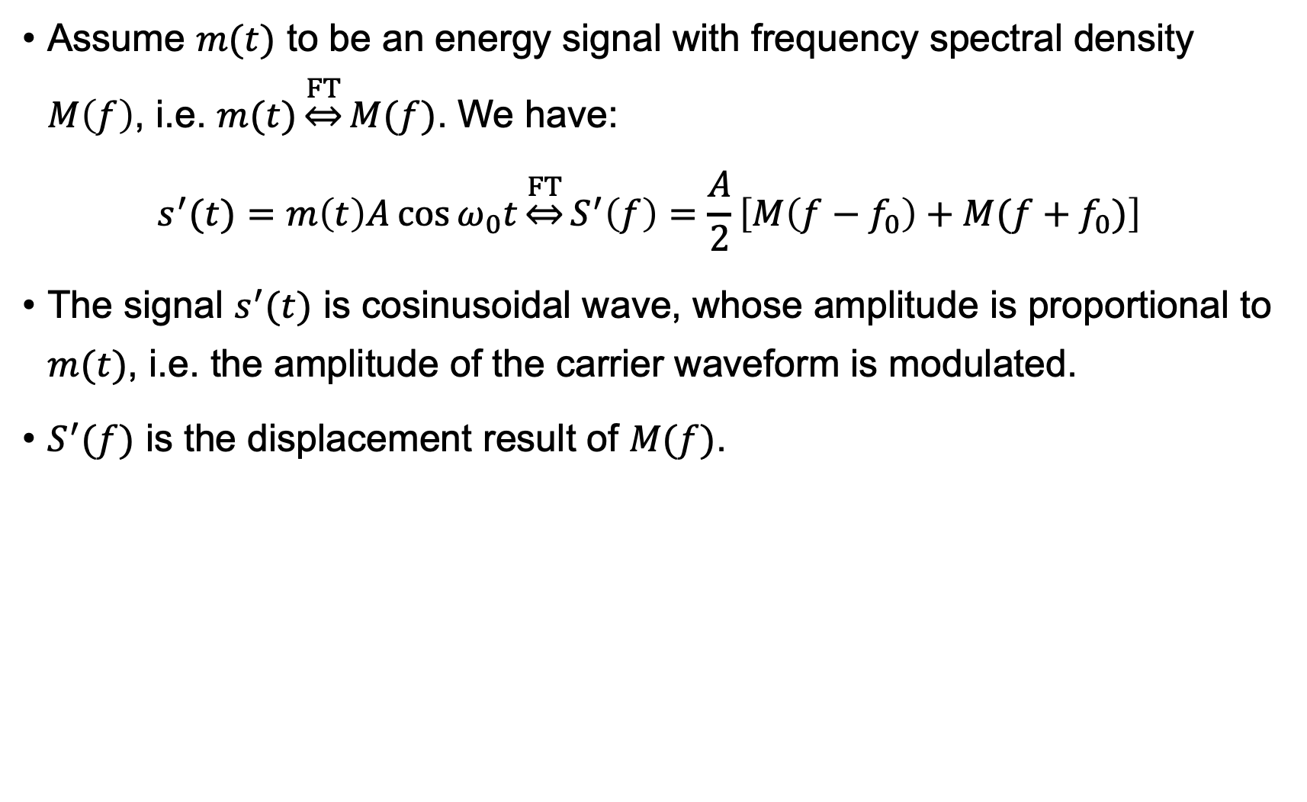
Linear Modulation
Assume $m(t)$ to be an energy signal with frequency spectral density $M\left(f\right)$, i.e. $m(t)\underset{⇔}{FT}M(f)$. We have:
$$s^{′}(t)=m\left(t\right)A\cos{ω_{0}t}\underset{⇔}{FT}S^{′}\left(f\right)=\frac{A}{2}\left[M\left(f−f_{0}\right)+M(f+f_{0})\right]$$
The signal $s^{′}(t)$ is cosinusoidal wave, whose amplitude is proportional to $m(t)$, i.e. the amplitude of the carrier waveform is modulated.
$S^{′}(f)$ is the displacement result of $M(f)$.
M(f)
S ′(f)
0
f
f
-f₀
0
f₀
(a) Frequency spectral density of input signal
(b) Frequency spectral density
of output signal

Slide 7
Modulation
Amplitude Modulation (AM)
Double-sideband Modulation (DSB)
Single-sideband Modulation (SSB)
Vestigial Sideband Modulation (VSB)
Angle Modulation
CONTENTS
目录

Slide 8
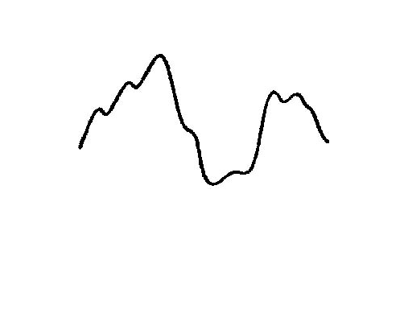
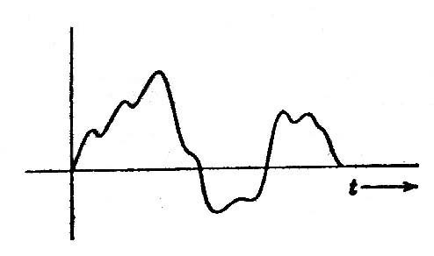
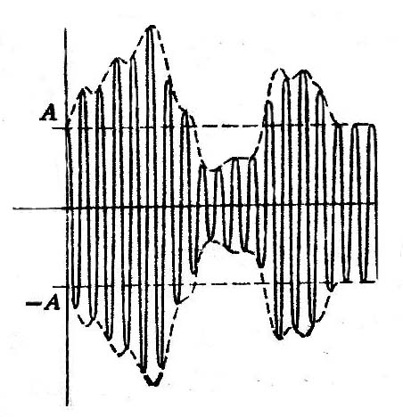
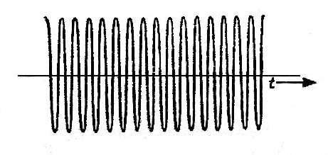




Amplitude Modulation (AM)
Let $m\left(t\right)=1+m^{′}(t)$, $\left|m^{′}\left(t\right)\right|≤1$
1 can be seen as the DC component, $m^{′}(t)$ is the AC component
The maximum of $|m^{′}(t)|$ is called modulation index $m$ ($m≤1$)
The output of the multiplier is
$$s^{′}\left(t\right)=\left[1+m^{′}(t)\right]A\cos{ω_{0}t}$$
1+m′(t)
m′(t)
1
$$+ 1 =$$
0
1+m′(t)
1
$$×$$
$$=$$
0

Slide 9


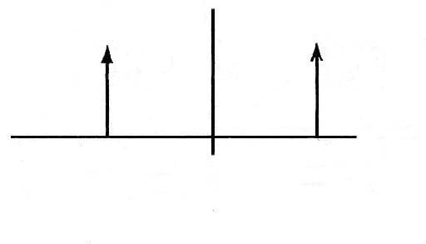

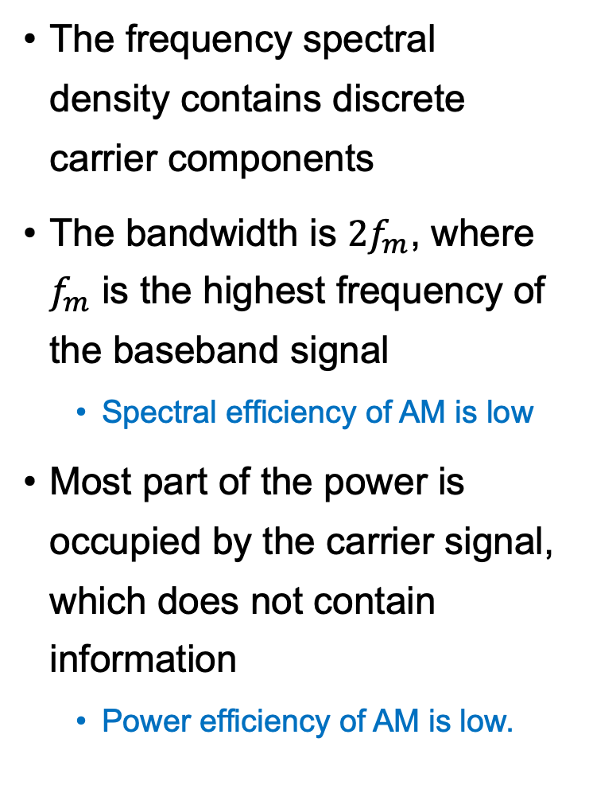
Spectrum of AM Signals
The frequency spectral density contains discrete carrier components
The bandwidth is $2f_{m}$, where $f_{m}$ is the highest frequency of the baseband signal
Spectral efficiency of AM is low
Most part of the power is occupied by the carrier signal, which does not contain information
Power efficiency of AM is low.
m'(t)
M’(f)
t
⇔
f_{m}
f
-f_{m}
c(t)
C(f)
A
t
⇔
f
-f₀
f₀
-A
s(t)
S (f)
t
⇔
f
-f₀
f₀
2f_{m}
2f_{m}

Slide 10

Exercise
Let the modulated signal $s′\left(t\right)=\left(1+a\cos{Ωt}\right)\cos{ω_{0}t}$, calculate, when $a=1$ (or 100%) and $a=0.5$ (or $50\%$), the ratio of the sum of the two sideband powers to the total modulated signal power.

Slide 11
Demodulation of AM Signals
An envelope detector is normally used to restore the original modulating signal.
The envelope detector consists of a rectifier and a low-pass filter.
A capacitor is used to separate the DC component
_{Rectifier}
_{Low-pass filter}
Envelope detector

Slide 12
Modulation
Amplitude Modulation (AM)
Double-sideband Modulation (DSB)
Single-sideband Modulation (SSB)
Vestigial Sideband Modulation (VSB)
Angle Modulation
CONTENTS
目录

Slide 13




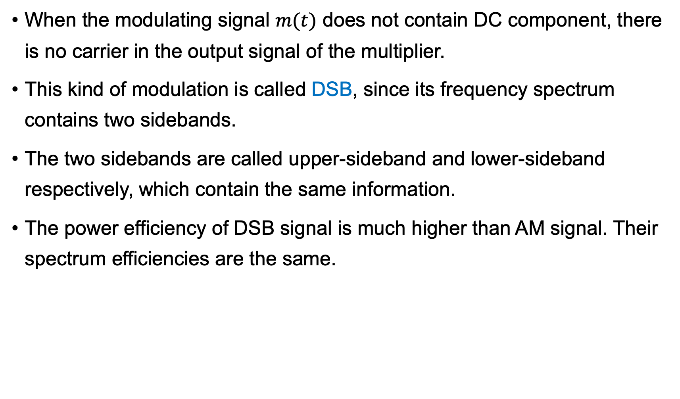
Double-sideband Modulation (DSB)
When the modulating signal $m(t)$ does not contain DC component, there is no carrier in the output signal of the multiplier.
This kind of modulation is called DSB, since its frequency spectrum contains two sidebands.
The two sidebands are called upper-sideband and lower-sideband respectively, which contain the same information.
The power efficiency of DSB signal is much higher than AM signal. Their spectrum efficiencies are the same.
M(f)
S(f)
Upper-sideband
Upper-sideband
Lower-sideband
f
f
0
-f₀
0
f₀
(a) Frequency spectral density of modulating signal
(b) Frequency spectral density
of modulated signal

Slide 14
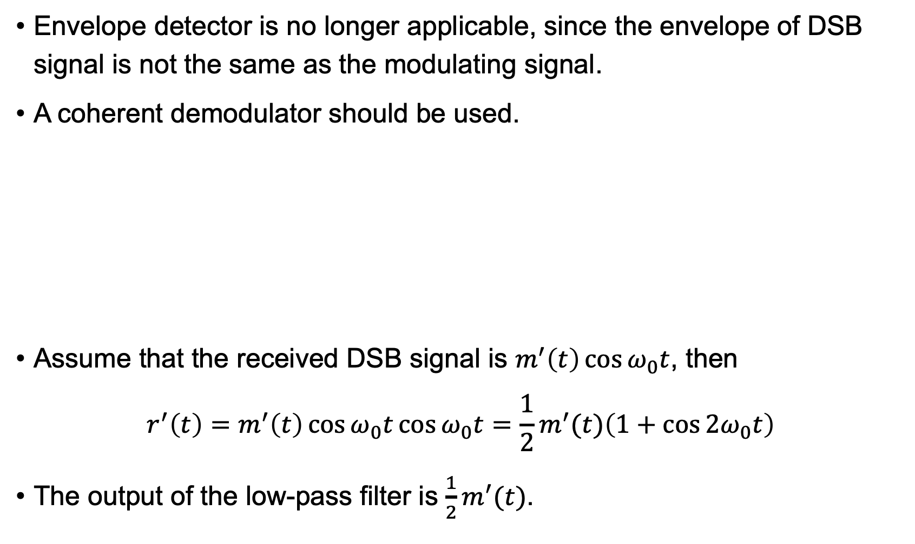
Demodulation of DSB Signals
Envelope detector is no longer applicable, since the envelope of DSB signal is not the same as the modulating signal.
A coherent demodulator should be used.
Assume that the received DSB signal is $m^{′}\left(t\right)\cos{ω_{0}t}$, then
$$r^{′}\left(t\right)=m^{′}\left(t\right)\cos{ω_{0}t}\cos{ω_{0}t}=\frac{1}{2}m^{′}(t)\left(1+\cos{2ω_{0}t}\right)$$
The output of the low-pass filter is $\frac{1}{2}m^{′}(t)$.
r′(t)
Received signal
s(t)
×
LPF
Baseband signal
m(t)
cosω₀t

Slide 15
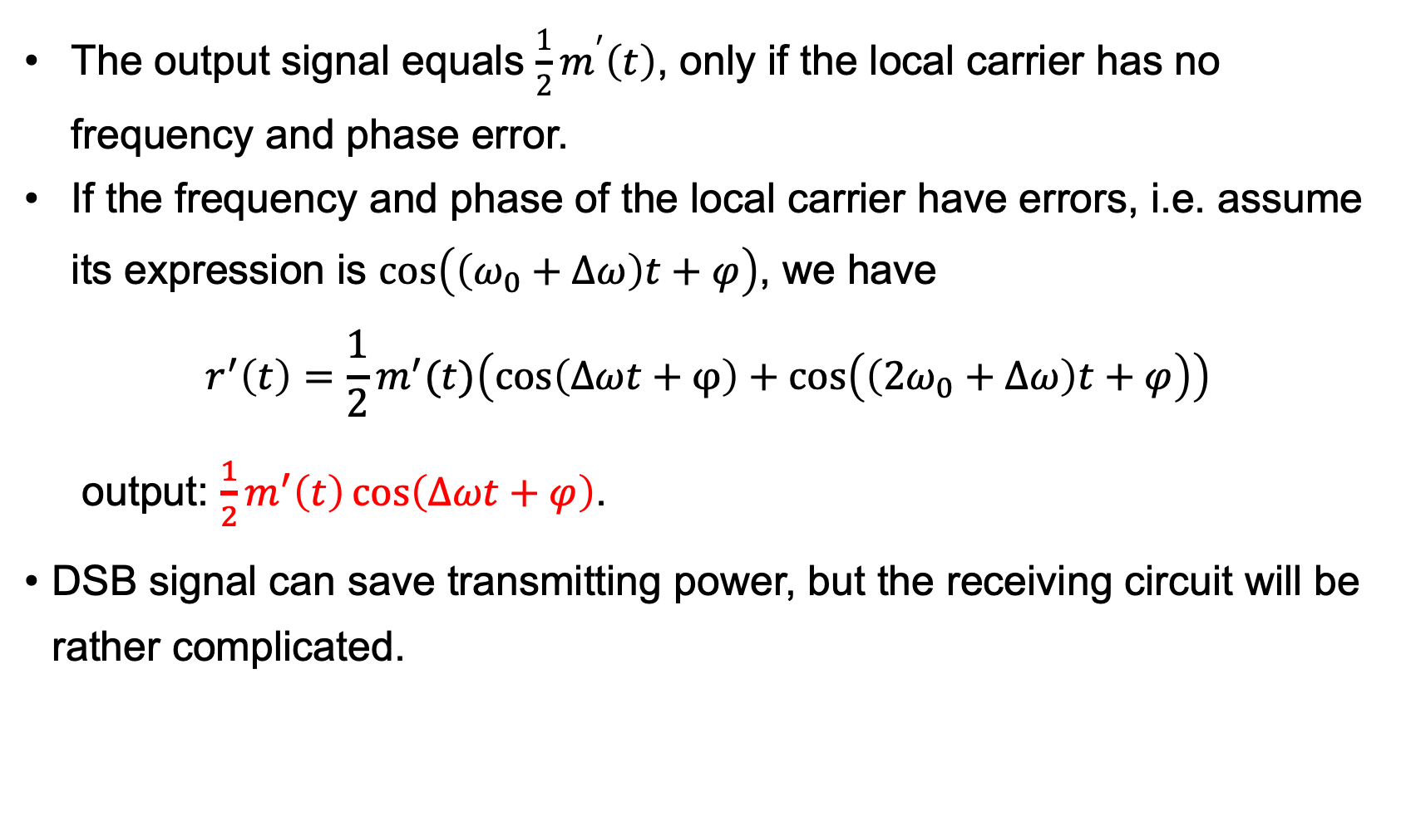
Demodulation of DSB Signals
The output signal equals $\frac{1}{2}m^{′}\left(t\right)$, only if the local carrier has no frequency and phase error.
If the frequency and phase of the local carrier have errors, i.e. assume its expression is $\cos\left(\left(ω_{0}+∆ω\right)t+φ\right)$, we have
$$r^{′}\left(t\right)=\frac{1}{2}m^{′}(t)\left(\cos\left(Δωt+φ\right)+\cos\left(\left(2ω_{0}+Δω\right)t+φ\right)\right)$$
output: $\frac{1}{2}m^{′}\left(t\right)\cos\left(Δωt+φ\right)$.
DSB signal can save transmitting power, but the receiving circuit will be rather complicated.
Notes:
Pros and cons:

Slide 16
Modulation
Amplitude Modulation (AM)
Double-sideband Modulation (DSB)
Single-sideband Modulation (SSB)
Vestigial Sideband Modulation (VSB)
Angle Modulation
CONTENTS
目录

Slide 17



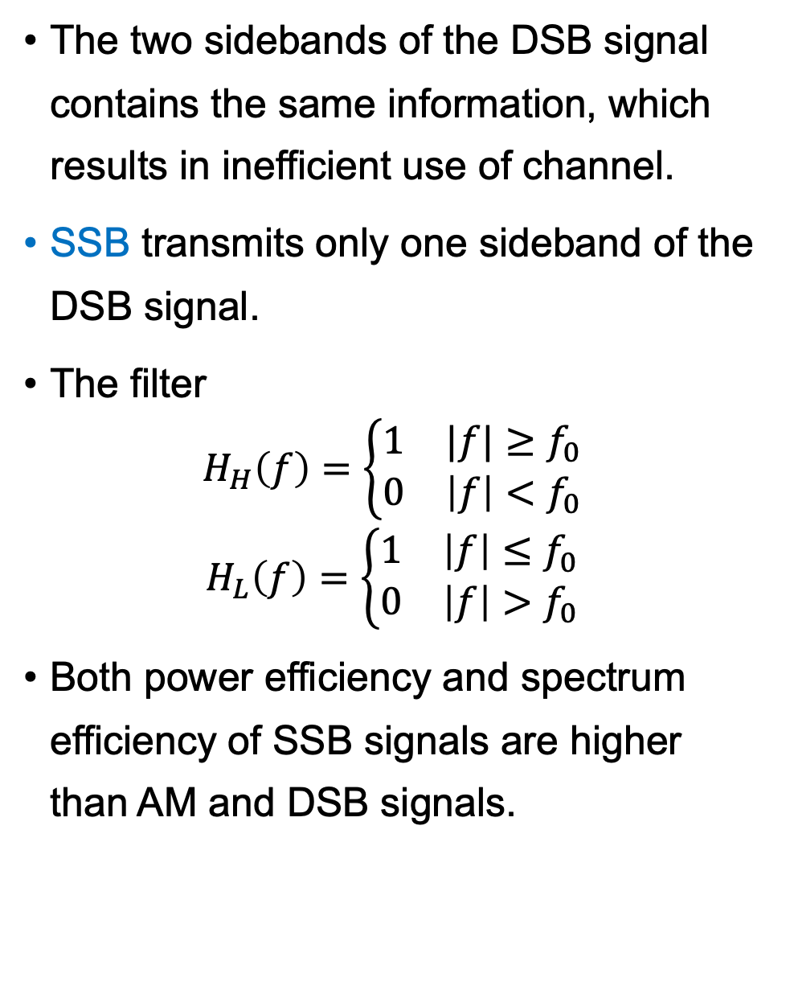
Single-sideband Modulation (SSB)
The two sidebands of the DSB signal contains the same information, which results in inefficient use of channel.
SSB transmits only one sideband of the DSB signal.
The filter
$$H_{H}\left(f\right)=\left\{\begin{matrix}1 & |f|≥f_{0} \\ 0 & \left|f\right|<f_{0}\end{matrix}\right.$$
$$H_{L}\left(f\right)=\left\{\begin{matrix}1 & \left|f\right|≤f_{0} \\ 0 & \left|f\right|>f_{0}\end{matrix}\right.$$
Both power efficiency and spectrum efficiency of SSB signals are higher than AM and DSB signals.
Lower-sideband
S′(f)
Upper-sideband
Upper-sideband
-f₀
0
f₀
f
(a) Signal frequency spectrum before filtering
H_{H}(f)
S(f)
H_{H}(f)
Upper-sideband
Upper-sideband
-f₀
0
f₀
f
(b) Upper-sideband filter characteristic and signal frequency spectrum
S(f)
H_{L}(f)
Lower-sideband
-f₀
f₀
f
(c) Lower-sideband filter characteristic and signal frequency spectrum
17

Slide 18
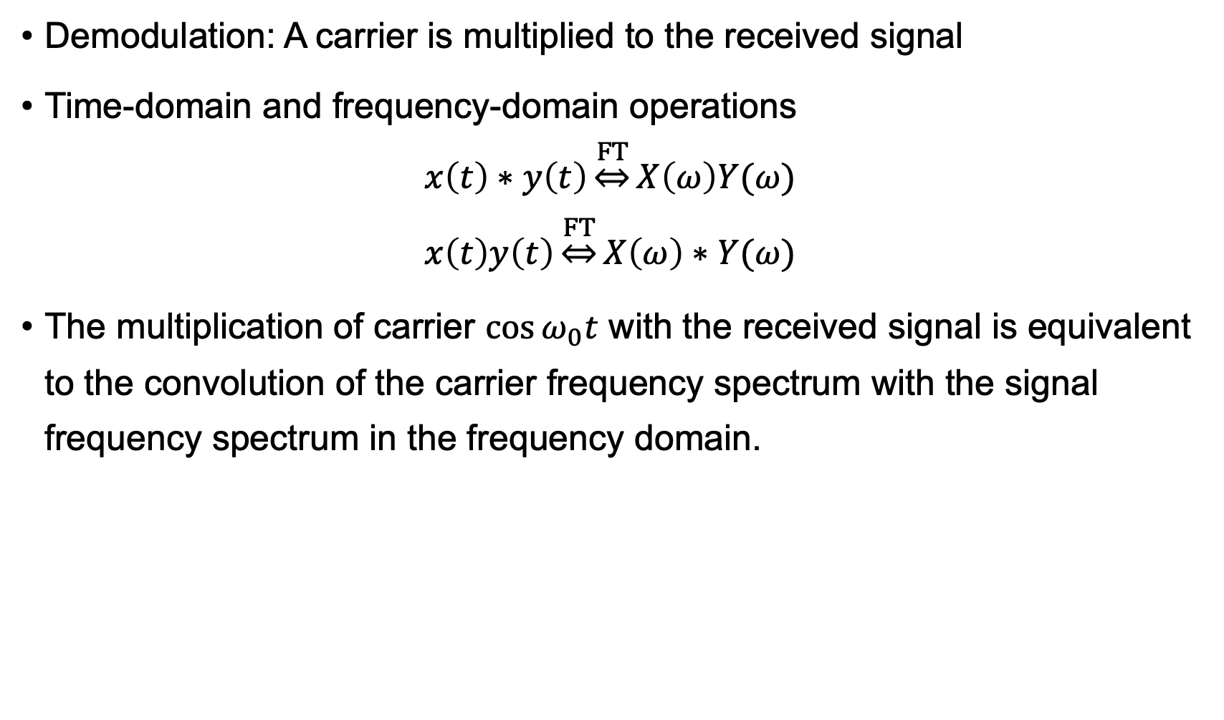
Demodulation of SSB Signals
Demodulation: A carrier is multiplied to the received signal
Time-domain and frequency-domain operations
$$x\left(t\right)∗y\left(t\right)\underset{⇔}{FT}X\left(ω\right)Y(ω)$$
$$x\left(t\right)y\left(t\right)\underset{⇔}{FT}X\left(ω\right)∗Y(ω)$$
The multiplication of carrier $\cos{ω_{0}t}$ with the received signal is equivalent to the convolution of the carrier frequency spectrum with the signal frequency spectrum in the frequency domain.
Notes:
Pros and cons:

Slide 19
Modulation
Amplitude Modulation (AM)
Double-sideband Modulation (DSB)
Single-sideband Modulation (SSB)
Vestigial Sideband Modulation (VSB)
Angle Modulation
CONTENTS
目录

Slide 20
Vestigial Sideband Modulation (VSB)
Despite the high power and spectrum efficiency, SSB requires high system complexity
The local carrier at the demodulator must have the same frequency and phase as that in the transmitter
The modulator should have a very high-quality filter to attain SSB from DSB or AM signals.
VSB allows the modulating signal to contain very low frequency and DC components
s′(t)
r′(t)
Modulating
signal
m(t)
×
H(f)
Modulated signal
s(t)
Received signal
s(t)
×
LPF
Baseband signal
m(t)
Acosω₀t
cosω₀t

Slide 21
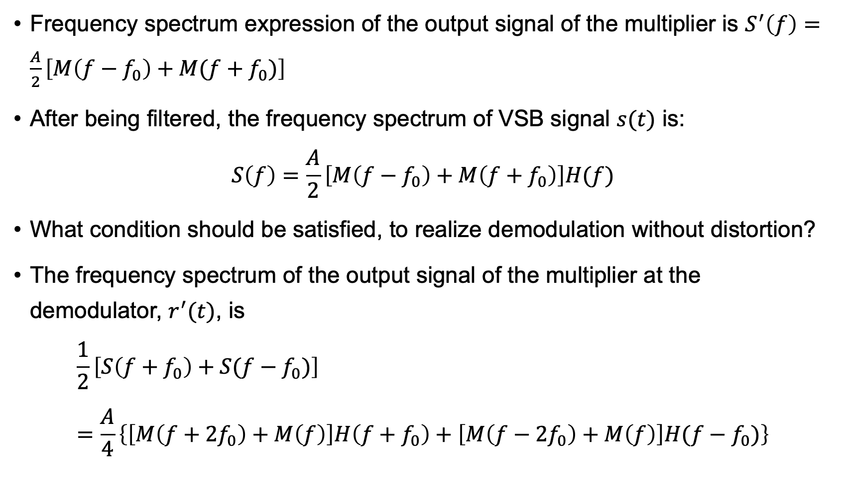
Vestigial Sideband Modulation (VSB)
Frequency spectrum expression of the output signal of the multiplier is $S^{′}\left(f\right)=\frac{A}{2}\left[M\left(f−f_{0}\right)+M(f+f_{0})\right]$
After being filtered, the frequency spectrum of VSB signal $s(t)$ is:
$$S\left(f\right)=\frac{A}{2}\left[M\left(f−f_{0}\right)+M\left(f+f_{0}\right)\right]H(f)$$
What condition should be satisfied, to realize demodulation without distortion?
The frequency spectrum of the output signal of the multiplier at the demodulator, $r^{′}(t)$, is
$$\frac{1}{2}\left[S\left(f+f_{0}\right)+S(f−f_{0})\right]=\frac{A}{4}\left\{\left[M\left(f+2f_{0}\right)+M\left(f\right)\right]H\left(f+f_{0}\right)+\left[M\left(f−2f_{0}\right)+M\left(f\right)\right]H(f−f_{0})\right\}$$

Slide 22
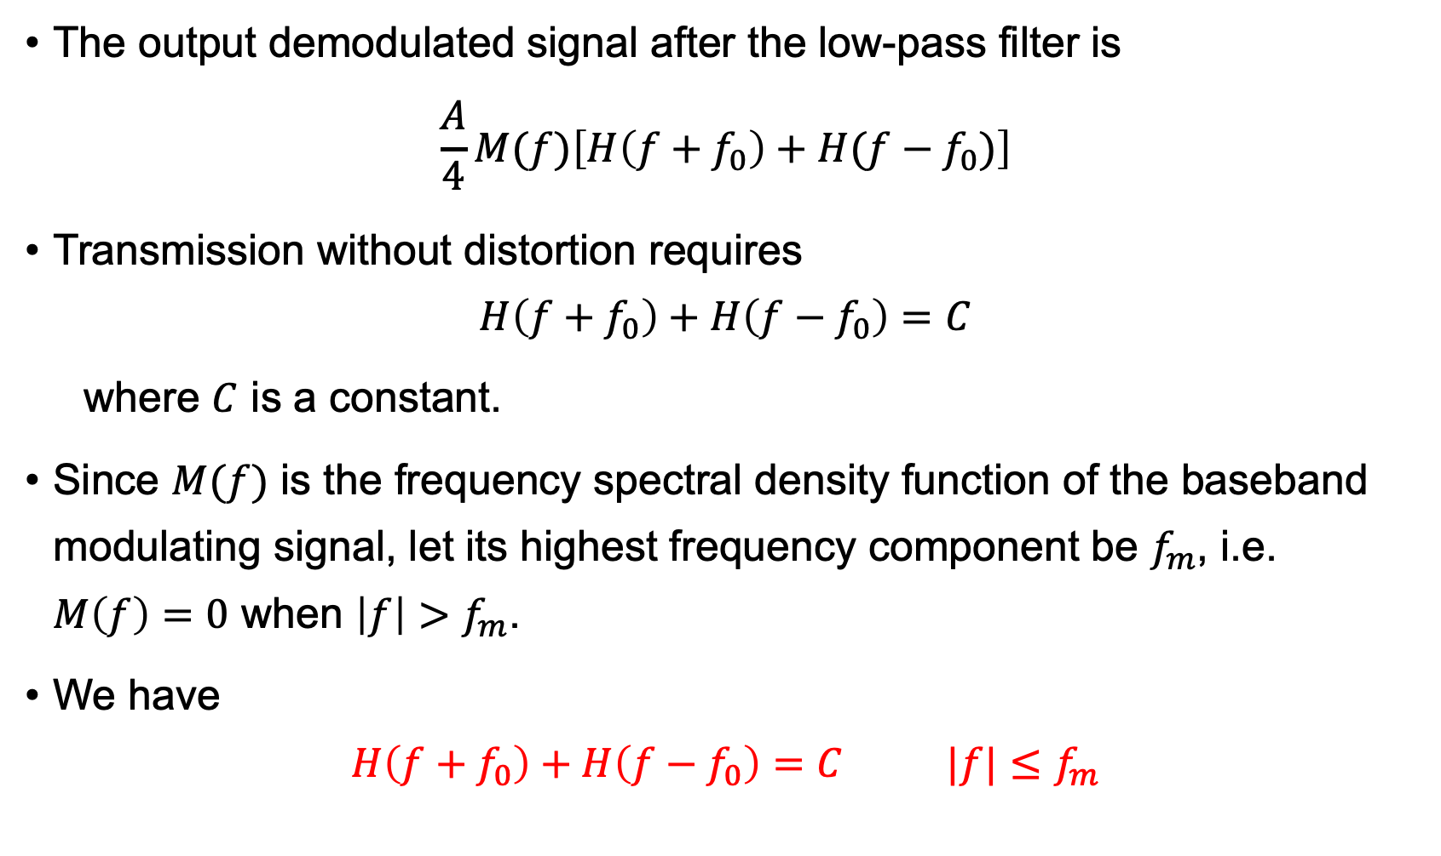
Vestigial Sideband Modulation (VSB)
The output demodulated signal after the low-pass filter is
$$\frac{A}{4}M(f)\left[H\left(f+f_{0}\right)+H(f−f_{0})\right]$$
Transmission without distortion requires
$$H\left(f+f_{0}\right)+H\left(f−f_{0}\right)=C$$
where $C$ is a constant.
Since $M(f)$ is the frequency spectral density function of the baseband modulating signal, let its highest frequency component be $f_{m}$, i.e. $M\left(f\right)=0$ when $\left|f\right|>f_{m}$.
We have
$$H\left(f+f_{0}\right)+H\left(f−f_{0}\right)=C |f|≤f_{m}$$

Slide 23
Vestigial Sideband Modulation (VSB)
H(f)
f
-(f₀+f_{m})
-f₀
0
f₀
f₀+f_{m}
H(f + f₀)
f
-2f₀
0
f_{m}
H(f - f₀)
f
0
2f₀
H(f + f₀) + H(f – f₀)
f
-2f₀
-f_{m}
0
f_{m}
2f₀

Slide 24
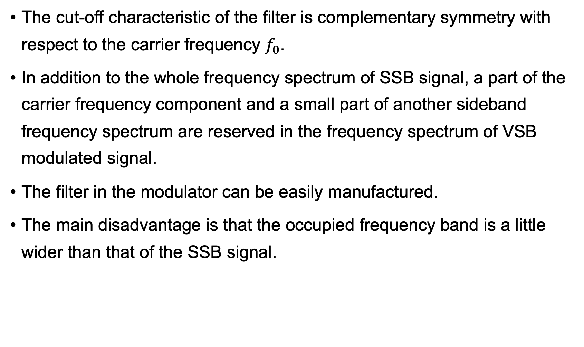
Vestigial Sideband Modulation (VSB)
The cut-off characteristic of the filter is complementary symmetry with respect to the carrier frequency $f_{0}$.
In addition to the whole frequency spectrum of SSB signal, a part of the carrier frequency component and a small part of another sideband frequency spectrum are reserved in the frequency spectrum of VSB modulated signal.
The filter in the modulator can be easily manufactured.
The main disadvantage is that the occupied frequency band is a little wider than that of the SSB signal.

Slide 25
Modulation
Amplitude Modulation (AM)
Double-sideband Modulation (DSB)
Single-sideband Modulation (SSB)
Vestigial Sideband Modulation (VSB)
Angle Modulation
CONTENTS
目录

Slide 26
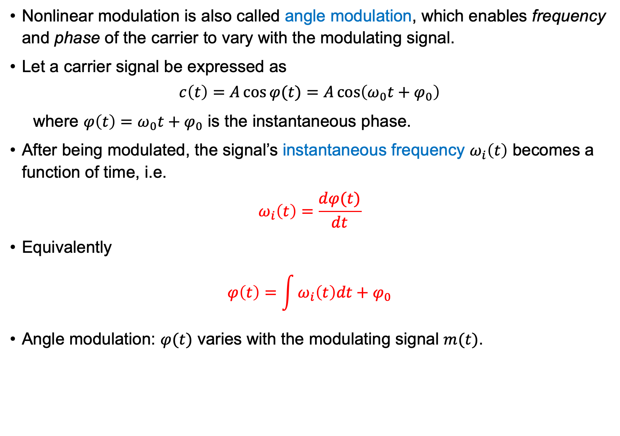
Nonlinear Modulation
Nonlinear modulation is also called angle modulation, which enables frequency and phase of the carrier to vary with the modulating signal.
Let a carrier signal be expressed as
$$c\left(t\right)=A\cos{φ(t)}=A\cos\left(ω_{0}t+φ_{0}\right)$$
where $φ\left(t\right)=ω_{0}t+φ_{0}$ is the instantaneous phase.
After being modulated, the signal’s instantaneous frequency $ω_{i}\left(t\right)$ becomes a function of time, i.e.
$$ω_{i}\left(t\right)=\frac{dφ(t)}{dt}$$
Equivalently
$$φ\left(t\right)=\int{ω_{i}\left(t\right)dt}+φ_{0}$$
Angle modulation: $φ(t)$ varies with the modulating signal $m(t)$.

Slide 27
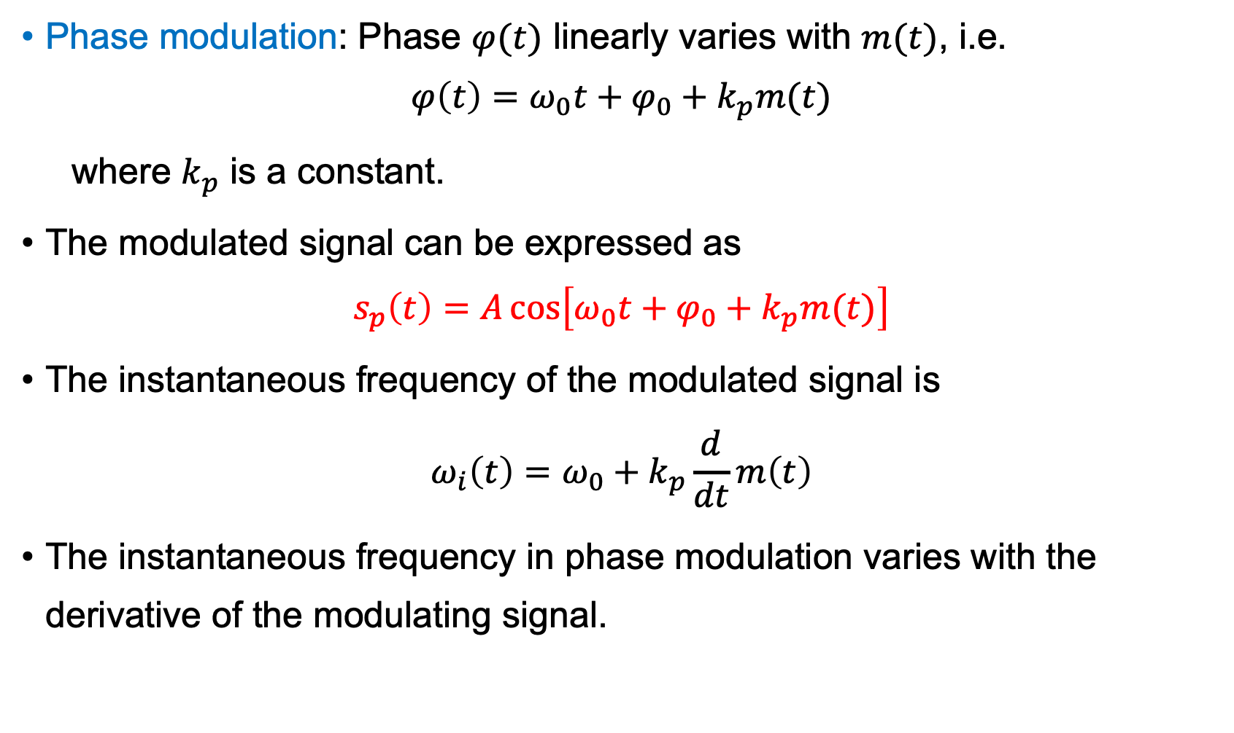
Phase Modulation (PM)
Phase modulation: Phase $φ(t)$ linearly varies with $m(t)$, i.e.
$$φ\left(t\right)=ω_{0}t+φ_{0}+k_{p}m(t)$$
where $k_{p}$ is a constant.
The modulated signal can be expressed as
$$s_{p}\left(t\right)=A\cos\left[ω_{0}t+φ_{0}+k_{p}m(t)\right]$$
The instantaneous frequency of the modulated signal is
$$ω_{i}\left(t\right)=ω_{0}+k_{p}\frac{d}{dt}m\left(t\right)$$
The instantaneous frequency in phase modulation varies with the derivative of the modulating signal.

Slide 28
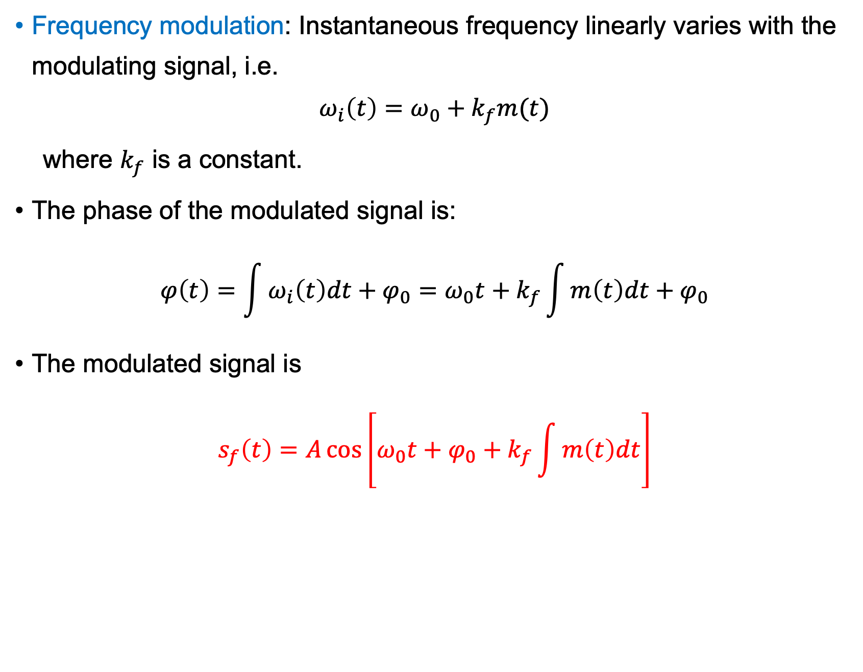
Frequency Modulation (FM)
Frequency modulation: Instantaneous frequency linearly varies with the modulating signal, i.e.
$$ω_{i}\left(t\right)=ω_{0}+k_{f}m(t)$$
where $k_{f}$ is a constant.
The phase of the modulated signal is:
$$φ\left(t\right)=\int{ω_{i}\left(t\right)dt}+φ_{0}=ω_{0}t+k_{f}\int{m\left(t\right)dt}+φ_{0}$$
The modulated signal is
$$s_{f}\left(t\right)=A\cos\left[ω_{0}t+φ_{0}+k_{f}\int{m\left(t\right)dt}\right]$$

Slide 29
PM and FM Signals
Frequency modulation
Phase modulation

Slide 30
Exercise
What are the pros and cons of FM and PM, compared with linear modulation methods?

Slide 31
Summary
Analog modulation can be classified as linear modulation and nonlinear modulation.
Frequency spectrum structure of a linearly modulated signal is the displacement of that of the modulating signal.
Linear modulation includes AM, DSB, SSB, and VSB.
Nonlinear modulation is also called angle modulation, including frequency modulation and phase modulation.
Frequency spectrum structure of a non-linearly modulated signal is different from that of the modulating signal.

Slide 32
Thank You!

