Slide 1
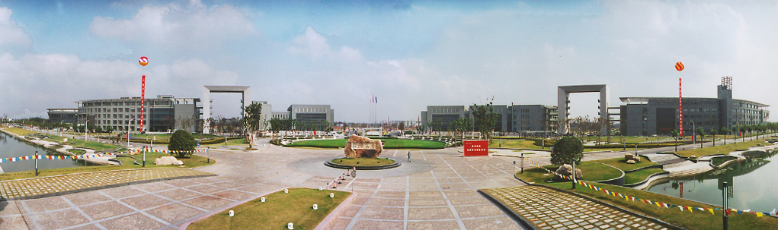
（信息与）通信技术（基础）
Module 8: Measure of Information
王超
电子与信息工程学院 - 信息与通信工程系
教授/博士生导师
Email: chaowang@tongji.edu.cn

Slide 2


Measure of Information
Shannon Information Content and Entropy
Continuous Random Variables
Relative Entropy and Mutual Information
CONTENTS
目录
Notes:
Baseband center point detection

Slide 3
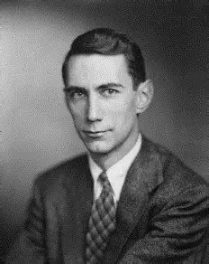
Father of Information Age
1916 - Born in Michigan
1936 - Bachelor in Electrical Engineering and Mathematics at University of Michigan
1937 - Master in Electrical Engineering at MIT
1940 - PhD in Mathematics at MIT
1948 - “A Mathematical Theory of Communication”
Claude Shannon
(1916-2001)

Slide 4
Measure of Information
Before Shannon’s paper, information had been viewed as a kind of poorly defined miasmic fluid.
But after the paper, it became apparent that information is a well-defined and measurable quantity.
Essentially, gaining information is removal of uncertainty.
We need a quantity to measure uncertainty.
Uncertainty is a property of random events.
Information is a function of probability.

Slide 5
Measure of Information
A mathematical definition of information should have the following properties
Information is a non-negative quantity.
If an outcome occurs with probability 1, we attain no information from the occurrence of it.
The amount of information associated with an outcome decreases smoothly and monotonically with increasing probability of the outcome.
The amount of information associated with a set of independent outcomes is sum of the information of individual outcomes.

Slide 6
Measure of Information
Shannon Information Content and Entropy
Continuous Random Variables
Relative Entropy and Mutual Information
CONTENTS
目录
Notes:
Baseband center point detection

Slide 7
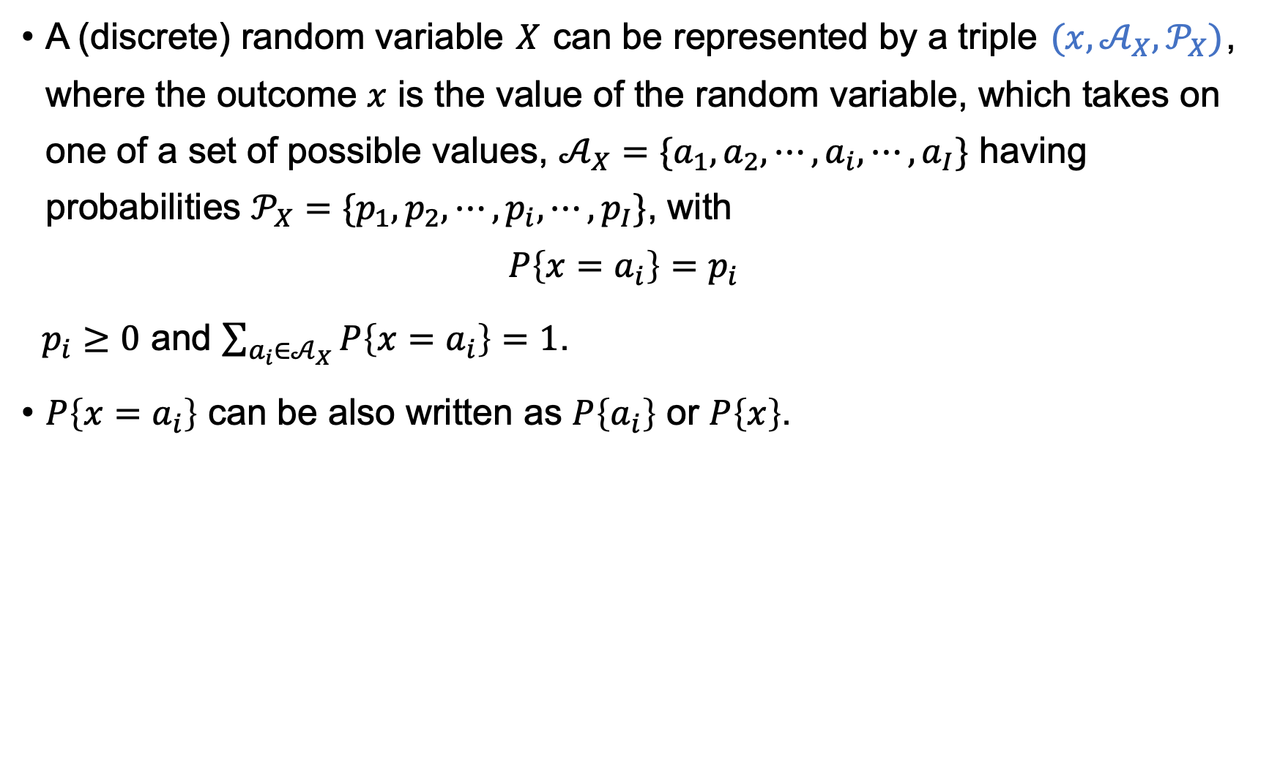
Random Variable
A (discrete) random variable $X$ can be represented by a triple $(x,𝒜_{X},𝒫_{X})$, where the outcome $x$ is the value of the random variable, which takes on one of a set of possible values, $𝒜_{X}=\{a_{1},a_{2},⋯,a_{i},⋯,a_{I}\}$ having probabilities $𝒫_{X}=\{p_{1},p_{2},⋯,p_{i},⋯,p_{I}\}$, with
$$P\left\{x=a_{i}\right\}=p_{i}$$
$p_{i}≥0$ and $\sum_{a_{i}∈𝒜_{X}}{P\left\{x=a_{i}\right\}}=1$.
$P\left\{x=a_{i}\right\}$ can be also written as $P\left\{a_{i}\right\}$ or $P\left\{x\right\}$.

Slide 8
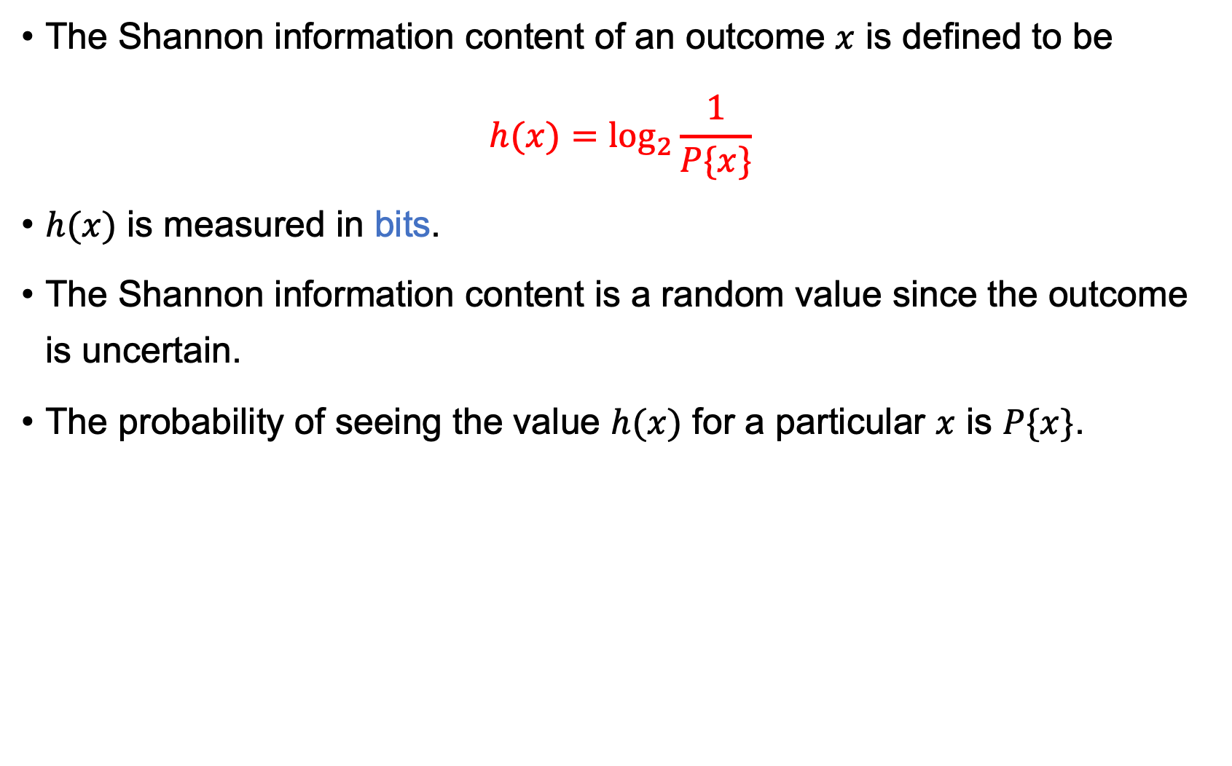
Shannon Information Content
The Shannon information content of an outcome $x$ is defined to be
$$h(x)=\log_{2}{\frac{1}{P\{x\}}}$$
$h(x)$ is measured in bits.
The Shannon information content is a random value since the outcome is uncertain.
The probability of seeing the value $h(x)$ for a particular $x$ is $P\{x\}$.

Slide 9
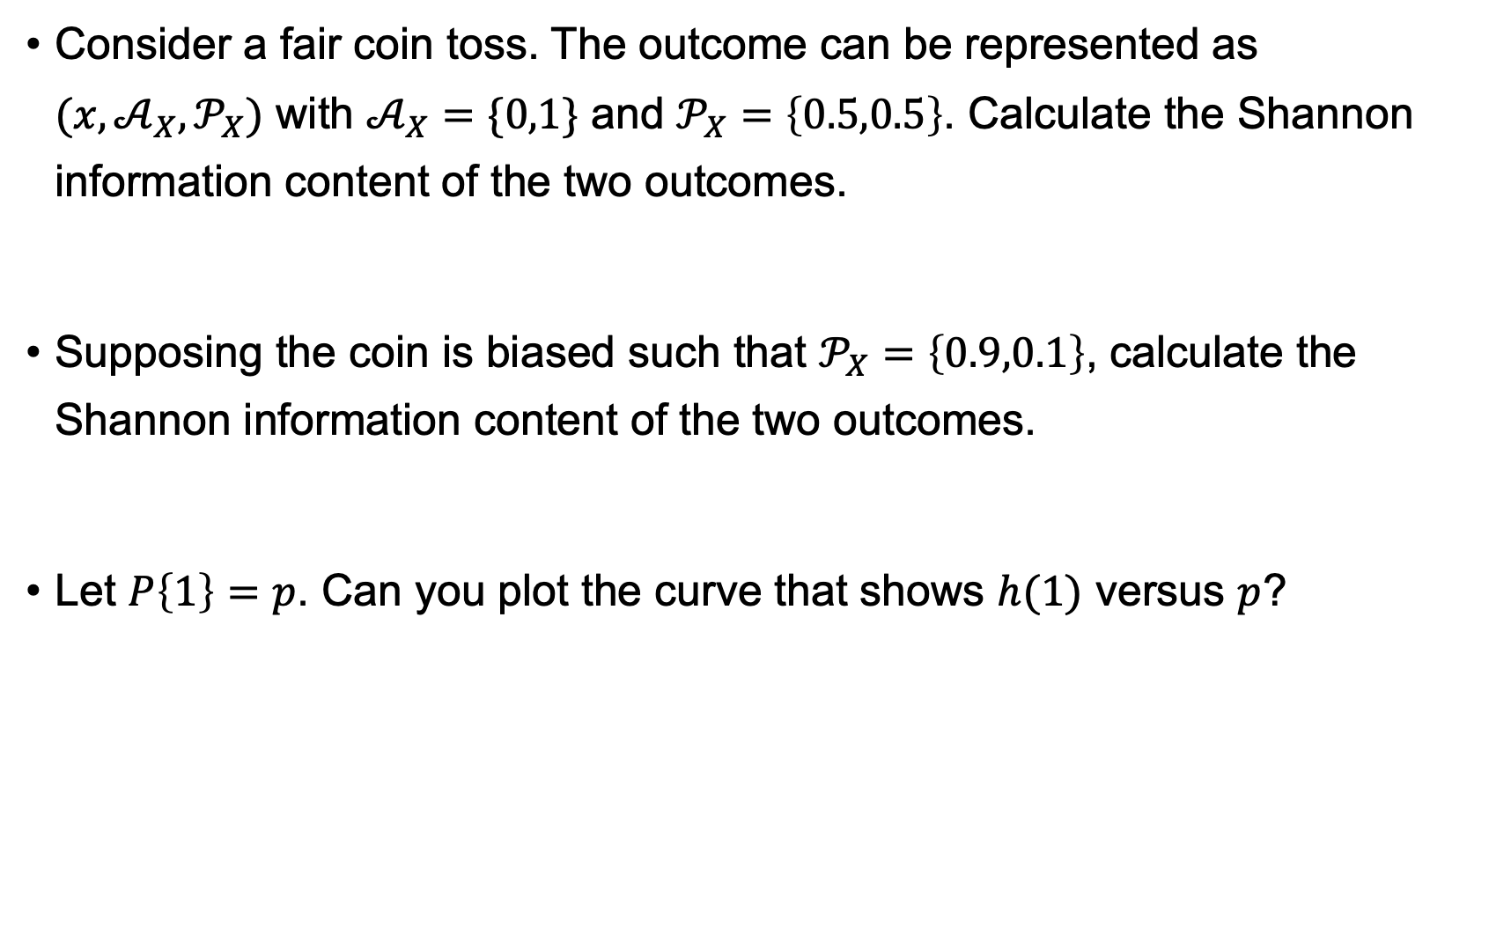
Exercises
Consider a fair coin toss. The outcome can be represented as $(x,𝒜_{X},𝒫_{X})$ with $𝒜_{X}=\{0,1\}$ and $𝒫_{X}=\left\{0.5,0.5\right\}$. Calculate the Shannon information content of the two outcomes.
Supposing the coin is biased such that $𝒫_{X}=\left\{0.9,0.1\right\}$, calculate the Shannon information content of the two outcomes.
Let $P\left\{1\right\}=p$. Can you plot the curve that shows $h(1)$ versus $p$?

Slide 10
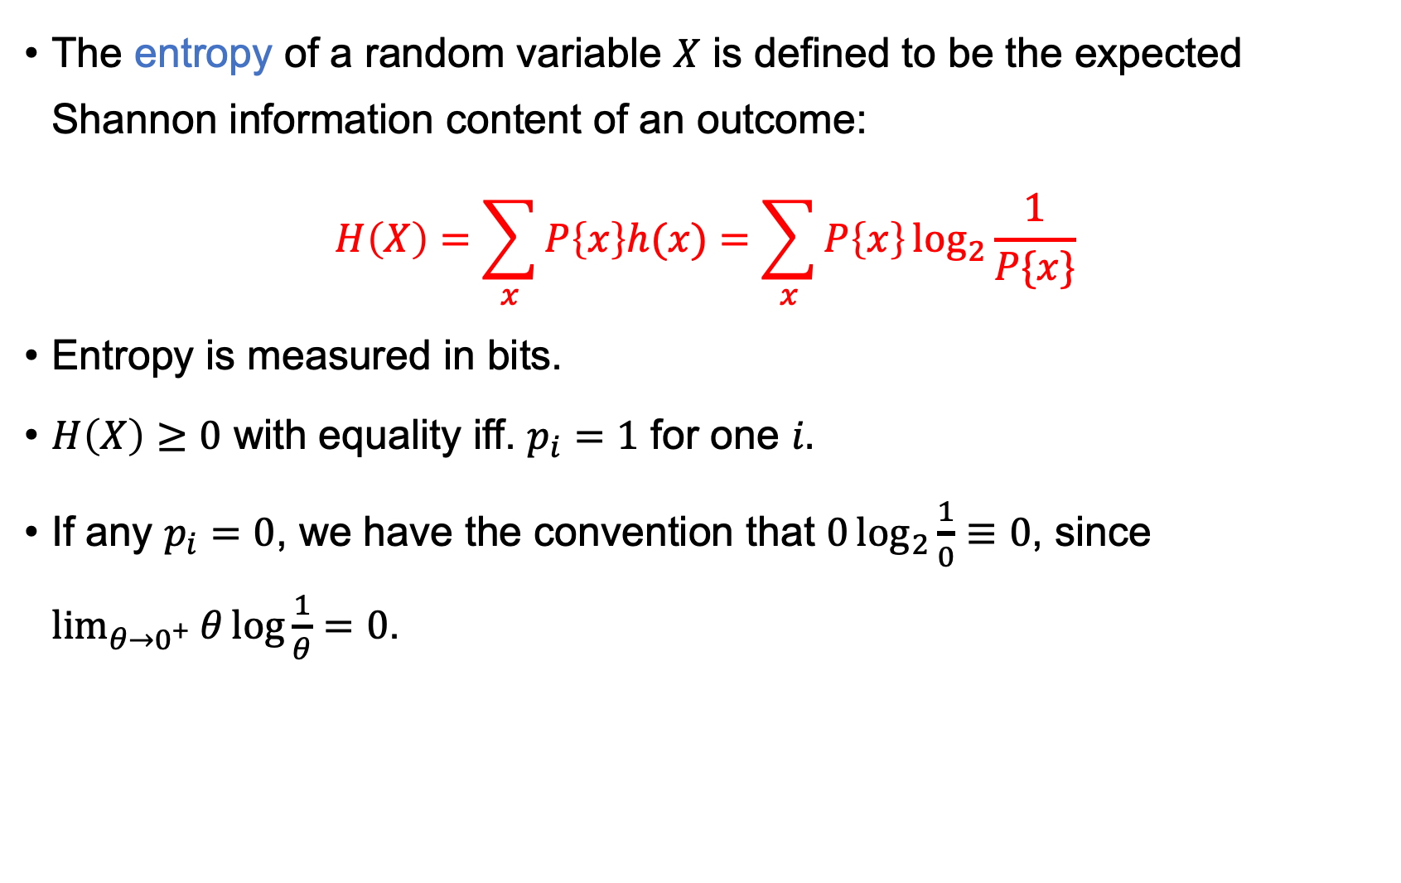
Entropy
The entropy of a random variable $X$ is defined to be the expected Shannon information content of an outcome:
$$H\left(X\right)=\sum_{x}{P\left\{x\right\}h(x)}=\sum_{x}{P\left\{x\right\}\log_{2}{\frac{1}{P\{x\}}}}$$
Entropy is measured in bits.
$H\left(X\right)≥0$ with equality iff. $p_{i}=1$ for one $i.$
If any $p_{i}=0$, we have the convention that $0\log_{2}{\frac{1}{0}}≡0$, since $\lim_{θ→0^{+}}{θ\log{\frac{1}{θ}}=0}$.

Slide 11

Exercises
Calculate the entropy of a fair coin toss.
Calculate the entropy of tossing a biased coin with $𝒫_{X}=\left\{0.9,0.1\right\}$.
Let $P\left\{1\right\}=p$. Can you plot the curve that shows $H(X)$ versus $p$?

Slide 12
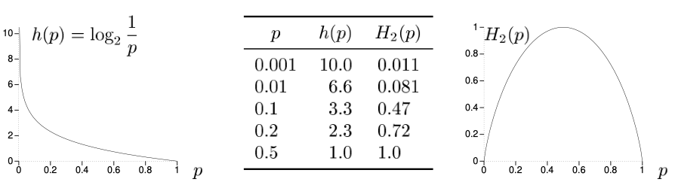

The Binary Entropy Function
The entropy of random variable $X$: $(x,\left\{a,b\right\},\{p,1−p\})$ is termed binary entropy function:
$$H_{2}\left(p\right)=p\log_{2}{\frac{1}{p}}+(1−p)\log_{2}{\frac{1}{1−p}}$$

Slide 13
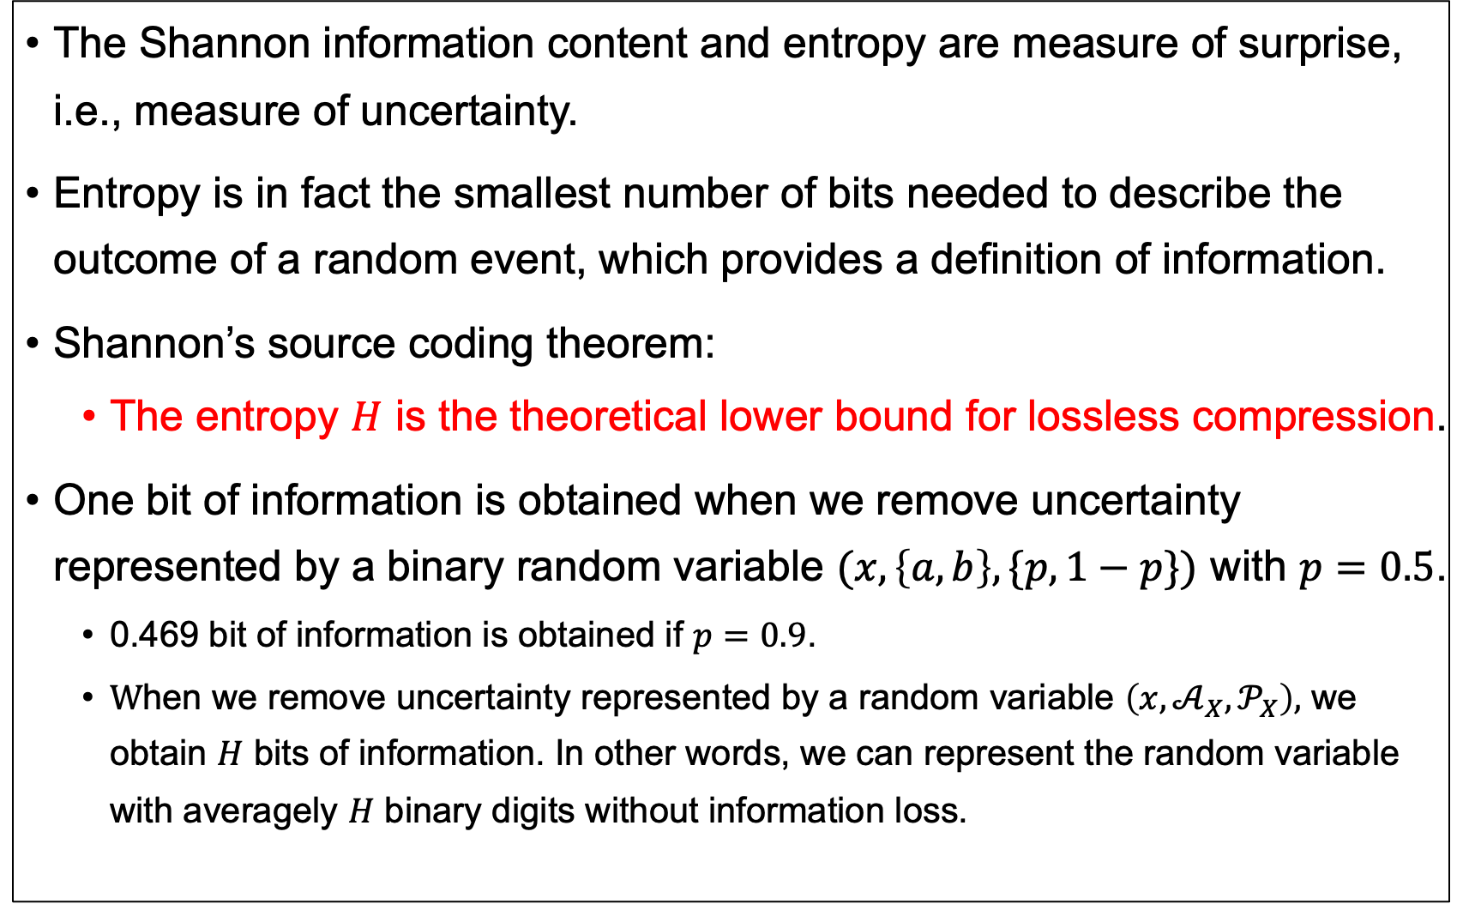
Interpretation of Entropy
The Shannon information content and entropy are measure of surprise, i.e., measure of uncertainty.
Entropy is in fact the smallest number of bits needed to describe the outcome of a random event, which provides a definition of information.
Shannon’s source coding theorem:
The entropy $H$ is the theoretical lower bound for lossless compression.
One bit of information is obtained when we remove uncertainty represented by a binary random variable $(x,\left\{a,b\right\},\{p,1−p\})$ with $p=0.5$.
0.469 bit of information is obtained if $p=0.9$.
$\text{W}\text{hen} \text{we} \text{remove} \text{uncertainty} \text{represented} \text{by} \text{a} \text{random} \text{variable} \left(x,𝒜_{X},𝒫_{X}\right),$ we obtain $H$ bits of information. In other words, we can represent the random variable with averagely $H$ binary digits without information loss.

Slide 14
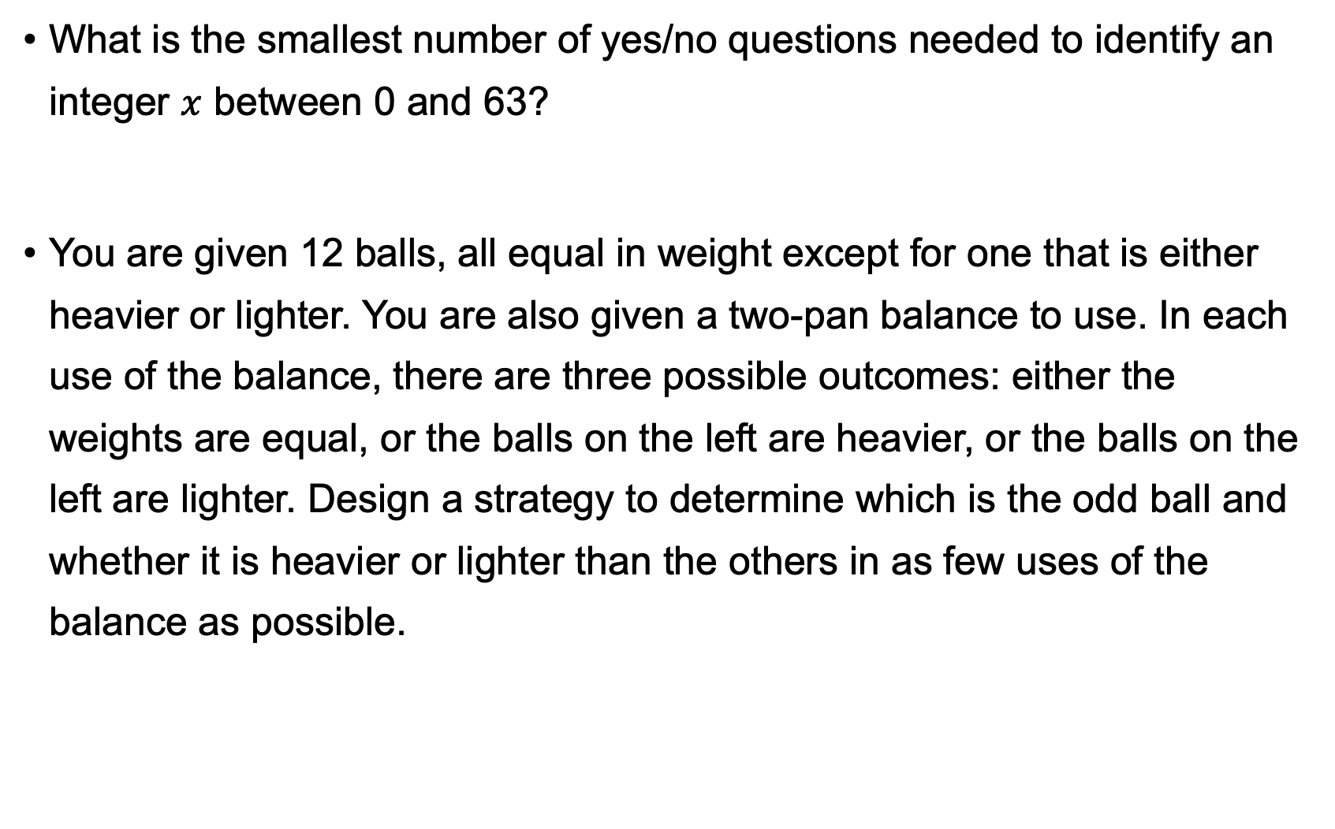
Exercises
What is the smallest number of yes/no questions needed to identify an integer $x$ between 0 and 63?
You are given 12 balls, all equal in weight except for one that is either heavier or lighter. You are also given a two-pan balance to use. In each use of the balance, there are three possible outcomes: either the weights are equal, or the balls on the left are heavier, or the balls on the left are lighter. Design a strategy to determine which is the odd ball and whether it is heavier or lighter than the others in as few uses of the balance as possible.

Slide 15
Exercises
Jo went to a hospital to diagnose if he had a type of heart disease. He is 46 years old, and the CRP (C-reactive protein) test result was high. The hospital had 10 patients’ records. Can the doctor predict Jo’s condition based on the knowledge learned from the records?
Patient Number | Age | CRP Test Result | Heart Disease
1 | >50 | High | Yes
2 | >50 | High | Yes
3 | >50 | Normal | Yes
4 | >50 | Normal | No
5 | >50 | Normal | No
6 | <50 | High | Yes
7 | <50 | High | No
8 | <50 | Normal | No
9 | <50 | Normal | No
10 | <50 | Normal | No

Slide 16
Measure of Information
Shannon Information Content and Entropy
Continuous Random Variables
Relative Entropy and Mutual Information
CONTENTS
目录
Notes:
Baseband center point detection

Slide 17
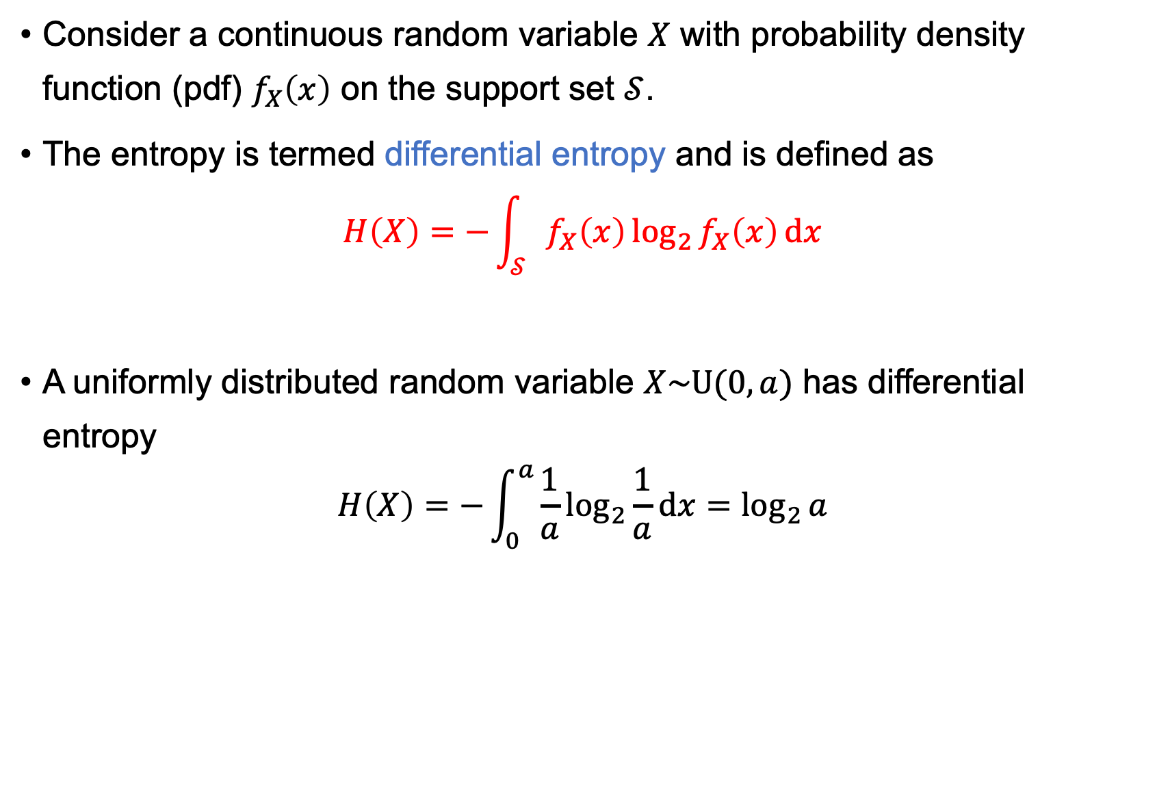
Differential Entropy
Consider a continuous random variable $X$ with probability density function (pdf) $f_{X}\left(x\right)$ on the support set $𝒮$.
The entropy is termed differential entropy and is defined as
$$H\left(X\right)=−\int_{𝒮}{f_{X}\left(x\right)}\log_{2}{f_{X}\left(x\right)}dx$$
A uniformly distributed random variable $X\sim \text{U}(0,a)$ has differential entropy
$$H\left(X\right)=−\int_{0}^{a}{\frac{1}{a}}\log_{2}{\frac{1}{a}}dx=\log_{2}{a}$$

Slide 18
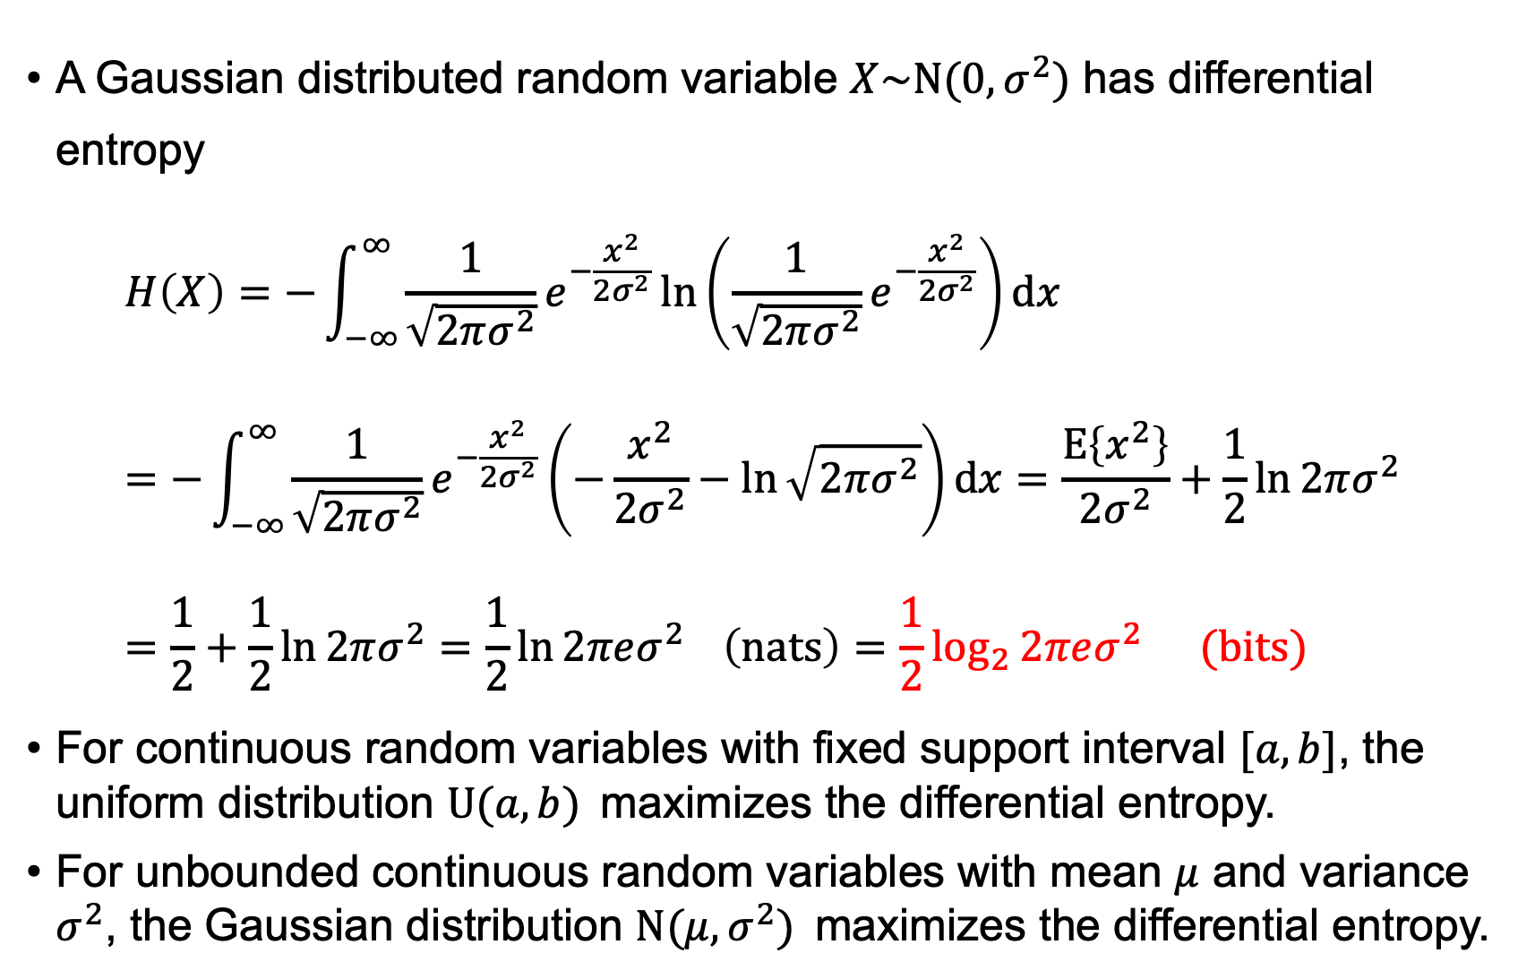
Gaussian Random Variable
A Gaussian distributed random variable $X\sim \text{N}(0,σ^{2})$ has differential entropy
$$H\left(X\right)=−\int_{−∞}^{∞}{\frac{1}{\sqrt{2πσ^{2}}}}e^{−\frac{x^{2}}{2σ^{2}}}\ln\left(\frac{1}{\sqrt{2πσ^{2}}}e^{−\frac{x^{2}}{2σ^{2}}}\right)dx=−\int_{−∞}^{∞}{\frac{1}{\sqrt{2πσ^{2}}}}e^{−\frac{x^{2}}{2σ^{2}}}\left(−\frac{x^{2}}{2σ^{2}}−\ln{\sqrt{2πσ^{2}}}\right)dx=\frac{Ε\left\{x^{2}\right\}}{2σ^{2}}+\frac{1}{2}\ln{2πσ^{2}}=\frac{1}{2}+\frac{1}{2}\ln{2πσ^{2}}=\frac{1}{2}\ln{2πeσ^{2}} \left(nats\right)=\frac{1}{2}\log_{2}{2πeσ^{2}} (bits)$$
For continuous random variables with fixed support interval $[a,b]$, the uniform distribution $\text{U}(a,b)$maximizes the differential entropy.
For unbounded continuous random variables with mean $μ$ and variance $σ^{2}$, the Gaussian distribution $\text{N}(μ,σ^{2})$maximizes the differential entropy.

Slide 19
Measure of Information
Shannon Information Content and Entropy
Continuous Random Variables
Relative Entropy and Mutual Information
CONTENTS
目录
Notes:
Baseband center point detection

Slide 20
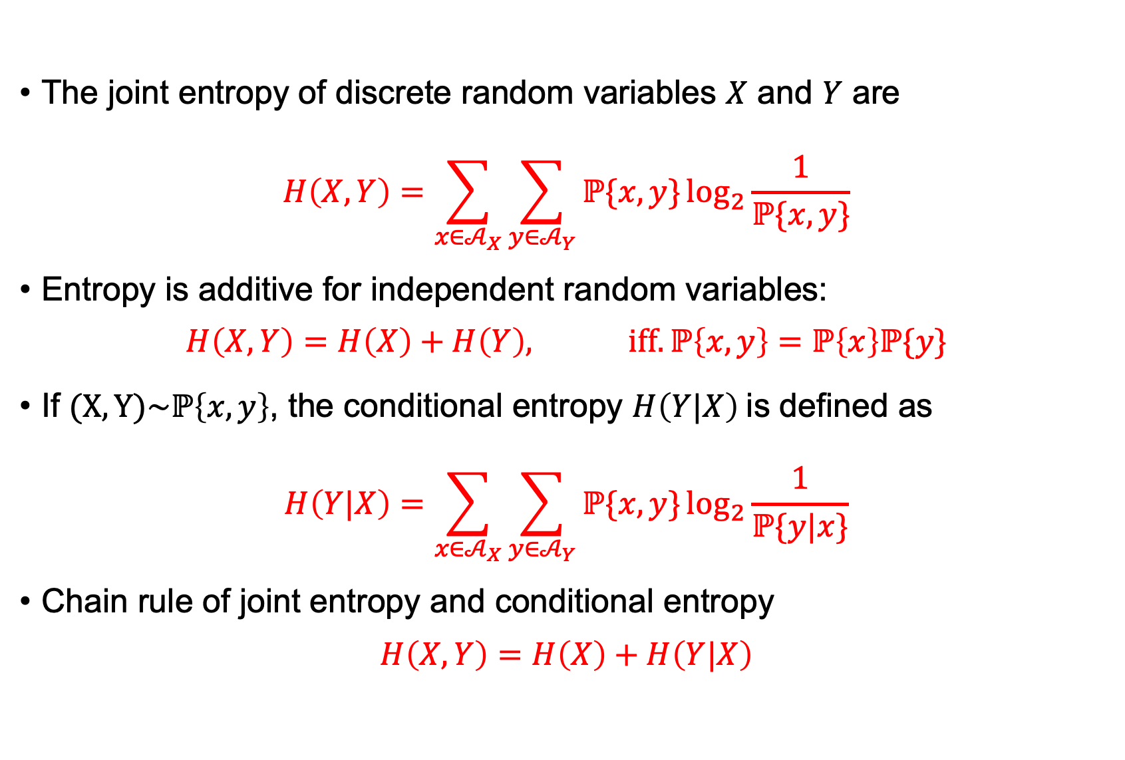
Joint Entropy
The joint entropy of discrete random variables $X$ and $Y$ are
$$H\left(X,Y\right)=\sum_{x∈𝒜_{X}}{\sum_{y∈𝒜_{Y}}{ℙ\{x,y\}}\log_{2}{\frac{1}{ℙ\{x,y\}}}}$$
Entropy is additive for independent random variables:
$$H\left(X,Y\right)=H\left(X\right)+H\left(Y\right), iff.ℙ\left\{x,y\right\}=ℙ\left\{x\right\}ℙ\{y\}$$
If $(X,Y)\sim ℙ\left\{x,y\right\}$, the conditional entropy $H\left(Y|X\right)$is defined as
$$H\left(Y|X\right)=\sum_{x∈𝒜_{X}}{\sum_{y∈𝒜_{Y}}{ℙ\{x,y\}}\log_{2}{\frac{1}{ℙ\{y|x\}}}}$$
Chain rule of joint entropy and conditional entropy
$$H\left(X,Y\right)=H\left(X\right)+H\left(Y|X\right)$$

Slide 21
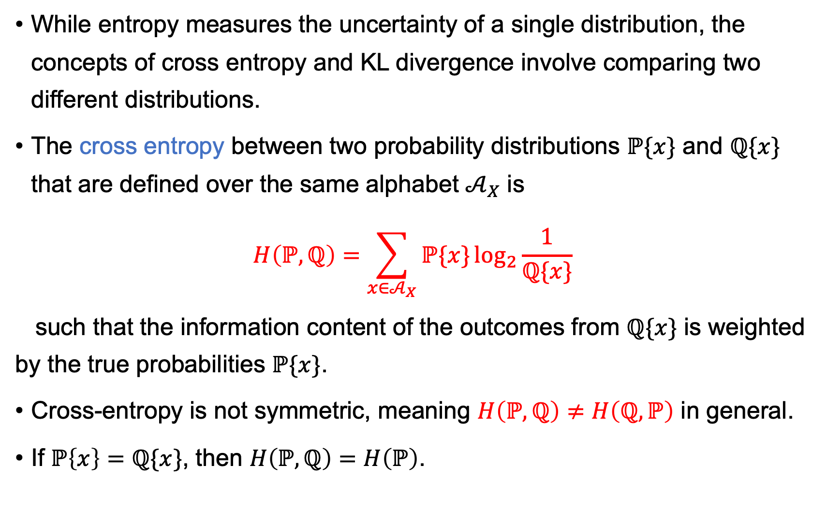
Cross Entropy
While entropy measures the uncertainty of a single distribution, the concepts of cross entropy and KL divergence involve comparing two different distributions.
The cross entropy between two probability distributions $ℙ\{x\}$ and $ℚ\{x\}$ that are defined over the same alphabet $𝒜_{X}$ is
$$H\left(ℙ,ℚ\right)=\sum_{x∈𝒜_{X}}{ℙ\{x\}\log_{2}{\frac{1}{ℚ\{x\}}}}$$
such that the information content of the outcomes from $ℚ\{x\}$ is weighted by the true probabilities $ℙ\{x\}$.
Cross-entropy is not symmetric, meaning $H\left(ℙ,ℚ\right)≠H\left(ℚ,ℙ\right)$ in general.
If $ℙ\left\{x\right\}=ℚ\{x\}$, then $H\left(ℙ,ℚ\right)=H\left(ℙ\right)$.

Slide 22
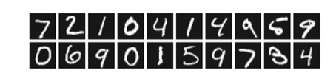
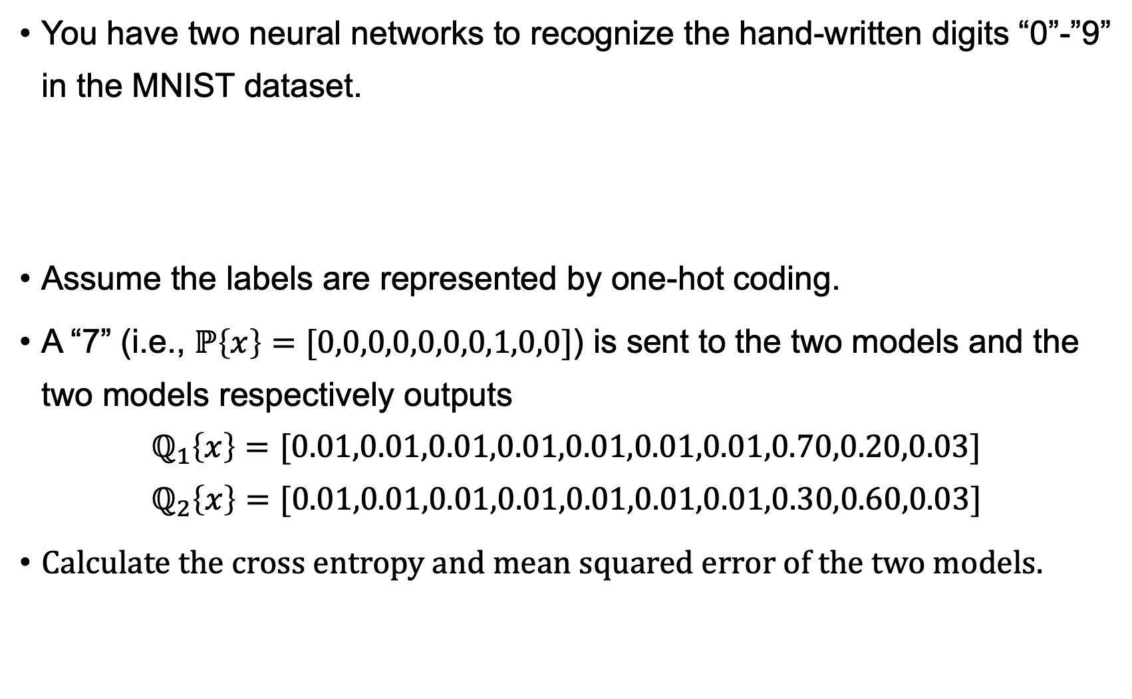
Exercise
You have two neural networks to recognize the hand-written digits “0”-”9” in the MNIST dataset.
Assume the labels are represented by one-hot coding.
A “7” (i.e., $ℙ\left\{x\right\}=[0,0,0,0,0,0,0,1,0,0]$) is sent to the two models and the two models respectively outputs
$$ℚ_{1}\left\{x\right\}=[\text{0.01,0.01,0.01,0.01,0.01,0.01,0.01,0.70,0.20,0.03}]$$
$$ℚ_{2}\left\{x\right\}=[\text{0.01,0.01,0.01,0.01,0.01,0.01,0.01,0.30,0.60,0.03}]$$
Calculate the cross entropy and mean squared error of the two models.

Slide 23
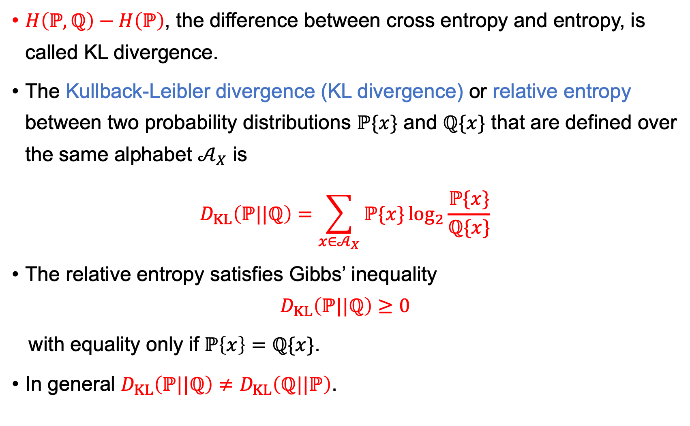
KL Divergence
$H\left(ℙ,ℚ\right)−H\left(ℙ\right)$, the difference between cross entropy and entropy, is called KL divergence.
The Kullback-Leibler divergence (KL divergence) or relative entropy between two probability distributions $ℙ\{x\}$ and $ℚ\{x\}$ that are defined over the same alphabet $𝒜_{X}$ is
$$D_{KL}\left(ℙ||ℚ\right)=\sum_{x∈𝒜_{X}}{ℙ\{x\}\log_{2}{\frac{ℙ\{x\}}{ℚ\{x\}}}}$$
The relative entropy satisfies Gibbs’ inequality
$$D_{KL}\left(ℙ||ℚ\right)≥0$$
with equality only if $ℙ\left\{x\right\}=ℚ\{x\}$.
In general $D_{KL}\left(ℙ||ℚ\right)≠D_{KL}\left(ℚ||ℙ\right)$.

Slide 24
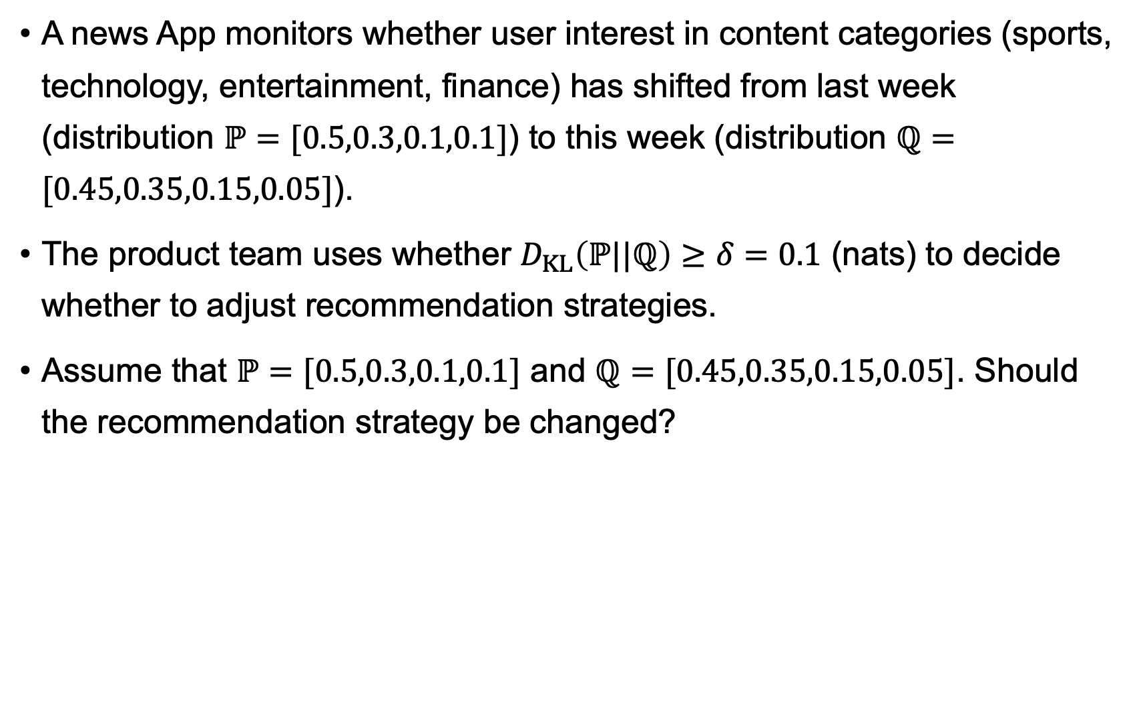
Exercise
A news App monitors whether user interest in content categories (sports, technology, entertainment, finance) has shifted from last week (distribution $ℙ=[0.5,0.3,0.1,0.1]$) to this week (distribution $ℚ=[0.45,0.35,0.15,0.05]$).
The product team uses whether $D_{KL}\left(ℙ||ℚ\right)≥δ=0.1$ (nats) to decide whether to adjust recommendation strategies.
Assume that $ℙ=[0.5,0.3,0.1,0.1]$ and $ℚ=[0.45,0.35,0.15,0.05]$. Should the recommendation strategy be changed?

Slide 25
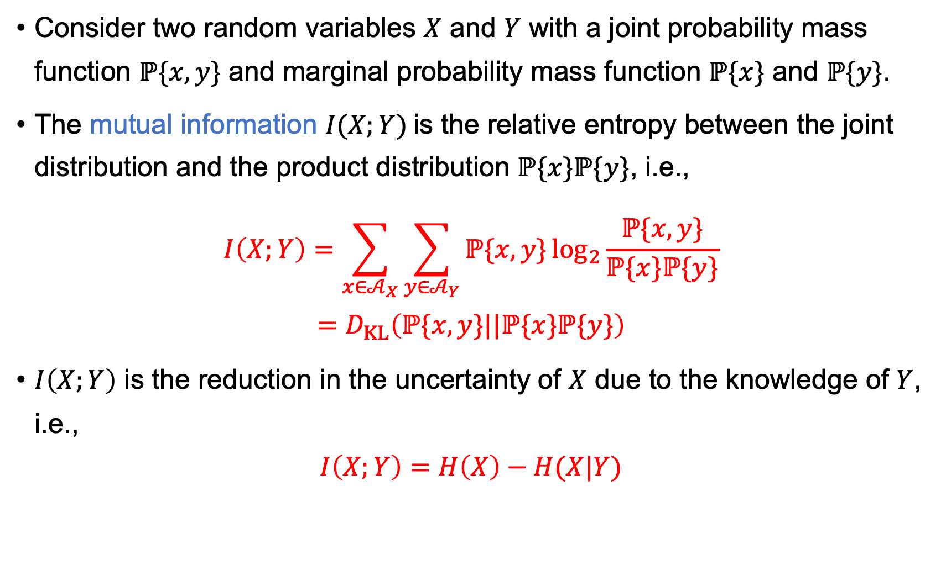
Mutual Information
Consider two random variables $X$ and $Y$ with a joint probability mass function $ℙ\{x,y\}$ and marginal probability mass function $ℙ\{x\}$ and $ℙ\{y\}$.
The mutual information $I(X;Y)$is the relative entropy between the joint distribution and the product distribution $ℙ\{x\}ℙ\{y\}$, i.e.,
$$I\left(X;Y\right)=\sum_{x∈𝒜_{X}}{\sum_{y∈𝒜_{Y}}{ℙ\{x,y\}}\log_{2}{\frac{ℙ\{x,y\}}{ℙ\{x\}ℙ\{y\}}}}$$
$$=D_{KL}\left(ℙ\{x,y\}||ℙ\{x\}ℙ\{y\}\right)$$
$I\left(X;Y\right)$ is the reduction in the uncertainty of $X$ due to the knowledge of $Y$, i.e.,
$$I\left(X;Y\right)=H\left(X\right)−H(X|Y)$$

Slide 26
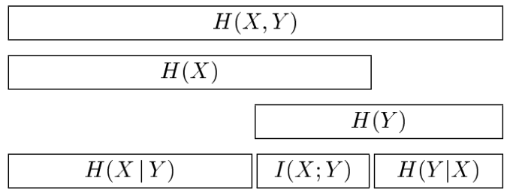

Mutual Information
$$I\left(X;Y\right)=H\left(X\right)−H\left(X | Y\right)=H\left(Y\right)−H(Y|X)$$
$$I\left(X;Y\right)=H\left(X\right)+H(Y)−H(X,Y)$$
$$I\left(X;Y\right)=I\left(Y;X\right)$$
$$I\left(X;X\right)=H\left(X\right)$$

Slide 27
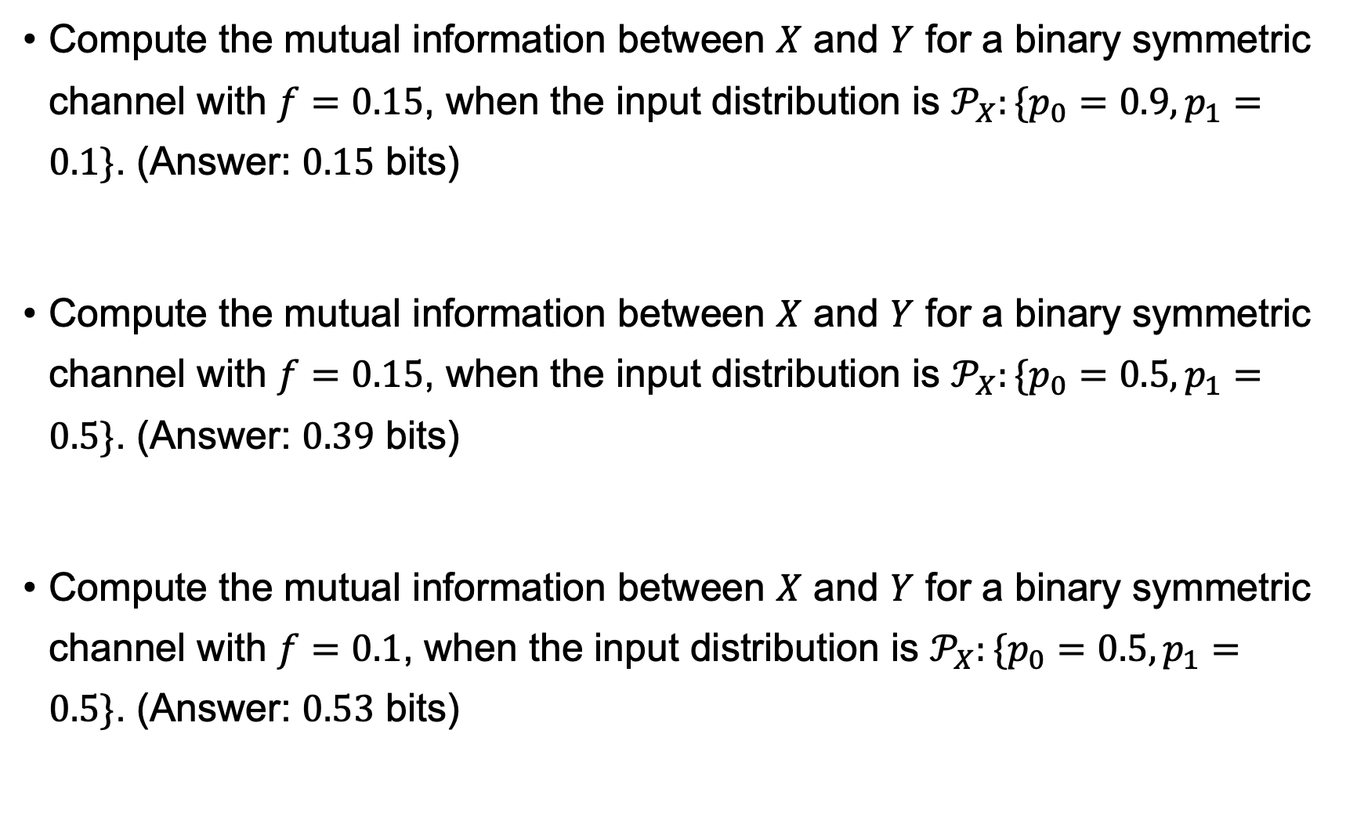
Exercise
Compute the mutual information between $X$ and $Y$ for a binary symmetric channel with $f=0.15$, when the input distribution is $𝒫_{X}:\{p_{0}=0.9,p_{1}=0.1\}$. (Answer: $0.15$ bits)
Compute the mutual information between $X$ and $Y$ for a binary symmetric channel with $f=0.15$, when the input distribution is $𝒫_{X}:\{p_{0}=0.5,p_{1}=0.5\}$. (Answer: $0.39$ bits)
Compute the mutual information between $X$ and $Y$ for a binary symmetric channel with $f=0.1$, when the input distribution is $𝒫_{X}:\{p_{0}=0.5,p_{1}=0.5\}$. (Answer: $0.53$ bits)

Slide 28
Exercise
You are building an email classification system to distinguish spam from normal. You have collected 1,000 labeled emails (500 spam, 500 ham).
Your goal is to find which words are most useful for identifying spam, so you can use them as features for a classifier.
You have three candidate words: "invoice" , "hello" , and "free" .
Question: Which word has the strongest statistical association with spam?
 | Spam | Normal
Contain “Invoice” | 180 | 20
No “Invoice” | 320 | 480
 | Spam | Normal
Contain “Hello” | 50 | 250
No “Hello” | 450 | 250
 | Spam | Normal
Contain “Free” | 300 | 100
No “Free” | 200 | 400

Slide 29
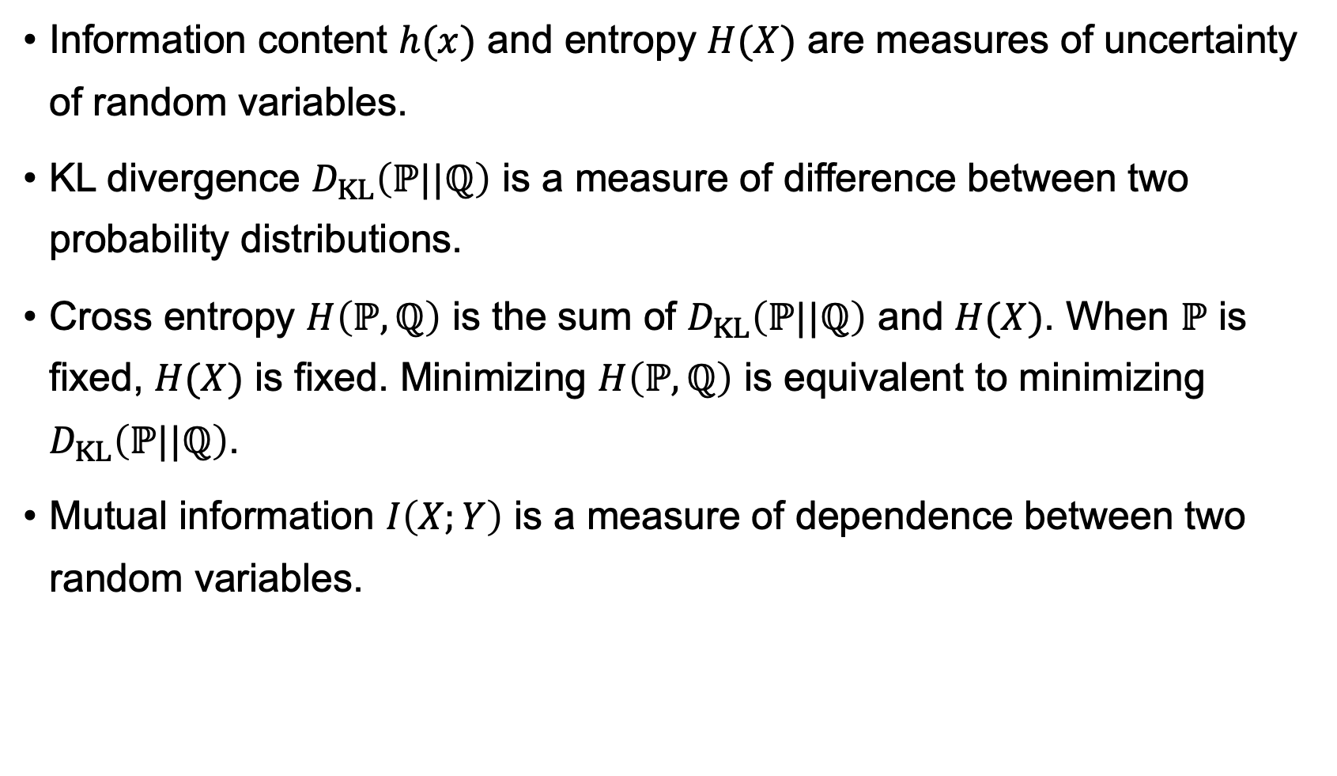
Summary
Information content $h(x)$ and entropy $H(X)$ are measures of uncertainty of random variables.
KL divergence $D_{KL}\left(ℙ||ℚ\right)$ is a measure of difference between two probability distributions.
Cross entropy $H\left(ℙ,ℚ\right)$ is the sum of $D_{KL}\left(ℙ||ℚ\right)$ and $H(X)$. When $ℙ$ is fixed, $H(X)$ is fixed. Minimizing $H\left(ℙ,ℚ\right)$ is equivalent to minimizing $D_{KL}\left(ℙ||ℚ\right)$.
Mutual information $I\left(X;Y\right)$ is a measure of dependence between two random variables.

Slide 30
Thank You!

