Slide 1
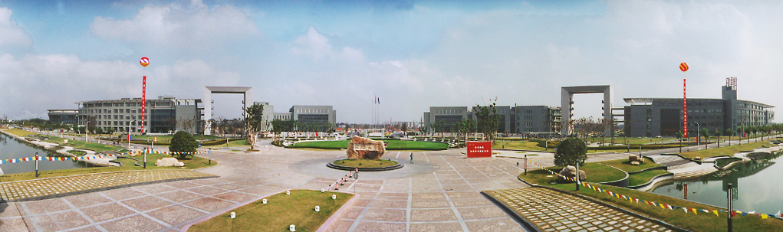
（信息与）通信技术（基础）
Module 9: Data Compression and Channel Coding
王超
电子与信息工程学院 - 信息与通信工程系
教授/博士生导师
Email: chaowang@tongji.edu.cn

Slide 2


Compression with Huffman Code
Error Correction with Hamming Code
CONTENTS
目录
Notes:
Baseband center point detection

Slide 3
Data Compression
Data compression is the process of encoding information using fewer bits than the original representation.
It is a reduction in the number of bits needed to represent data.
It can save storage capacity, speed up file transfer, and decrease costs for storage hardware and network bandwidth.
Lossy compression is the type of data compression where some amount of the original information is permanently discarded in order to significantly reduce the file size (e.g., JPEG, MPEG, MP3).
Lossless compression is the type of data compression that allows the exact original data to be perfectly reconstructed from the compressed data (e.g., PNG, FLAC, ZIP).

Slide 4
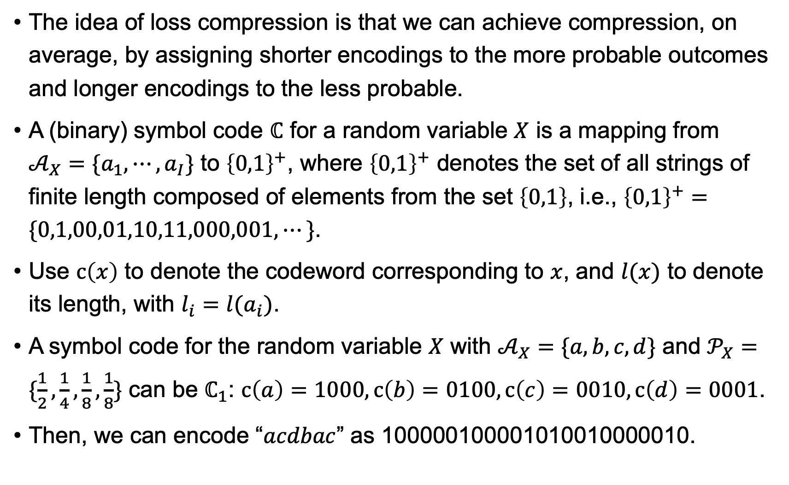
Symbol Codes
The idea of loss compression is that we can achieve compression, on average, by assigning shorter encodings to the more probable outcomes and longer encodings to the less probable.
A (binary) symbol code $ℂ$ for a random variable $X$ is a mapping from $𝒜_{X}=\{a_{1},⋯,a_{I}\}$ to ${\left\{0,1\right\}}^{+}$, where ${\left\{0,1\right\}}^{+}$ denotes the set of all strings of finite length composed of elements from the set $\left\{0,1\right\}$, i.e., ${\left\{0,1\right\}}^{+}=\{0,1,00,01,10,11,000,001,⋯\}$.
Use $c\left(x\right)$ to denote the codeword corresponding to $x$, and $l(x)$ to denote its length, with $l_{i}=l(a_{i})$.
A symbol code for the random variable $X$ with $𝒜_{X}=\{a,b,c,d\}$ and $𝒫_{X}=\{\frac{1}{2},\frac{1}{4},\frac{1}{8},\frac{1}{8}\}$ can be $ℂ_{1}$: $c\left(a\right)=1000,c\left(b\right)=0100, c\left(c\right)=0010, c\left(d\right)=0001$.
Then, we can encode “$acdbac$” as 100000100001010010000010.

Slide 5
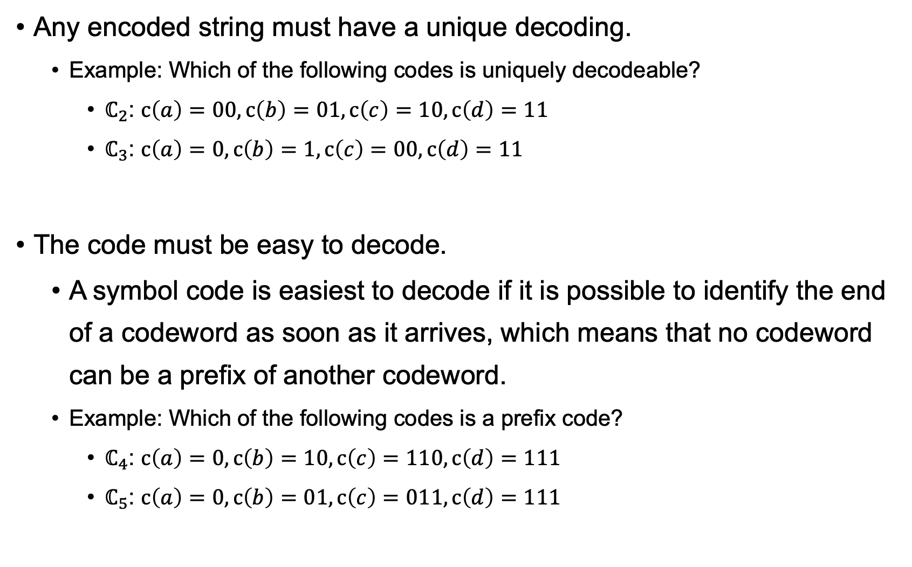
Requirements for a Useful Symbol Code
Any encoded string must have a unique decoding.
Example: Which of the following codes is uniquely decodeable?
$ℂ_{2}$: $c\left(a\right)=00,c\left(b\right)=01, c\left(c\right)=10, c\left(d\right)=11$
$ℂ_{3}$: $c\left(a\right)=0,c\left(b\right)=1, c\left(c\right)=00, c\left(d\right)=11$
The code must be easy to decode.
A symbol code is easiest to decode if it is possible to identify the end of a codeword as soon as it arrives, which means that no codeword can be a prefix of another codeword.
Example: Which of the following codes is a prefix code?
$ℂ_{4}$: $c\left(a\right)=0,c\left(b\right)=10, c\left(c\right)=110, c\left(d\right)=111$
$ℂ_{5}$: $c\left(a\right)=0,c\left(b\right)=01, c\left(c\right)=011, c\left(d\right)=111$

Slide 6
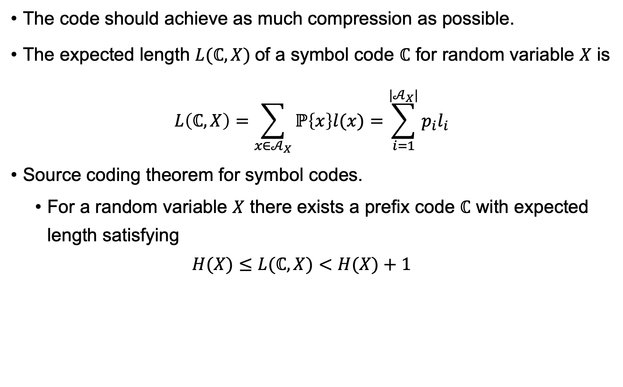
Requirements for a Useful Symbol Code
The code should achieve as much compression as possible.
The expected length $L(ℂ, X)$of a symbol code $ℂ$ for random variable $X$ is
$$L\left(ℂ, X\right)=\sum_{x∈𝒜_{X}}{ℙ\left\{x\right\}l(x)}=\sum_{i=1}^{|𝒜_{X}|}{p_{i}l_{i}}$$
Source coding theorem for symbol codes.
For a random variable $X$ there exists a prefix code $ℂ$ with expected length satisfying
$$H(X)≤L(ℂ, X)<H(X)+1$$

Slide 7
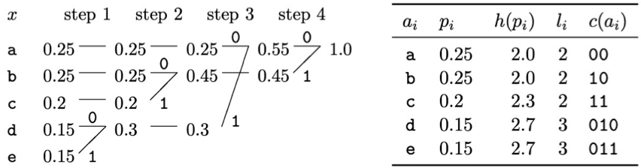
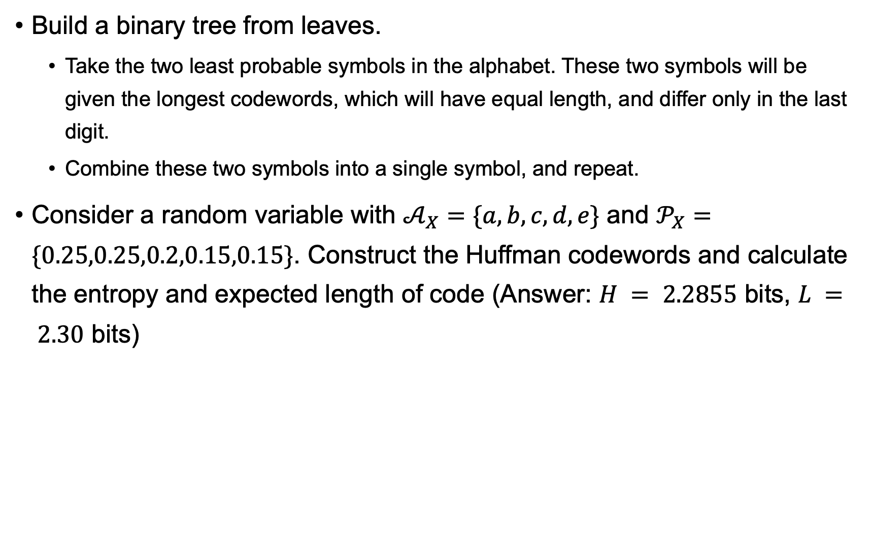
The Huffman Coding Algorithm
Build a binary tree from leaves.
Take the two least probable symbols in the alphabet. These two symbols will be given the longest codewords, which will have equal length, and differ only in the last digit.
Combine these two symbols into a single symbol, and repeat.
Consider a random variable with $𝒜_{X}=\{a,b,c,d,e\}$ and $𝒫_{X}=\{0.25,0.25,0.2,0.15,0.15\}$. Construct the Huffman codewords and calculate the entropy and expected length of code (Answer: $H = 2.2855$ bits, $L = 2.30$ bits)

Slide 8
Pros and Cons of Huffman Code
Advantages
There is no better symbol code for a source than the Huffman code: The Huffman algorithm produces an optimal symbol code for a random variable.
Disadvantages
Huffman codes do not handle changing source probabilities.
A Huffman code incurs an overhead of between 0 and 1 bits per symbol.

Slide 9
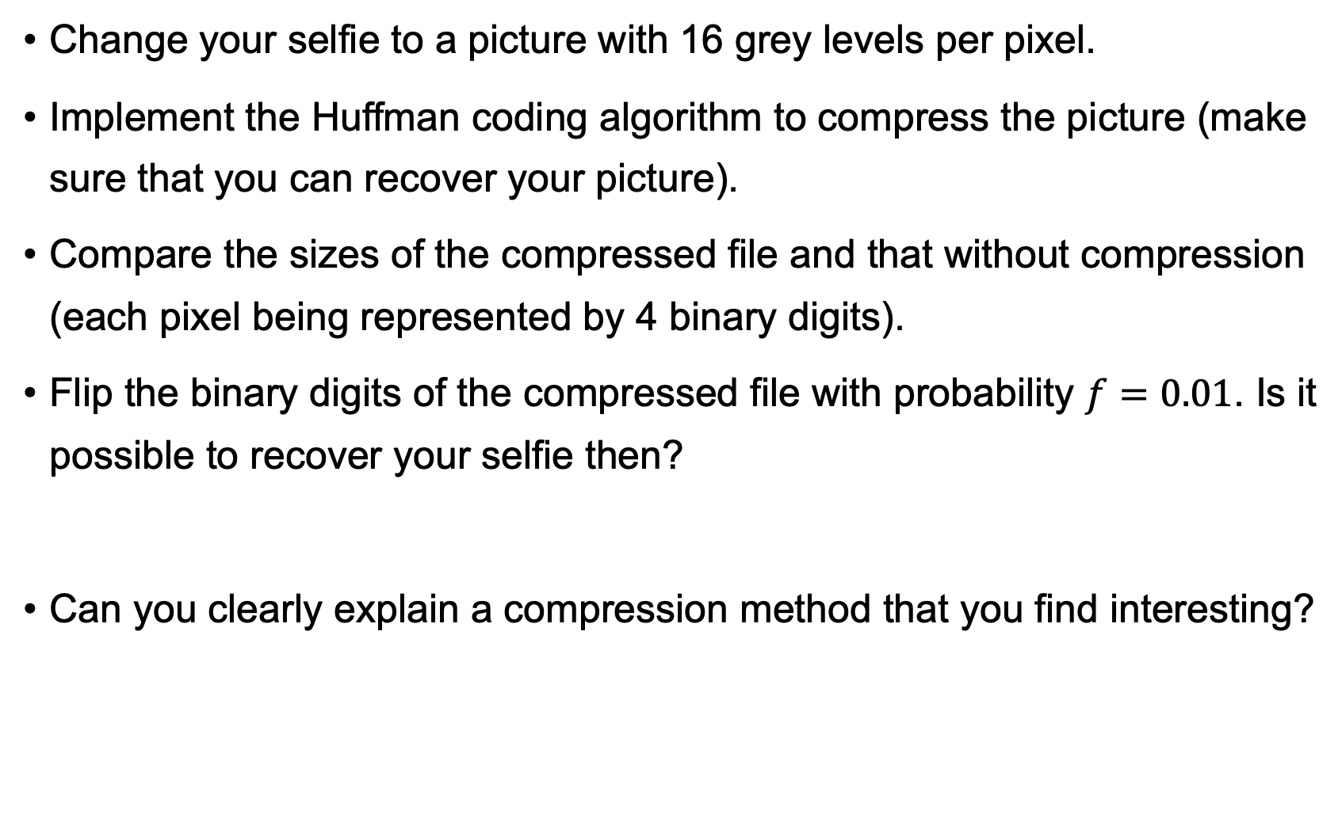
Exercise
Change your selfie to a picture with 16 grey levels per pixel.
Implement the Huffman coding algorithm to compress the picture (make sure that you can recover your picture).
Compare the sizes of the compressed file and that without compression (each pixel being represented by 4 binary digits).
Flip the binary digits of the compressed file with probability $f=0.01$. Is it possible to recover your selfie then?
Can you clearly explain a compression method that you find interesting?

Slide 10
Compression with Huffman Code
Error Correction with Hamming Code
CONTENTS
目录
Notes:
Baseband center point detection

Slide 11
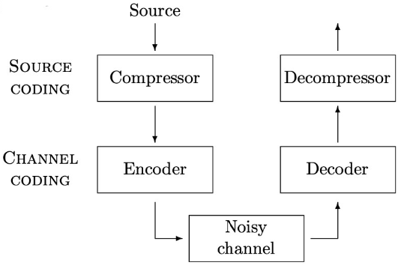
Channel Coding
Real channels are always noisy.
Channel coding allows a noisy channel to behave like a noiseless channel, by adding redundancy designed to make the noisy received signal decodeable.

Slide 12
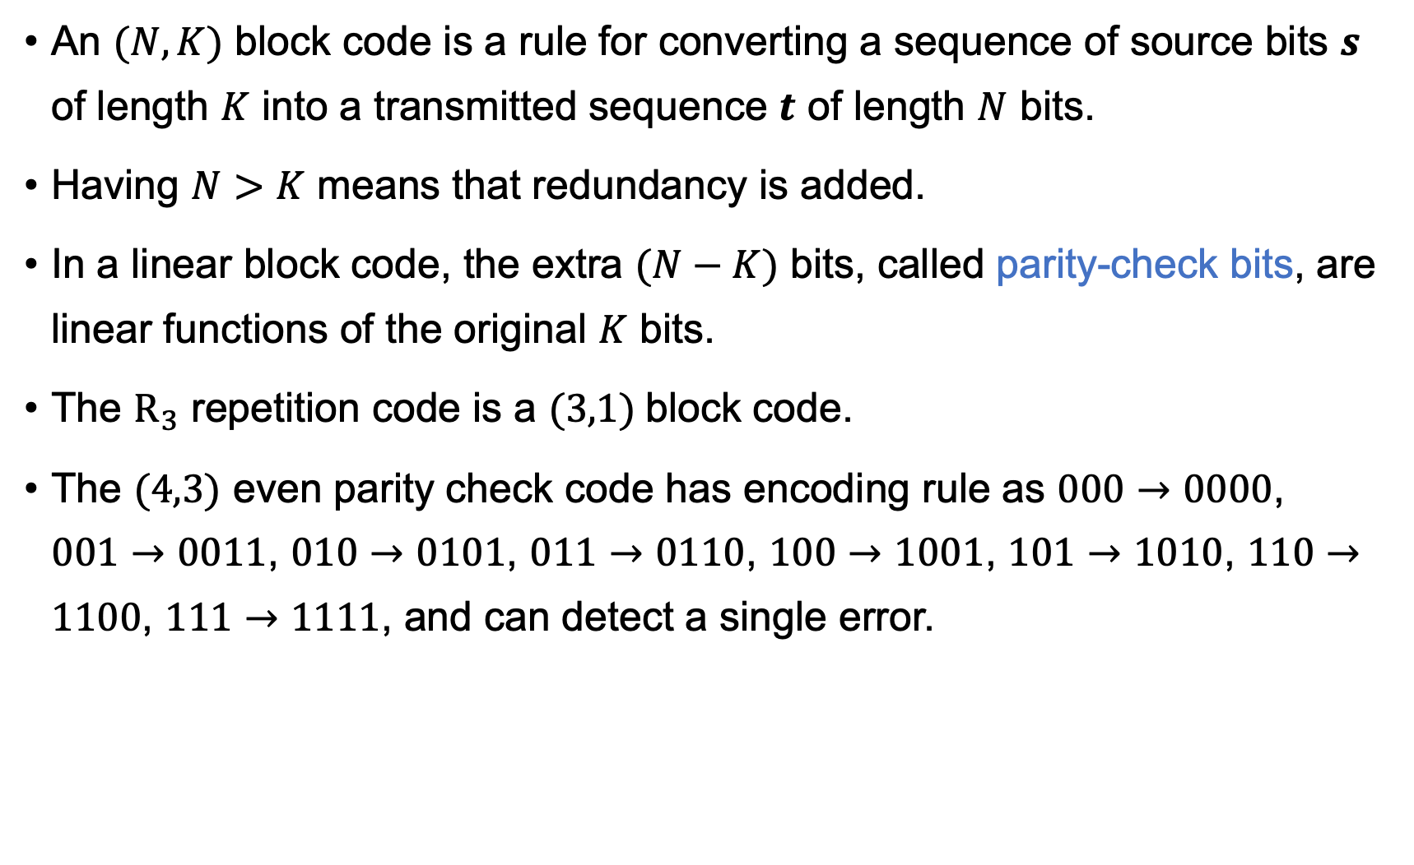

Linear $(N,K)$Block Code
An $(N,K)$ block code is a rule for converting a sequence of source bits $s$ of length $K$ into a transmitted sequence $t$ of length $N$ bits.
Having $N>K$ means that redundancy is added.
In a linear block code, the extra $(N−K)$ bits, called parity-check bits, are linear functions of the original $K$ bits.
The $R_{3}$ repetition code is a $(3,1)$block code.
The $(4,3)$ even parity check code has encoding rule as $000→0000$, $001→0011$, $010→0101$, $011→0110$, $100→1001$, $101→1010$, $110→1100$, $111→1111$, and can detect a single error.

Slide 13
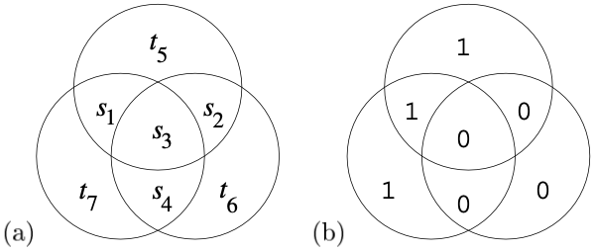
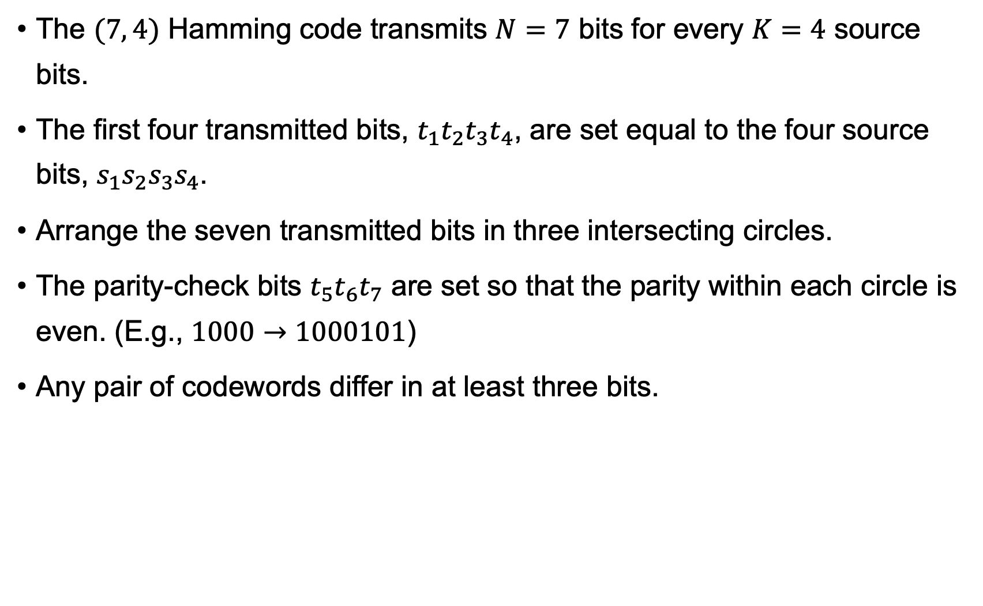
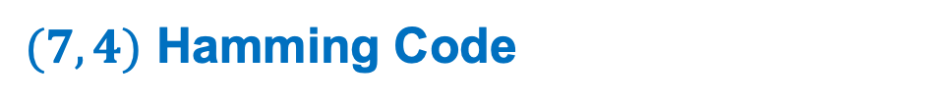
$(7,4)$ Hamming Code
The $(7, 4)$ Hamming code transmits $N=7$ bits for every $K=4$ source bits.
The first four transmitted bits, $t_{1}t_{2}t_{3}t_{4}$, are set equal to the four source bits, $s_{1}s_{2}s_{3}s_{4}$.
Arrange the seven transmitted bits in three intersecting circles.
The parity-check bits $t_{5}t_{6}t_{7}$ are set so that the parity within each circle is even. (E.g., $1000→1000101$)
Any pair of codewords differ in at least three bits.

Slide 14
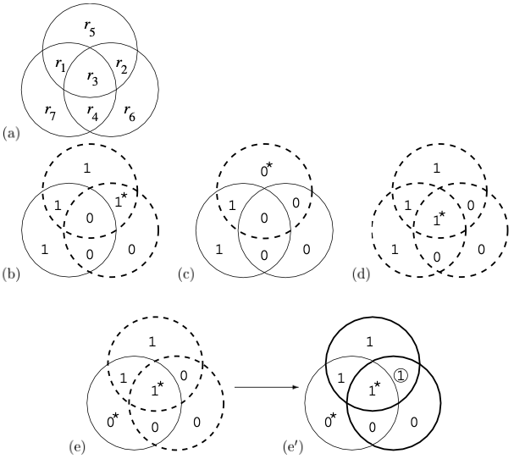
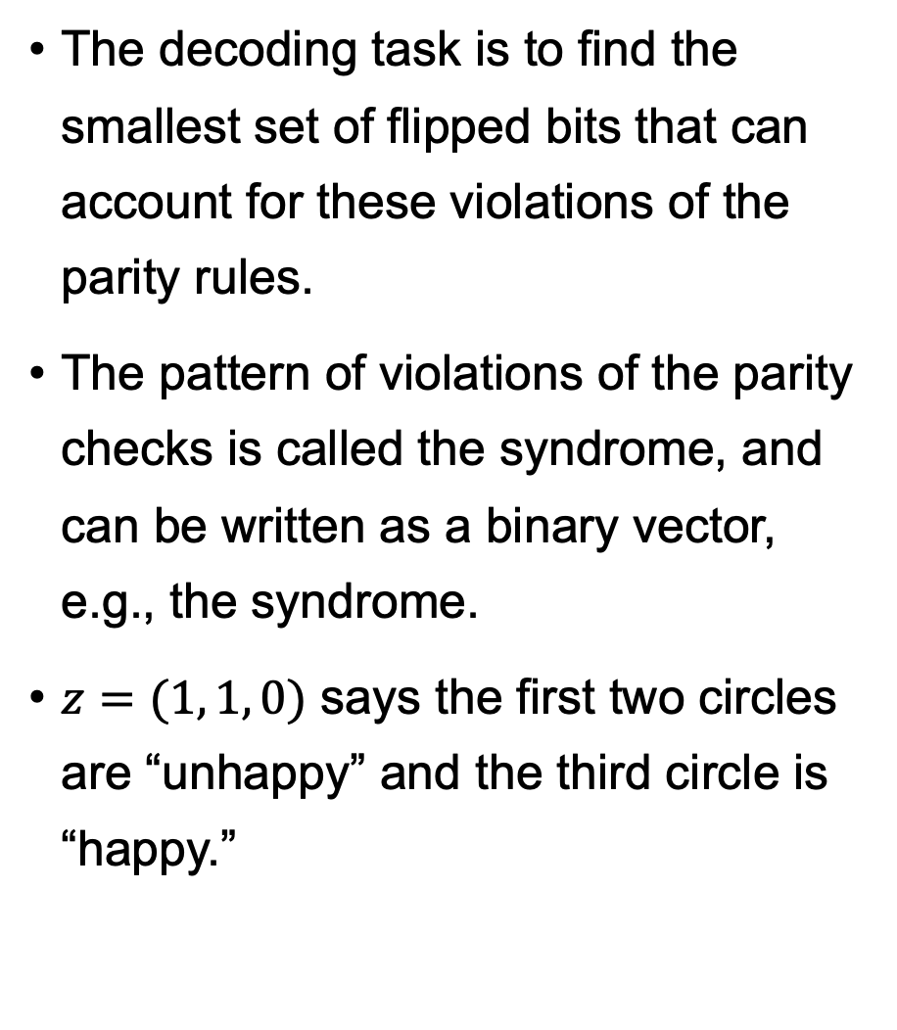
Syndrome Decoding
The decoding task is to find the smallest set of flipped bits that can account for these violations of the parity rules.
The pattern of violations of the parity checks is called the syndrome, and can be written as a binary vector, e.g., the syndrome.
$z=(1, 1, 0)$ says the first two circles are “unhappy” and the third circle is “happy.”

Slide 15
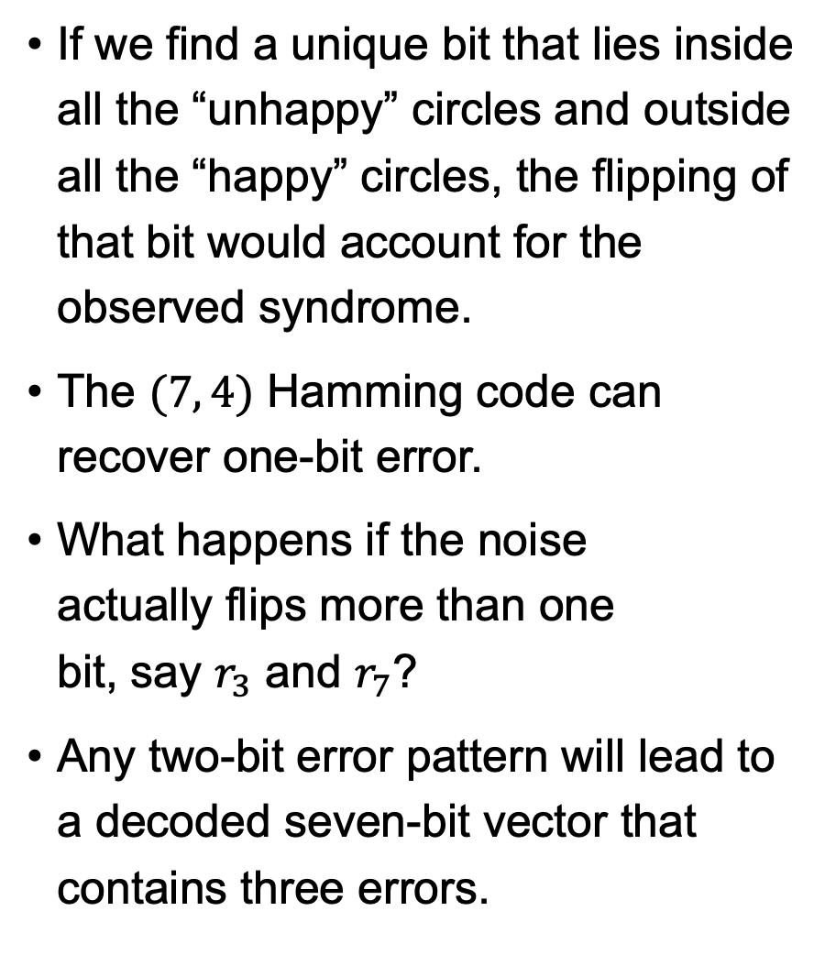
Syndrome Decoding
If we find a unique bit that lies inside all the “unhappy” circles and outside all the “happy” circles, the flipping of that bit would account for the observed syndrome.
The $(7, 4)$ Hamming code can recover one-bit error.
What happens if the noise actually flips more than one bit, say $r_{3}$ and $r_{7}$?
Any two-bit error pattern will lead to a decoded seven-bit vector that contains three errors.

Slide 16

Exercise
Change your selfie to a picture with 16 grey levels per pixel.
Implement the Huffman coding algorithm to compress the picture.
Flip the binary digits of the compressed file with probabilities$f=0.1$, $f=0.01$, $f=0.001$, and$f=0.0001$. Is it possible to recover your selfie then?

Slide 17
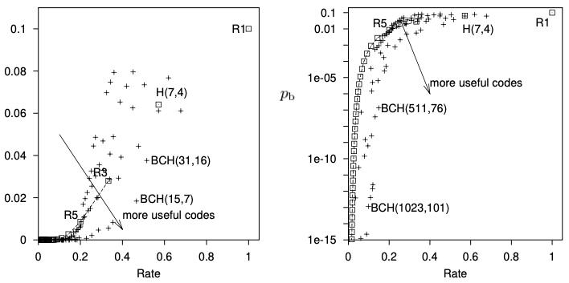

Transmission Rate vs. Error Probability
Before Shannon, it was believed that the boundary between achievable and non-achievable points in the $(R,p_{b})$ plane was a curve passing through the origin $\left(R,p_{b}\right)=(0,0)$.

Slide 18
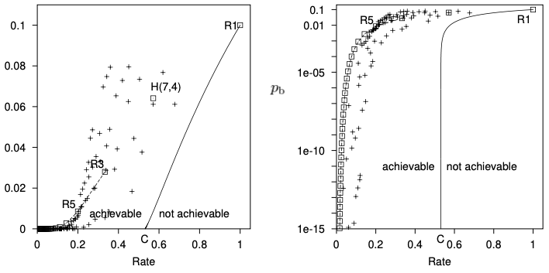

Transmission Rate vs. Error Probability
Shannon proved that the boundary meets the $R$ axis at a non-zero value $R=C$.
$C$ is called the capacity of the channel, where with $X$ and $Y$ being the input and output of the channel respectively:
$$C=\max_{𝒫_{X}}{I(X;Y)}$$

Slide 19
Thank You!

