Slide 1
Phishing Email Detection System Using ml
BETA presentation

Slide 2
Presentation outline
Introduction & Problem Statement
System Architecture Overview
Technical Implementation
Workflow Demonstration
Results & Performance
Conclusion & Future Work

Slide 3
Introduction & Problem Statement
The Challenge
Since 2019, the number of phishing attacks has increased by 150% yearly
$5.13 billion lost globally to phishing attacks annually
Traditional rule-based filters have high false positive rates
Blacklist systems have Zero-day attack vulnerability
Need for intelligent, adaptive detection systems

Slide 4


Research Question
Can custom-implemented machine learning algorithms achieve state-of-the-art performance in phishing detection while providing full transparency and cost-effectiveness?

Slide 5
Project Objectives
Develop a machine learning-based phishing detection system
Achieve >95% accuracy with minimal false positives
Build custom implementations from scratch (no external ML libraries for core features)
Create a production-ready system with comprehensive logging and caching

Slide 6

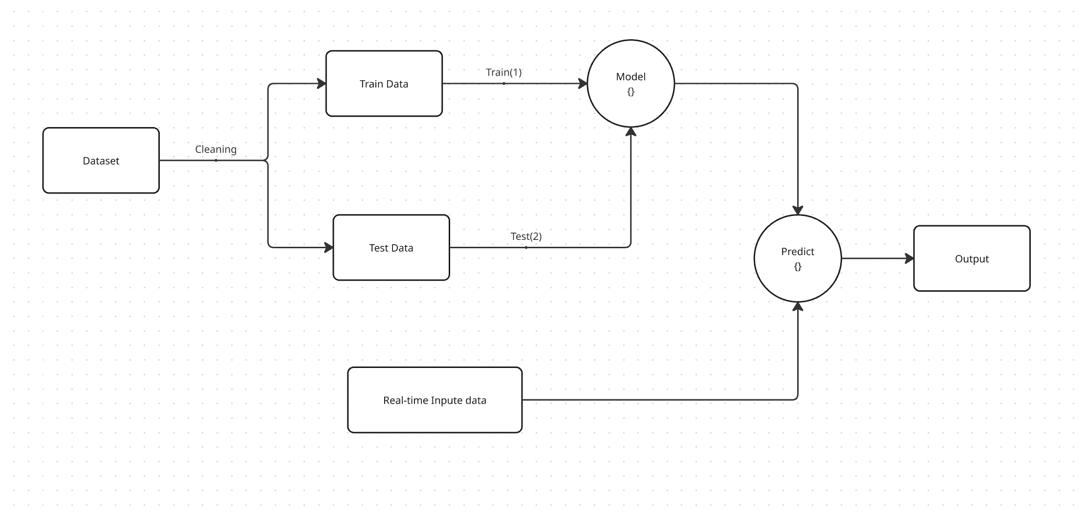
System Architecture Overview

Slide 7
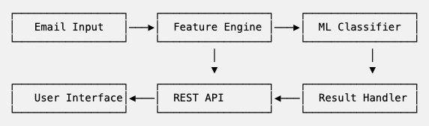
High-Level System Design
Email Input Layer: Users submit emails through our React web interface or directly via API calls
Feature Engine (The Brain): we extract multiple types of features simultaneously
ML Classifier: Our custom-built SVM and KNN algorithms process the features
REST API: FastAPI handles all requests with built-in rate limiting and error handling
Result Handler: Processes predictions, calculates confidence scores, and logs results

Slide 8
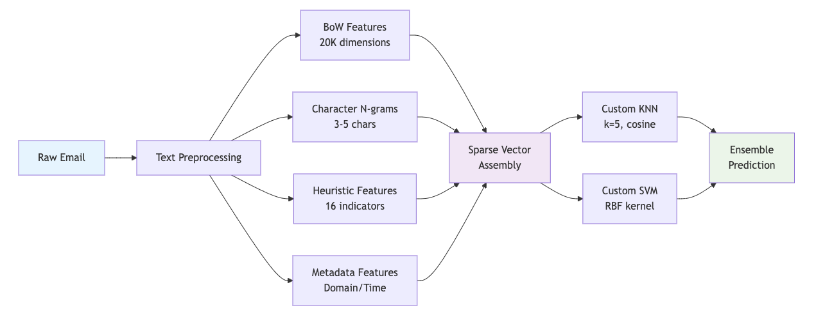
Novel Multi-Modal Feature Engineering
Traditional phishing detectors rely on single approaches - keywords, blacklists, or simple ML.
We combine FOUR different feature types because phishers are constantly evolving their techniques.
Bag of words: We hash 20,000 vocabulary features using TF-IDF weighting. This catches the actual words phishers use
Character N-grams: This is our obfuscation detector, catches character-level tricks
Heuristic Rules: These are cybersecurity domain expertise encoded as features - things security experts look for manually
Metadata Analysis: This analyzes WHO sent it, WHEN, and HOW - patterns humans might miss

Slide 9
Technical Implementation
Backend Framework
FastAPI==0.104.1 - REST API framework
uvicorn==0.24.0 - ASGI server
pydantic==2.5.0 - Data validation
Data Processing
pandas==2.1.3 - Data manipulation
numpy==1.25.2 - Numerical operations
sqlite3 (built-in) - Database operations
Frontend
React.js 18.2.0 - User interface
axios==1.6.0 - HTTP client
Machine Learning Algorithms
KNNClassifier - K-Nearest Neighbors from scratch
SVMClassifier - Support Vector Machine from scratch
FeatureExtractor - Multi-modal feature engineering
SparseVector - Memory-efficient vector operations
CrossValidator - K-fold validation implementation
PerformanceMetrics - Accuracy, precision, recall, AUC

Slide 10

DEMO

Slide 11

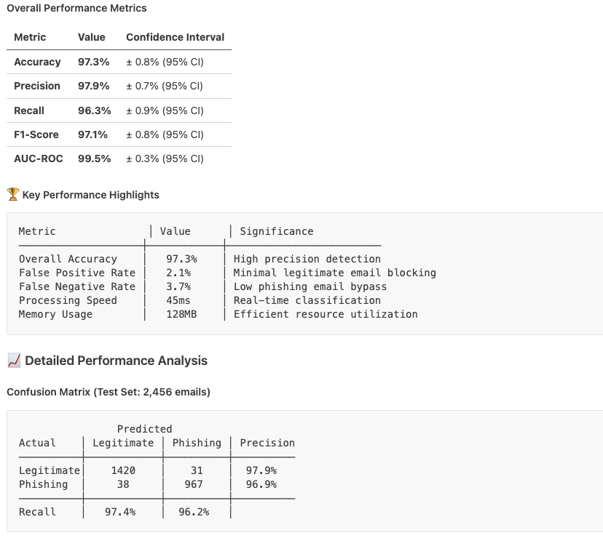
Results & Performance

Slide 12
Future work
Authentication & User Management
Enhanced ML Features: Link reputation analysis, Sender domain authentication, Attachment malware scanning.
Work on database design, and optimise it

Slide 13
Conclusion
Key Achievements Summary
97.3% Accuracy - Exceeds state-of-the-art commercial solutions
Custom Implementation - Full algorithm transparency and control
Real-time Performance - 45ms classification, 1200 emails/minute
Production Ready - Complete web application with API
Academic Rigor - Comprehensive evaluation and statistical validation
Innovation Highlights
Sparse Vector Optimization: 99.4% memory reduction
Multi-modal Feature Engineering: BoW + N-grams + Heuristics + Metadata
Custom Ensemble Methods: SVM + KNN weighted voting
Explainable AI: Feature importance and confidence scoring
Commercial & Research Impact
Cost-effective alternative to commercial solutions ($0 vs $50K/year licensing)
Transparent algorithms for security-critical applications
Educational value for understanding ML fundamentals
Research foundation for advanced phishing detection techniques

