Slide 1
INTRODUCTION
1.The main requirements of transformer in todays world
2.For manufacturing transformer design requires three main steps (Design, Assemble & testing)
3.The goal is to explore and analyze various design method

Slide 2
OBJECTIVE
The prime objective of the project is to develop Power and Distribution Transformer designing software using python Tkinter GUI.
Steps:
To understand and explore existing techniques and standards of transformer design.
To visit transformer manufacturing unit.
Understand cost estimation
Finalize the software
Software Trials

Slide 3
PRE-REQUISITES
To start designing a transformer we need to know the following basic things below.
Single phase or three phase
Distribution transformer or power transformer
Economic or energy efficient
Required capacity
LV and HV ratings
Vector Group
Available materials in India

Slide 4
DESIGN
Design of transformer can be categorized into following strategic steps.
Core design.
LV winding design.
HV winding design.
Final dimension and weight.
Cost Estimation
Performance parameter calculation

Slide 5
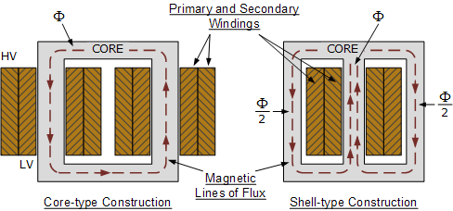
CONSTRUCTION OF CORE
CORE TYPE – leakage flux is more. More losses. Natural cooling is not possible.
SHELL TYPE- leakage flux is less. Less losses. Winding is distributed type.

Slide 6
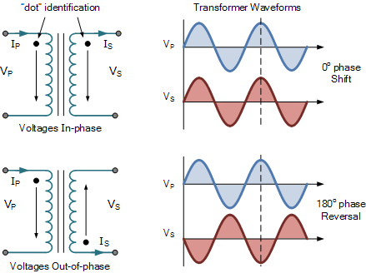
DOT ORIENTATION
The ability to adjust the turn ratio for which voltage control of the transformer is generally performed.

Slide 7
LOSSES
Hysteresis losses
Eddy current losses
Copper losses

Slide 8
CORE LAMINATION
Eddy current losses in the transformer cannot be eliminated completely, but they can be greatly reduced by reducing the thickness of the steel core. This is done through laminations of the core.

Slide 9
SOFTWARE
DESIGN LANGUAGE : PYTHON
MODULE: TKINTER

Slide 10
DESIGN PROCESS:
Explore software development field
Learn to design software using python tkinter
Make lengthy and error prone calculation easy and accessible at a single click

Slide 11
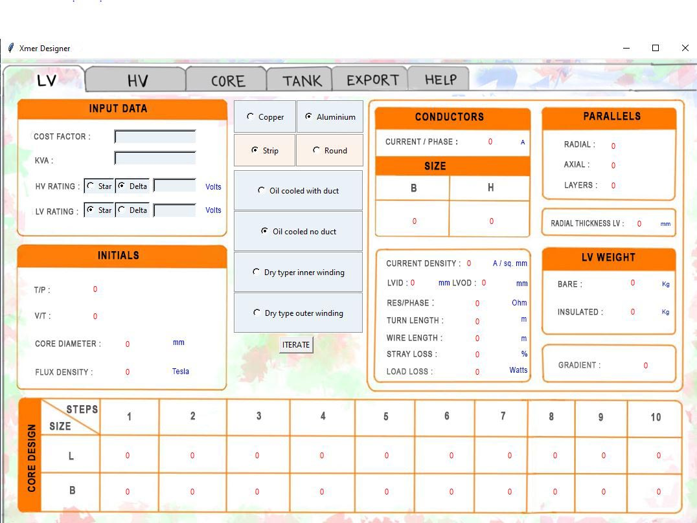
FEATURES
LV design
HV design
Core design
Tank design
Export Tab
Help Tab

Slide 12
WIDGETS
Label
Entry box
Image
Button
Radio button
Frame
Notebook

Slide 13
Manual Designing Process
LV Design
HV Design
Core Design
Tank Design
Conservator Design
Regulation and efficiency

Slide 14
Our Manual Designs
3 PHASE, 15KVA, 400/230 V, DISTRIBUTION TRANSFORMER, ECONOMIC, DRY TYPE, Ynd1, AN-AN.
3 PHASE, 66KVA, 11000/433 V, DISTRIBUTION TRANSFORMER, BALANCED, DYn11, ON-AN.
3 PHASE, 100KVA, 11000/433 V, DISTRIBUTION TRANSFORMER, ECONOMIC, DYn11, ON-AN

Slide 15
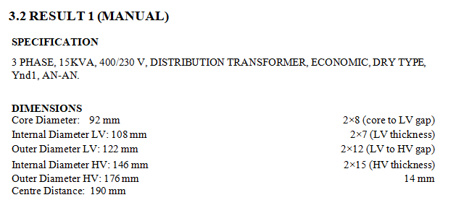
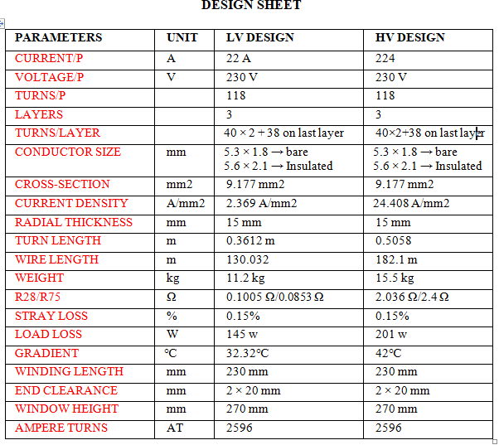

Slide 16
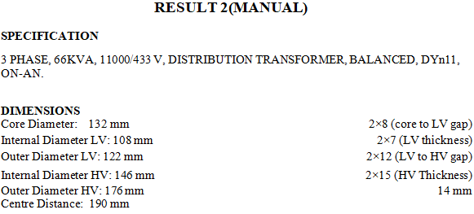
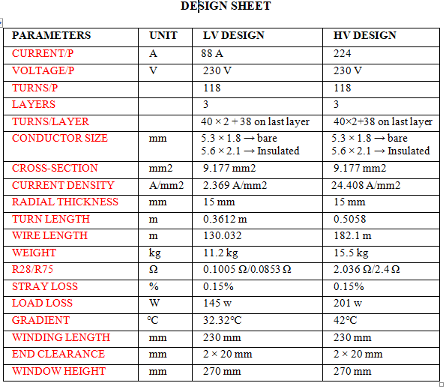

Slide 17
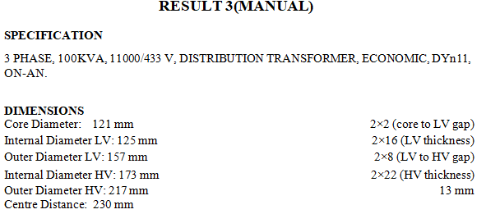
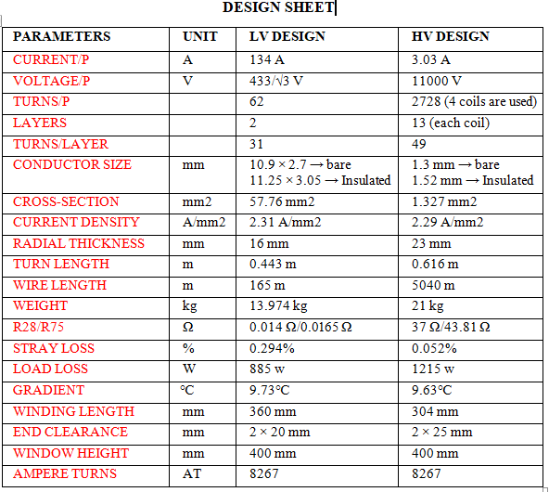

Slide 18
RESULT VERIFICATION
HOW DO WE KNOW THAT THE SOFTWARE IS GIVING CORRECT OUTPUT?
CRITERIAS:
% IMPEDANCE (~2%)
TEMPERATURE GRADIENT (<14 Degree Celsius)
EFFICIENCY
COST
LOAD LOSSES (<2000 watts)
NO LOAD LOSS (<345 watts)
VOLTAGE REGULATION (2-3%)

Slide 19
CONCLUSION AND SUGGESTION

