Slide 1
PMIM502 Data Visualization
AV – 2311233

Slide 2
Design Process
START
FRAMEWORK*
TEA
AF2
BRIEF
DATA
WORK*
REVIEW
+
EDITORIAL
PEER
Self Review
Two Classmates
Four Friends
DESIGN
No
If
Happy
Yes
END
*Reference: Data Visualisation; Andy Kirk

Slide 3
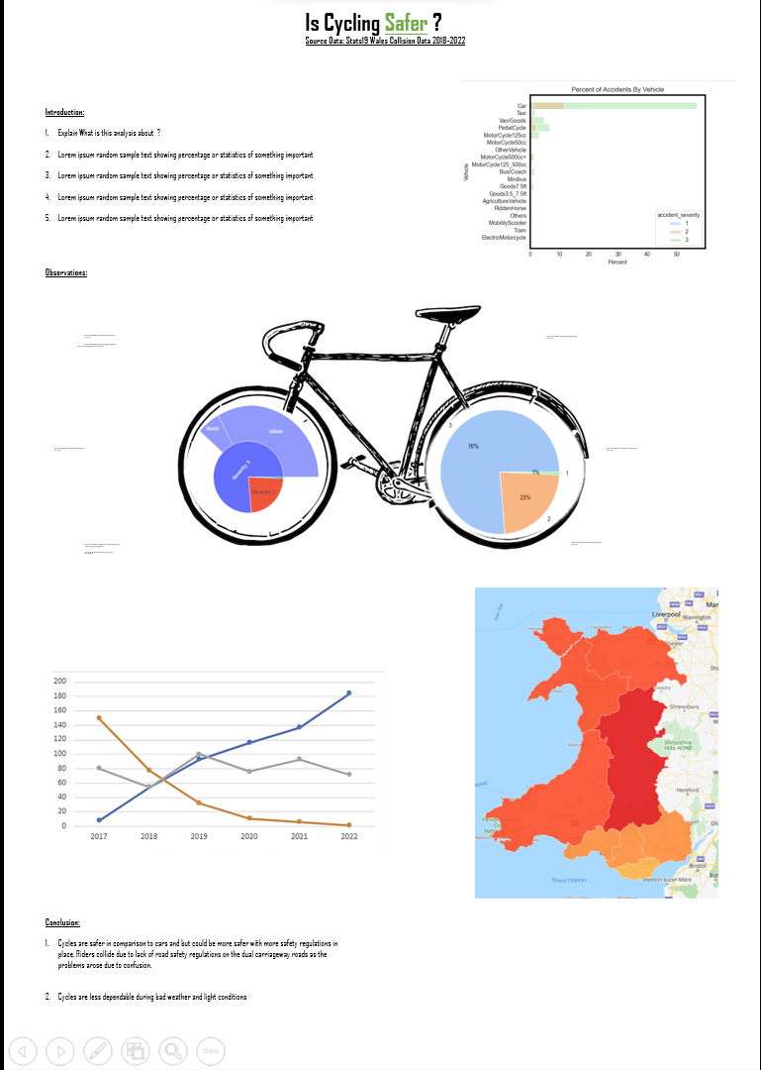
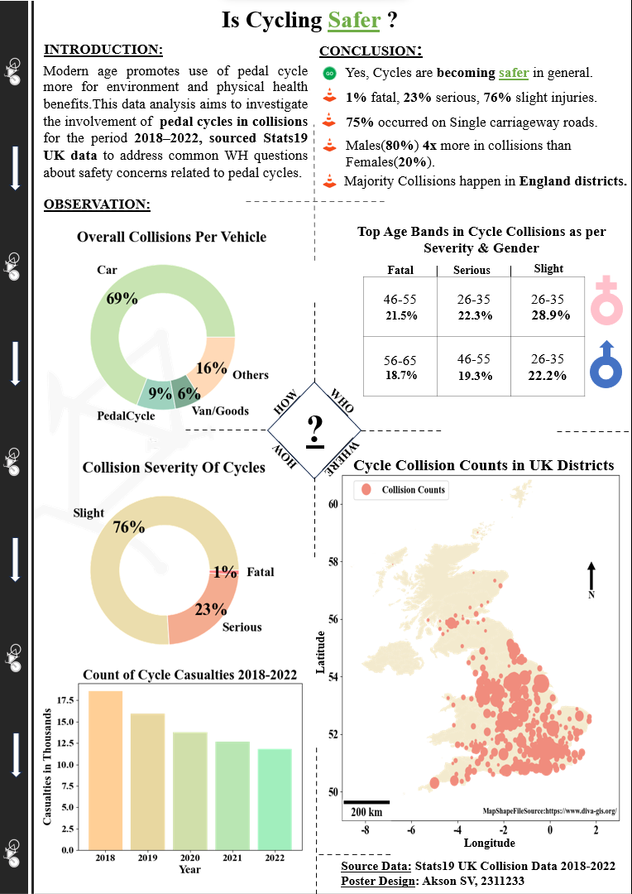
Start Point
End Point

Slide 4
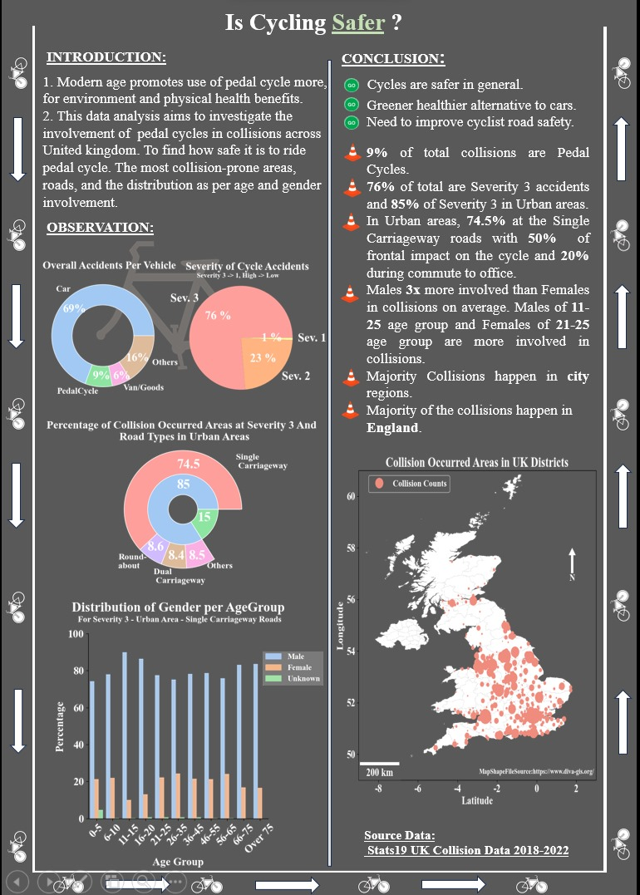
Intermediate Point
Start Point
End Point
3
Revisions
3 Revisions
Total Designs = 6 Revisions + 3 Review Points

Slide 5
Design Ideas & Elements
  A. Road Elements
    Traffic Cones
    Green Go Sign
    Logical dividers
    Cul-de-sac / Quadrant Intersection
    Cycle Lane
  B. Visual Encoding
    Green colour in the Safer Title
    Directions in cycle lane indicate flow to read the poster
    Quadrant intersection dictates the flow to read the plots and compartmentalize the findings
    Question mark to implicitly attach questions to the sections of the poster
    Gender representations using symbols
    Numbers / Text Highlighted in bold and different size
    Largest Size represents highest percentage in the age band table
    Largest size of point represents highest casualties in the map

Slide 6
For Reference

Slide 7
Questions
Why / how this design?
  - Aim was to provide scientific poster with subtle touch of elements associated with the road / transport / traffic concept.
  - Arrived at the design after 9 revisions and implementations.
  - Exhibitory poster, the observations of the analysis are exhibited.
  - Basic questions used to derive the safety factor of cycling, How many instances of collision are cycles across all vehicles, how severe
  are the collisions, where (locality wise) the collisions are higher, and who are involved in such collisions.
Why donut plots?
  - Simple to understand.
  - Could be integrated creatively as wheels of a bicycle.
Why bar chart ?
  - Simple to convey the decreasing trend of casualties with the visual effect of colour gradient going from orange to green indicating
  and supporting the conclusion that cycling is becoming safer.
Why table in gender and not any plots ?
- Given the space constraint, it was basic intuition that a table would look good and provide more clarity than a cluttered visualization,
a design choice.
- Its supportive in the demographic angle, like ‘who’ are more involved in the cycle collision. The most involved is middle men and
women from 26-35, implicit idea is they were commuting to work and mentioned in the conclusion that majority accidents happen in
the single carriageway roads where there is no physical dividers, Its implicit derivation that the top age bands are given for the
respective groups, rest falling in that group will be smaller than that.

Slide 8
Questions
5. What was the motivation behind the quadrant design?
- A weekend shopping memory.
6. What does the conclusion convey ?
- 4 cautionary facts, the positive fact is that cycling is becoming safer.
7. Why font size and what font are followed ?
- The criteria was to be able to see the font from a certain distance, font size and family was finalized through
revisions, tried Agency FB for sporty look, Road Transport fonts for contextual look, Times New roman for
scientific look.
- Tried 30 – 96 font size and goldilocks range was the 44 – 88.
8. What does the map convey?
- The ‘where’ section of the poster showing the location on a higher level of the occurring collisions.
9. What colour scheme were followed ?
- Pastel light colours, why ? Because light colours are easy on eyes, and associate the positive result of the question
asked.

Slide 9
Thank you
AV – 2311233

