Slide 1
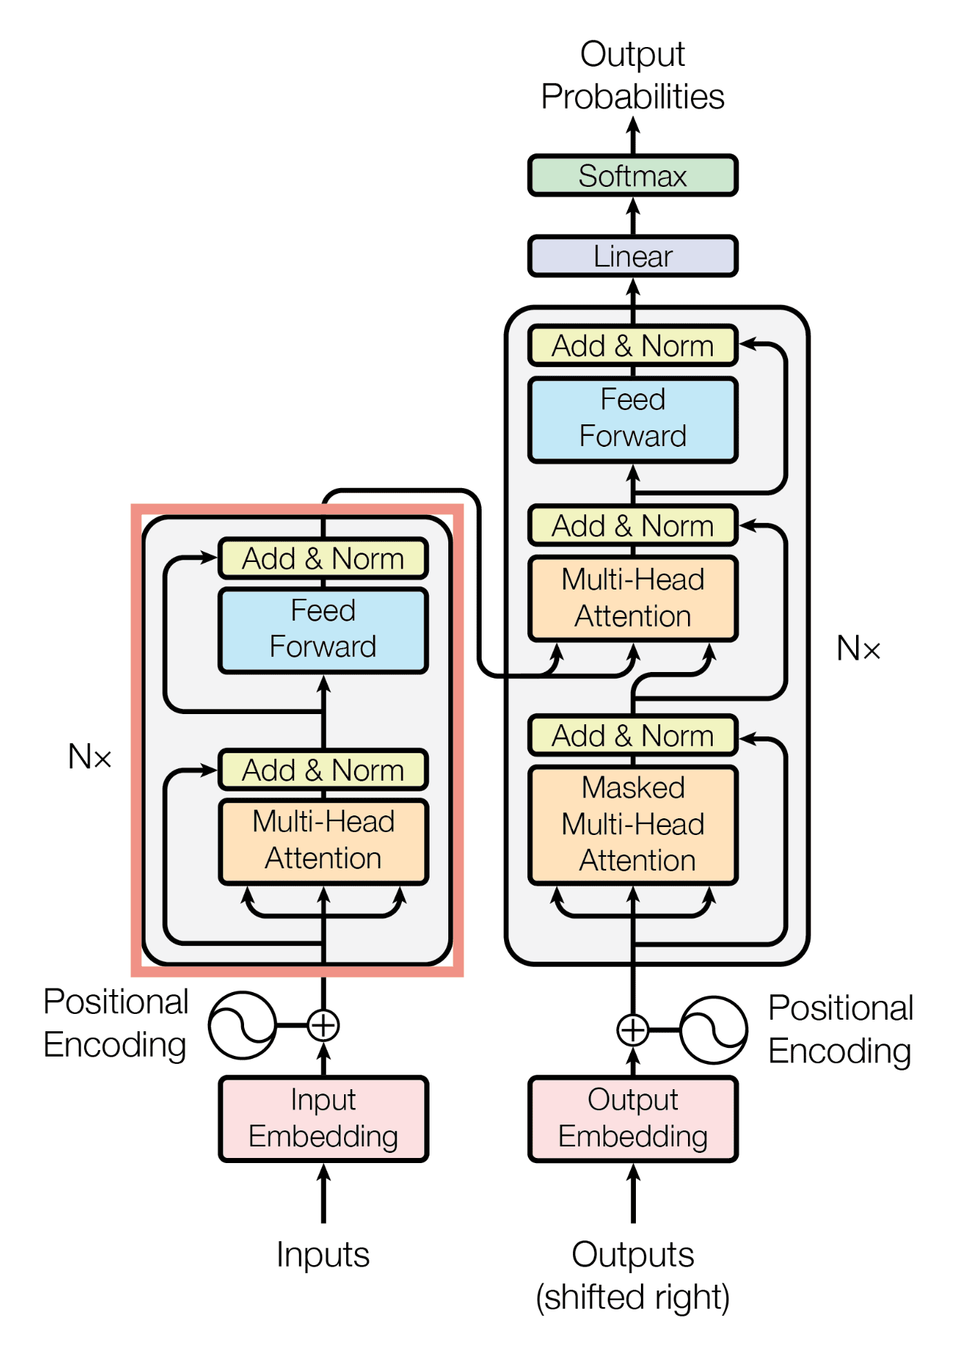
Assessment of fine-tuned open-source large language models
on gold standard synthetic epilepsy clinical notes with focus on Seizure Frequency and Prescriptions
Presenter:
Akson Sam Varghese
2311233
M. Sc. Health Data Science
Singleton Park Campus, Swansea University
GitHub:
https://github.com/Xnsam/HDS

Slide 2
Motivation
Aim: To perform clinical NER on clinical notes to extract Seizure Frequency (SF) and Prescriptions.
Why Seizure Frequency ?
Why Prescription ?
Seizure Frequency could be used to understand Assess Seizure Freedom and effectiveness of drugs in controlling the seizures
Poor documentation and audit trail of seizure frequency robs opportunity to research
Capture a rate of seizure to improve clinician-patient engagement and care, study comorbidities e.g. depression induced due to drugs
Research exists in extracting prescriptions from notes for digitization, auditing and automation
Crack the existing benchmark with new data extraction approach
Nuanced to extract dosage of drugs, to increase or decrease dosage, intake frequency – direct indicators of epilepsy status
?
References:
Wang et al., 2015; Fonferko-Shadrach et al., 2019; Li et al 2021; Xie et al., 2022; Lehman, E et al., 2023;

Slide 3
Example
Given Clinical Text Dataset
Extract JSON
Dear Dr,
Diagnosis: symptomatic, structural right temporal lobe epilepsy
Subarachnoid haemorrhage (right MCA) 2017
Current antiepileptic medication: lamotrigine 75 mg twice a day (to increase as stated below)
seizure type and frequency: focal seizures with loss of awareness (Unusual smell) approximately 2 to 3 per month.
Investigations: CT head 2017 collier in situ plus low density right temporal lobe
I reviewed this 57 year old man in clinic today. He continues to have what he calls “absences” which are focal seizures. During them, he has a smell which is difficult to describe. He will lose awareness for a couple of minutes. When he has the warning of an unusual smell he will sit down. He injured his right elbow in a seizure last year.
As he is continuing to have seizures, I suggest that he increases the lamotrigine slowly by 25 mg every fortnight, to an initial dose of 100 mg twice a day. If he has no side-effects with this, then he can again continue to increases the lamotrigine by no more than 25 mg every fortnight.
I will see him again in around six months time, should there be a problem before then he can contact my secretary on the number above.
[
{
"entity": "Prescription",
"start_index": "152",
"end_index": "181",
"text": "lamotrigine-75-mg-twice-a-day",
"attributes": {
"DrugName": "lamotrigine",
"DrugDose": "75",
"DoseUnit": "mg",
"Frequency": "2"
}
},
{
"entity": "SeizureFrequency",
"start_index": "239",
"end_index": "276",
"text": "focal-seizures-with-loss-of-awareness",
"attributes": {
"LowerNumberOfSeizures": "2",
"UpperNumberOfSeizures": "3",
"TimePeriod": "Month",
"NumberOfTimePeriods": "1"
}
}
]
Prescription
Seizure

Slide 4
Literature Review – Search Query Formulation
Query combination
  Query combination was formed by using the topics mentioned in the literature search flow chart,
  Terms parent and child combination along with synonyms
  Query Structure: Parent term ( AND / OR ) Child Term ( AND / OR )
NLP
AND
Information Extraction
AND
Epilepsy
AND
Clinical NER
OR
LLMs
Query Examples:
Clinical NER with LLMs
Information extraction with LLMs
Biomedical information extraction with LLMs
NLP and clinical NER epilepsy applications
Clinical NER with LLMs in epilepsy

Slide 5
Literature Review – Consult Diagram
Sort Type:
Relevance -
Date -
Search tool:
INSPEC -
IEEE -
PubMed -
Google scholar -
query:
what is epilepsy, Definitions of epilepsy,
Studies in epilepsy, Classification of epilepsy
query: Attention is all you need, origin of transformers
Definitions
Total: 40 | Selected: 5 | Cite Chains: 0
Transformers
Total: 40 | Selected: 11 | Cite Chains: 0
Epilepsy
LLMs
query: Foundation models origin, GPU computing in machine learning, foundation models in healthcare
query:
UK Epilepsy statistics
Foundation
models
Total: 40 | Selected: 4 | Cite Chains: 0
Statistics
Total: 40 | Selected: 2 | Cite Chains: 0
query: definition of natural language processing
query: clinical NER with LLMs, information extraction with LLMs, biomedical information extract ion with LLMs
query: Large language models in healthcare
Definitions
Total: 40 | Selected: 3 | Cite Chains: 0
LLMs in health
Total: 40 | Selected: 3 | Cite Chains: 0
Total: 10 | Selected: 5 | Cite Chains: 0
Search Tree
query: NLP in healthcare, Applications of NLP in healthcare
Clinical NER with LLMS
Applications
Total: 40 | Selected: 8 | Cite Chains: 0
NLP
query: Large language models in epilepsy
query: NLP in epilepsy
LLMs in epilepsy
Total: 33 | Selected: 7 | Cite Chains: 0
query:
Seizure frequency, clinical notes, importance of seizure frequency
NLP +
Healthcare
NLP +
Epilepsy
Total: 40 | Selected: 5 | Cite Chains: 0
Seizure frequency
Total: 10 | Selected: 5 | Cite Chains: 0
query: What are clinical notes, origins of clinical notes
NER in epilepsy
About
Total: 40 | Selected: 2 | Cite Chains: 0
query:
Extract medicine prescriptions from clinical notes, extract interventions
query: Clinical NER applications, information extraction in NLP, biomedical information extraction
Prescriptions
Total: 10 | Selected: 4 | Cite Chains: 0
Clinical Notes
NLP
Applications
query: Generate Synthetic clinical notes, automated clinical coding
Total: 20 | Selected: 6 | Cite Chains: 3
Synthetic clinical Notes
Total: 40 | Selected: 4 | Cite Chains: 0
NLP + Information Extraction

Slide 6
Literature Review – Results
Knowledge Graph
Machine Learning
Prompt
Tuning
Deep
Learning
Rule
Based
Statistics
Overall
Total references – NLP: 78; Epilepsy: 19
Unique Themes – 6
Combination of Themes – 6+
Pre-LLMs ERA
Number of papers – 7
Number of models ( architecture ) overall – 7
Number of themes – 5
LLMs ERA
Number of papers – 4
Number of models ( architecture ) overall – 23
Number of themes – 3
* See appendix for more detailed metrics on models

Slide 7
Development Cycle
200 synthetic clinic notes and corresponding JSON, annotated by clinicians extracted and manually annotated via markup*
Dataset
Data
Preprocessing
Model
Fine tuning
Model
Evaluation
EDA
Baseline
Models
Post
Processing
* Development is an iterative and Semi-cyclic process
Gold standard annotation of epilepsy clinic letters for the development of information extraction tools (zenodo.org)

Slide 8
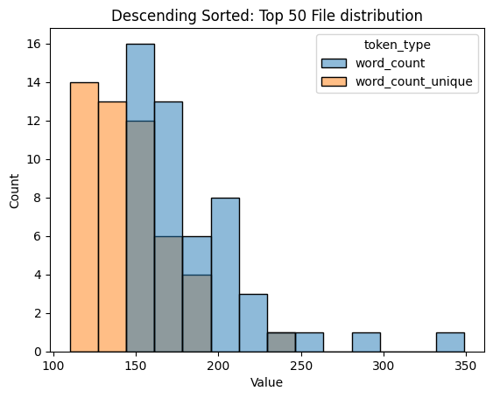
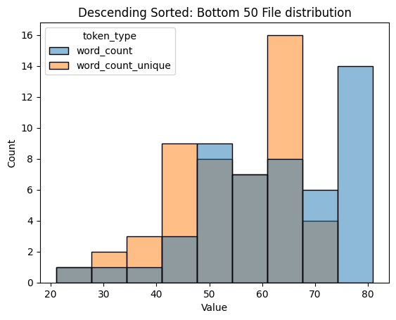
Exploratory Data Analysis
Distribution of length of single clinical notes
Insight
Identified outlier
Average size of the documents with and without unique words in top 50 and bottom 50 files

Slide 9
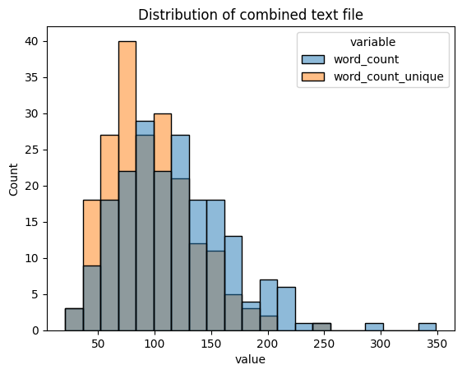
Exploratory Data Analysis
2. Combined text file: Removed stop words, punctuations, symbols, spaces using standard English and MedSpacy tokenizer, tokenized and counted words
To understand what should be the max length value in the tokenizer
If padding / truncation is required in the data
Insight
Centre and distribution of word in the entire file collection
Outlier in the file collection
Max length of the string

Slide 10
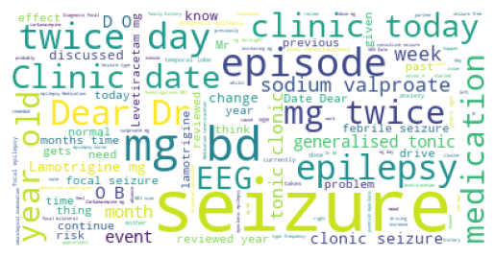
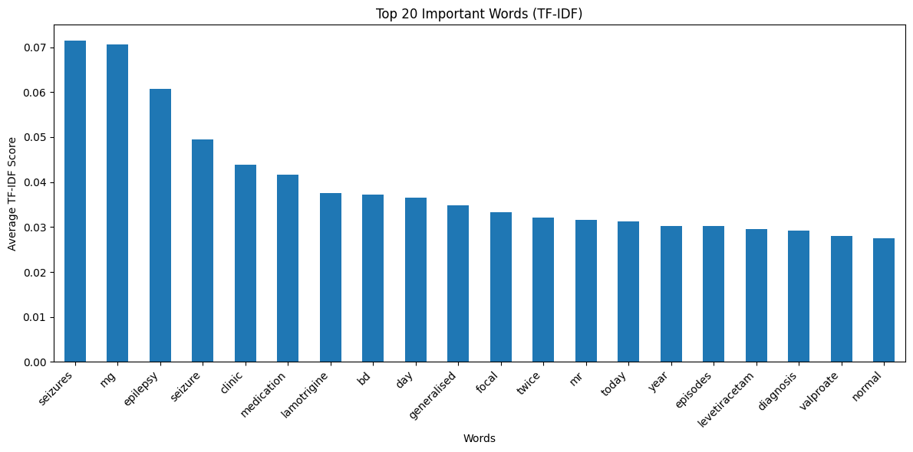
Exploratory Data Analysis
3. Word Importance
Insight
Most important word in the entire file collection
Top 20 TF – IDF values sorted words in the documents

Slide 11
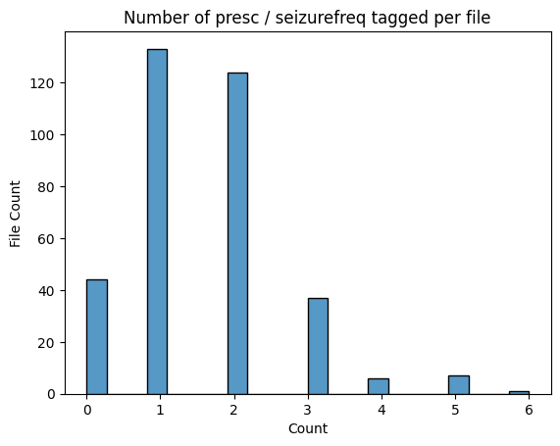
Data Preprocess
Data Checks
  Prescriptions Absent – 10 / 200
  Seizure Frequency Absent – 34 / 200
  Both Absent – 10 / 200
  Unique JSON structure
    Seizure – 25 patterns
    Prescriptions – 3 patterns
Insight
Unequal distribution of data in the JSON files
Mismatch in data dictionary structure
Action
Design separate Input-output pair for the seizure frequency and prescription
Create customized structure for each change in the prompt input
Data cleaning and simplification is required

Slide 12
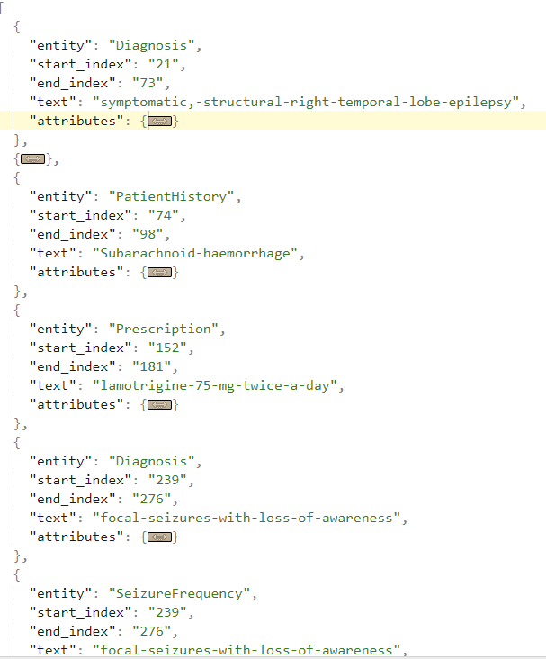
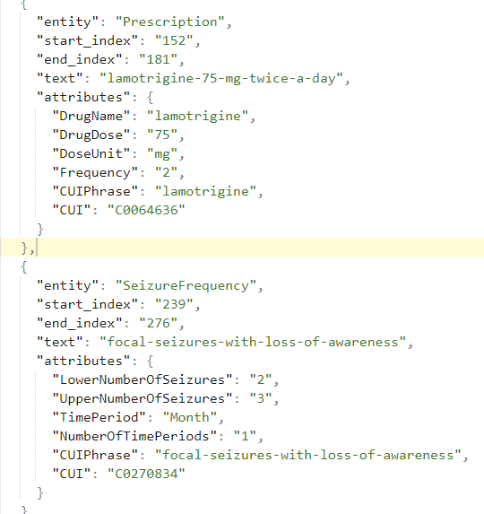
Data Preprocess
B. Data Cleaning and simplification
Filter out only Seizure Frequency and Prescription associated JSON
Removed CUI ID
Removed the Hyphens from text field in the JSON files
Removed “entity” key – value from the JSON
Cleaned and Removed Unexpected characters in clinical text
  Trimmed white spaces and additional tab spaces
  Removed characters “\u00a0” encoding errors

Slide 13
Data Preprocess
C. Input-Output Pairing
Input
Output
Clinical Text
{“entity”: “seizurefrequency”, …. }
seizure_frequency.jsonl
Clinical Text
{“entity”: “prescription”, …. }
prescription.jsonl
JSONL is a text-based format using the . jsonl file extension that is basically the same as JSON format but implemented using newline characters to separate JSON values

Slide 14
Data Preprocess
D. Input Templates – Fine Tuning
Instruction Template
Chat System Template
"""Your task is to extract prescription information from a clinical text
Below is the clinical notes from a doctor, delimited by triple quotes.
clinical text: ```{clinical_text}```.
Extract the {extract_entity} only from the clinical text in JSON format.
Give me the output in the json format as mentioned below, delimited by
triple quotes
```{json_format}```.
"""
### Human: Your task is to extract prescription information from a clinical text
<<Instruction Template>>
### Answer:
Llama Chat System Input Template
[
{"role": "system", "content": example["instruction"][i]},
{"role": "assistant", "content": example["output"][i]},
]

Slide 15




LLM Model Candidates
Models were built on seizure frequency and prescription separately. Open Source Models are selected.
Pennlaine/Mistral-7B-v02-Entity-Extraction
NousResearch/Llama-2-7b-chat-hf
NousResearch/Hermes-3-Llama-3.1-8B
mistralai/Mistral-7B-Instruct-v0.2
google/gemma-2-2b

Slide 16
Model Training Process
Data Setup
Load Pre-processed Data
Model Setup
Model Train
Download Model + Tokenizer
4Bit
Quantization
PEFT
Setup SFT Trainer
Tokenize
Train + Checkpoint
Validation Setup
Prediction / Generation
Gemini 1.5 Flash
Data
Processing
Validation
Metrics

Slide 17
Result Validation - Multi-label classification
The results were converted to python dictionary and treated as multi-label classification for validation
Dictionary Key Metrics
Dictionary Value Metrics
Ground Truth keys are the keys of the dictionary and predicted keys are the keys of the generated dictionary
Ground values are the values of the dictionary and predicted values are the values of of the generated dictionary
{ “text”: “Levetiracetam”, “start_index”: 1, “end_index”: 20 ….}
{ “text”: “Levetiracetam”, “start_index”: 1, “end_index”: 20 ….}
Metrics
Exact match Ratio
0/1 loss ( 1 – exact match ratio )
Hamming Loss
F1 Score
Recall
Precision
Reference: https://mmuratarat.github.io/2020-01-25/multilabel_classification_metrics

Slide 18
Result Validation - Multi-label classification
Multi-label classification metrics for Prescriptions
Type | Model |  | Exact Match Ratio | Hamming Loss | Recall | Precision | F1 Measure
Fine Tuning | Llama 2 | Key match | 1.00 | 0 | 1.00 | 1.00 | 1.00
 |  | Value Match | 0 | 0.38 | 0.62 | 1.00 | 0.76
Size of the train set: 264. Size of the validation set: 30
Multi-label classification metrics for Seizure Frequency
Type | Model |  | Exact Match Ratio | Hamming Loss | Recall | Precision | F1 Measure
Fine Tuning | Llama 2 | Key match | 1.00 | 0 | 1.00 | 1.00 | 1.00
 |  | Value Match | 0 | 0.30 | 0.60 | 1.00 | 0.74
Size of the train set: 236. Size of the validation set: 27

Slide 19

Result Validation - String comparison
Text comparison between the ground truth and predicted / generated text
String comparison methods
Sørensen–Dice Coefficient: A similarity algorithm that computes difference coefficients of adjacent character pairs.
Ground Truth . : lamotrigine-75-mg-twice-a-day
VS
Generated / Extracted: lamotrigine-75-mg-twice-a-day
Reference: (Dice, 1945)

Slide 20
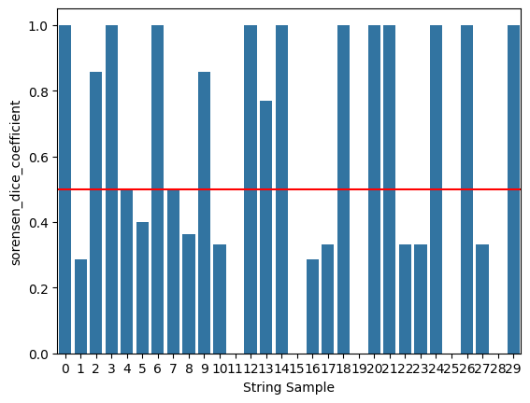
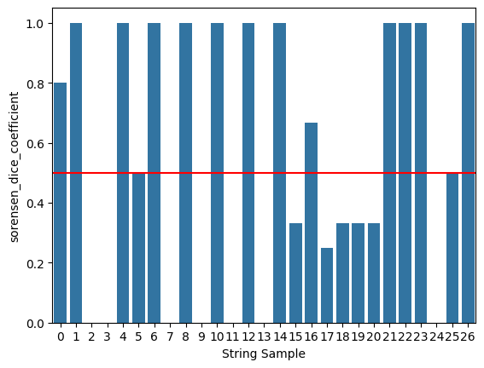
Result Validation - String comparison
Generated text string match – word level
Sorensen Dice Coefficient Prescriptions
Sorensen Dice Coefficient Seizure Frequency
Threshold: 0.5; 10% validation dataset

Slide 21
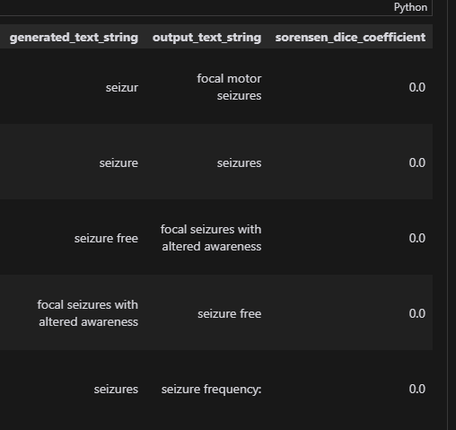
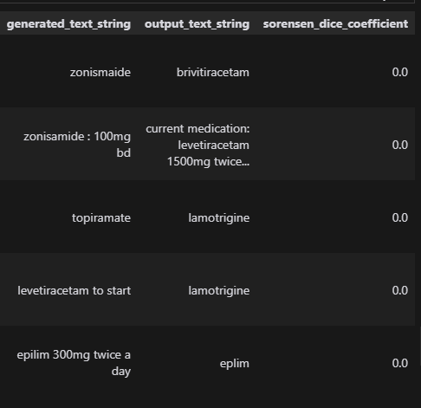
Error Analysis Sample
Seizure Frequency
Prescription

Slide 22
Future Work
Data
Model
Validation
Data Augmentation and resampling techniques like random resampling, SMOTE & variants
Possibility to increase sample size
Feature engineering
Research models – Mixtral 8 x 7B
SLM – Microsoft phi3.5
Prompt Tuning / Engineering; chain prompting ( COT )*
More Compute Time
LangChain, RAG & variants approach
Output JSON generation - single + multiple
Start – End index of text locations
Hyperparameter tuning
Word accuracy calibration
Human Intervention for improved accuracy
InterpretEval https://arxiv.org/pdf/2011.06854
* Intended to complete by submission

Slide 23
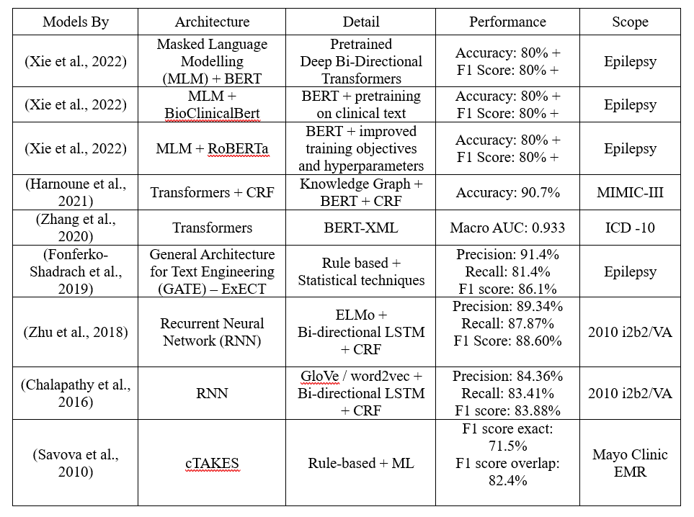
Appendix: Literature Review - Results
Pre-LLMs ERA - Clinical NER tasks

Slide 24
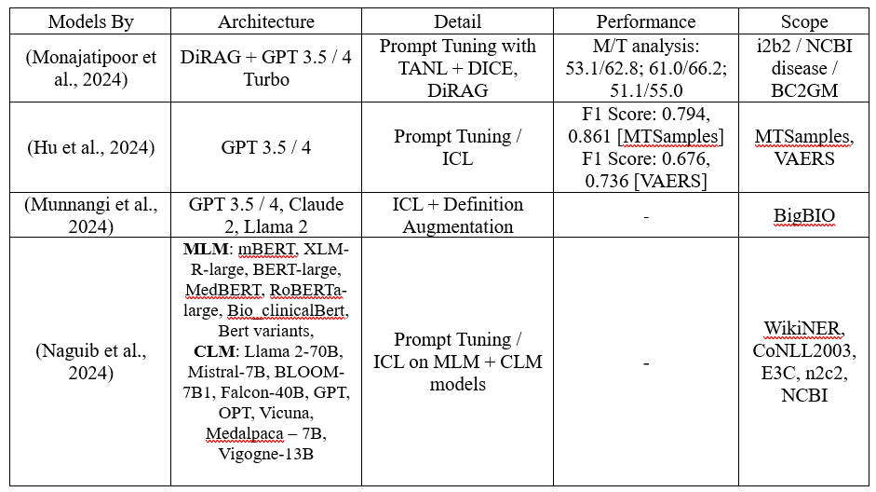
Appendix: Literature Review – Results
LLMs Era - Clinical NER tasks

