Slide 1


Team Details
  Team name: Ctrl+Alt+Hiru
  Team leader name: Hirun Chamara
  Problem Statement: BFSI · Intelligent Risk, Fraud & Financial Experiences: wealth firms run each client on separate systems, fraud slips through the gaps, and bolted-on AI is a black box.
A
Atrium
People decide. The AI shows its working.

Slide 2
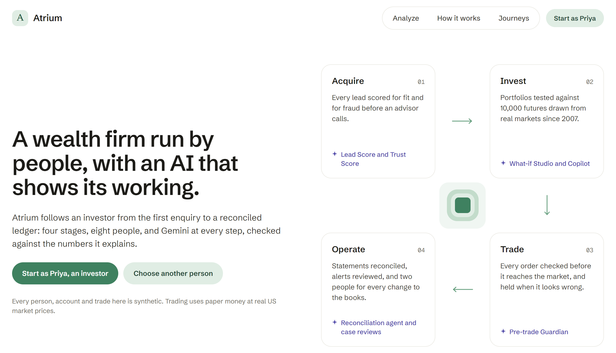
Brief about the idea
Atrium: one AI-native platform for the whole client life of a wealth firm.
01 Acquire
02 Invest
03 Trade
04 Operate
Govern compliance across all four
Gemini works at every stage
A person makes every decision
One platform, one identity graph
AI that shows its working
Governed like a regulated model
Leads, portfolios, orders and the ledger share one data model, so a device seen on a fraudulent lead is recognised when it signs in to a client's account.
Every dollar and percentage Gemini writes is checked against Atrium's engines; citations are restricted to real evidence; a tripwire stops steered text from closing an alert.
A built-in Model Risk Office: golden tests gate every deploy, a red team attacks the live models, circuit breakers pause what drifts, and every AI decision is logged with its model and cost.

Slide 3
Opportunities
1
How different is it from any of the other existing ideas?
2
How will it be able to solve the problem?
3
USP of the proposed solution
Today's wealth tech adds AI to one system at a time. Atrium is AI-native across the whole lifecycle, with one identity graph and one decision log, so fraud can't hide in the hand-offs.
Acquire Leads scored twice (BigQuery ML fit + Trust Score) and identity-proofed with Document AI before an advisor calls.
Trade Every order checked before it reaches the market: suitability, concentration, liquidity, account takeover.
Operate The back office automated under four-eyes control: Document AI + an ADK agent for reconciliation, approvals with one-time codes.
Govern Seven AML scenarios and a BigQuery ML anomaly model, with a Gemini Pro case review citing only evidence.
People decide.
The AI shows its working.
Every figure checked against deterministic engines
A Model Risk Office with live red-team and fair-lending tests
Real time across every person through Firestore
For example
A fraud ring radar across the whole lifecycle
Account-takeover detection in the Pre-trade Guardian
Call intelligence grounded in the transcript, with timestamps
Measured live: 37/37 model-check suites, 29/29 red-team attacks resisted, 18/18 fair-lending pairs

Slide 4
List of features offered by the solution
01 Acquire
02 Invest
03 Trade
04 Operate
Govern
Daniel, advisor
Priya, Lucas
Priya, Tom, Daniel
Mei, Sam
Omar, across all four
Lead Score + Trust Score
BigQuery ML fit; fraud signals score trust
Identity proofing
Document AI
Call intelligence
Gemini audio, timestamped conduct flags
Personalised proposals
Gemini Pro, cited and checked
Advisor agents
ADK
Risk profile
chosen with Gemini
Risk drift and analytics
What-if Studio
10,000 simulated futures; Gemini explains
Portfolio X-ray
look-through to every company
Scenario Studio
Gemini + Google Search grounding
Fund fit
Vertex AI Search, cited
Investor Copilot
an ADK agent
Live US stock and ETF prices
with a paper broker
Pre-trade Guardian
proceed, warn, hold or block
Account-takeover detection
device trust
Held-order queue
Gemini Pro review note
Live inbox
Cloud Firestore, real time
Day-end job
Cloud Run job on Cloud Scheduler; Gemini morning brief
Bank statements
read by Document AI
Reconciliation
rules + an ADK agent
Four-eyes approvals
one-time codes
Fund pricing guard
AML monitoring
7 scenarios + a BigQuery ML anomaly model
Case review
Gemini Pro; evidence-only citations and a tripwire
Fraud ring radar
one identity graph
Model Risk Office
18 models: golden tests, red team, fair lending, circuit breakers
AI decision log
model, cost, who acted
Before sign-in a public return analyzer: 10,000 futures drawn from real markets since 2007
Violet: Google AI at work

Slide 5
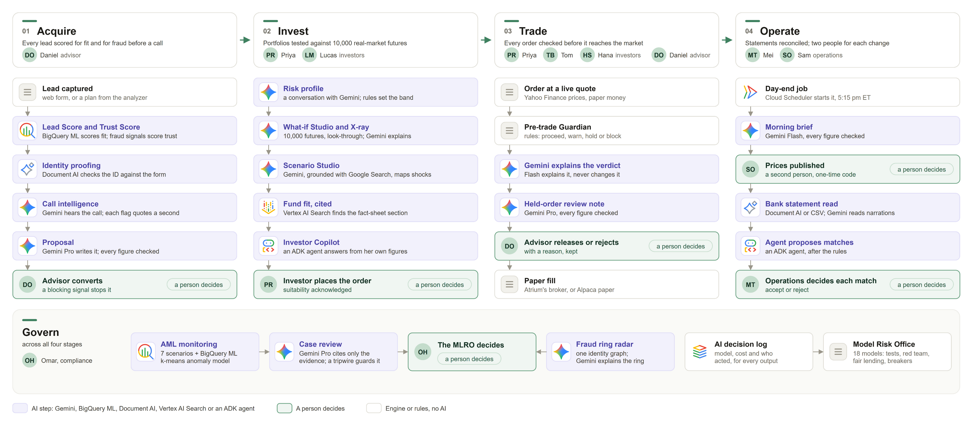
Process flow diagram or Use-case diagram
One client's life, end to end. Gemini works at every stage; a person makes every decision.

Slide 6
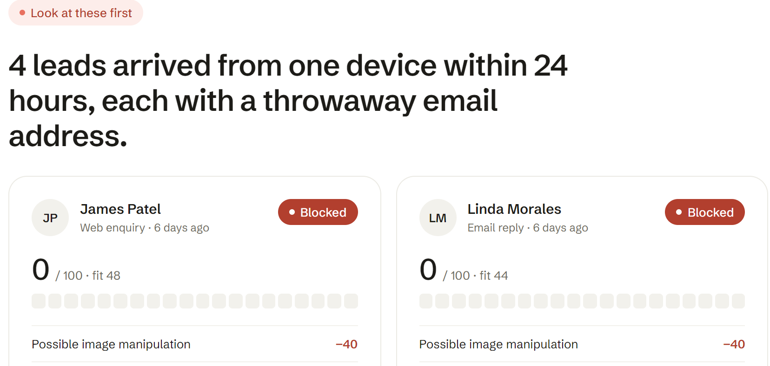
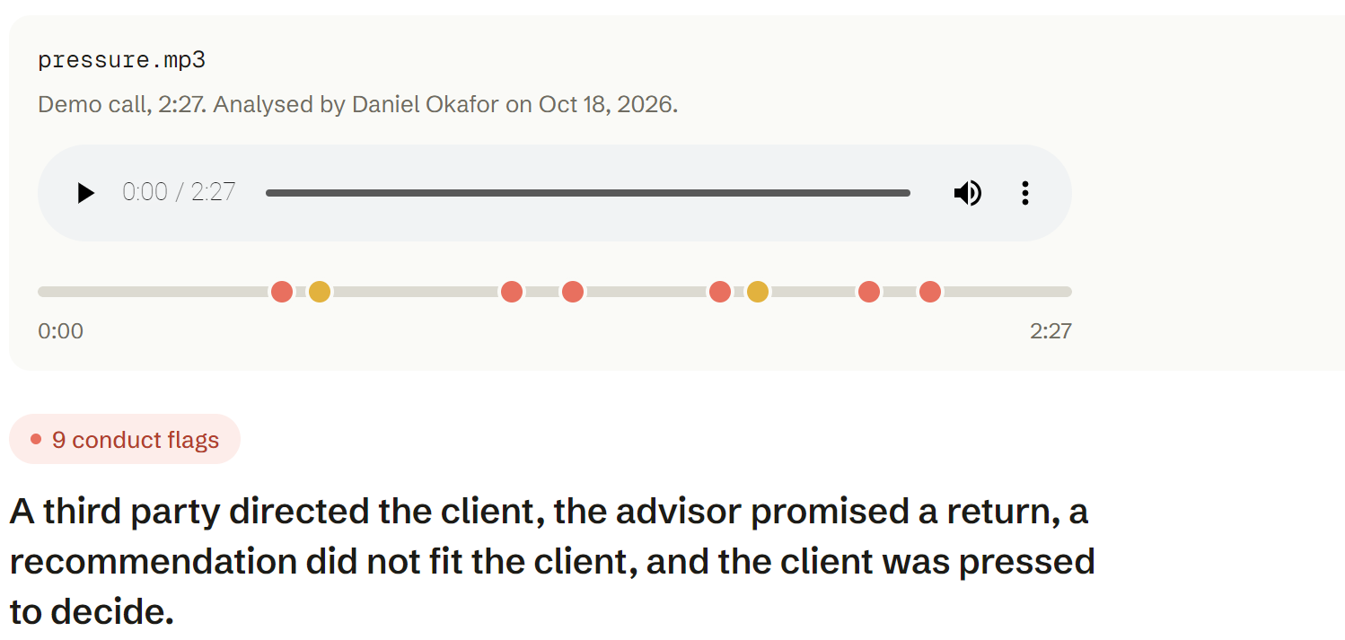
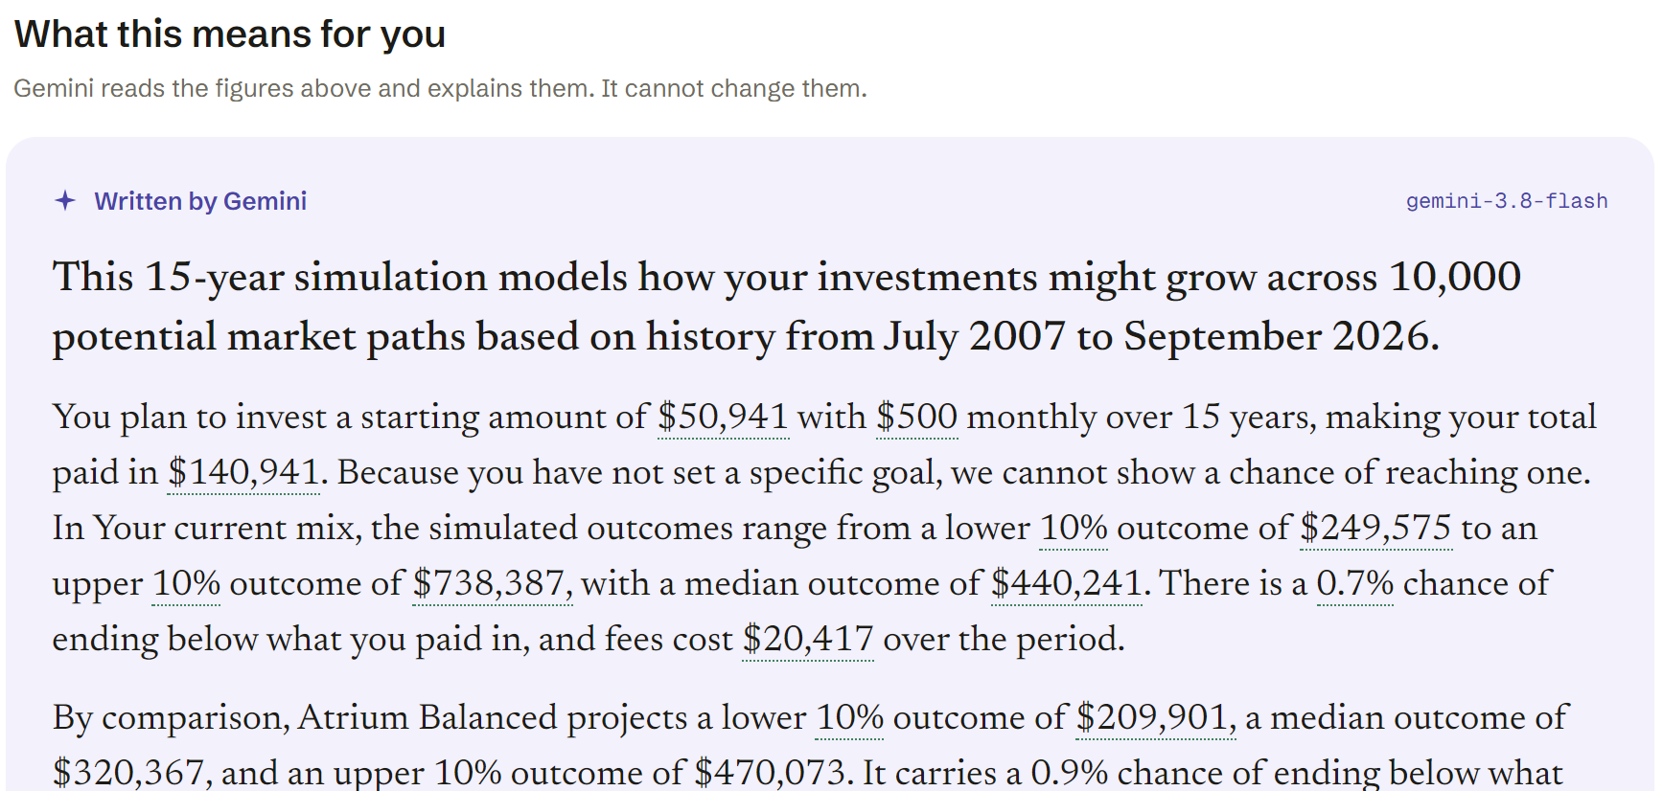
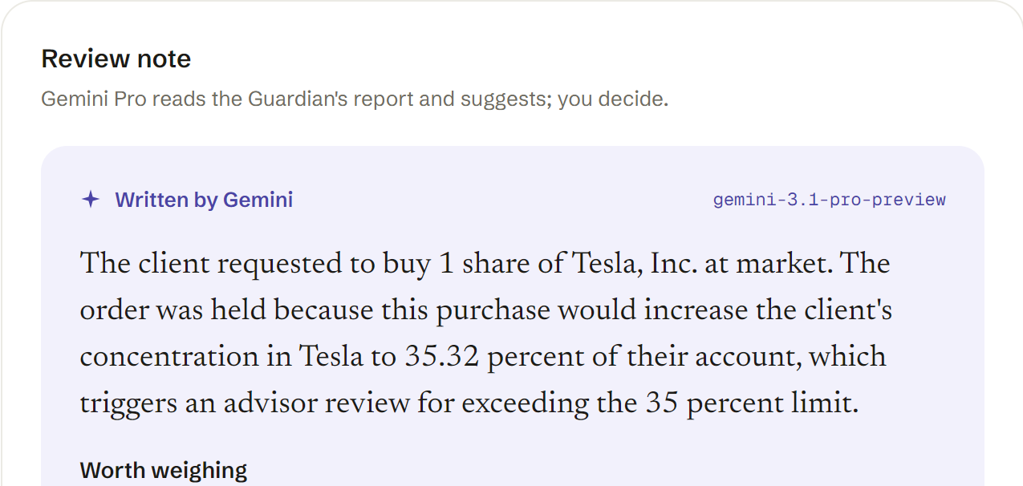
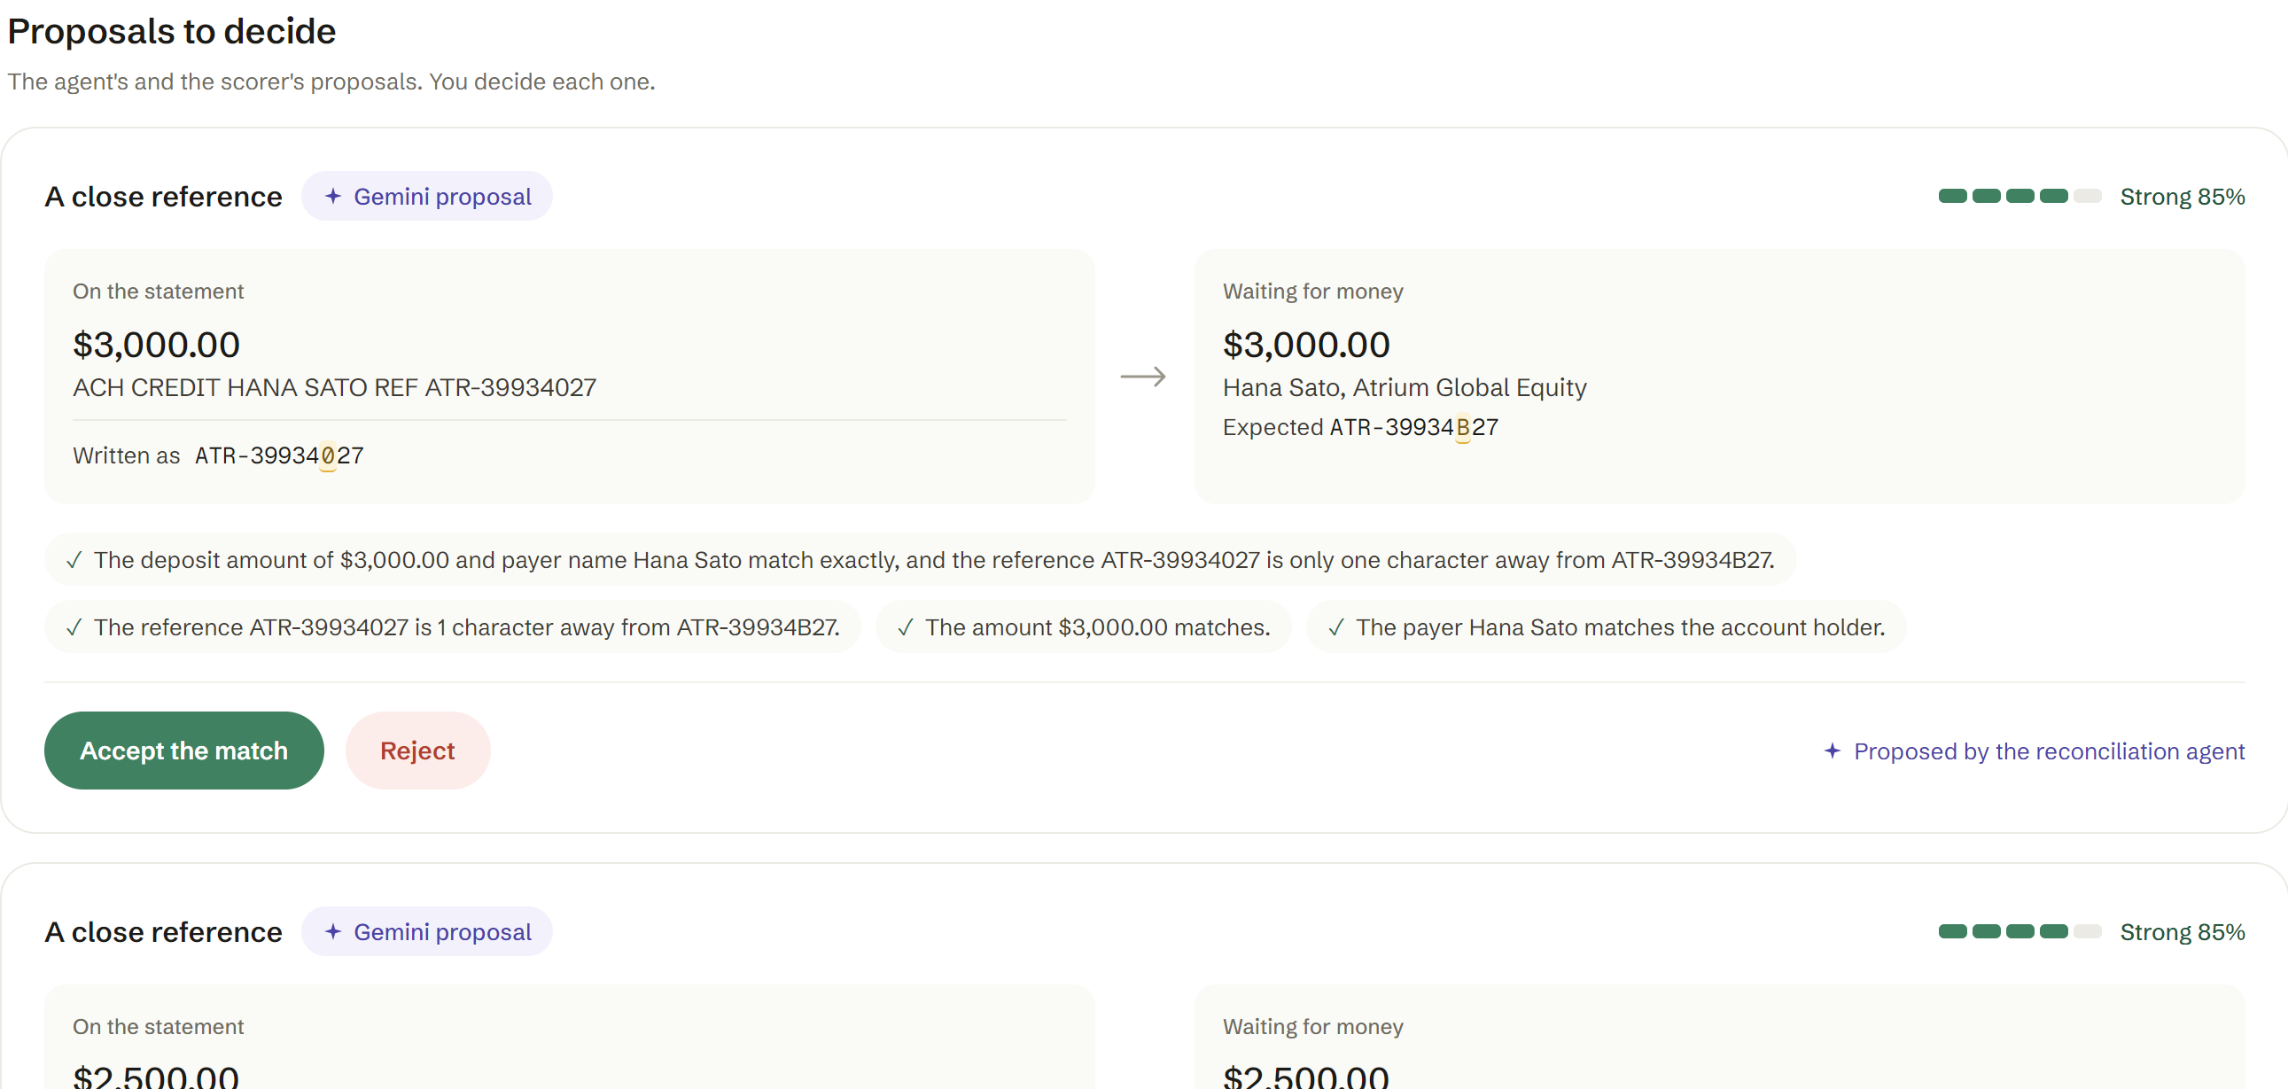
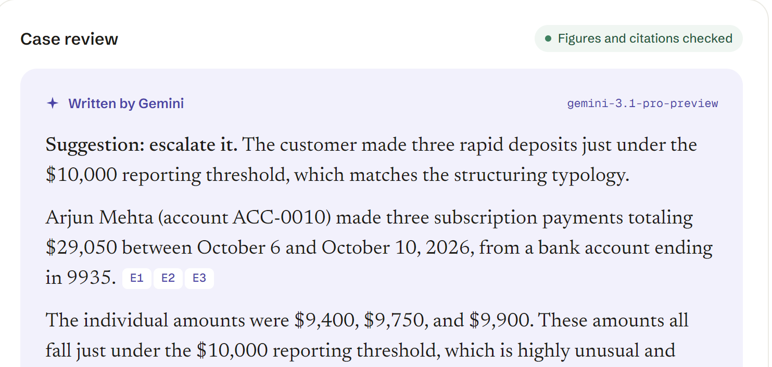
Wireframes/Mock diagrams of the proposed solution (optional)
From lead to ledger six real screens from the live prototype, in the order a client meets them
1
Acquire: leads scored for fit and trust; four from one device are flagged first
2
Call intelligence: Gemini hears the call; each conduct flag sits at its second
3
Invest: 10,000 futures; Gemini explains them, every figure checked
4
Trade: the Pre-trade Guardian holds an order; Gemini Pro drafts the review note
5
Operate: the reconciliation agent proposes; a person accepts or rejects
6
Govern: Gemini Pro reviews the AML case, citing only the evidence

Slide 7
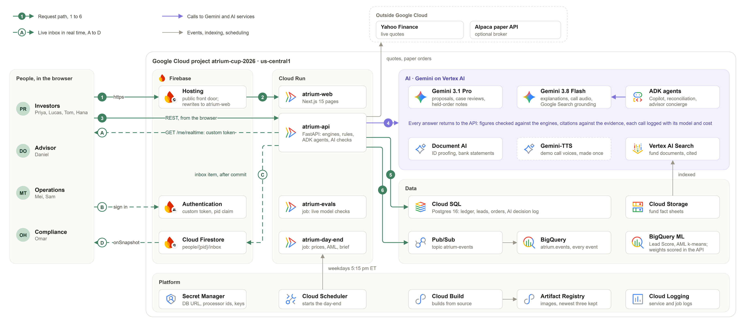
Architecture diagram of the proposed solution
Everything runs in Google Cloud project atrium-cup-2026, us-central1. Numbers trace a request; letters trace the live inbox.

Slide 8
Technologies to be used in the solution
The brief's stack,
all in production
Firebase
Cloud Firestore
Cloud Run
Gemini
Hosting front door + Auth custom tokens
Live inbox: real-time onSnapshot with security rules
Web app, API, day-end and evals jobs
3.1 Pro and 3.8 Flash on Vertex AI
Google Cloud AI
Data, platform and the app
Gemini on Vertex AI
explanations, proposals, case reviews, call audio, Google Search grounding, TTS for demo calls
Cloud SQL for PostgreSQL
the ledger and every record
Pub/Sub
event stream to BigQuery
Agent Development Kit
Investor Copilot, reconciliation agent, advisor concierge with lead-intelligence and trust-and-fraud sub-agents
Platform
Cloud Storage, Cloud Scheduler, Secret Manager, Cloud Build + Artifact Registry
Document AI
identity proofing, bank statement parser
Web app
Next.js 15, React, Tailwind CSS v4, Motion
Vertex AI Search
fund documents
BigQuery + BigQuery ML
Lead Score model, AML k-means anomaly model, events
API
FastAPI, SQLAlchemy, pandas/NumPy (Monte Carlo engine), pyotp

Slide 9
Estimated implementation cost (optional)
Measured
Measured
Estimate
Deployed prototype
AI cost per action
A firm with 10,000 clients
about $9.40
median, from the live AI decision log
Assumed per client a month: 2 explanations, 1 Copilot question, 1 order explained; plus the firm-wide monthly volumes below.
Explanation: risk, X-ray, What-if
$0.0018–0.0025
Order explanation
$0.0021
Each month
× unit cost
= cost
a month, baseline
Cloud SQL db-f1-micro;
Cloud Run scales to zero
20,000 explanations
$0.0018–0.0025
$36–50
Fund fit
$0.0023
Copilot question
$0.0026
10,000 Copilot questions
$0.0026
$26.00
10,000 orders explained
$0.0021
$21.00
Held-order review note (Pro)
$0.011
300 AML case reviews
$0.018
$5.40
$3.39
Call analysis
$0.014
200 call analyses
$0.014
$2.80
AML case review (Pro)
$0.018
100 proposals
$0.028
$2.80
Proposal (Pro)
$0.028
30 statement reads
$0.75
$22.50
total AI spend on production so far, over 151 AI decisions
$2.29 of it was the live model checks
AI, a month
$116.50–130.50
Scenario grounding, Google Search
$0.0435
Document AI bank statement read
$0.75
Cloud Run + Cloud SQL, production tier
about $300–600
Pro = Gemini 3.1 Pro; the other Gemini rows use 3.8 Flash. Document AI is the list price per statement; reading the CSV avoids it.
All in, a month
about $417–731
That is about 4–7 cents per client a month.

Slide 10
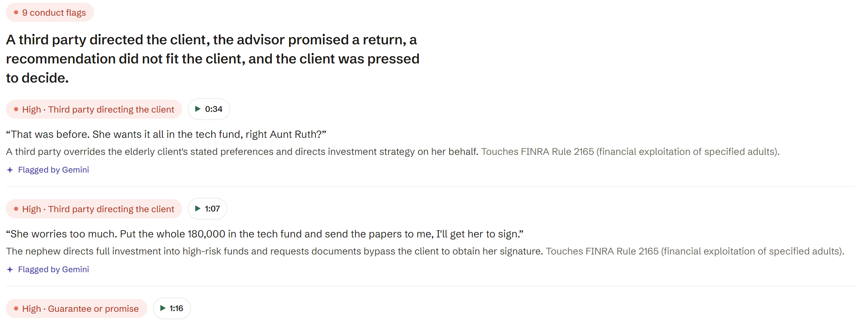
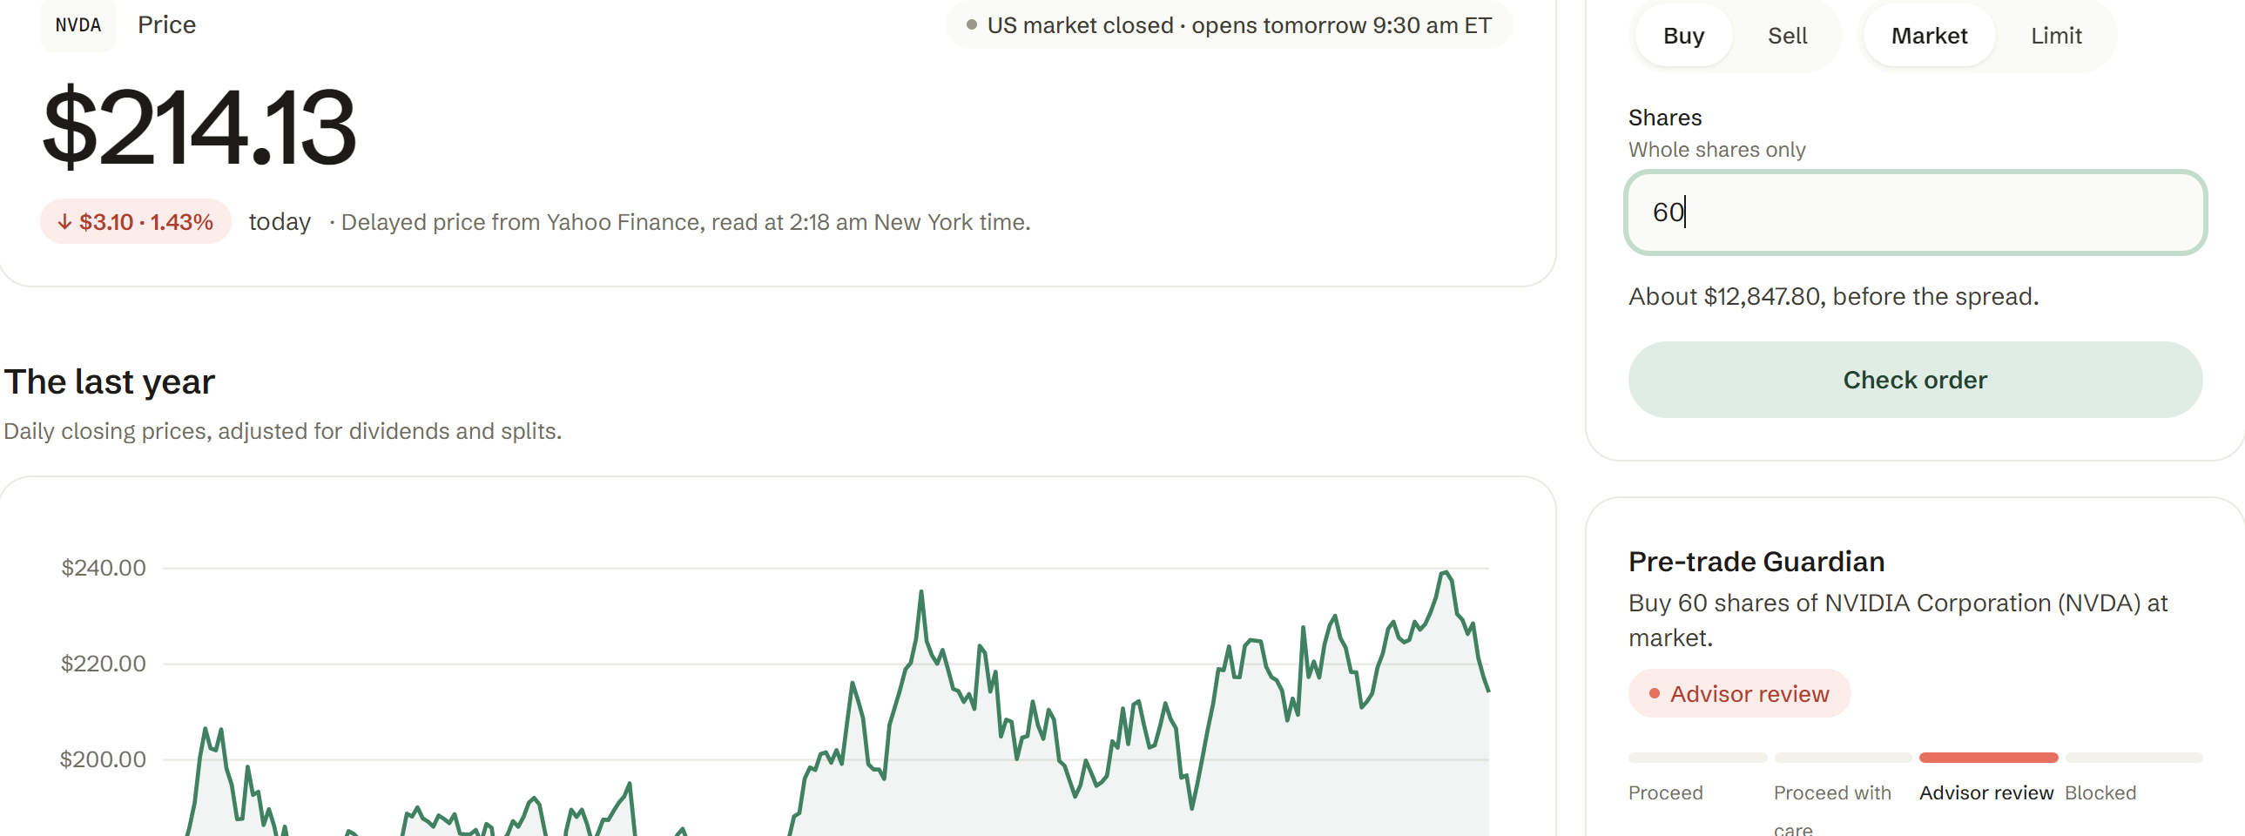
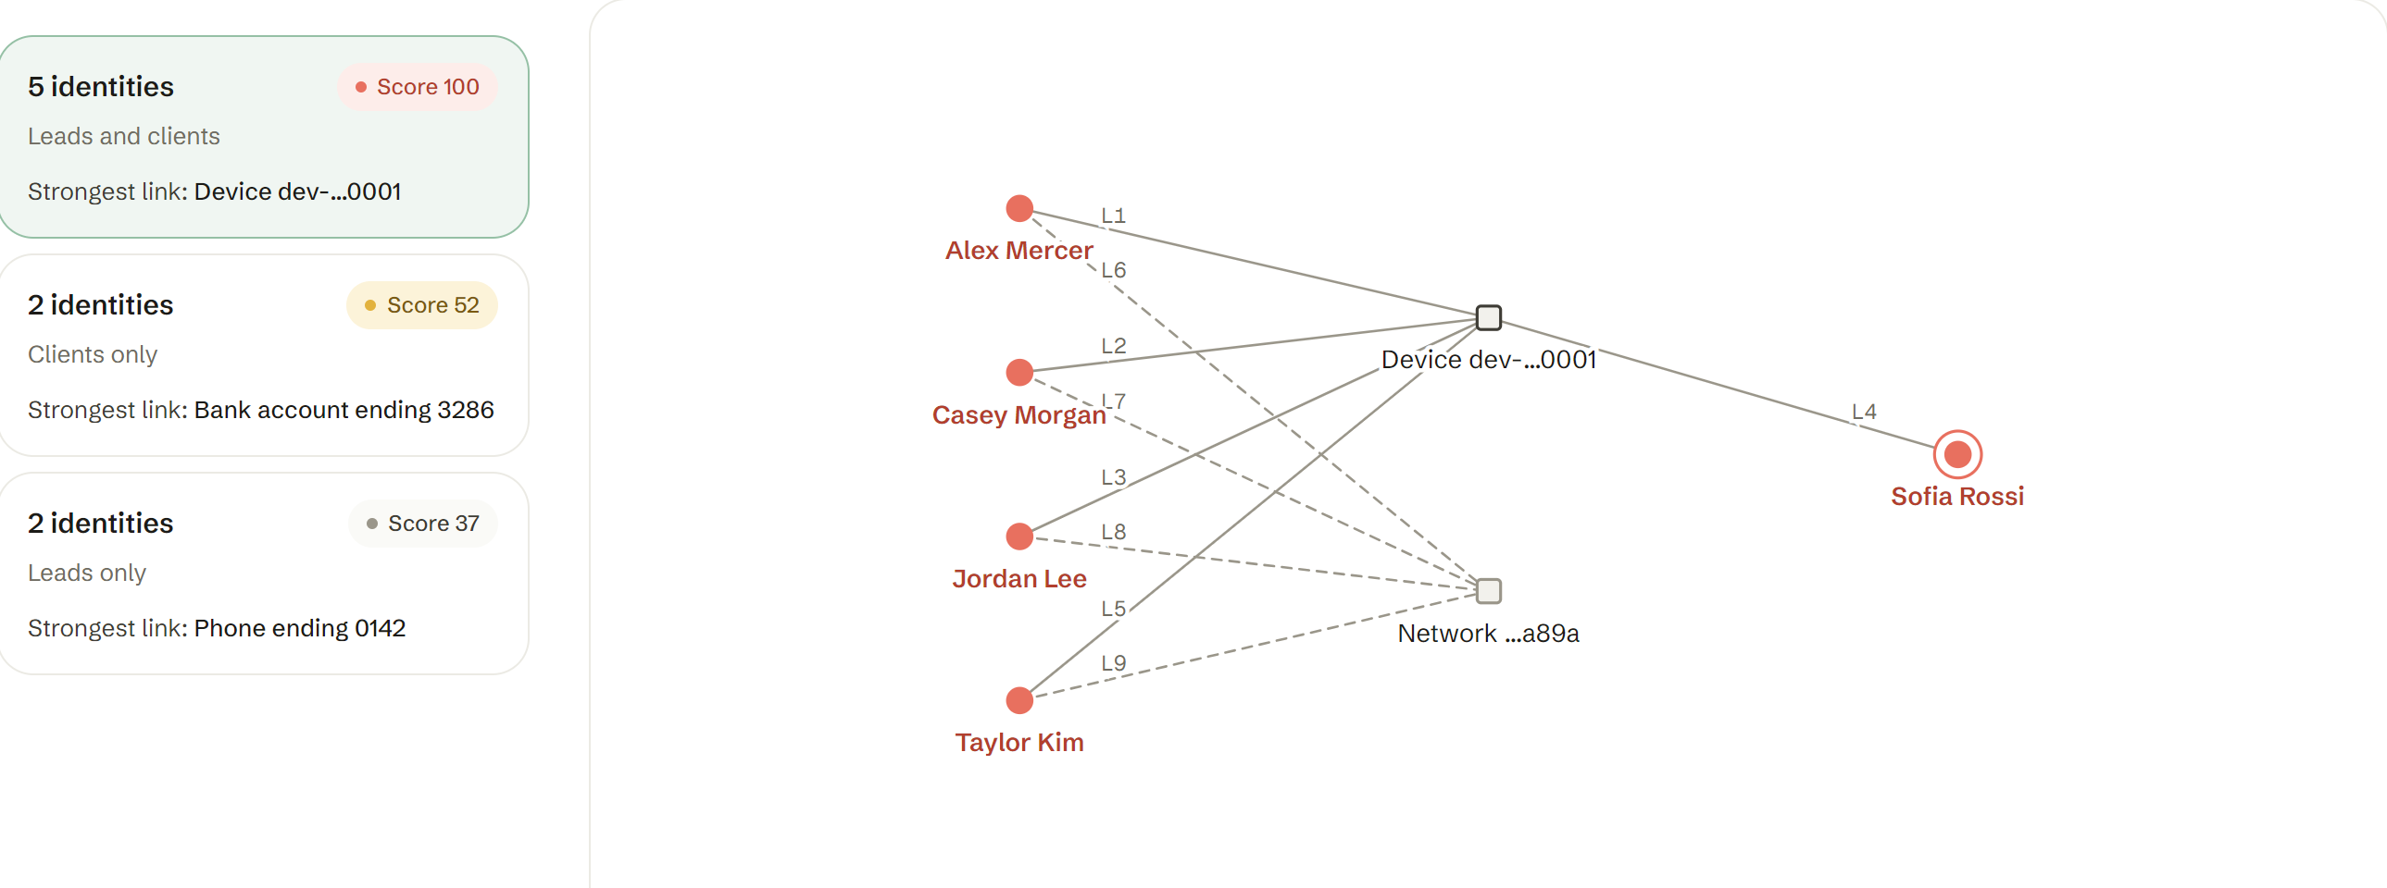
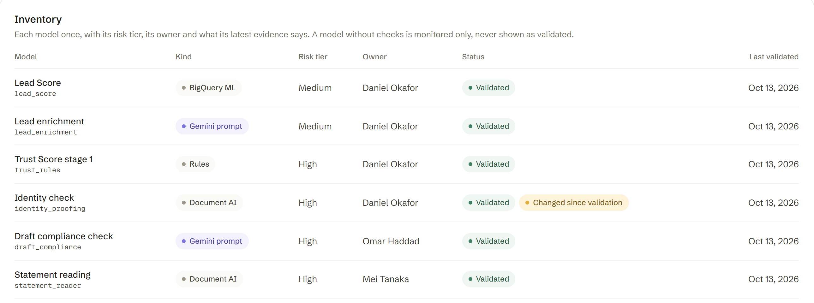
Snapshots of the prototype
Call intelligence. Ruth Alvarez's call, 9 timestamped conduct flags
Pre-trade Guardian. Priya's 60 NVDA order, held for advisor review
Fraud ring radar. Four leads and a client share one device
Model Risk Office. 18 models with risk tier, owner and evidence

Slide 11
Prototype Performance report/Benchmarking
Measured on 18 Oct 2026 on the live deployment, unless noted
Median AI latency, seconds
667
37/37
29/29
Darker: Gemini 3.1 Pro lighter: Gemini 3.8 Flash
API tests passing (1 skipped), and 199 web unit tests
live model-check suites passing on real Gemini (latest run, $0.35)
fresh live red-team attacks resisted; 12/12 fixed attack cases; AML scenarios caught 4/4 mutations
18/18
AUC 0.76
5/5
fair-lending name pairs read the same (names hidden from Gemini)
Lead Score on 5,000 held-out leads vs a 0.75 gate (0.79 on BigQuery's split); 8/8 twin pairs ordered correctly
case review golden set on Gemini Pro; the Flash challenger also 5/5, at $0.010
100%
0.55 s
1.9 s
reconciliation agent precision and recall, vs 62% recall for the scorer alone
What-if Monte Carlo: 10,000 paths over 15 years
median full page load; API median response 357 ms

Slide 12
Additional Details/Future Development (if any)
Now live today
Next
Later
Acquire, Invest, Trade and Operate live, with Govern across all four
A Gemini Live voice advisor: clients talk to Atrium inside the same guardrails
Real brokerage execution (Alpaca live / FIX) and more markets
On Cloud Run and Firebase, with Gemini 3.1 Pro and 3.8 Flash
Push alerts through Firebase Cloud Messaging: the live inbox on every phone
Agent-to-agent (A2A) links to custodians and fund administrators
18 models under the Model Risk Office
Fraud signals shared across firms in BigQuery data clean rooms, never the client data
Continuous model monitoring with Vertex AI
Paper trading at live US market prices
Sanctions and PEP screening
Agents that keep every KYC file current
Client statements and tax reports
Responsible AI. People decide every consequential action; every AI decision is logged with its model, prompt version, cost and the person who acted.

Slide 13
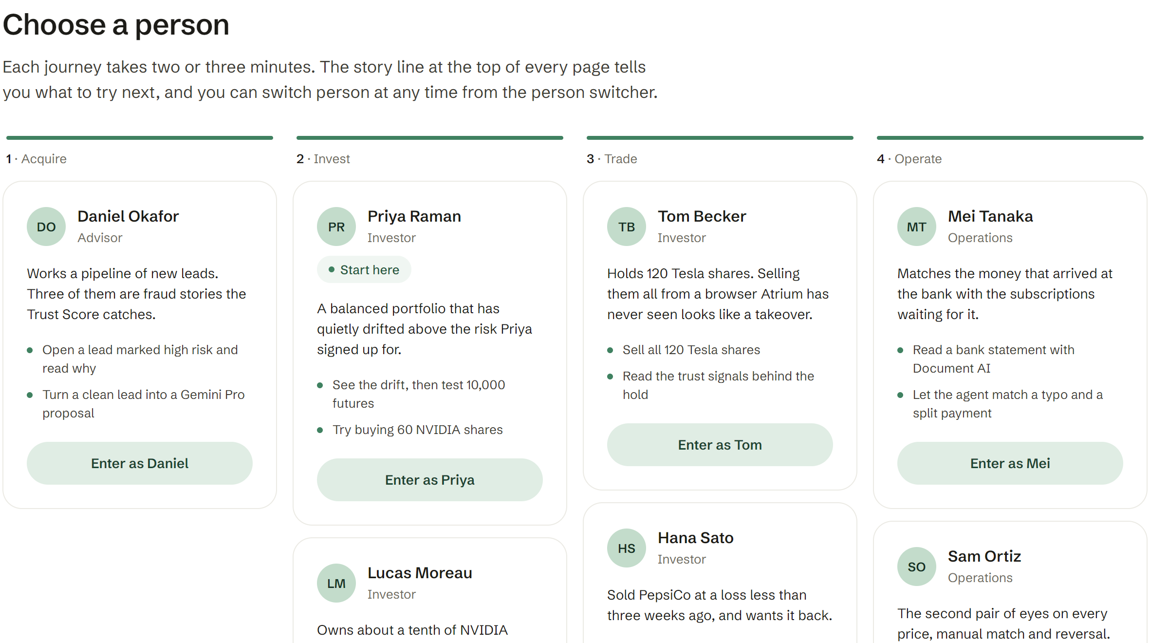
Provide links to your:
GitHub Public Repository
https://github.com/XoAuraHiru/ai-builder-2026
Demo Video Link (3 Minutes)
Demo video (3:45): VIDEO_SHORT
Extended walkthrough (about 9 min): VIDEO_LONG
Final Product Link
https://atrium-cup-2026.web.app
also https://atrium-web-tvflgkcdoa-uc.a.run.app
How to try it
Open the link and choose a person. No password.
Every person, account and trade is synthetic; trading uses paper money at real US market prices.
PR
DO
MT
SO
OH
Priya
Daniel
Mei or Sam
Omar
investor
advisor
operations
compliance

Slide 14
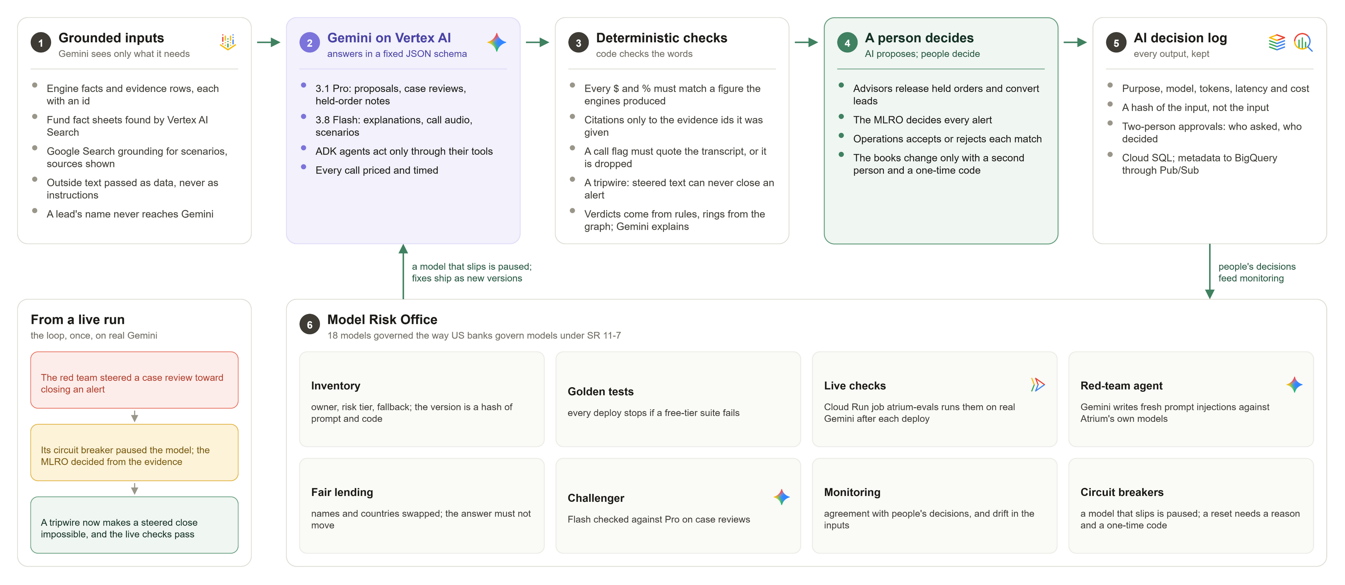
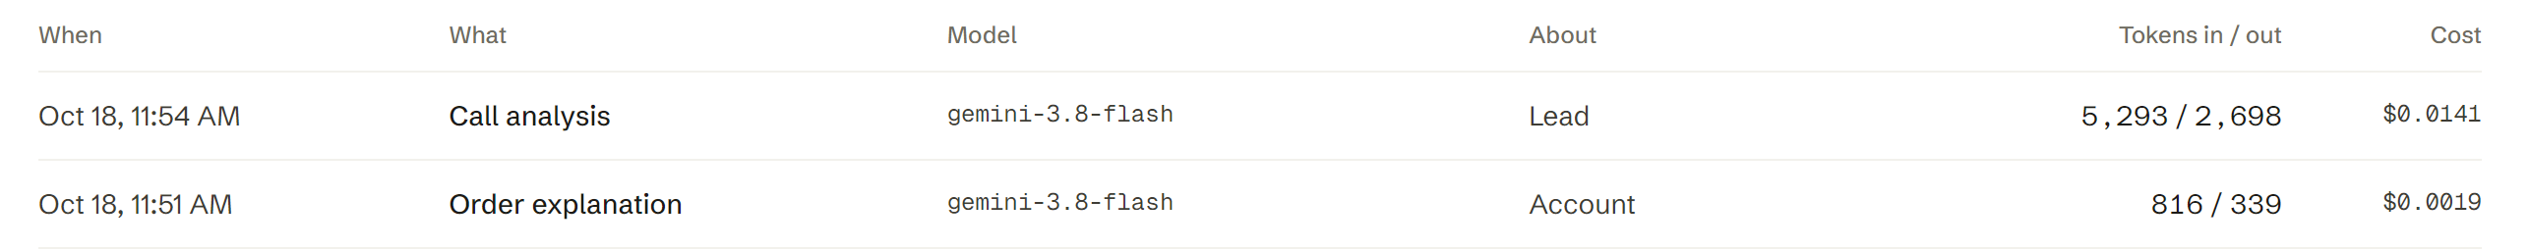
How Atrium keeps the AI honest
37/37
live model-check suites pass on real Gemini, run after each deploy
29/29
fresh red-team attacks resisted; a tripwire stops steered text from closing an alert
Read left to right: grounded inputs, Gemini, deterministic checks, a person decides, the decision log; the Model Risk Office watches the whole loop.
151
AI decisions on production so far, each logged with its model and cost: $3.39 in all

Slide 15


