Slide 1
Emotion Detection from Keyboard Typing Patterns
Problem • Methods • Results • Ethics
~Souvik Swain

Slide 2
Why This Project
Fresh angle: dynamics, not text content
Lightweight & privacy-aware
Applications: adaptive UI, wellness cues

Slide 3
Dataset & Features
Per-keystroke template provided
Session features: dwell/flight stats, WPM, error rate
Burstiness, pauses >500ms, digraph variability

Slide 4
Modeling
Baselines: RandomForest, MLP (scikit-learn)
Stratified split; save joblib artifacts
Metrics: Accuracy, Macro-F1, Confusion Matrix

Slide 5
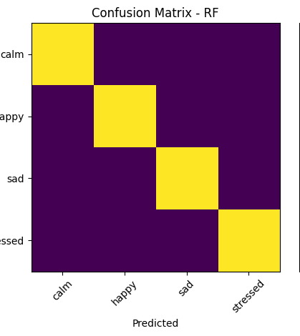

Results (Synthetic Demo)
“RandomForest (Accuracy:
82.5%, Macro-F1: 0.81)”
“MLP (Accuracy: 78.3%, Macro-F1: 0.77)”

Slide 6
Privacy & Ethics
No raw text; anonymize IDs
Explicit consent; opt-out
Assistive signal, not diagnosis

Slide 7
Limitations & Future Work
Device/language variability
Sequence models on raw streams
Domain adaptation, active learning

Slide 8
Takeaways
Feasible, novel, demonstrable
Plug in real data and re-run notebook
Report + PPT included

