Slide 1
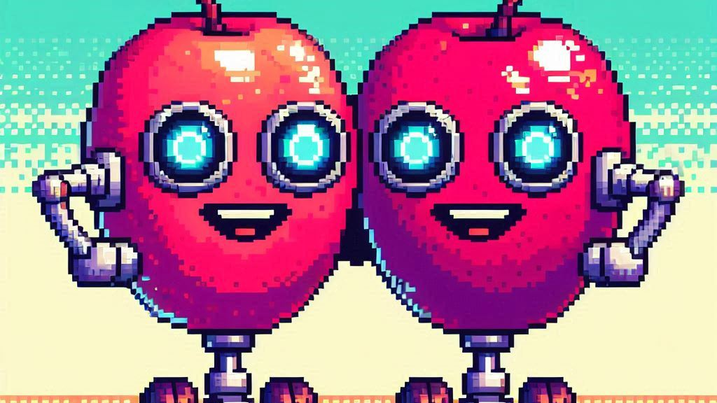
Fruit freshness classification using FruitQ dataset

Slide 2
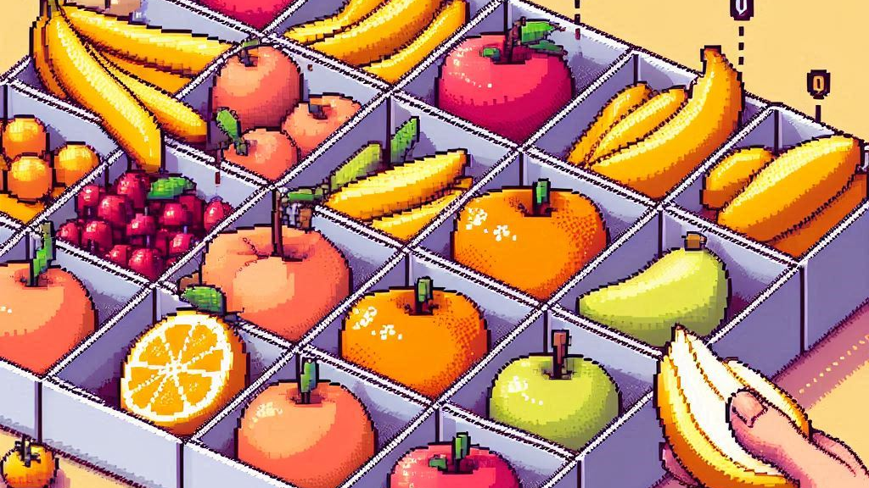
Goal of the model
The goal of the model is to identify 10 different fruits, including bananas, cucumbers, grapes, kaki, papayas, peaches, pears, peppers, strawberries, and watermelon, and classify each fruit into one of three categories: Fresh, Mild, or Rotten.
In total, there are 32 classes, as there is no data available for fresh strawberries.
Training an accurate model to classify these fruits effectively could be valuable in the agricultural sector, helping to reduce the amount of mild and rotten fruit sold in stores.
Additionally, this model can assist retailers in determining the quality of fruit and ensure they only purchase from suppliers who offer the highest quality products.

Slide 3
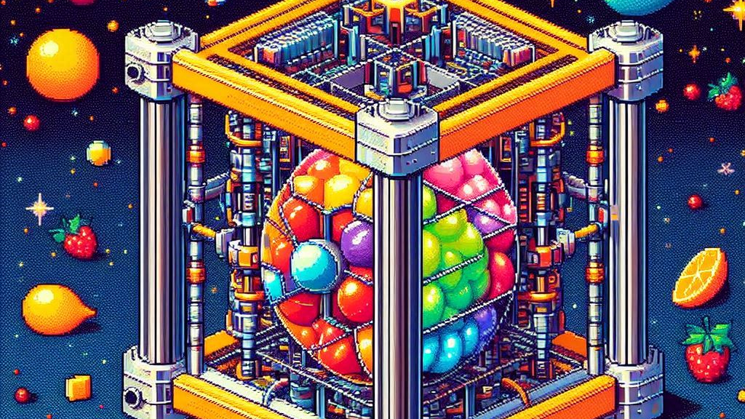
Techniques and technology used for model
Used a Convolutional Neural Network (CNN) due to its effective architecture for classification tasks.
PyTorch was chosen as the framework for training the model because of its flexibility and robustness.
Utilized Cura to do training on GPU. A TPU v2 on Google Colab was used.
Numpy was employed for array manipulation.
Matplotlib was used to generate figures.

Slide 4
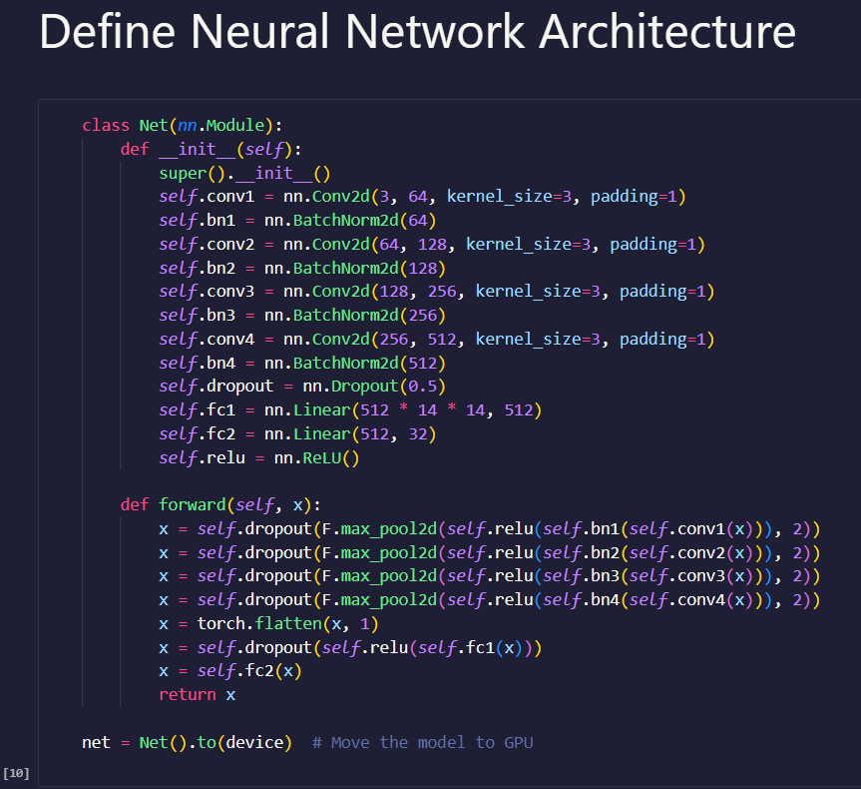
Neural network architecture
Conv2D: A filter or kernel "slides" across the 2D input data, carrying out elementwise multiplication.
BatchNorm2d: The number of dimensions or channels that are produced by the previous layer and enter the batch normalization layer.
Dropout: Data or noise intentionally excluded from a neural network to enhance processing efficiency and reduce time to results.
Linear / fully connected: Applies a linear transformation to the incoming data.
ReLU: Activation function.
Def forward: Defines how the input data passes through the network's layers to produce the output.

Slide 5
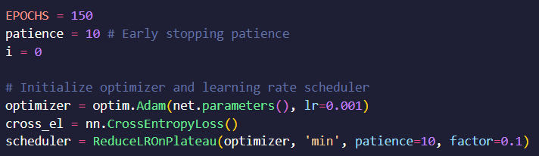
Neural network hyperparameters
Trained for 150 epoch with a patience value of 10.
The patience value is there to stop the model from overtraining when it can’t improve the model’s loss for 10 consistent epochs.
Optimizer: Creates an Adamaoptimizer with a learning rate of 0.001 to update the parameters of the model net during training.
Cross-Entropy Loss: Defines the loss function for training, specifically Cross-Entropy Loss, which is commonly used for classification tasks. It measures the difference between the predicted class probabilities and the actual class labels.
Scheduler: Reduces the learning rate of the optimizer when a monitored metric (e.g., loss) has stopped improving. patience=10 means the learning rate will be reduced after 10 epochs of no improvement, and factor=0.1 specifies that the learning rate will be multiplied by 0.1 when reduced.

Slide 6

Training
Training was conducted on Google Colab.
The model was trained for a total of 127 epochs, with the lowest loss of 0.03364849469035231 achieved during epoch 117.
Since there was no improvement in the last 10 epochs, the training process was terminated due to the patience condition of 10 being met.

Slide 7

Results
On a test dataset of 300 images, the model achieved an accuracy of 91.5%.

Slide 8

Application development
Used Tkinter to create the user interface for the application.
Integrated the neural network classes into the application.
Implemented the neural network architecture within it.
Additionally, developed functions to interact with the model, allowing the application to display fruit classifications when an image is selected.

Slide 9
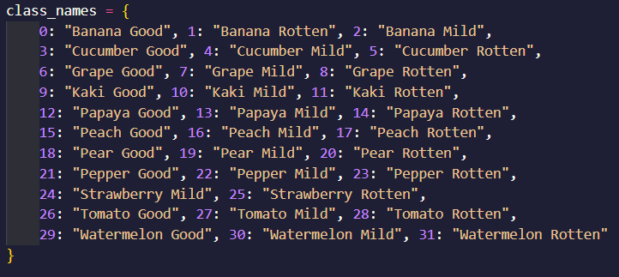
Class declarations

Slide 10
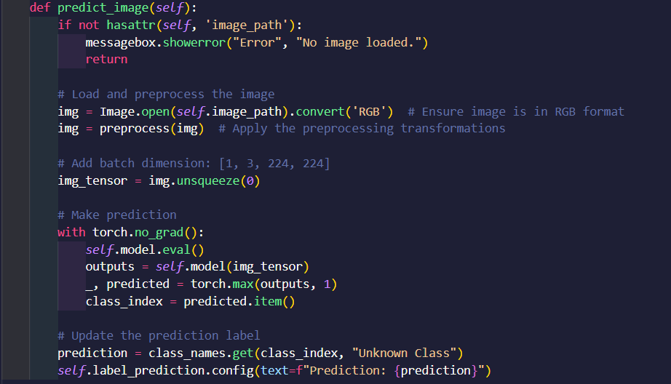
Function to predict image classification

Slide 11

Visualizing filters and feature maps
Implemented keras vgg16 to visualize the feature maps and filters.
Filter defined: filter (or kernel) is a small matrix of weights used to detect specific features in the input data. Filters slide (or convolve) over the input image and perform element-wise multiplication followed by summation to produce a feature map.
Filter function: Filters are responsible for extracting features from the input. For instance, a filter might detect horizontal edges, vertical edges, or specific textures. During training, the weights in the filters are adjusted to improve their ability to detect useful features.
Feature map defined: A feature map (or activation map) is the output of applying a filter (also known as a kernel) to an input image or to the previous layer’s output. It represents the spatial layout of the features detected by the filter in the input.
Feature map function: Each feature map captures different aspects or features of the input data, such as edges, textures, or patterns. For example, in an image processing CNN, a feature map might highlight areas where a particular texture or edge occurs.

Slide 12

Why do all these visualizations?
Visualizations like these are part of a subfield of AI called explainable AI (XAI).
IBM defines XAI as the following: “Explainable artificial intelligence (XAI) is a set of processes and methods that allows human users to comprehend and trust the results and output created by machine learning algorithms. “
This means that the goal of these visualizations are to get people to trust AI solutions by being able to explain what AI does. Being able to explain something to somebody and giving somebody an understanding of it makes people more likely to trust the solution. This means that businesses would be more likely to implement software solutions that consists out of AI implementations.

Slide 13
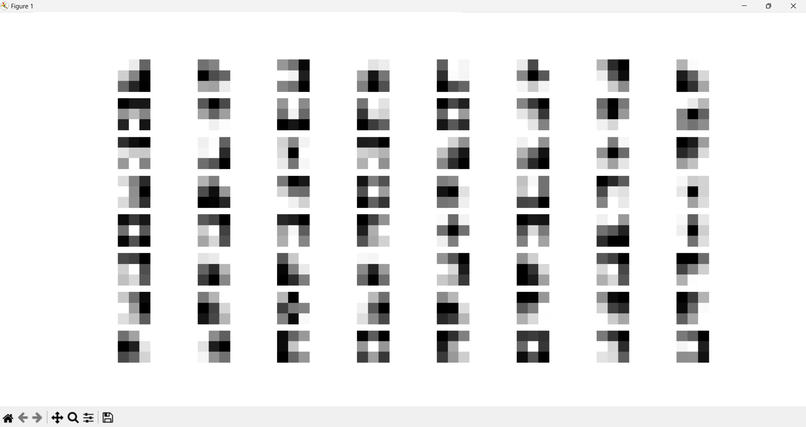
Visualizing filters of a fresh banana

Slide 14
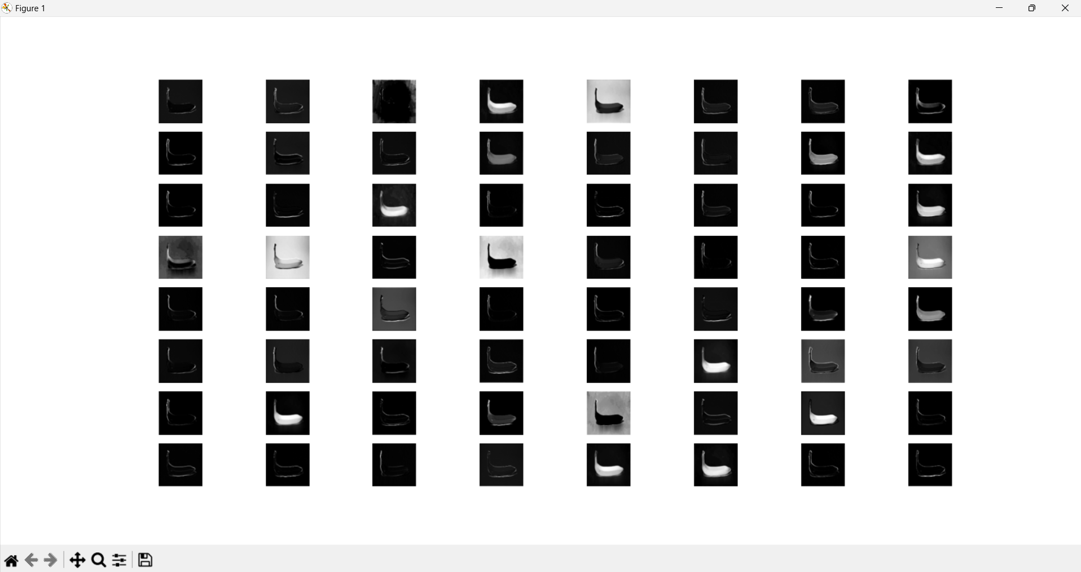
Visualize feature maps of a fresh banana

Slide 15

Bibliography
AI Boys V2. (2024). Documentation of Fresh Fruit Detection AI. Swanepoel, B., du Plessis, A., and Deng, N.
Generated all my images using Bing AI: https://www.bing.com/images/create
IBM. (n.d.). Explainable Artificial Intelligence (XAI). Available at: https://www.ibm.com/topics/explainable-ai
Brownlee, J. (2019). How to Visualize Filters and Feature Maps in Convolutional Neural Networks. Machine Learning Mastery. Available at: https://machinelearningmastery.com/how-to-visualize-filters-and-feature-maps-in-convolutional-neural-networks/
Terra, J. (2024). Keras vs TensorFlow vs PyTorch: Key Differences Among Deep Learning Frameworks. Simplilearn. Available at: https://www.simplilearn.com/keras-vs-tensorflow-vs-pytorch-article#:~:text=TensorFlow%20and%20PyTorch%20each%20have,perfect%20for%20study%20and%20experimentation

Slide 16

Demo of project!

