Slide 1

OnlineShop2025
Desktop E-commerce Application
OnlineShop2025
Course:
OBJECT-ORIENTED PROGRAMMING (OOP)
Class:
24CNTT
Academic Year:
2024-2025
Implemented by:
Nguyễn Hồ Hồng Sơn, Trần Chí Nguyện
Instructor:
TS. Lê Ngọc Hiếu
Location, Date:
Ho Chi Minh City, May 2025

Slide 2

OnlineShop2025
Table of Contents
1 Project Introduction | 10 | Internal Mechanics (Part 2: UI Logic)
2 Technology Stack Overview | 11 | Testing Environment & Scenarios
3 Key Libraries and Frameworks | 12 | Test Results & Performance Evaluation
4 Problem Statement & Research Context | 13 | Product Evaluation (Strengths)
5 Proposed Solution & Architecture | 14 | Product Evaluation (Limitations)
6 Functional Requirements | 15 | Conclusion
7 Non-Functional Requirements & UI Design | 16 | Future Development
8 Main System Workflows | 17 | Q&A / Thank You
9 Internal Mechanics (Part 1: Data Access)

Slide 3
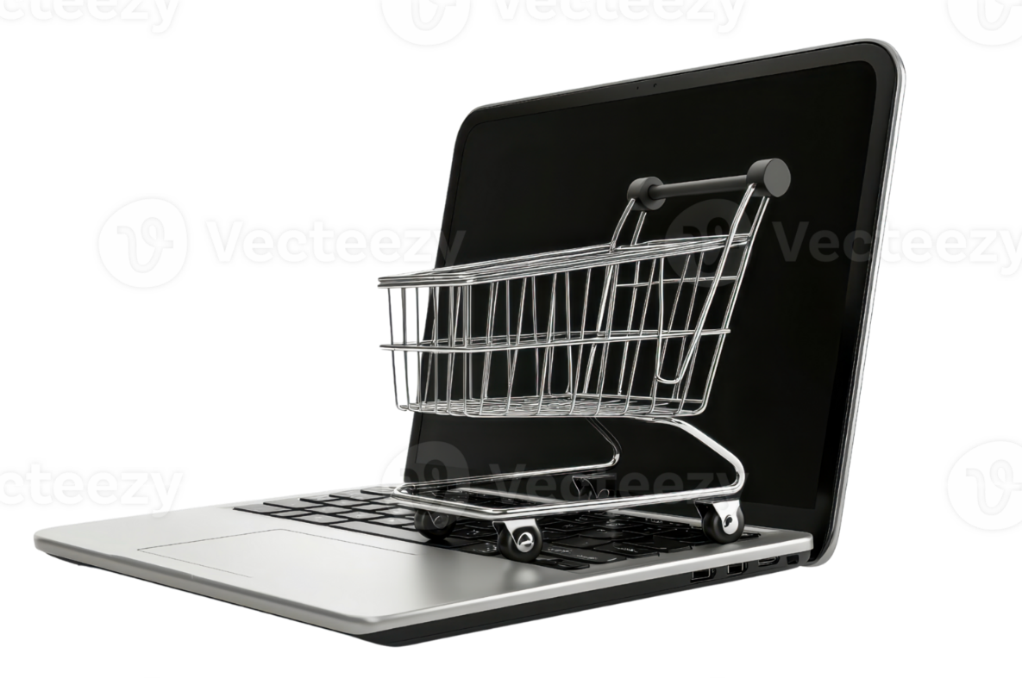
OnlineShop2025
Project Introduction
Motivation
The rise of e-commerce necessitates robust and user-friendly desktop applications for specific user bases
Existing solutions are often web-based, while desktop applications offer enhanced performance and better integration with local systems
Need for practical learning project to apply OOP principles, JavaFX for modern GUI, and database interaction
Project Objectives
Develop a comprehensive desktop e-commerce application using Java and JavaFX
Implement core e-commerce functionalities (authentication, product catalog, shopping cart, orders)
OnlineShop2025 Vision:
A seamless shopping experience with desktop performance and web-like convenience, bringing together OOP concepts in a practical application.
Apply OOP principles, utilize JavaFX for modern UI, manage data with MySQL database
Create functional and intuitive application suitable for demonstration
Scope & Target Users
Data:
Product information, user accounts, order details
Features:
User login/registration, product browsing, shopping cart, checkout simulation
Technology:
Java, JavaFX (FXML, SceneBuilder), MySQL, CSS
Users:
General consumers for browsing and purchasing simulation
OnlineShop2025 - Desktop E-commerce Application
Made with Genspark

Slide 4



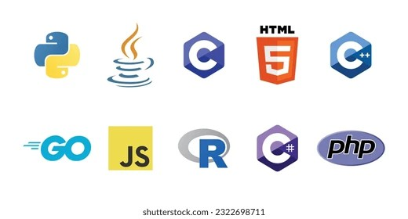


Technology Stack Overview
OnlineShop2025
OOP with Java
JavaFX
MySQL Database
Core paradigm for structured, maintainable, and scalable system design.
Oracle's platform for rich client applications with modern UIs.
Popular open-source RDBMS known for reliability and ease of use.
Encapsulation: Model classes with private attributes and public getters/setters
FXML: XML-based UI structure
SceneBuilder: Visual UI design
Relational Data Model: Data organized into tables with defined relationships
Inheritance: Base controller classes or service classes
MVC Pattern: Separation of concerns
Rich Controls: UI components
SQL: Standard language for database interaction (CRUD operations)
Polymorphism: Interfaces for services with multiple implementations
CSS Styling: UI customization
Event Handling: User interactions
MySQL Workbench: GUI tool for database design, SQL execution, and administration
Abstraction: Focus on essential features and interactions
Technology Integration
→
→
Java OOP
JavaFX UI
MySQL DB
OnlineShop2025 - Desktop E-commerce Application
Made with Genspark

Slide 5






OnlineShop2025
Key Libraries and Frameworks
JavaFX SDK
MySQL Connector/J
Java Collections Framework
Provides core UI components and controls for creating rich desktop applications.
Official JDBC driver for connecting Java applications to MySQL databases.
Essential for in-memory data management and operations.
Core UI Controls: Button, Label, TextField, TableView, ScrollPane
SQL Query Execution: Execute queries, fetch results
List: ArrayList<Product>, ObservableList<CartItem>
Data Updates: Insert, update, delete operations
Map: HashMap for caching and lookups
javafx.fxml: For loading FXML layouts
Used within: DBConnection.java utility class
Data Flow: Storing and manipulating collections of objects
Layout Panes: BorderPane, VBox, HBox, StackPane
javafx.scene.media: For video playback
JavaFX SDK
UI presentation
Integration
Collections
Data structures
Integration
MySQL Connector
Data persistence

Slide 6






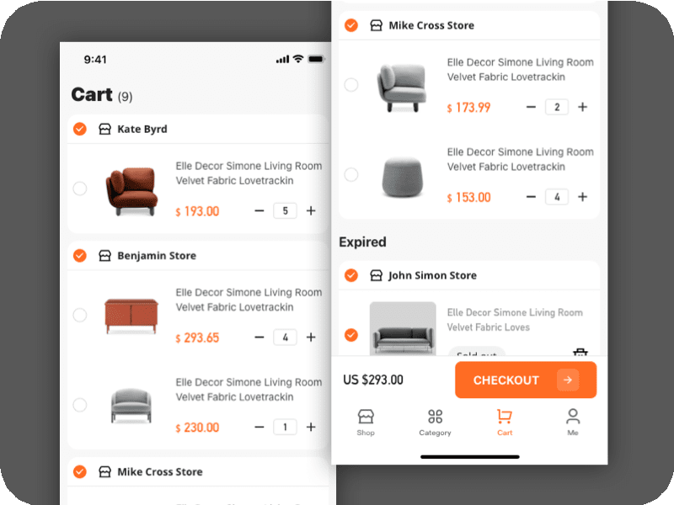
OnlineShop2025
Problem Statement & Research Context
Current Landscape
Existing Desktop Solutions
The Gap to Address
Dominated by large web platforms (Amazon, eBay, FPTShop, Tiki)
Less common for general B2C e-commerce compared to web/mobile
Dedicated desktop applications can offer enhanced performance and richer UIs
Mobile applications prevalent for on-the-go shopping
Primarily exist for specific B2B scenarios
Better integration with local systems for specific tasks
Web-centric approach dominates market share
Internal management tools rather than consumer- facing
Learning opportunity to apply OOP, GUI design, and database concepts
+
=
Web
Mobile
E-commerce
B2B Management
Desktop E-commerce Solution
Project Aim
This project aims to create a functional, well-structured desktop online shop prototype demonstrating OOP, GUI design, database interaction, and session management concepts.
Made with Genspark
OnlineShop2025 - Desktop E-commerce Application

Slide 7






Proposed Solution & System Architecture
OnlineShop2025
Proposed Solution: OnlineShop2025
Desktop e-commerce application built with Java and JavaFX
User authentication, product browsing, shopping cart management
Data persistence with MySQL database
Presentation Layer (View + Controller)
View (FXML Files)
Controller (Java Classes)
Login.fxml Dashboard.fxml ShoppingCart.fxml MyProfile.fxml OrderHistory.fxml
LoginController.java DashboardController.java ShoppingCartController.java MyProfileController.java
Data Flow
Business Logic/Service Layer
ShoppingCartManager.java: Manages cart state and operations (singleton) UserSession.java: Manages logged-in user information (singleton)
Potential Services: Product, Order, User services (if logic becomes complex)
Data Access Layer (DAL)
Currently embedded in controllers (could be extracted to DAOs) Uses DBConnection.java for database connectivity
Handles CRUD operations with prepared statements
Database (MySQL)
Stores users, products, orders data
OnlineShop2025 - Desktop E-commerce Application
Made with Genspark

Slide 8








OnlineShop2025
Functional Requirements
User Authentication
Product Catalog
Shopping Cart
User login with username/password
Display products on dashboard
Add products to cart
Future: User registration
Browse by category (Электроника, Книги, etc.)
View cart contents (product, quantity, price)
User logout
Search products (name, category)
Update item quantity
Future: Product detail view
Remove items / clear cart
Display cart subtotal
User Profile
Order History
Checkout Process
View profile information
Display past orders for logged-in user
"Proceed to Checkout" button
Update editable information (email, name, address)
Show order ID, date, product details
Simulated checkout flow
Non-editable: username, registration date
Display quantity and price per item
Functionality to be fully implemented later
Shopping Icon
Modern Shopping Experience
User-Centered Design
MySQL Integration

Slide 9







OnlineShop2025
Non-Functional Requirements & UI Design
Non-Functional Requirements
User Interface Design
Usability
Tools & Technologies: JavaFX, FXML, SceneBuilder, CSS
Login Screen Dashboard
Intuitive interface with clear navigation and user feedback
Performance
Responsive application with fast load times and product display
Sign In
$99 $149
Categories, search, product cards
$129
Modern design with video background
Reliability
Stable application with minimal crashes and graceful error handling
Product Cards
Cart View
Profile View
Item Product 1
Price
$99
Username Email:
Phone:
Save
Security (Basic)
Product Add
Total:
$99
User authentication with session management (password hashing planned)
All views designed for consistency with clean, table-based or form-based layouts for clarity. CSS styling is applied via application.css.
Maintainability
Organized code structure with separation of concerns (FXML, Controllers)

Slide 10











Main System Workflows
OnlineShop2025
Login Workflow
Product Browsing & Cart Workflow
User launches app → Login screen appears User enters credentials → Clicks "Sign In"
LoginController calls authenticateAndFetchUser
authenticateAndFetchUser queries users table
DashboardController.initialize loads products from DB
If valid: User object stored in UserSession → Dashboard loaded
User clicks category → handleCategoryLinkAction filters products
If invalid: Error alert shown
User clicks "Add to Cart" → createProductCard's action
ShoppingCartManager.getInstance().addProduct() called
Confirmation alert shown
Viewing Cart Workflow
Viewing My Profile Workflow
User clicks "Cart" navigation button
User clicks "Account" > "My Profile"
DashboardController.handleViewCart loads ShoppingCart.fxml
DashboardController.handleMyAccount checks UserSession
ShoppingCartController.initialize gets cart items from ShoppingCartManager
Loads MyProfile.fxml into main content area
TableView populated with cart items (product, quantity, price)
MyProfileController.initialize gets User from UserSession
UI fields populated with user information

Slide 11
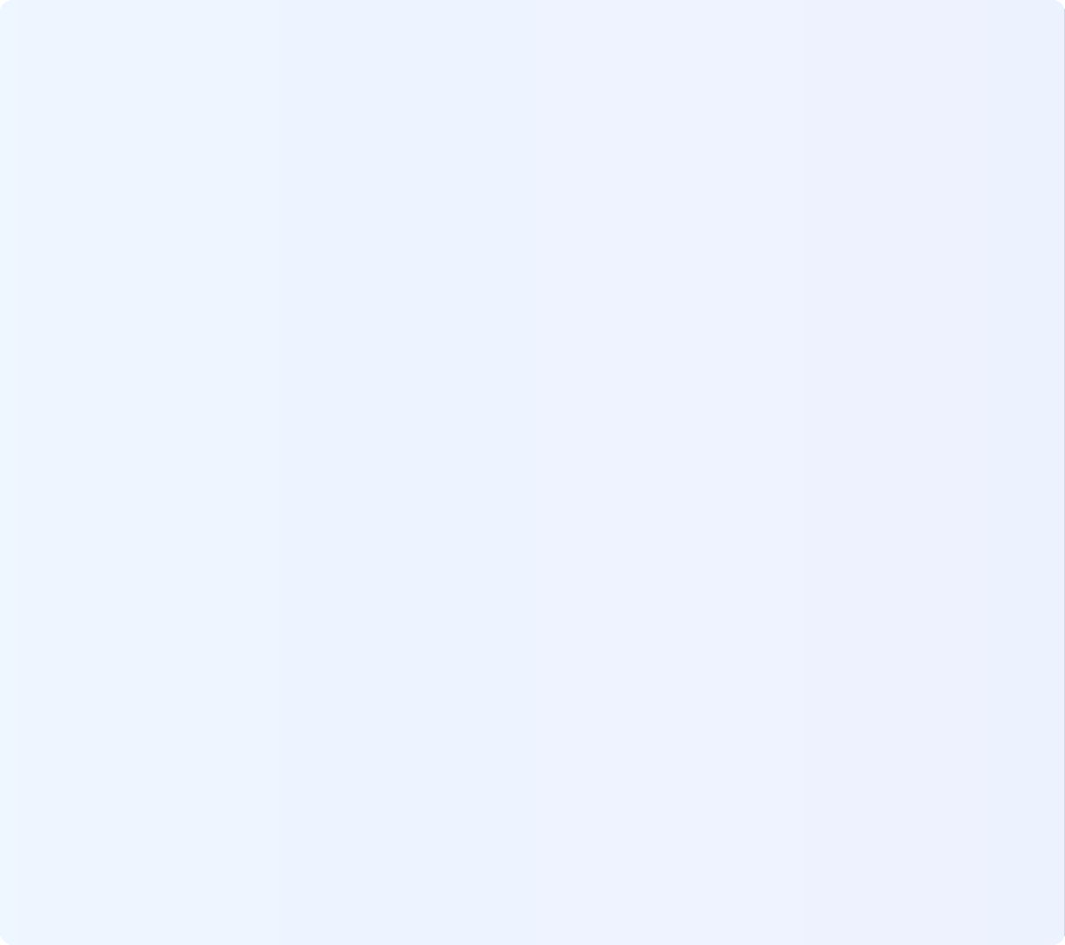




OnlineShop2025
Internal Mechanics (Part 1: Data Access & Services)
Data Models (model package) Data Access Logic
User.java Product.java
Model
Model
SQL queries currently embedded within controller methods
userId: int - productId: int
username: String - productName: String
email: String - category: String
fullName: String - price: double
address: String - imagePath: String
/ Example from DashboardController private void loadProductsFromDatabase() {
try (Connection conn = DBConnection.getInstance().getConnection()) { String sql = "SELECT * FROM products";
PreparedStatement pstmt = conn.prepareStatement(sql); ResultSet rs = pstmt.executeQuery();
+ getters/setters
while (rs.next()) { allProductsFromDB.add(new Product(
rs.getInt("product_id"), rs.getString("product_name"), rs.getString("category"), rs.getDouble("price"), rs.getString("image_path")
));
}
} catch (SQLException e) {
System.err.println("Error loading products: " + e.getMessage());
}
}
- phone: String
+ getters/setters
CartItem.java
Model
OrderSummary.java
Model
- product: Product
- orderId: int
- quantity: int
- date: LocalDateTime
+ getters/setters
+ getTotal(): double
- productId: int
quantity: int
totalPrice: double
+ getters/setters
Controller
DBConnection
MySQL
Made wit Genspark

Slide 12



OnlineShop2025
Internal Mechanics (Part 1: Data Access & Services)
Database Connection
Connect.DBConnection.java
Service-like Managers
Singleton
/ Singleton instance
private static Connection connection; private static DBConnection instance;
ShoppingCartManager.java Singleton
UserSession.java
Singleton
- cartItems: List<CartItem>
- loggedInUser: User
public static DBConnection getInstance() { if (instance = null) {
instance = new DBConnection();
}
return instance;
}
+ getInstance(): ShoppingCartManager
+ getInstance(): UserSession
+ setLoggedInUser(User): void
+ addProduct(Product): void
+ getLoggedInUser(): User
+ removeItem(int): void
+ clearSession(): void
+ updateQuantity(int, int): void
public Connection getConnection() throws SQLException { if (connection = null | connection.isClosed()) {
try { Class.forName("com.mysql.cj.jdbc.Driver"); connection = DriverManager.getConnection(
"jdbc:mysql: /localhost:3306/onlineshop", "username", "password");
} catch (ClassNotFoundException e) {
/ Handle exception
}
}
return connection;
}
Global access point for user info
+ getSubtotal(): double
+ getCartItems(): List<CartItem>
In-memory cart storage
Both managers use the Singleton pattern for application-wide access to a single instance
Made wit Genspark

Slide 13
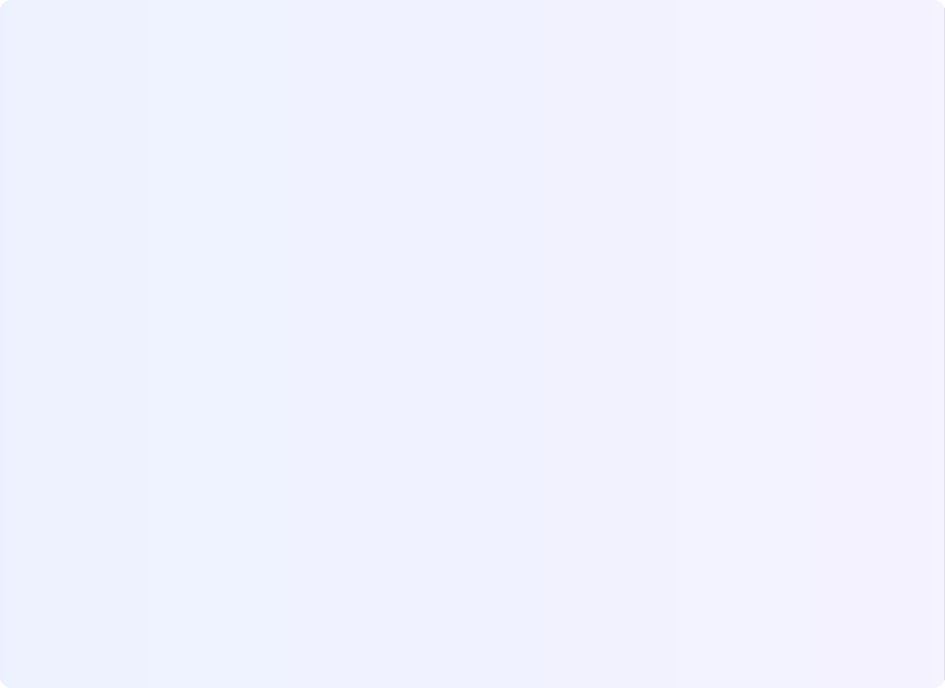









OnlineShop2025
Internal Mechanics (Part 2: UI Logic & Others)
FXML and Controllers
Product Display
Each screen has a corresponding controller class with @ FXML annotations
Dynamically creates VBox "cards" for each product
private VBox createProductCard(Product product)
Login.fxml
LoginController.java
{
/ Create main container VBox card = new VBox(5);
card.getStyleClass().add("product-card");
FXML with Event Handler
<Button text="Sign In" onAction="#handleLogin" >
Product Name
$99.99
/ Load image
ImageView imageView = new ImageView(); if (product.getImagePath() = null) {
loadImageInBackground(imageView, product.getImagePath());
Controller with @ FXML
Add to Cart
@FXML
private TextField usernameField;
Error Handling & User Feedback
@FXML
private void handleLogin() {
String username = usernameField.getText();
/ Authenticate user
}
Error Alert
Information Alert
Invalid credentials or operation failed
Successful operations & confirmations
private void showAlert(Alert.AlertType type, String title, String header, String content) {
Alert alert = new Alert(type); alert.setTitle(title); alert.setHeaderText(header); alert.setContentText(content); alert.showAndWait();
}
Console error logging:System.err.println( .)
Dynamic Content Loading
JavaFX FXML Loading
DashboardController uses FXMLLoader to load different views into its central ScrollPane
CSS Styling
private void loadContentView(String fxmlPath) { try {
Parent view = FXMLLoader.load( getClass().getResource(fxmlPath));
mainScrollPane.setContent(view);
} catch (IOException e) {
/ Error handling
}
}
ShoppingCart.fxml MyProfile.fxml
application.css
External CSS
.root {
-fx-font-family: 'Segoe UI';
-fx-background-color: #f8f9fa;
}
.button {
-fx-background-color: #3b82f6;
-fx-text-fill: white;
-fx-background-radius: 4px;
}
.product-card {
-fx-background-color: white;
-fx-padding: 10px;
-fx-effect: dropshadow(gaussian, #00000022, 5, 0, 0, 2);
}
Linked in FXML:<stylesheets><URL value="@application.css" > /stylesheets>
OrderHistory.fxml
OnlineShop2025 - Desktop E-commerce Application
Made with Genspark

Slide 14
OnlineShop2025
Internal Mechanics (Part 2: UI Logic & Others)
Dynamic Content Loading
JavaFX FXML Loading
DashboardController uses FXMLLoader to load different views into its central ScrollPane
CSS Styling
private void loadContentView(String fxmlPath) { try {
Parent view = FXMLLoader.load( getClass().getResource(fxmlPath));
mainScrollPane.setContent(view);
} catch (IOException e) {
/ Error handling
}
}
ShoppingCart.fxml MyProfile.fxml
application.css
External CSS
.root {
-fx-font-family: 'Segoe UI';
-fx-background-color: #f8f9fa;
}
.button {
-fx-background-color: #3b82f6;
-fx-text-fill: white;
-fx-background-radius: 4px;
}
.product-card {
-fx-background-color: white;
-fx-padding: 10px;
-fx-effect: dropshadow(gaussian, #00000022, 5, 0, 0, 2);
}
Linked in FXML:<stylesheets><URL value="@application.css" > /stylesheets>
OrderHistory.fxml
Made with Genspark

Slide 15














OnlineShop2025
Testing Environment & Scenarios
Key Test Scenarios
Login
Development Environment
Successful login with valid credentials Failed login with invalid username/password Login with empty fields
Operating System
Windows 11 Pro
IDE
Eclipse IDE
Dashboard & Product Display
JDK
Oracle JDK 22.0.2
JavaFX SDK
Version 22.0.1
Products load correctly Category navigation works
Featured products display Search functionality
Database
MySQL Server 8.0.x
DB Tool
MySQL Workbench
Shopping Cart
My Profile
Add product to cart Update item quantity Remove item from cart Clear entire cart
Correct user info displayed Username field is non-editable Update editable fields
Order History
Navigation & Logout
Correct order items displayed Needs user filtering
Navigation between screens Logout clears session

Slide 16



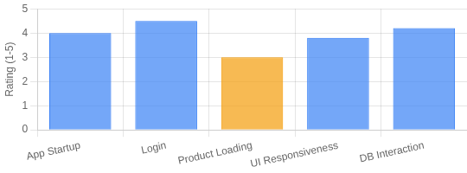
OnlineShop2025
Test Results & Performance Evaluation
Performance Evaluation
Test Results
Login
Successfully logs in valid users Displays appropriate error messages
Dashboard & Product Display
Products load correctly from database
Category and search filters function as expected Background banner loads correctly
Initial lag with large product sets
Performance Notes
Shopping Cart
Add/view/update/remove items Subtotal calculation accurate
My Profile
User info correctly displayed Updates saved to database
Application Startup
Reasonable
Login Time
Quick
Product Loading
Acceptable for small lists
Order History
Displays order items
Needs user-specific filtering
Navigation & Logout
Navigation functions correctly Logout clears session
Noticeable delay with large unfiltered lists
UI Responsiveness
Generally good
Except during initial mass product display
Database Interaction
Performs well
Simple queries work efficiently with current data size
Success
Area for improvement
Made with Genspark
OnlineShop2025 - Desktop E-commerce Application

Slide 17








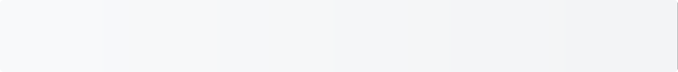






OnlineShop2025
Product Evaluation (Strengths)
Core E-commerce Functionality
Modern Desktop UI
Clear Architecture
Successfully implemented key features including user login, product browsing, cart management, and profile handling.
JavaFX with FXML and CSS provides a visually appealing and interactive user experience with consistent styling.
MVC-like separation of UI (FXML), UI logic (Controllers), and data (Models, DB) promotes maintainability.
Database Integration
Session Management
Dynamic Content Loading
Successful connection and CRUD operations with MySQL database for products and users data persistence.
UserSession singleton provides effective management of logged-in user state across different views.
Dashboard effectively loads different views (Profile, Cart, Orders) into a central content area.
Reusable Components
Product card generation method provides a modular approach to display products consistently.
Key Strengths Summary
Modular
Visually Appealing
Well Structured
Data Persistent
Maintainable

Slide 18










OnlineShop2025
Product Evaluation (Limitations)
Performance Issues Security Concerns
Incomplete Features
No Admin Panel
FlowPane-based product display lags significantly with large product lists without pagination or virtualization.
Login currently uses placeholder password comparison; lacks real-world hashing (bcrypt, etc.).
Checkout process, user registration, advanced search/filtering, and product detail view are not fully developed.
Lacks features for administrators to manage products, users, and orders directly through the application.
Error Handling
No Automated Testing
Image Management
Data Validation
While basic alerts are present, more comprehensive and user-friendly error handling and logging is needed.
Lack of unit or integration tests makes refactoring risky and quality assurance more manual and time- consuming.
Product images rely on simple local paths; a more robust system for managing product images is needed.
Input validation (email format, phone number format, password strength) is minimal and could be improved.
Impact Assessment
Critical Limitations
Security Performance
Medium Impact
No Testing
Error Handling
Risk Analysis
These limitations are typical for an academic project at this stage and provide clear paths for future development. Security and performance should be prioritized in subsequent versions.

Slide 19






OnlineShop2025
Conclusion
OnlineShop2025 successfully demonstrates the development of a desktop e-commerce application prototype using Java, JavaFX, and MySQL. Core functionalities for user interaction, product display, and basic data management have been implemented, showcasing key OOP principles and GUI design techniques. The project serves as a solid foundation for a more feature-rich e- commerce platform.
Key Achievements
User Authentication & Session
Functional login system with session management across views
Dynamic Product Display
Category-based browsing with search functionality
Shopping Cart Operations
Complete cart functionality with add, remove, update, and total calculation
Layered Architecture
MVC-like structure with clean separation of concerns
Project Status
Foundation for Future Development
Core Features
85%
Identified limitations provide clear directions for future improvements in performance, security, and feature completeness.
Security
45%
Architecture
90%

Slide 20





OnlineShop2025
Future Development
Development Roadmap
Phase 1: Core Improvements
Phase 2: Extension
Phase 3: Quality & Polish
Performance Optimization
Implement robust pagination for product listings and explore GridView from ControlsFX for better virtualization techniques.
High
Med
Automated Testing
Introduce unit tests (JUnit) for business logic and data access layers to improve code reliability.
Med
Admin Module
Create an administrative interface for managing products, categories, users, and orders with proper access controls.
Enhanced Security
Implement strong password hashing (e.g., bcrypt) for user registration and login authentication.
High
Database Refinement
Restructure orders table into main_orders and order_items for better representation. Implement proper user_id foreign key.
Advanced Features
Implement advanced search and filtering options Add product reviews and ratings system
Wishlist functionality for saved products Payment gateway integration (simulation)
Med
Complete Core Features
Real Product Images
Fully develop the checkout process, implement comprehensive product detail view, and build user registration functionality.
Improved UI/UX
Refine CSS, add subtle animations, and improve overall user experience based on user testing and feedback.
Integrate a system for associating actual images with products and storing them efficiently.
Implementation Timeline
Phase 1: Q3 2025
Phase 2: Q4 2025
Phase 3: Q1 2026
Priority features within each phase will be implemented first

Slide 21

OnlineShop2025
Conclusion
So we have heard what I said about my app. Since this is our first time working on it, it seems quite basic, but because of that, we have learned wonderful things and continue to develop it. Thank you all and the teachers for listening to my presentation; this is the end. (If you want to learn more, you can refer to the Eclipse file as well as the Word file.)
Thank you for accompanying NS SHOP.
We promise to provide a better experience in the future.

