Slide 2
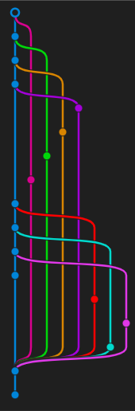
GIT
The gold standard of version control
Valentin Langegger, Elias Leonhardsberger
22.06.2024
Technical English
FH Hagenberg

Slide 3
Version Control – Why?
Code conflicts
Lack of history
Data loss

Slide 4
Git – The Beginning
Linux kernel-team used BitKeeper
BitKeeper revoked free license in 2005
Linus Torvalds decided to take matter into his own hand

Slide 5
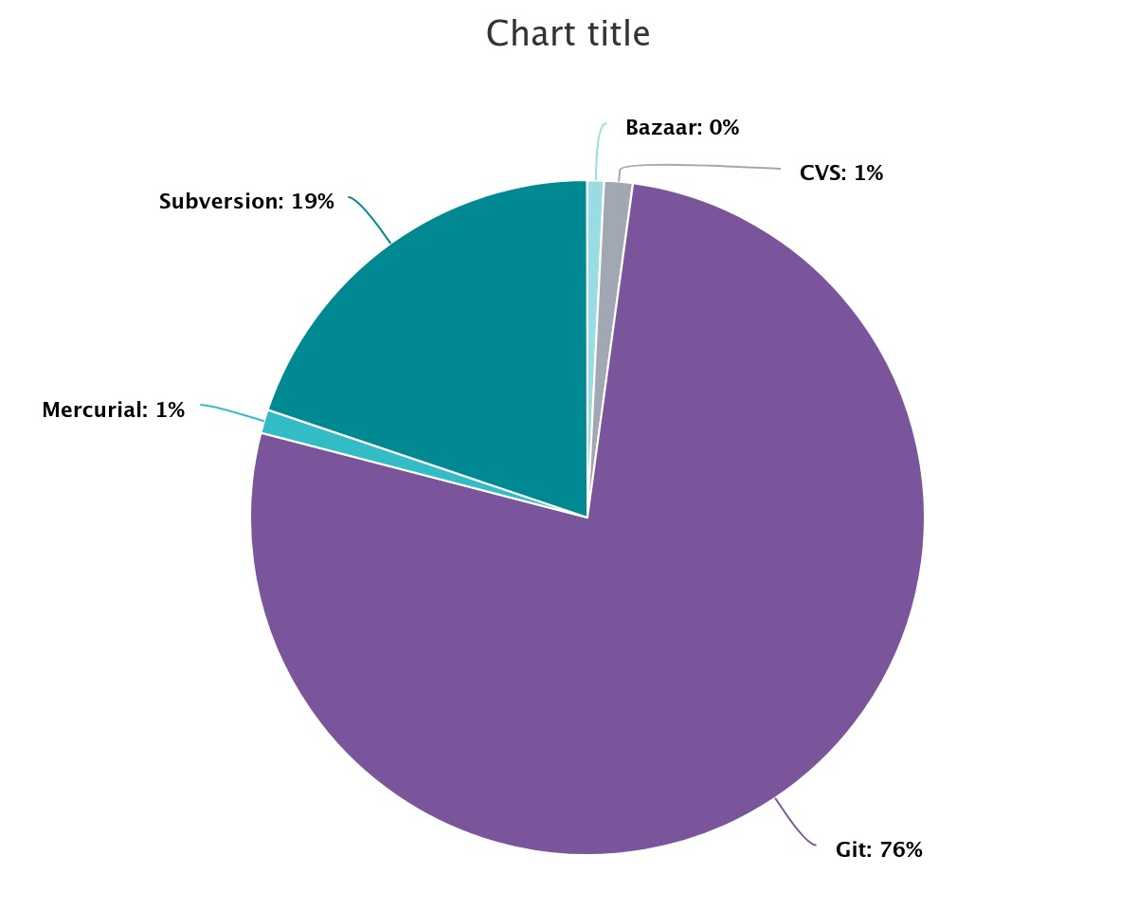
Git – Domination(In Open Source)
https://openhub.net/repositories/compare

Slide 6
Git – Use Cases
Version Control
Branching and merging
CI/CD
Code Reviews

Slide 7
Git – Version Control
Track changes
Rollback changes
Multiple devs working on same codebase

Slide 8

Git – Branches and Merging
Developing features
Fixing bugs
Experimenting
All done in different branches
Merged together later on

Slide 9
Git – CI/CD
Automation of:
Building
Testing
Pushing to server
Etc.

Slide 10
Git – Code Review
Manager reviews your PR before merging into main

Slide 11
GitHub
Founded 2007, sold to Microsoft in 2018
Over 100 Million users (Jan. 2023)
All repos up until 2020 stored in Arctic World Archive
100 Million Repositories -> 21 Terabyte

Slide 12
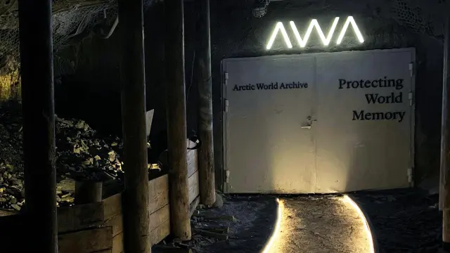
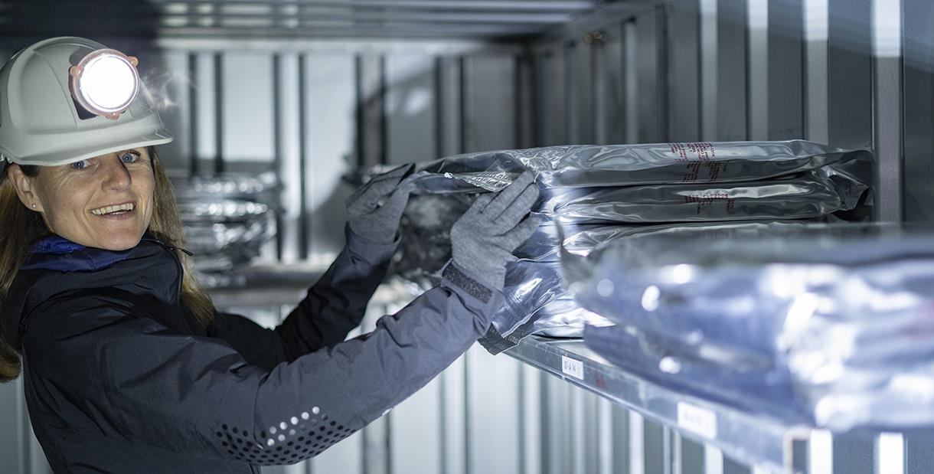
Arctic World Archive
Facility for data preservation
~200 meters beneath the surface
In an abandoned coal mine
Store data for up to 1000 years

Slide 13
GitLab
Founded in 2011
Started as open-source project
~30 Million users
Offers complete package from planning to monitoring
CI/CD deeply integrated

Slide 14
Concepts
Repository
The scope of a git environment, contains all files managed by git.
Commit
A snapshot of your repository. Records the changes to a repository.
Remote
A common repository for your team. Hosted on a central server (for example GitHub).
https://git-scm.com
https://training.github.com/downloads/github-git-cheat-sheet.pdf

Slide 15
Concepts
Fetch
Downloads commits from a remote.
Pull
Applies commits form a remote.
Push
Applies local changes on the remote.
https://git-scm.com

Slide 16
Branching
Problem:
How to unify all changes
Answer =>
https://git-scm.com

Slide 17
Merging
Joining change histories together

Slide 18

Fast Forward Merge
Changes get added at the end of the main branch
+
Easiest merge
Clean history
-
Not always possible
https://www.atlassian.com/de/git

Slide 19
Merge
Changes get added in a merge commit, preserving the branch
+
Full history
No lost commits
-
Cluttered history
Extra merge commit
https://www.atlassian.com/de/git

Slide 20

Rebase
Changes get added as NEW commits
+
Clean history
Interactive rebase possible
-
Rewrites history
Complex
Never rebase shared branches!!!
https://www.atlassian.com/de/git

Slide 21

Squash Commit and Rebase
Changes get added at the end of the main branch, as a single commit
+
Clean history
-
Rewrites history
Commits get compressed
Never rebase shared branches!!!
https://www.atlassian.com/de/git

Slide 22

Semi-linear Merge
Changes get added at the end of the main branch
+
Cleaner history than merge
No list commits
-
Rewrites history
Extra merge commit
https://www.atlassian.com/de/git

Slide 23
Live Demo
Using Git in Visual Studio

Slide 24
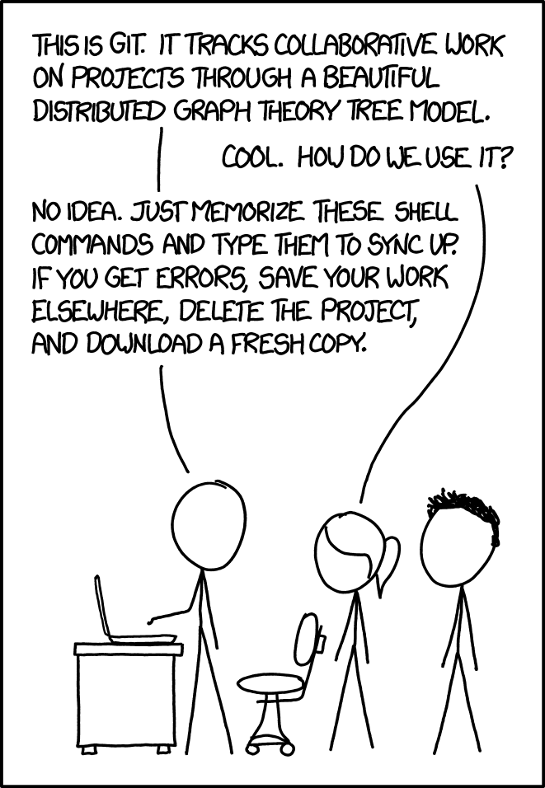
Sources
https://en.wikipedia.org/wiki/GitLab
https://en.wikipedia.org/wiki/GitHub
https://git-scm.com
https://training.github.com/downloads/github-git-cheat-sheet.pdf
https://www.atlassian.com/de/git
https://openhub.net/repositories/compare
https://xkcd.com/1597/

