Slide 2
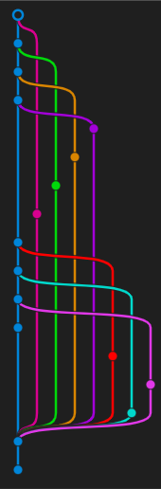
GIT
The gold standard of version control
Valentin Langegger, Elias Leonhardsberger
22.06.2024
Technical English
FH Hagenberg

Slide 3
Concepts
Repository
The scope of a git environment, contains all files managed by git.
Commit
A snapshot of your repository. Records the changes to a repository.
Remote
A common repository for your team. Hosted on a central server (for example GitHub).
https://git-scm.com
https://training.github.com/downloads/github-git-cheat-sheet.pdf

Slide 4
Concepts
Fetch
Downloads commits from a remote.
Pull
Applies commits form a remote.
Push
Applies local changes on the remote.
https://git-scm.com

Slide 5
Branching
Allows parallel versions
Example:
Feature Branches
Problem:
How to unify all changes
Answer =>
https://git-scm.com

Slide 6
Merging
Joining change histories together

Slide 7

Fast Forward Merge
Changes get added at the end of the main branch
+
Easiest merge
Clean history
-
Not always possible
https://www.atlassian.com/de/git

Slide 8

Merge
Changes get added in a merge commit, preserving the branch
+
Full history
No lost commits
-
Cluttered history
Extra merge commit
https://www.atlassian.com/de/git

Slide 9

Rebase
Changes get added as NEW commits
+
Clean history
Interactive rebase possible
-
Rewrites history
Complex
Never rebase shared branches!!!
https://www.atlassian.com/de/git

Slide 10

Squash Commit and Rebase
Changes get added at the end of the main branch, as a single commit
+
Clean history
-
Rewrites history
Commits get compressed
Never rebase shared branches!!!
https://www.atlassian.com/de/git

Slide 11

Semi-linear Merge
Changes get added at the end of the main branch
+
Cleaner history than merge
No list commits
-
Rewrites history
Extra merge commit
https://www.atlassian.com/de/git

Slide 12
Quellen
https://git-scm.com
https://training.github.com/downloads/github-git-cheat-sheet.pdf
https://www.atlassian.com/de/git

