Slide 1
Noch gar nicht gespielt
Level 1-1
Level 1-3
Level 1-2
Level 1-4
Level 1-5
Nur bis 1-2 geschafft
Level 1-1
Level 1-3
Level 1-2
Level 1-4
Level 1-5
Level 1 abgeschlossen
Level 1-1
Level 1-3
Level 1-2
Level 1-4
Level 1-5
Mittlere Schwierigkeit
Level 1-1
Level 1-3
Level 1-2
Level 1-4
Level 1-5
Schwere Schwierigkeit
Level 1-1
Level 1-3
Level 1-2
Level 1-4
Level 1-5
Schwere Schwierigkeit abgeschlossen
Level 1-1
Level 1-3
Level 1-2
Level 1-4
Level 1-5

Slide 2
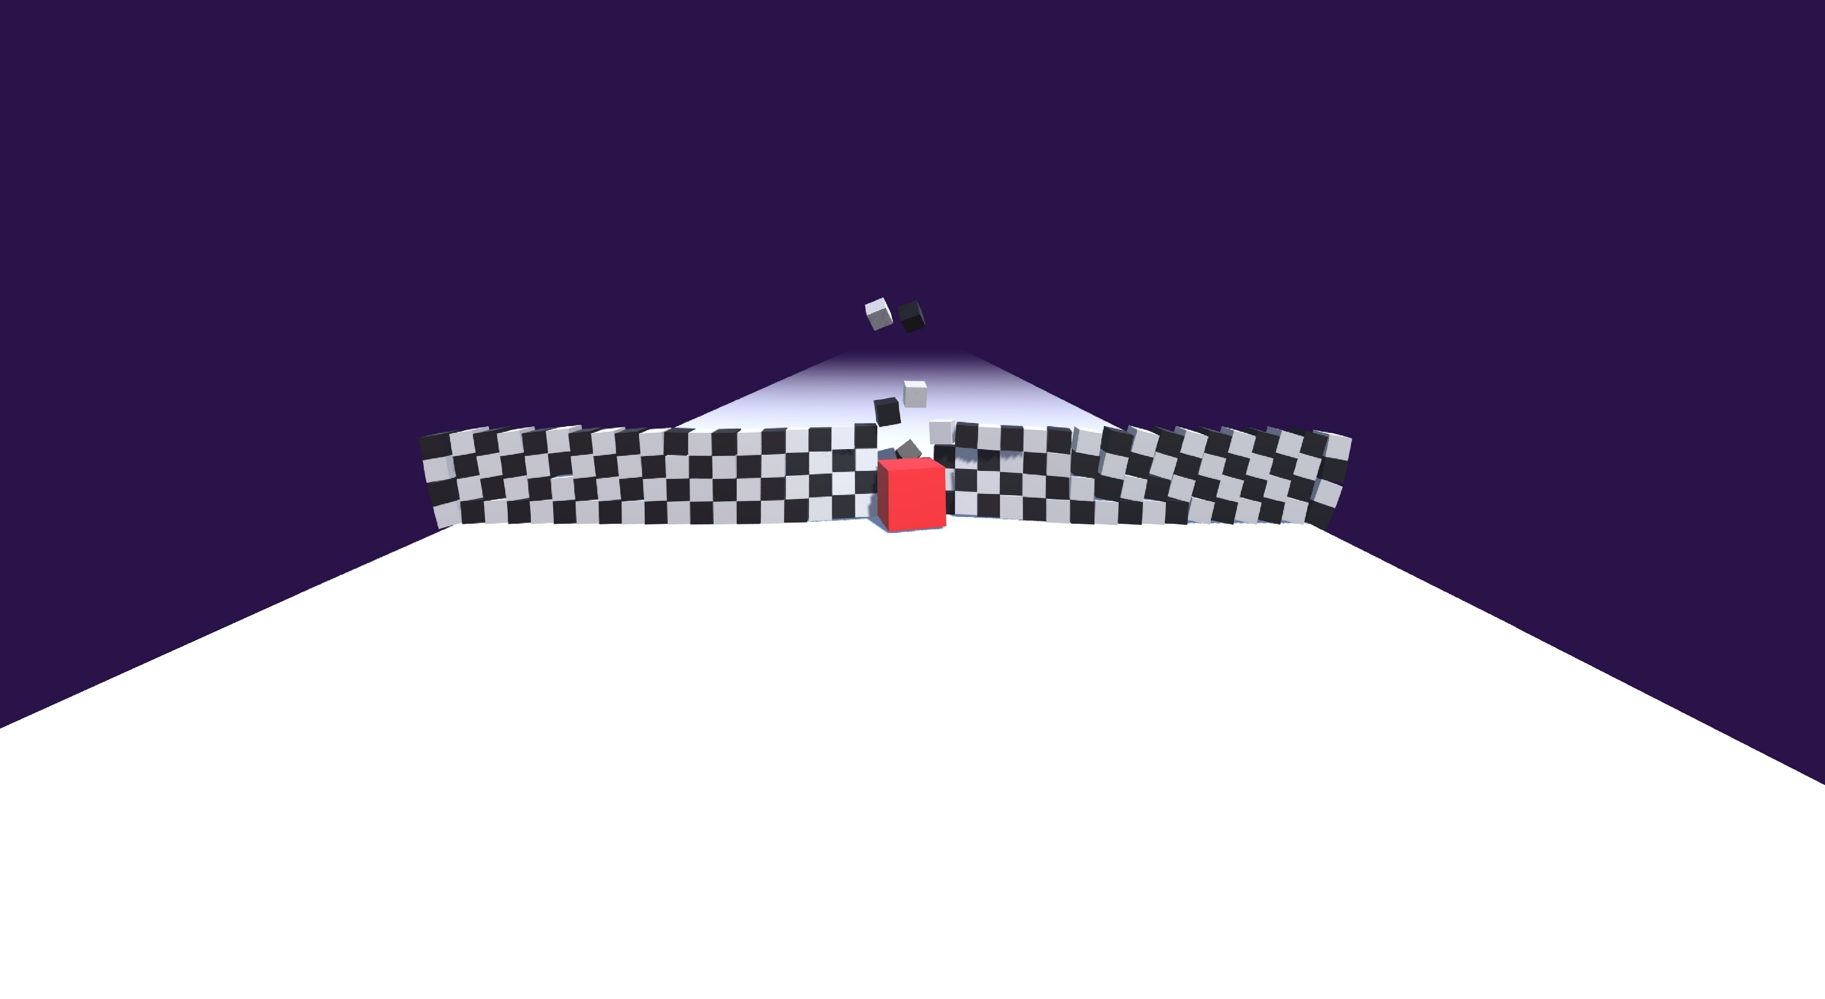
Some boring start level
Wohoo, a power up
…?
Level 1-1
Level 1-3
Level 1-2
Level 1-4
Level 1-5
Level 1-1
Level 1-3
Level 1-2
Level 1-4
Level 1-5
Level 1-1
Level 1-3
Level 1-2
Level 1-4
Level 1-5

Slide 3


Some boring start level
Wohoo, a power up
…?
Level 1-1
Level 1-3
Level 1-2
Level 1-4
Level 1-5
Level 2-1
Level 2-3
Level 2-2
Level 2-4
Level 2-5
Level 3-1
Level 1-3
Level 1-2
Level 1-4
Level 1-5

Slide 4

Some boring start level
Wohoo, a power up
…?
Level 1-1
Level 1-3
Level 1-2
Level 1-4
Level 1-5
Level 1-1
Level 1-3
Level 1-2
Level 1-4
Level 1-5
Level 1-1
Level 1-3
Level 1-2
Level 1-4
Level 1-5

Slide 5
Some boring start level
Wohoo, a power up
…?
Level 1-1
Level 1-3
Level 1-2
Level 1-4
Level 1-5
Level 1-1
Level 1-3
Level 1-2
Level 1-4
Level 1-5
Level 1-1
Level 1-3
Level 1-2
Level 1-4
Level 1-5

Slide 6
Some boring start level
Wohoo, a power up
…?
Easy
Level 1-1
Level 1-3
Level 1-2
Level 1-4
Level 1-5
Level 2-1
Level 1-3
Level 1-2
Level 1-4
Level 1-5
Level 3-1
Level 1-3
Level 1-2
Level 1-4
Level 1-5

Slide 7
Some boring start level
Wohoo, a power up
…?
Easy
Medium
Difficult
Level 1-1
Level 1-3
Level 1-2
Level 1-4
Level 1-5
Level 2-1
Level 1-3
Level 1-2
Level 1-4
Level 1-5
Level 3-1
Level 1-3
Level 1-2
Level 1-4
Level 1-5

Slide 8
Some boring start level
Wohoo, a power up
…?
Easy
Medium
Difficult
Level 1-1
Level 1-3
Level 1-2
Level 1-4
Level 1-5
Level 2-1
Level 1-3
Level 1-2
Level 1-4
Level 1-5
Level 3-1
Level 1-3
Level 1-2
Level 1-4
Level 1-5

Slide 9
Some boring start level
Wohoo, a power up
…?
Easy
Medium
Difficult
Level 1-1
Level 1-3
Level 1-2
Level 1-4
Level 1-5
Level 2-1
Level 1-3
Level 1-2
Level 1-4
Level 1-5
Level 3-1
Level 1-3
Level 1-2
Level 1-4
Level 1-5

Slide 10
Some boring start level
Wohoo, a power up
…?
Easy
Medium
Difficult
Level 1-1
Level 1-1
Level 1-1
Level 1-1
Level 1-1
Level 2-1
Level 1-3
Level 1-2
Level 1-4
Level 1-5
Level 3-1
Level 1-3
Level 1-2
Level 1-4
Level 1-5

Slide 11
Maps
Some boring start level
Wohoo, a power up
…?
Difficulty
Easy
Medium
Hard
Level 1-1
Level 1-4
Level 1-5
Level 3-1
Level 1-3
Level 1-2
Level 1-4
Level 1-5

Slide 12
Maps
Some boring start level
Wohoo, a power up
…?
Difficulty
Easy
Medium
Hard
Level 1-1
Level 1-1
Level 1-1
Level 1-1
Level 1-1
Level 2-1
Level 1-3
Level 1-2
Level 1-4
Level 1-5
Level 3-1
Level 1-3
Level 1-2
Level 1-4
Level 1-5

Slide 13
Maps
Some boring start level
Wohoo, a power up
…?
Difficulty
Easy
Medium
Hard
Level 1-1
Level 1-1
Level 1-1
Level 1-1
Level 1-1
Level 2-1
Level 1-3
Level 1-2
Level 1-4
Level 3-1
Level 1-3
Level 1-2
Level 1-4

Slide 14



Slide 15
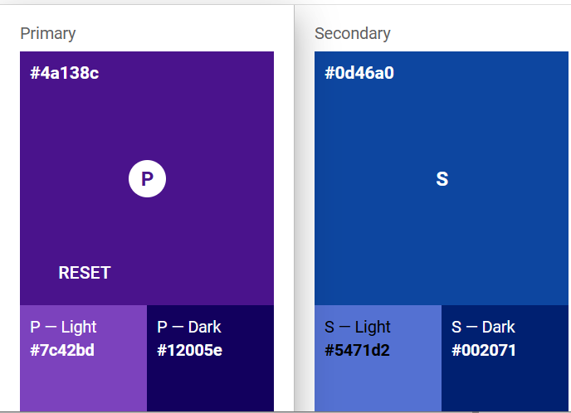
Some boring start level

