Slide 1

Alpha-Tech
Demo 3 Presentation

Slide 2
Team members and Roles
Xolo K Dandashe – Team leader
Thabo Ntsoane – Developer
Khodani M Mufamadi – Developer
Mpho Mashaba - Developer
Phuti K Setoba - Documentation
Musa Mathe – All-rounder

Slide 3
Project description
Our project is focused on building a mobile application that uses NFC to transfer information with a single tap from the business card which has a NFC chip and store the information on the user’s device. For devices that do not have NFC technology, we will be using a QR code generator and scanner for them to also be able to send or receive business cards. Our system will also be able to scan cards that do not have NFC chips on them.

Slide 4
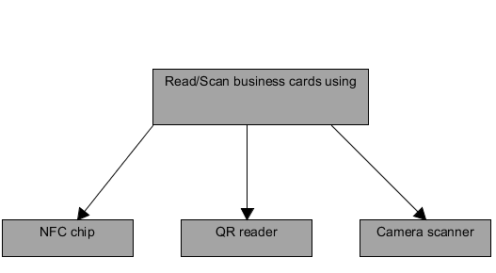
Diagram shows 3 different ways to capture business cards in simple form

Slide 5
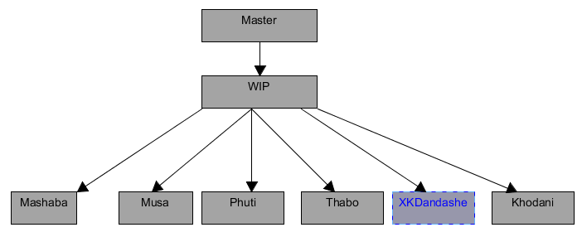
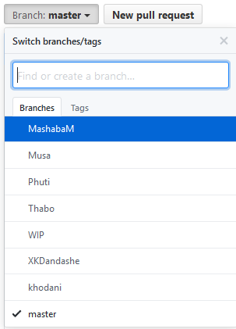
Git (Branching)

Slide 6
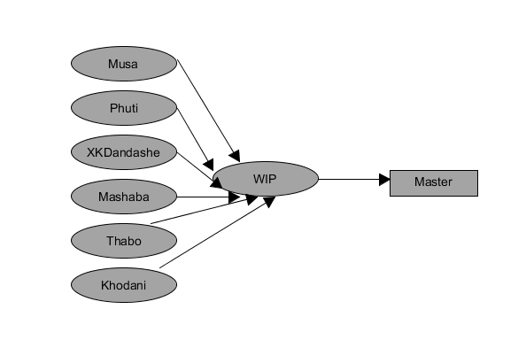
Merging

Slide 7
To ensure code quality
Android Studio code style will be used.
Coding standard document will be used for resources naming conventions, formatting and also to ensure version control.
Testing will be conducted using JUnit to run unit tests.
Lint tool will be used to identify bugs.
FindBugs tool will be used to spot issues related to performance and correctness of code.

