Slide 1
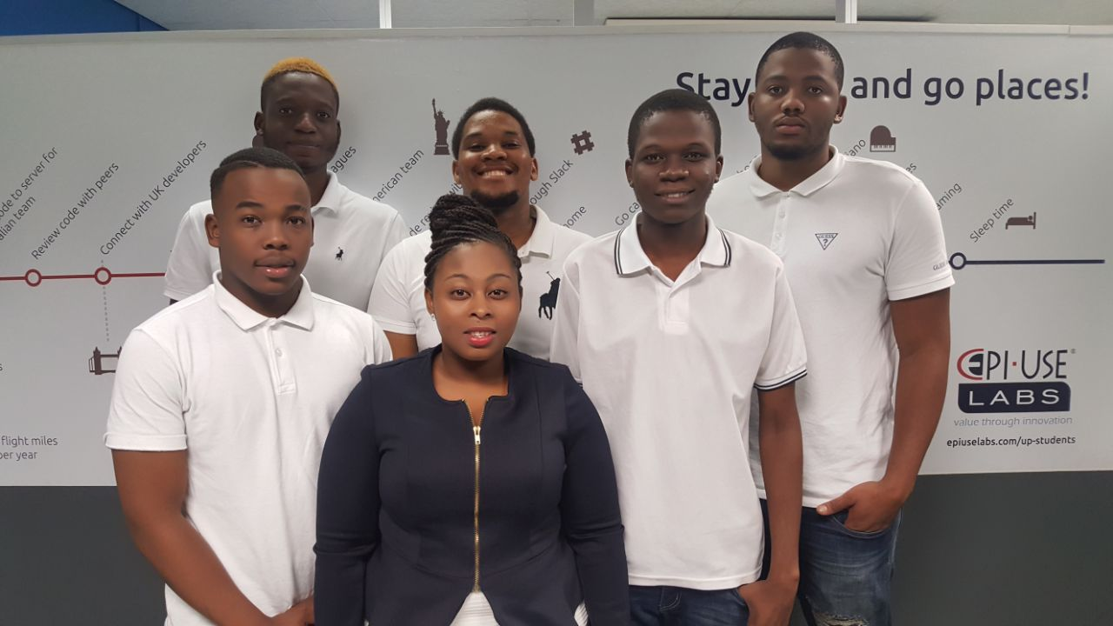

About the team:
Collaboration and synergy.
Passion and Creativity.
Enthusiasm.
Follow-through.
We believe:
“If everyone is moving forward together then success takes care of itself.”

Slide 2
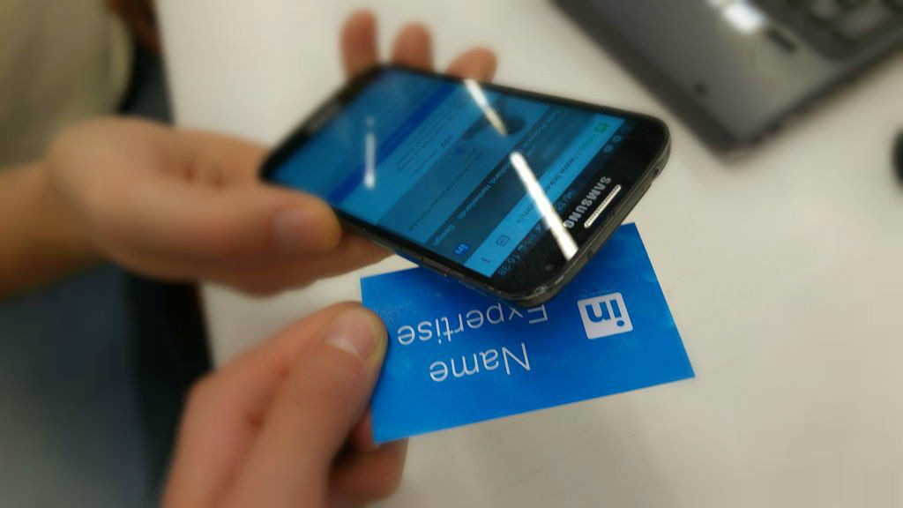
Project description
Our project is focused on building a mobile application that uses NFC to transfer information with a single tap from the business card which has a NFC chip and store the information on the user’s device .

Slide 3
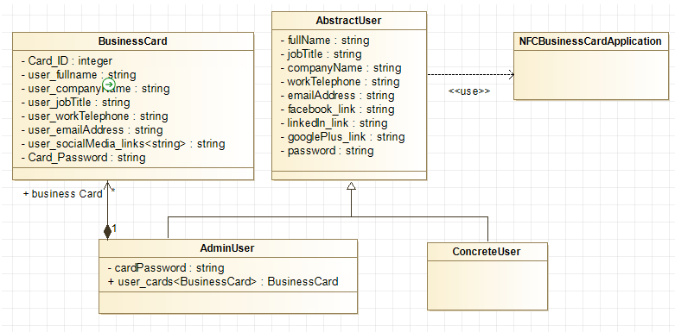
Domain Model

Slide 4






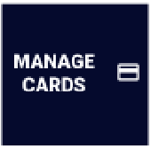
Requirements and design outline
Our application is to be used on mobile devices.
Our System allows digital information exchange.
Our system allows effective updates of information on the business cards.
It must be secure.
It must be user friendly.
A window with an arrow to the right – Button used to log in
Dustbin – Represents delete information from card option
Card image – Represents viewing a cards option
Files – Represents reading information on cards option.
Pencil – Represents an update option

Slide 5
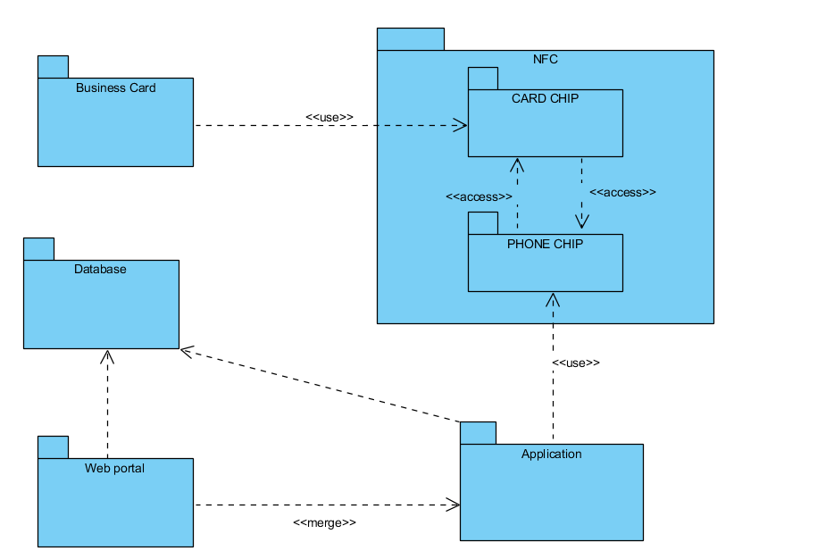
Package Diagram

Slide 6
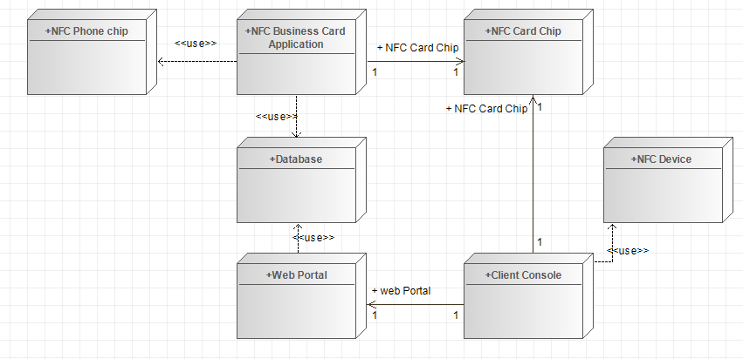
Deployment Diagram

Slide 7
References
Joep1986. 2015. Digital-Business-Card-With-NFC. [ONLINE] Available at: http://www.instructables.com/id/Digital-Business-Card-With-NFC/. [Accessed 10 March 2018].

