Slide 1
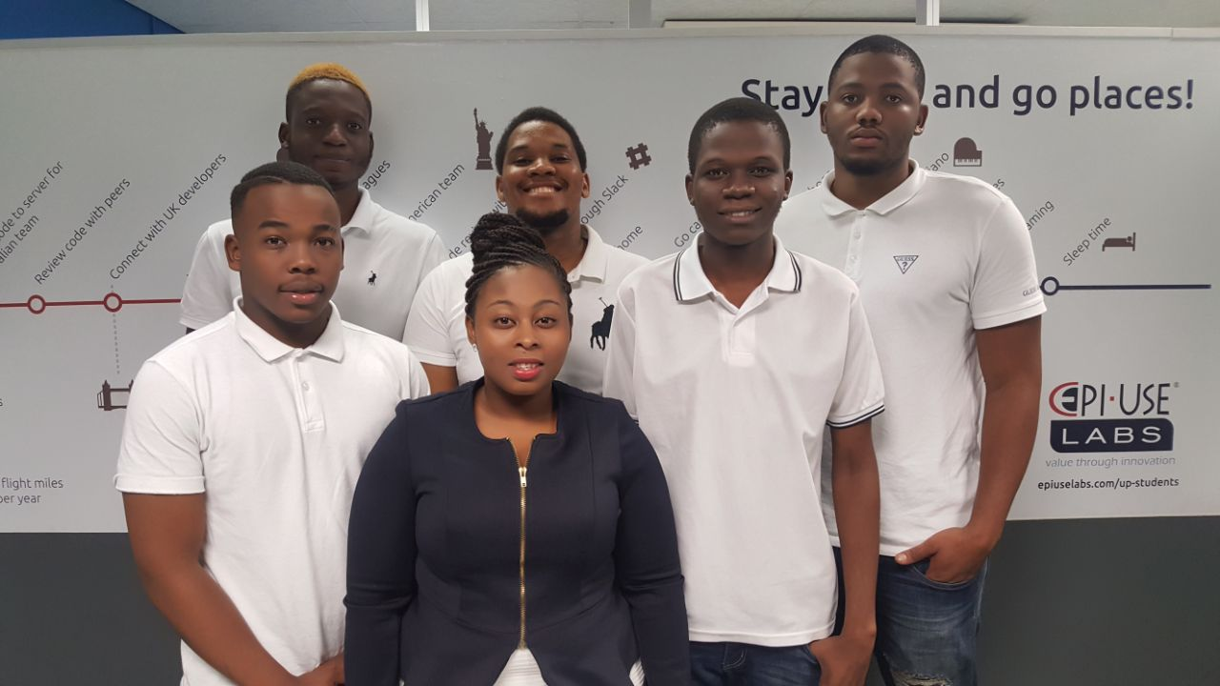

About the team:
Collaboration and synergy.
Passion and Creativity.
Enthusiasm.
Follow-through.
We believe:
“If everyone is moving forward together then success takes care of itself.”

Slide 2
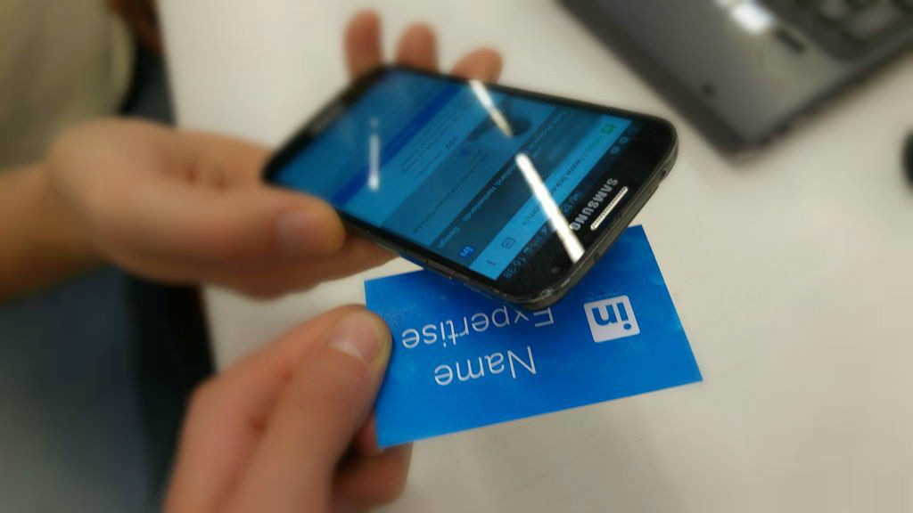
Project description
Our project is focused on building a mobile application that uses NFC to transfer information with a single tap from the business card which has a NFC chip and store the information on the user’s device .

Slide 3
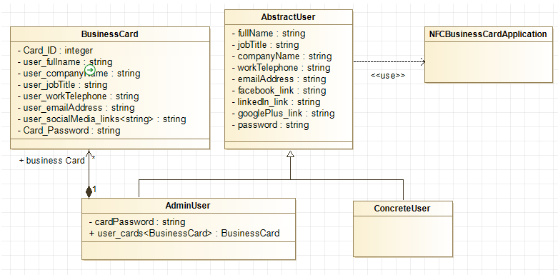
Domain Model

Slide 4






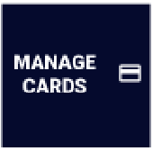
Requirements and design outline
Our application is to be used on mobile devices.
Our System allows digital information exchange.
s
Our system allows effective updates of information on the business cards.
It must be secure.
It must be user friendly.
A window with an arrow to the right – Button used to log in
Dustbin – Represents delete information from card option
Card image – Represents viewing a cards option
Files – Represents reading information on cards option.
Pencil – Represents an update option

Slide 5
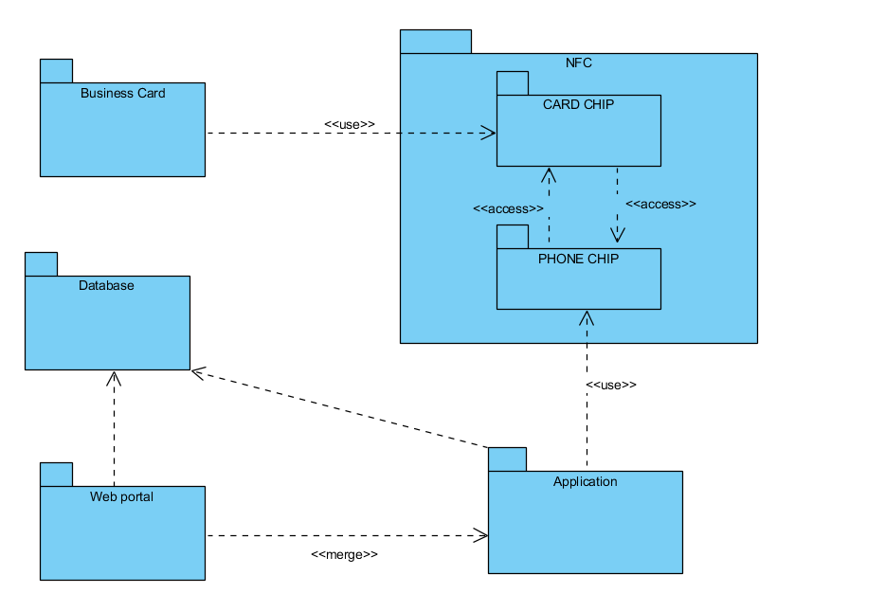
Package Diagram

Slide 6
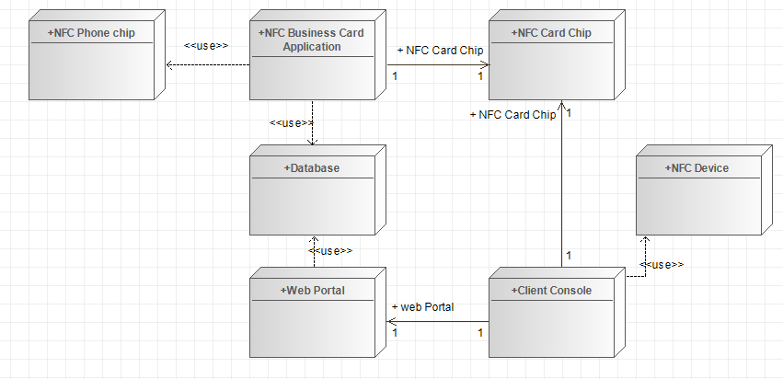
Deployment Diagram

Slide 7
References
Joep1986. 2015. Digital-Business-Card-With-NFC. [ONLINE] Available at: http://www.instructables.com/id/Digital-Business-Card-With-NFC/. [Accessed 10 March 2018].

