Slide 1
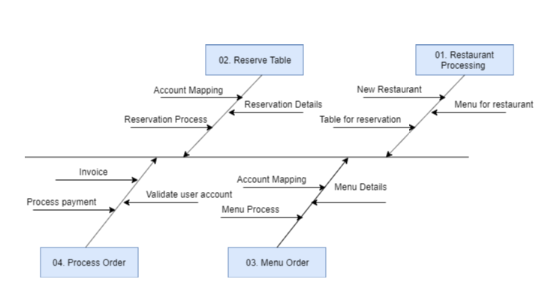
Fishbone Diagram Super Servoli Systems

