Slide 1


Project AWT: Adaptive Learning Analytics Dashboard Milestone 1
Merlin Schumann | Cecilie Viktoria Kudlek | Emilia Teresa Stepien | 7 November 2024

Slide 2



Group Members
Cecilie
Course of study: Information Systems Management M.Sc.
Merlin
Course of study:
Computer Engineering M.Sc.
Emilia
Course of study:
Information Systems Management M.Sc.

Slide 3
Outline
Problem Statement
Data Analysis
xAPI Profiles Data
Course Data
Concept for Generating Synthetic User’s Interaction Data
Approach
Personas
Data Requirements
Roadmap

Slide 4
1. Problem Statement
The Challenge
Our Solution
In today's digital education, stakeholders lack real-time insights into:
Learning progress
Individual knowledge levels
Specific learning needs
Development of a Learning Analytics Dashboard:
Generating synthetic user’s interaction data
Consolidating key metrics and indicators
Utilizing xAPI and LOM standards
Transforming raw data into actionable insights

Slide 5
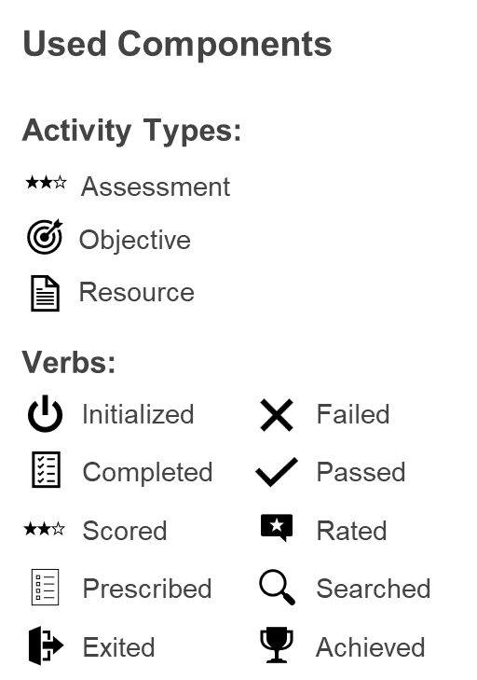
2. Data Analysis
2.1 xAPI Profiles Data:
Target Scores
Performance Tracking
Self & External Assessments
Statement Templates
Resource Initialization
Completion & Achievement
Activity Monitoring
Pass/Fail Status
Activity Rating
Search Actions

Slide 6
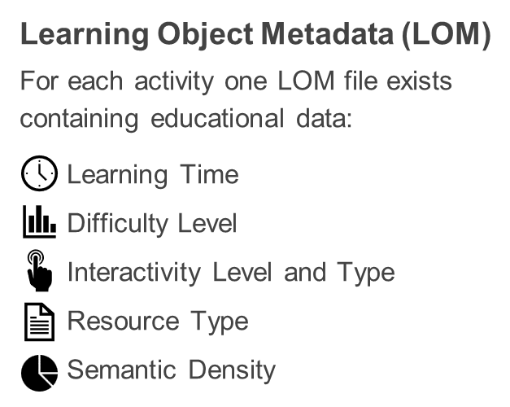
2. Data Analysis
2.2 Course’s Data:
Baumchirurg/-in
Grundlagen der Baumpflege
Grundlagen der Instandhaltung
Grundlagen des Kletterns
8 Activities
3 Activities
4 Activities

Slide 7

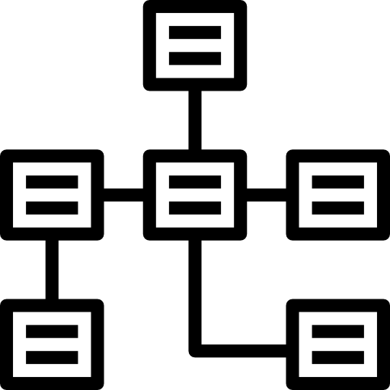



3. Concept for Generating Synthetic User Data
3.1 Approach: Script for Data Generation
adheres to xAPI schema (Statement Templates)
follows determined
data requirements
based on learner personas
constrained randomization

Slide 8
3. Concept for Generating Synthetic User Data
3.2 Personas:
Learner Profile | Description | % | Consistency | Effort | Scores | Duration
Strugglers | very low prior knowledge, puts in low effort and has an average pace of learning | 30 | average | low | very low | average
Average Students | average in all characteristics | 39 | average | average | average | average
Sprinters | average prior knowledge, low consistency in learning and low effort, but have a high pace | 8 | very low | very low | low | short
Gritty | average prior knowledge, high consistency and high effort, but work at a slow and steady pace | 10 | high | very high | very high | long
Coasters | very high prior knowledge, however, they have average pace and consistency, and put in low effort | 13 | average | low | average | average
[1] S. Mojarad, A. Essa, S. Mojarad, and R. S. Baker, "Data-driven learner profiling based on clustering student behaviors: learning consistency, pace and effort," in Proc. Int. Conf. Intell. Tutoring Syst., Springer, 2018, pp. 130–139.

Slide 9
3. Concept for Generating Synthetic User Data
3.2 Personas:
Outliers:
Outlier A - initially high consistency, high effort and high scores, but behavior changes: does not complete last assignments
Outlier B - low effort, loses consistency over time, but achieves average scores
Outlier C - frenetic activity: extremely high effort and very high consistency, average to high scores
Outlier D - very high consistency, high effort, excellent scores
[2] C. Treuillier and A. Boyer, "A new way to characterize learning datasets," in Proc. 14th Int. Conf. Comput. Supported Educ., SCITEPRESS-Science and Technology Publications, Apr. 2022, pp. 35-44.

Slide 10
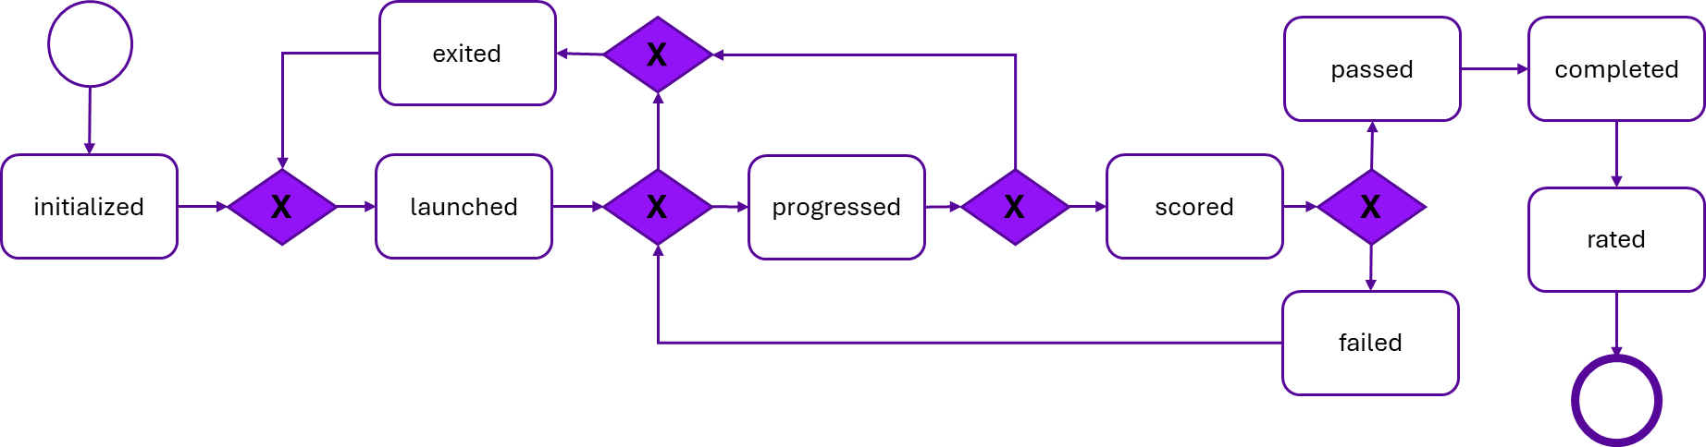
3. Concept for Generating Synthetic User Data
3.3 Data Requirements
Realistic timestamps that take times of day and the logical sequence of events into account
Defined minimum duration required to complete progress in a learning module
Defined maximum duration for a learning session
Score ∈ [0, n], with n ∈ ℕ
Minimum passing score >0

Slide 11
4. Roadmap
Milestone 1
07.11.2024
Milestone 2
19.12.2024
Milestone 3
13.02.2025
Final Submission
28.02.2025
Project Planning
Data Structure Analysis
Persona Definition
Synthetic Data Requirements Specification
Generation of Synthetic User Interaction Data
Selection of Key Stakeholders
Identification of Relevant Metrics and Indicators for Stakeholders
Development of Learning Analytics Dashboards
Creation of Services for Actionable Recommendations
Preparation of Preliminary Documentation
Finalization of Development
Completion of Final Documentation
Generation of Synthetic User Interaction Data
Selection of Key Stakeholders
Identification of Relevant Metrics and Indicators for Stakeholders

Slide 12
Thank You!

