Slide 1


Project AWT: Adaptive Learning Analytics Dashboard Milestone 2
Merlin Schumann | Cecilie Viktoria Kudlek | Emilia Teresa Stepien | 19 December 2024

Slide 2



Group Members
Cecilie
Course of study: Information Systems Management M.Sc.
Merlin
Course of study:
Computer Engineering M.Sc.
Emilia
Course of study:
Information Systems Management M.Sc.

Slide 3
Outline
Wrap-Up: Problem Statement
Generating Synthetic User’s Interaction Data
Components and Process
Results
Metrics and Indicators
Learner
Educator
Media Content Creator
Next Steps

Slide 4
1. Wrap-Up: Problem Statement
The Challenge
Our Solution
In today's digital education, stakeholders lack real-time insights into:
Learning progress
Individual knowledge levels
Specific learning needs
Development of a Learning Analytics Dashboard:
Generating synthetic user’s interaction data
Consolidating key metrics and indicators
Utilizing xAPI and LOM standards
Transforming raw data into actionable insights

Slide 5
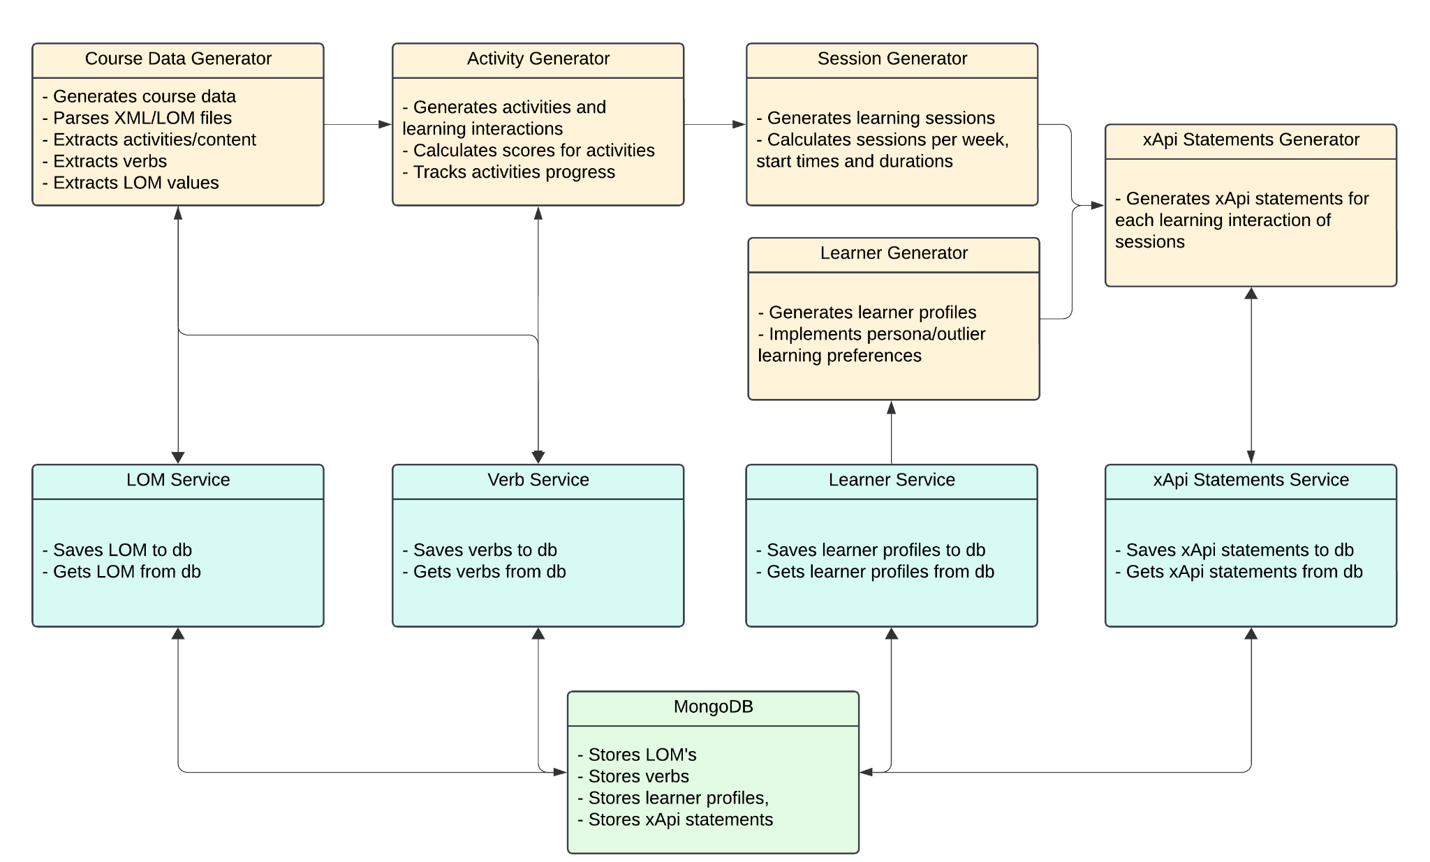
2. xApi Statement Generation
2.1 Components and Process

Slide 6
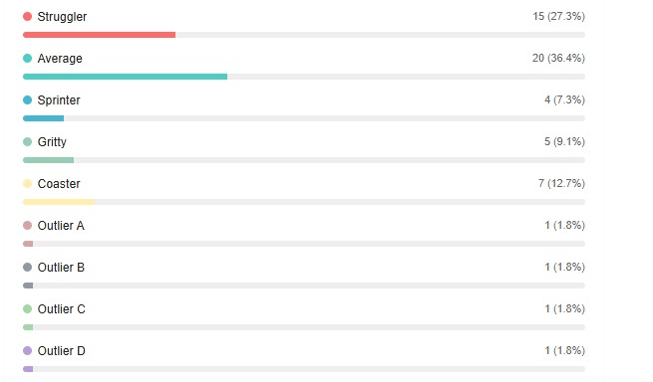
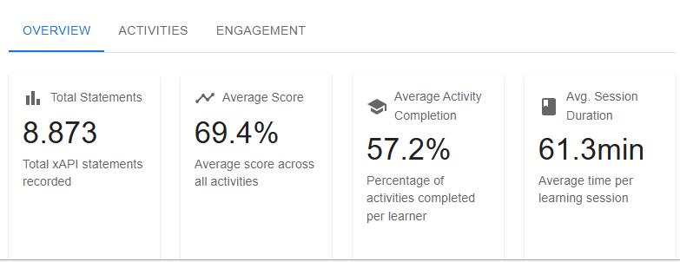
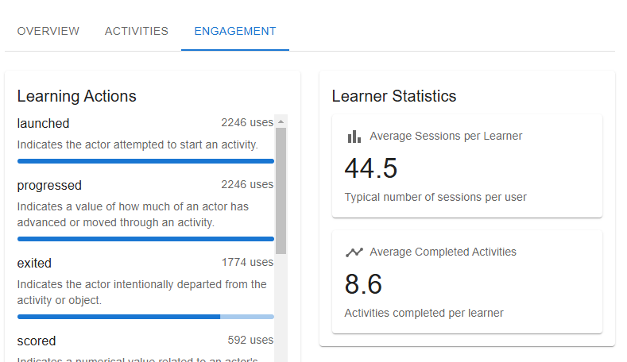
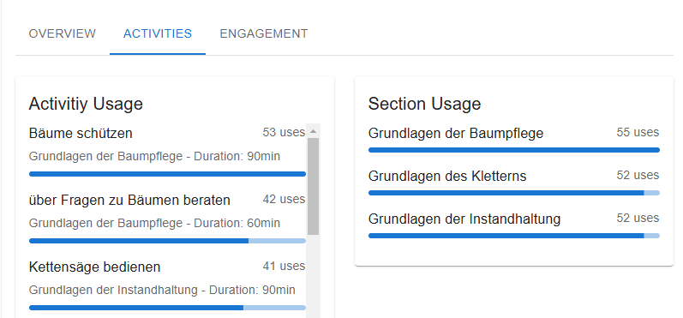
2. xApi Statement Generation
2.2 Generation Results
Distribution of Learner Profiles:
xAPI Statements Statistics:

Slide 7



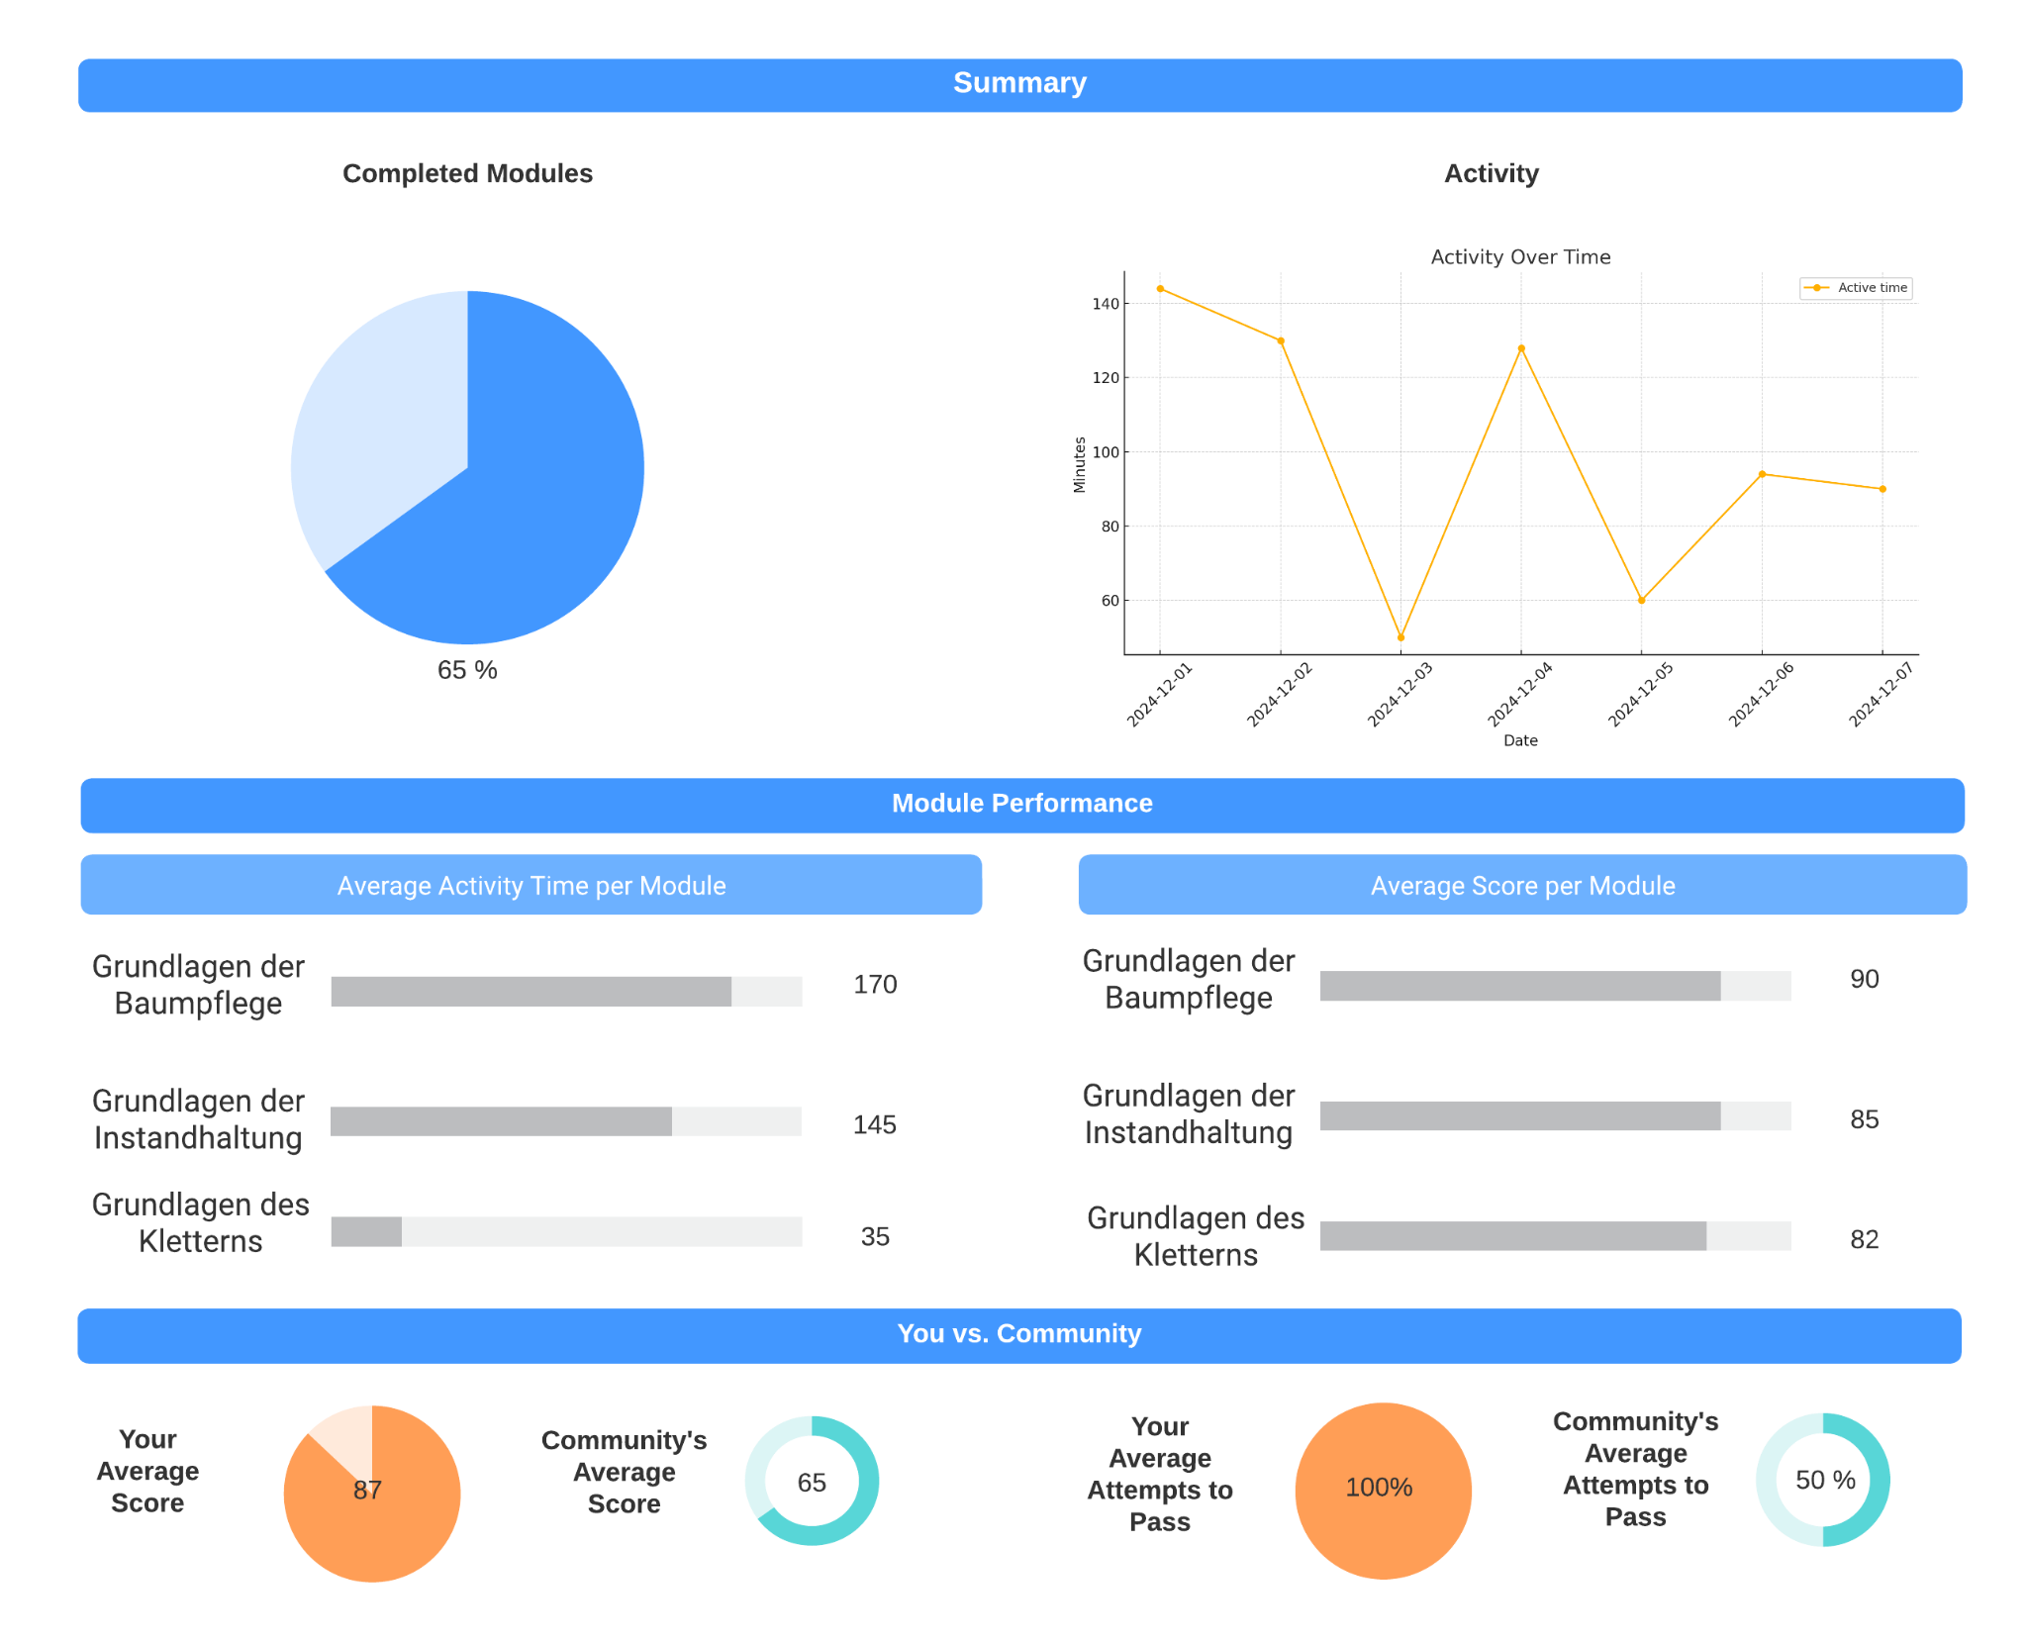
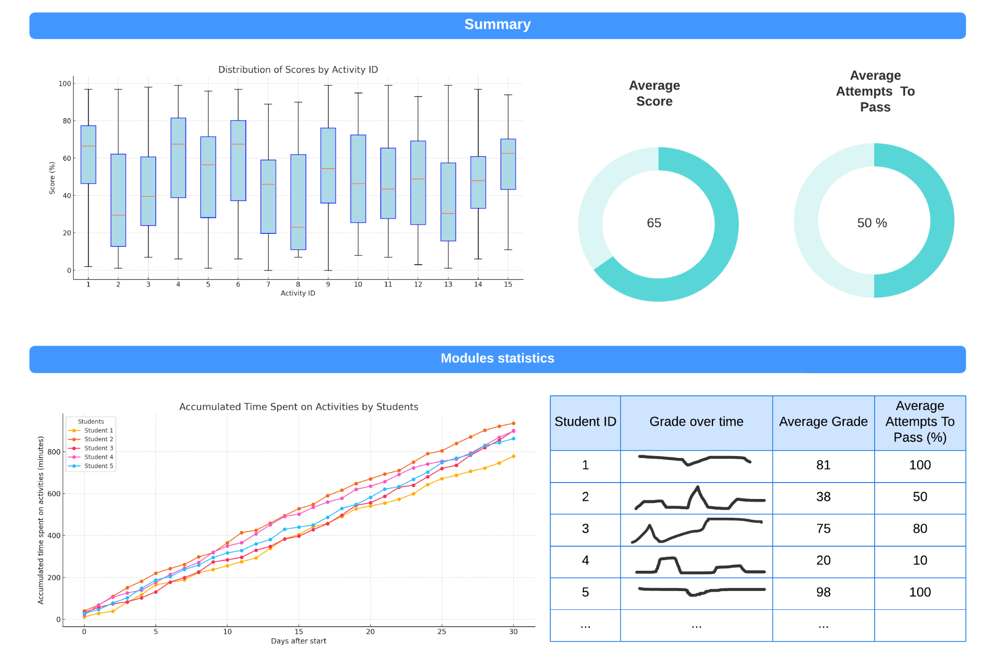
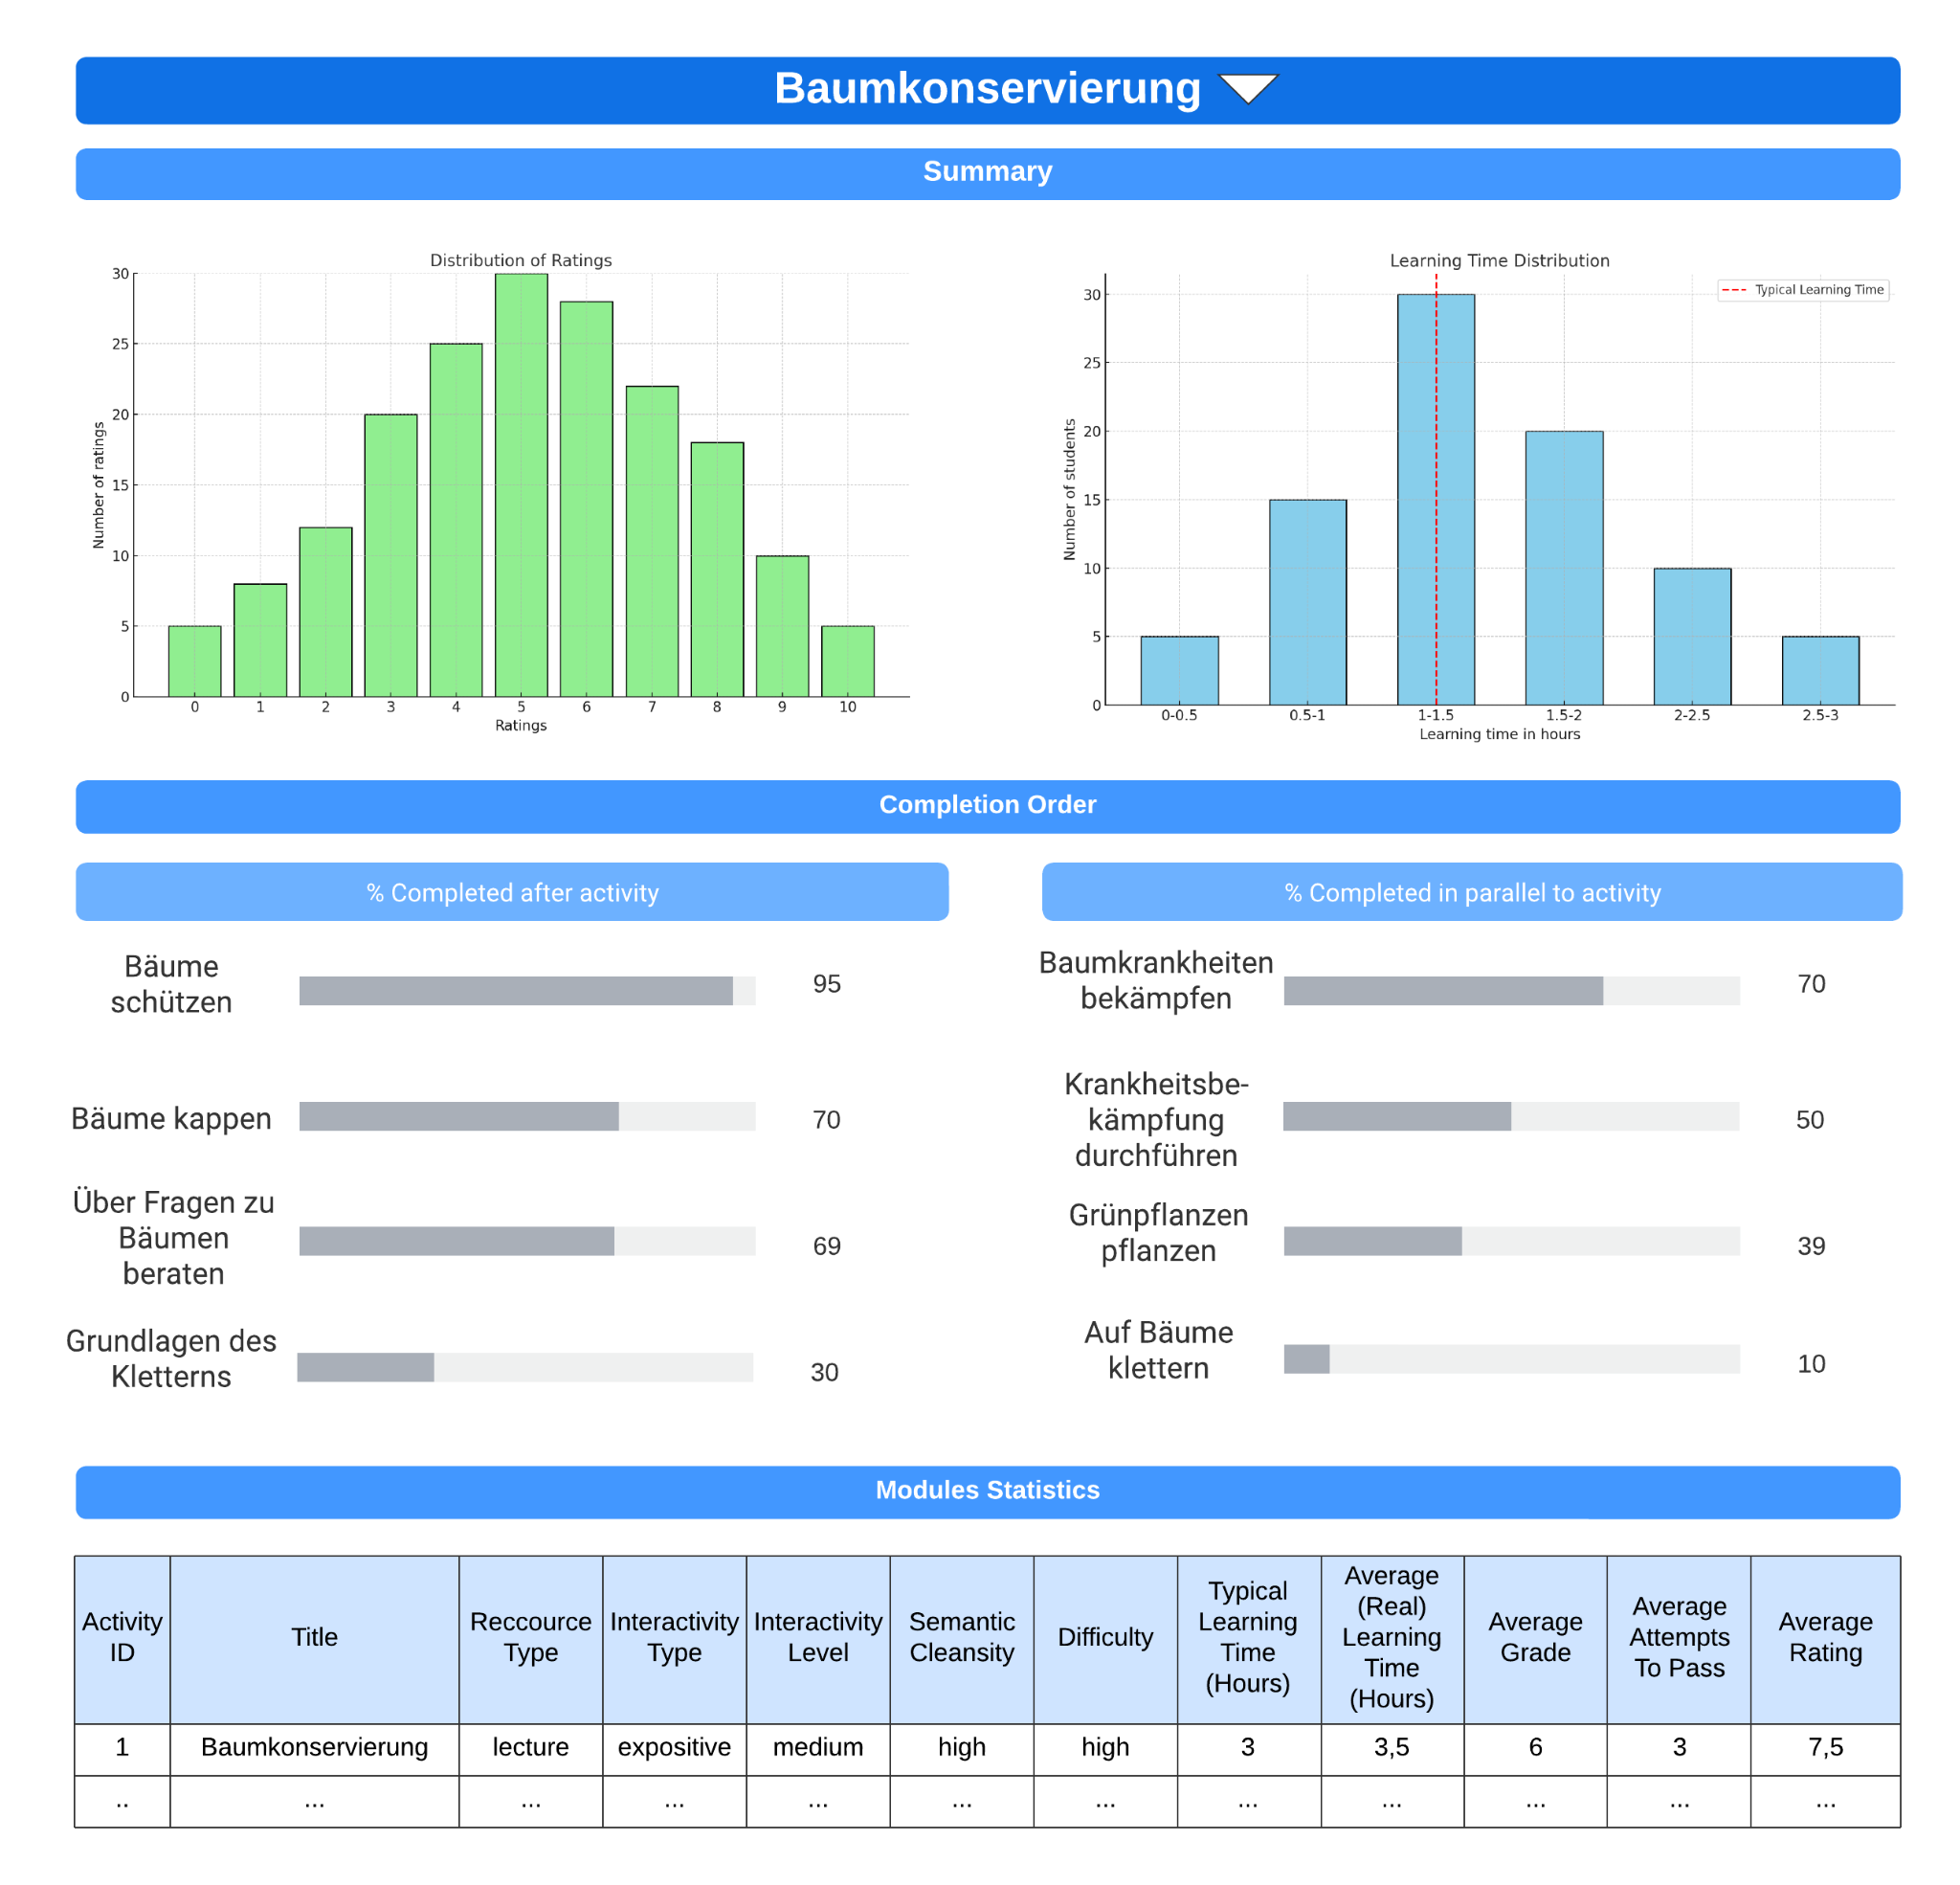
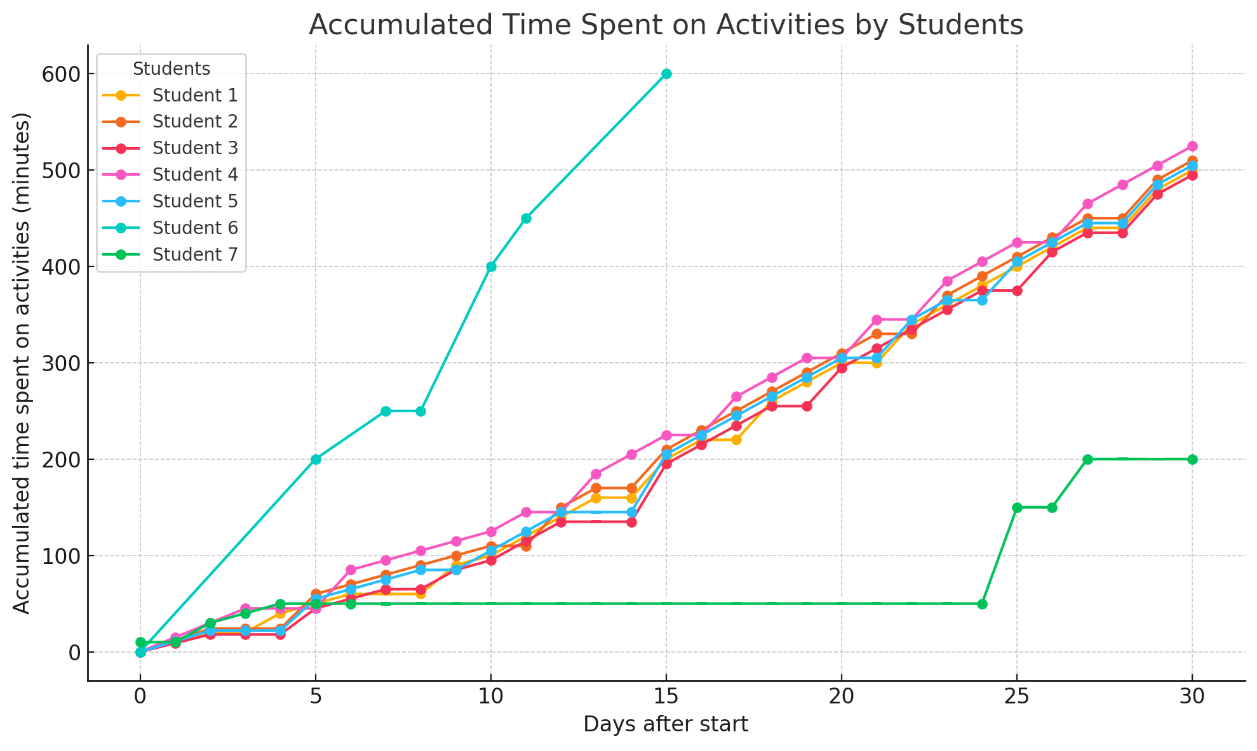
3. Metrics and Indicators
Stakeholders
Learner
Educator
Media
Content Creator

Slide 8
3. Metrics and Indicators
3.1 Learner’s Dashboard

Slide 9
3. Metrics and Indicators
3.2 Educator’s Dashboard

Slide 10
3. Metrics and Indicators
3.3 Media Content Creator’s Dashboard

Slide 11
4. Next Steps
Milestone 1
07.11.2024
Milestone 2
19.12.2024
Milestone 3
13.02.2025
Final Submission
28.02.2025
Project Planning
Data Structure Analysis
Persona Definition
Synthetic Data Requirements Specification
Generation of Synthetic User Interaction Data
Selection of Key Stakeholders
Identification of Relevant Metrics and Indicators for Stakeholders
Development of Learning Analytics Dashboards
Creation of Services for Actionable Recommendations
Preparation of Preliminary Documentation
Finalization of Development
Completion of Final Documentation

Slide 12
Thank You!

