Slide 1
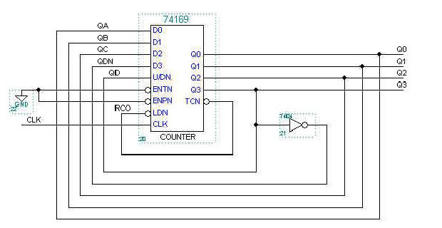

8.13

Slide 2
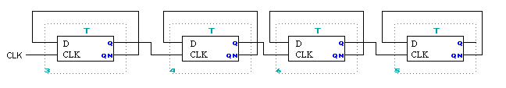
8.27
Design a 4-bit ripple down counter using four D flip-flops
1111
1110
1101
1100
1011
1010
1001
1000
0111
0110
0101
0100
0011
0010
0001
0000
FF0
FF1
FF2
FF3

Slide 3
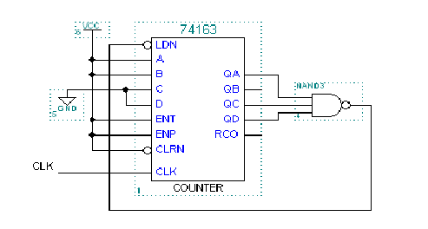
8.35 using 74x163 to design a modulo-11 counter:
3,4,5,…,12,13

Slide 4
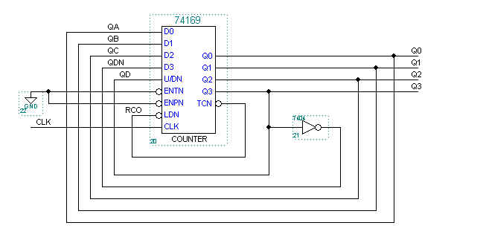
8.46 design modulo-16 counter using a 74x169 and at most a SSI package:7,6,5,4,3,2,1,0,8,9,10,11,12,13,14,15,7,…
U/D=0 Down couter:7,6,5…,0
U/P=1 Up counter: 8,9,10,…15

Slide 5
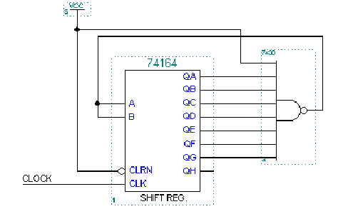
8.55 design an 8-bit self-correcting ring counter whose states are11111110,11111101,…01111111,using only two SSI/MSI packages

Slide 6
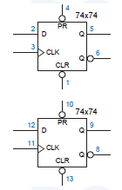
8.57 design two different 2-bit, 4-states counters, where each design uses just a single 74x74 package.

Slide 7
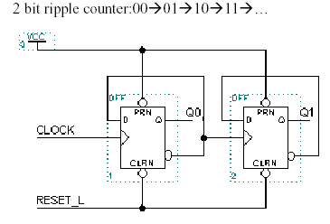
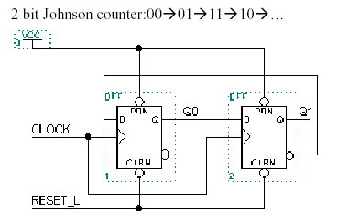

Slide 8
8.58
Q3 Q2 Q1 Q0 Q3* Q2* Q1* Q0*(D3 D2 D1 D0)
0000 0001
0001 0011
0011 0111
0111 1111
1111 1110
1110 1100
1100 1000
1000 0000

Slide 9
D0
Q3Q2
00 01 11 10
Q1Q0
00
01
11
10
1
d
1
d
d
d
D0=Q3’
1
1
d
d
d
d
同理：D1=Q0 D2=Q1 D3=Q2

Slide 10
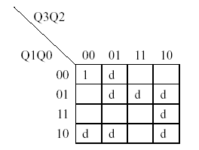

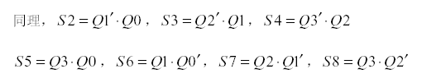
状态译码
S1:

Slide 11
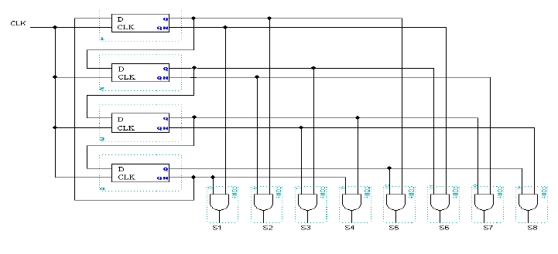
FF0
FF1
FF2
FF3

