Slide 1
6. 9
maximum: t_{pLH}=t_{pHL}=15 ns
tp = 3t_{pLH} + 3t_{pHL}
= 3×15 + 3×15
= 90 ns
Since t_{pLH} and t_{pHL} for a 74LS00 are identical, the same result is obtained using a single worst-case delay of 15ns.

Slide 2
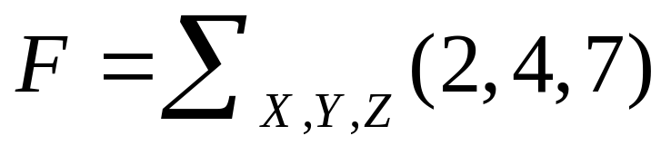
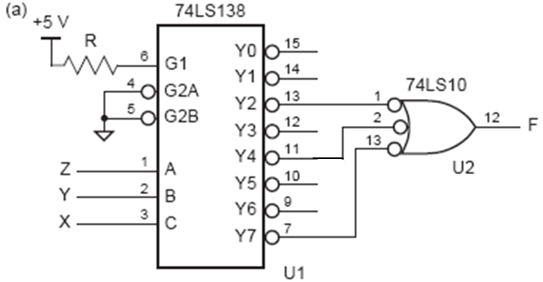
6.20 (a)

Slide 3
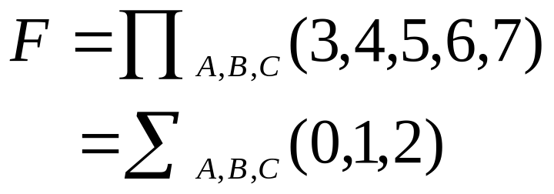
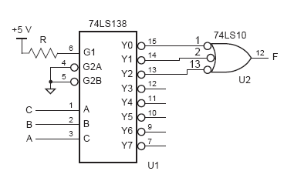
6.20 (b)

Slide 4
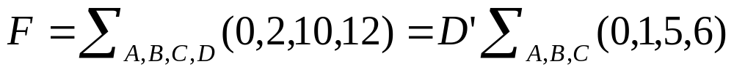
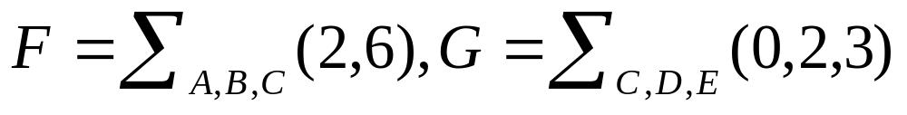
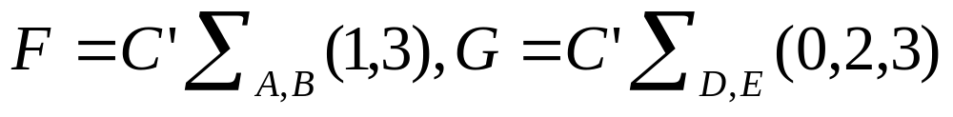
6.20(c)
6.20(f)

Slide 5
6.21
  Both halves of the ’139 are enabled simultaneously when EN_L is asserted. Therefore, two three-state drivers will be enabled to drive SDATA at the same time. Perhaps the designer forgot to put an extra inverter on the signal going to 1G or 2G, which would ensure that exactly one source drives SDATA at all times.

Slide 6
6.38 十进制译码器的设计
输入：四位 D、C、B、A，BCD码
输出：十位 Y0~Y9，十中取一码
DCBA | Y0 | Y1 | Y2 | Y3 | Y4 | Y5 | Y6 | Y7 | Y8 | Y9
0 0 0 0 | 1 | 0 | 0 | 0 | 0 | 0 | 0 | 0 | 0 | 0
0 0 0 1 | 0 | 1 | 0 | 0 | 0 | 0 | 0 | 0 | 0 | 0
0 0 1 0 | 0 | 0 | 1 | 0 | 0 | 0 | 0 | 0 | 0 | 0
0 0 1 1 | 0 | 0 | 0 | 1 | 0 | 0 | 0 | 0 | 0 | 0
… … | … …
1 0 0 1 | 0 | 0 | 0 | 0 | 0 | 0 | 0 | 0 | 0 | 1
1 0 1 0 | d | d | d | d | d | d | d | d | d | d
… … | d | d | d | d | d | d | d | d | d | d
1 1 1 1 | d | d | d | d | d | d | d | d | d | d

Slide 7
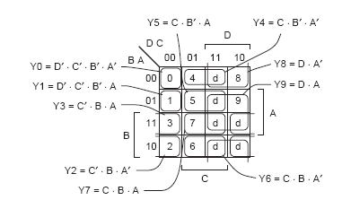
2个4输入的与门，6个3输入的与门，2个2输入的与门

Slide 8
4-16译码器的设计
DCBA | Y0 | Y1 | Y2 | Y3 | Y4 | Y5 | Y6 | Y7 | Y8 | Y9
0 0 0 0 | 1 | 0 | 0 | 0 | 0 | 0 | 0 | 0 | 0 | 0
0 0 0 1 | 0 | 1 | 0 | 0 | 0 | 0 | 0 | 0 | 0 | 0
0 0 1 0 | 0 | 0 | 1 | 0 | 0 | 0 | 0 | 0 | 0 | 0
0 0 1 1 | 0 | 0 | 0 | 1 | 0 | 0 | 0 | 0 | 0 | 0
… … | … …
1 0 0 1 | 0 | 0 | 0 | 0 | 0 | 0 | 0 | 0 | 0 | 1
1 0 1 0 | 0 | 0 | 0 | 0 | 0 | 0 | 0 | 0 | 0 | 0
… … | 0 | 0 | 0 | 0 | 0 | 0 | 0 | 0 | 0 | 0
1 1 1 1 | 0 | 0 | 0 | 0 | 0 | 0 | 0 | 0 | 0 | 0

Slide 9










DC
BA
00 01 11 10
0
00
01
11
10
4
8
5
9
1
3
7
2
6
10个4输入的与门

Slide 10
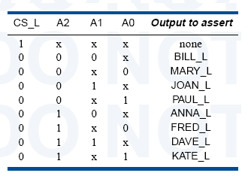
6.41 专用译码器的设计
输入：A2、A1、A0，使能信号CS_L
输出：8个信号

Slide 11
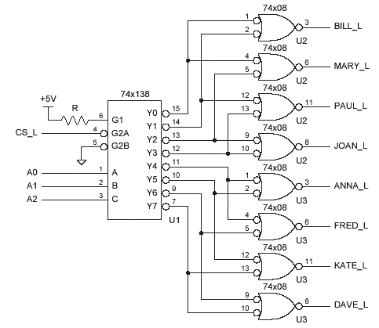

Slide 12
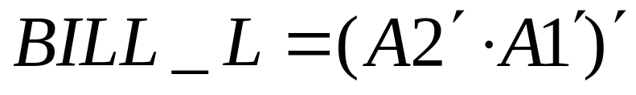
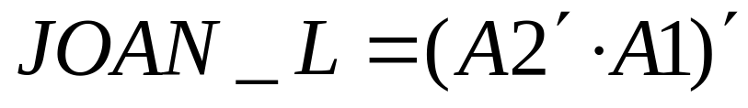



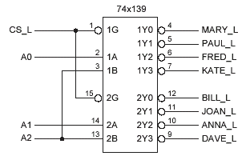
… … …

Slide 13
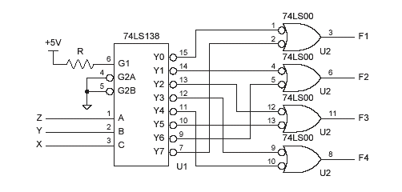
6.43
F1=m₀+m₇; F2=m₁+m₆
F3=m₂+m₅; F4=m₄+m₃

Slide 14
6.51 16-4编码器
I15 I14 … I8 I7 … I1 I0
Y3 Y2 Y1 Y0
1 0 0 0 0 0 0 0 1 1 1 1
0 1 0 0 0 0 0 0 1 1 1 0
… …
0 0 0 1 0 0 0 0 1 0 0 0
0 0 0 0 1 0 0 0 0 1 1 1
… …
0 0 0 0 0 0 1 0 0 0 0 1
0 0 0 0 0 0 0 1 0 0 0 0

Slide 15
Y3=I15+I14+…+I8
Y2=I15+I14+I13+I12+I7+I6+I5+I4
Y1=I15+I14+I11+I10+I7+I6+I3+I2
Y0=I15+I13+…+I1

Slide 16
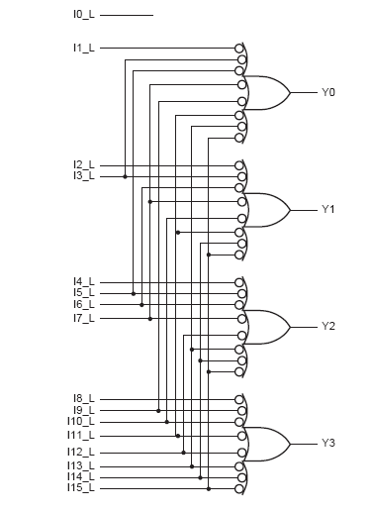
用与非门实现:
Y3=I15_L’+I14_L’+…+I8_L’
Y2=I15_L’+I14_L’+I13_L’+
I12_L’+ I7_L’+I6_L’+
I5_L’+I4_L’
Y1=I15_L’+I14_L’+I11_L’+
I10L’+I7_L’+I6_L’+
I3_L’+I2_L’
Y0=I15_L’+I13_L’+…+I1_L’

Slide 17
Design priority circuit with 74x148
8 active-high input I0～I7，I7 has the highest priority
address output A2～A0 active-high
if no input is asserted, then A2～A0 should be 000 and an IDLE output should be asserted
6.52
74x148
A2
EI
I7
I0
A2
A1
A0
GS
EO
I7
A1
A0
I0
IDLE

Slide 18
6.53 Design priority circuit with 74x148
8 active-low input I0_L～I7_L，I0_L has the highest priority
address output A2～A0 active-high
if at least one input is asserted, then an AVALID output Should be asserted
74x148
A2
A1
A0
GS
EO
A2
A1
A0
EI
I0_L
I7
I0
I7_L
AVALID

Slide 19
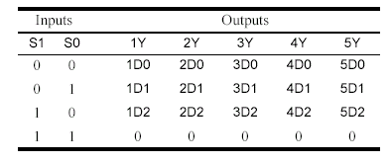
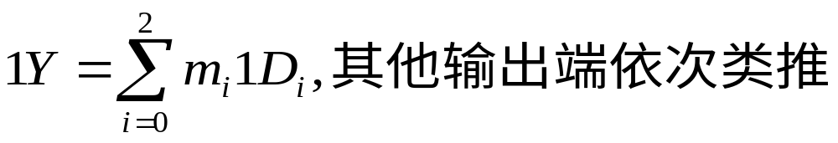
6.63 设计3输入5位的多路复用器（24引脚）
多路复用器功能表
D0: 1D0~5D0，D1: 1D1~5D1， D2:1D2~5D2

Slide 20
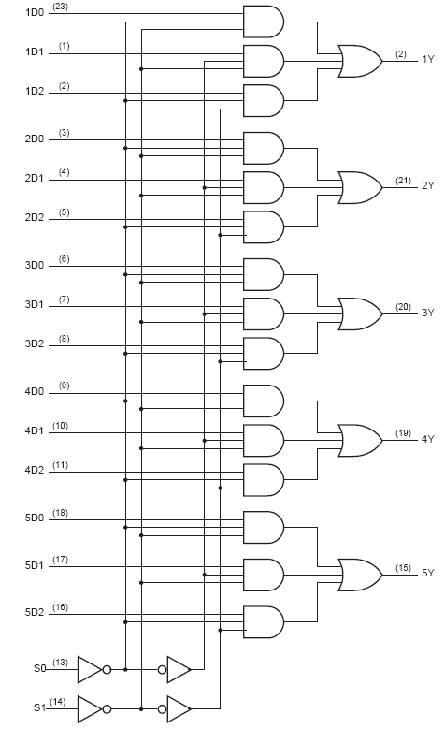
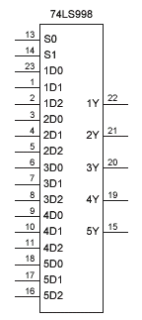

Slide 21
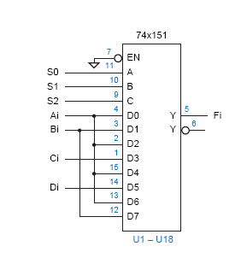
6.65 设计4输入18位的多路复用器
S2S1S0 | 选择输入
0 0 0 | A
0 0 1 | B
0 1 0 | A
0 1 1 | C
1 0 0 | A
1 0 1 | D
1 1 0 | A
1 1 1 | B
所有的C,B,A端口都分别连到
S2,S1,S0

Slide 22
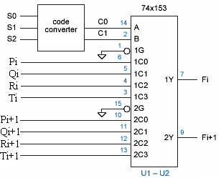
6.74 设计多路复用器(4个4位输入,修改了题目要求)
S2S1S0 | 端口
0 0 0 | P
0 0 1 | P
0 1 0 | P
0 1 1 | Q
1 0 0 | P
1 0 1 | P
1 1 0 | R
1 1 1 | T
C1C0
0 0
0 0
0 0
0 1
0 0
0 0
1 0
1 1
C1=S2S1 C0=S1S0

Slide 23

S2S1S0 | 端口 | C1C0
0 0 0 | P | 1 1
0 0 1 | P | 1 1
0 1 0 | P | 1 1
0 1 1 | Q | 1 0
1 0 0 | P | 1 1
1 0 1 | P | 1 1
1 1 0 | R | 0 1
1 1 1 | T | 0 0
C1=S2’+S1’ C0=S1’+S0’

