Slide 1
Introduction
Name:XpertEspire
Level:Bachelor{BCA(1st Year)}
RollNo:09
Subject:Computer Fundamentals and Apppli

Slide 2
Iron Man
Iron Man is a superhero appearing in American comic books published by Marvel Comics. Co-created by writer and editor Stan Lee, developed by scripter Larry Lieber, and designed by artists Don Heck and Jack Kirby, the character first appeared in Tales of Suspense #39 in 1962 (cover dated March 1963) and received his own title with Iron Man #1 in 1968. Shortly after his creation, Iron Man became a founding member of the superhero team the Avengers, alongside Thor, Ant-Man, the Wasp, and the Hulk. Iron Man stories, individually and with the Avengers, have been published consistently since the character's creation.
Iron Man is the superhero persona of Anthony Edward "Tony" Stark, a businessman and engineer who runs the weapons manufacturing company Stark Industries. When Stark was captured in a war zone and sustained a severe heart wound, he built his Iron Man armor and escaped his captors. Iron Man's suits of armor grant him superhuman strength, flight, energy projection, and other abilities. The character was created in response to the Vietnam War as Lee's attempt to create a likeable pro-war character. Since his creation, Iron Man has been used to explore political

Slide 3
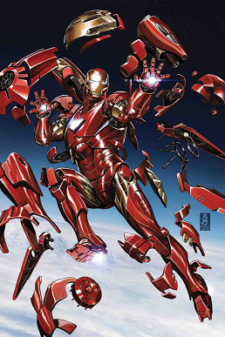
Major Iron Man stories include "Demon in a Bottle" (1979), "Armor Wars" (1987–1988), "Extremis" (2005), and "Iron Man 2020" (2020). He is also a leading character in the company-wide stories Civil War (2006–2007), Dark Reign (2008–2009), and Civil War II (2016). Additional superhero characters have emerged from Iron Man's supporting cast, including James Rhodes as War Machine and Riri Williams as Ironheart, as well as reformed villains, Natasha Romanova as Black Widow and Clint Barton as Hawkeye. Iron Man's list of enemies includes his archenemy, the Mandarin, various supervillains of communist origin, and many of Stark's business rivals.
Robert Downey Jr. portrayed Tony Stark in Iron Man (2008), the first film of the Marvel Cinematic Universe, and continued to portray the character until his final live-action appearance in Avengers: Endgame (2019). Downey's portrayal popularized the character, elevating Iron Man into one of Marvel's most recognizable superheroes. Other adaptations of the character appear in animated direct-to-video films, television series, and video games.

