Slide 1
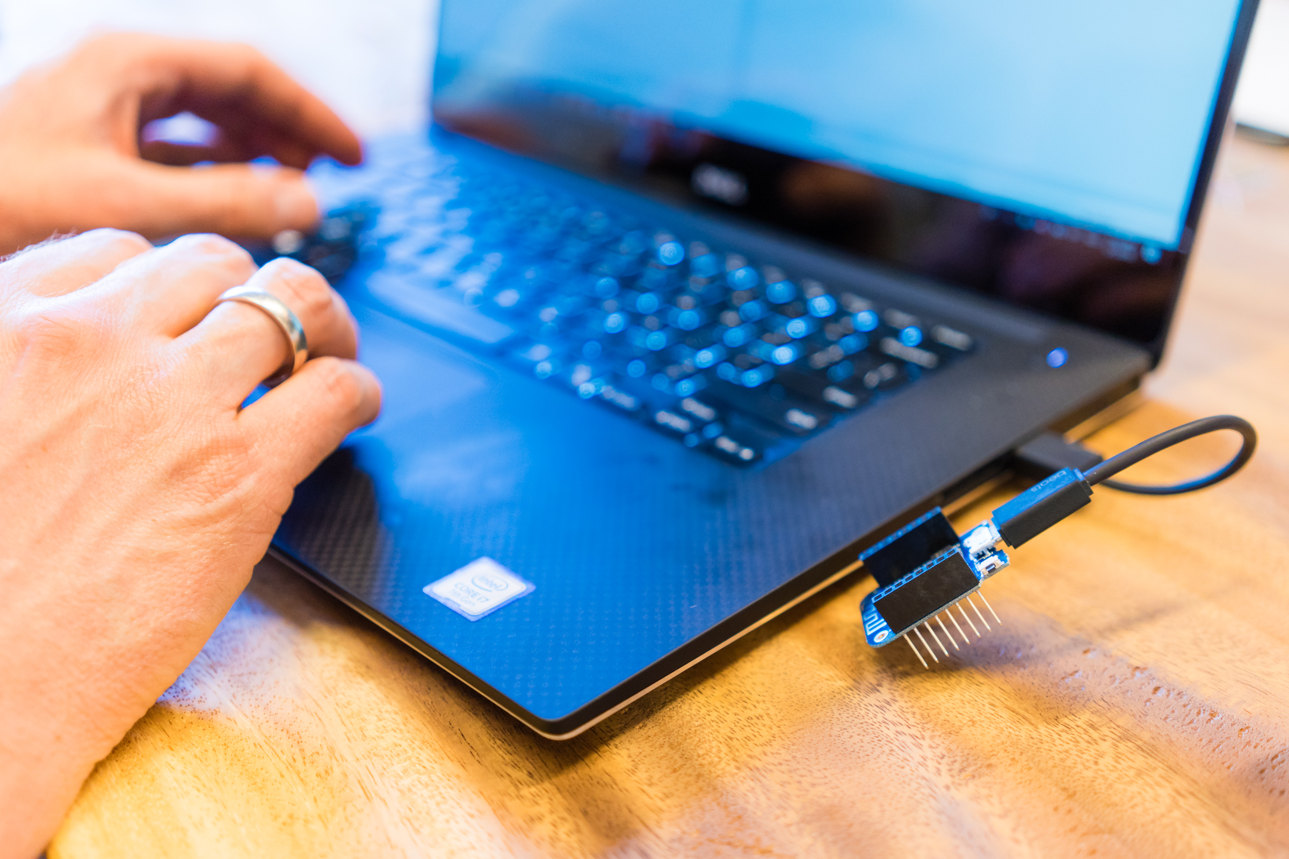
DIY Home Automation
Kees Verhaar & Loek Duys

Slide 2
https://xpir.it/mud-home-automation

