Slide 1


CryptoKnight
Plaintext was yesterday…
https://github.com/Xpitfire/cryptoknight
Daniel Glaser
Marius Dinu

Slide 2

CryptoKnight The next big thing?

Slide 3
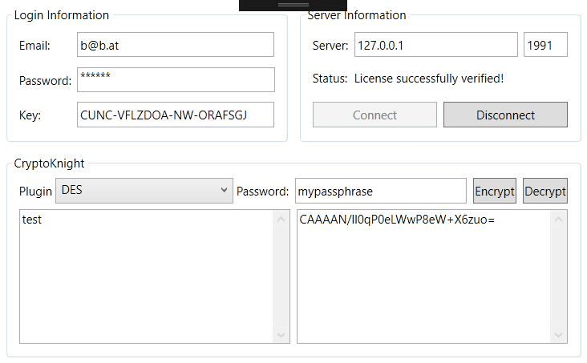
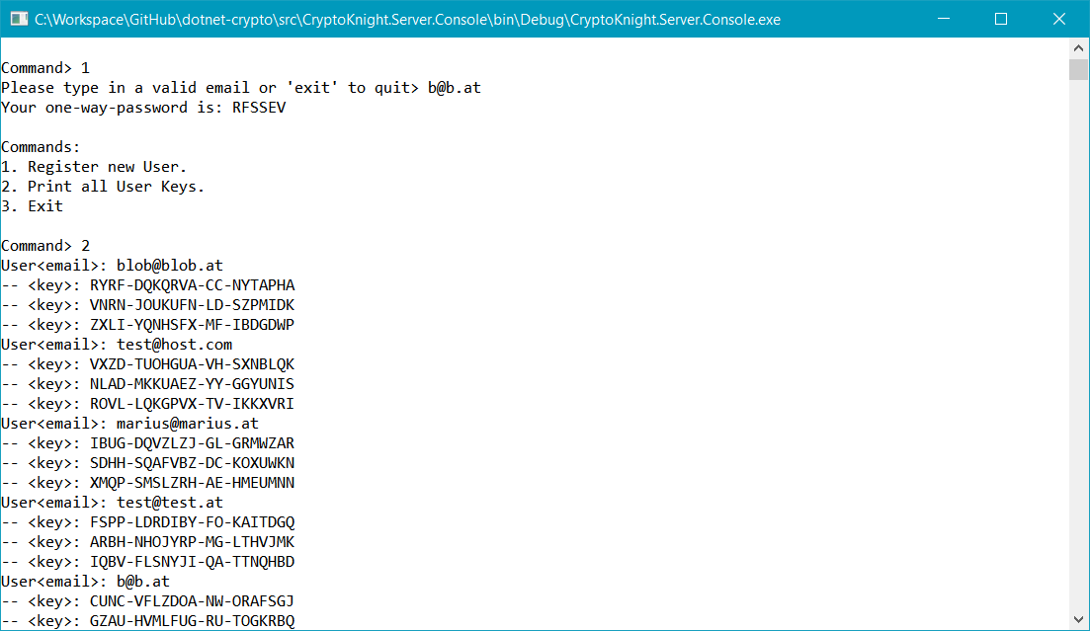
Apps

Slide 4
Architecture

Slide 5
Demo (Go Code or Go Home)

Slide 6
Q?

