Slide 1

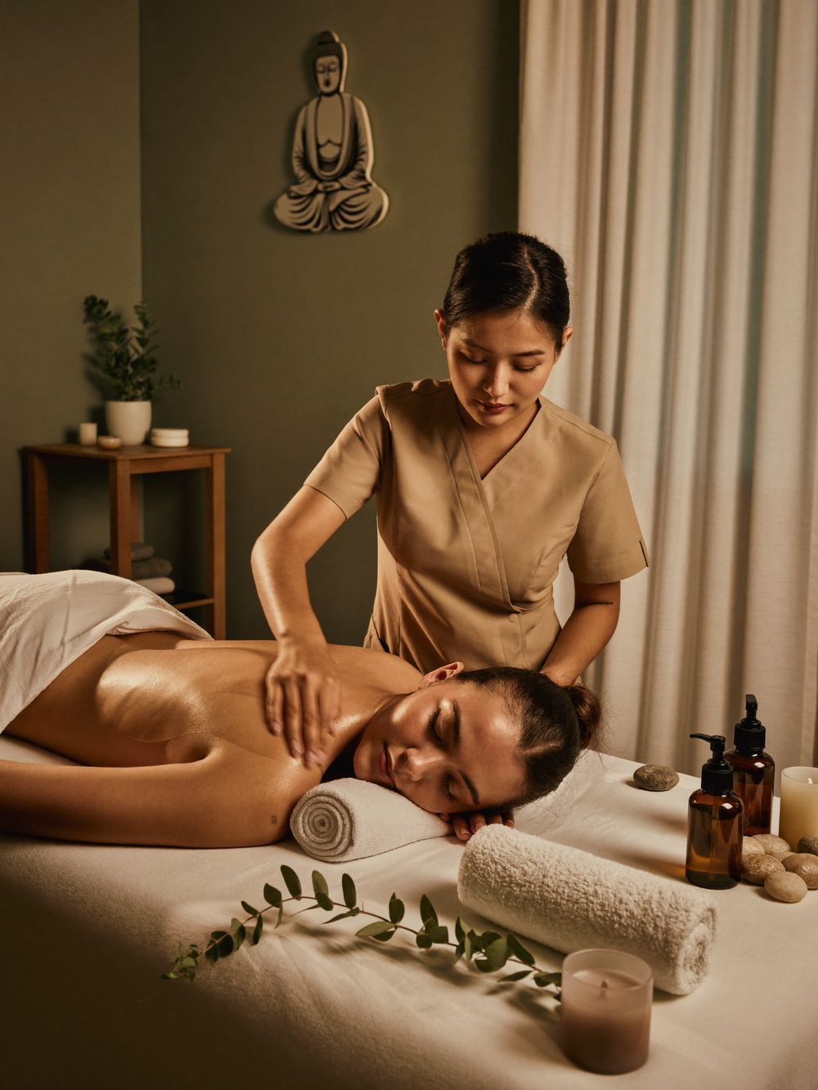
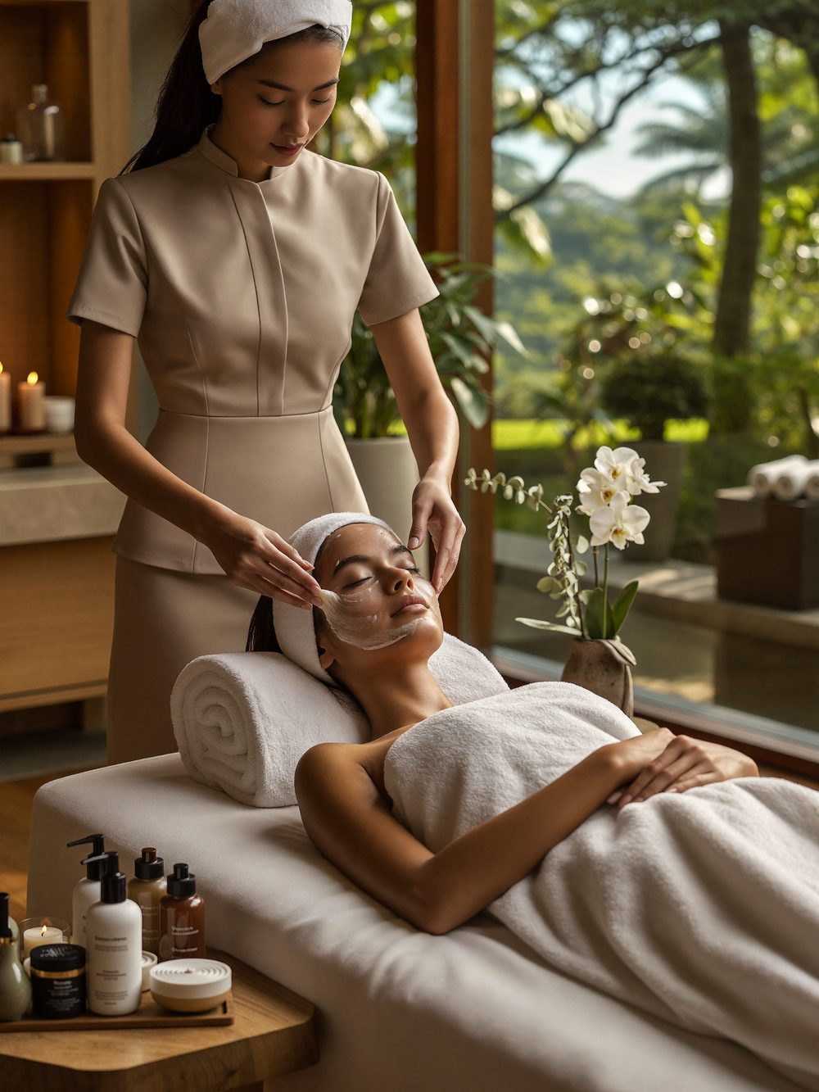
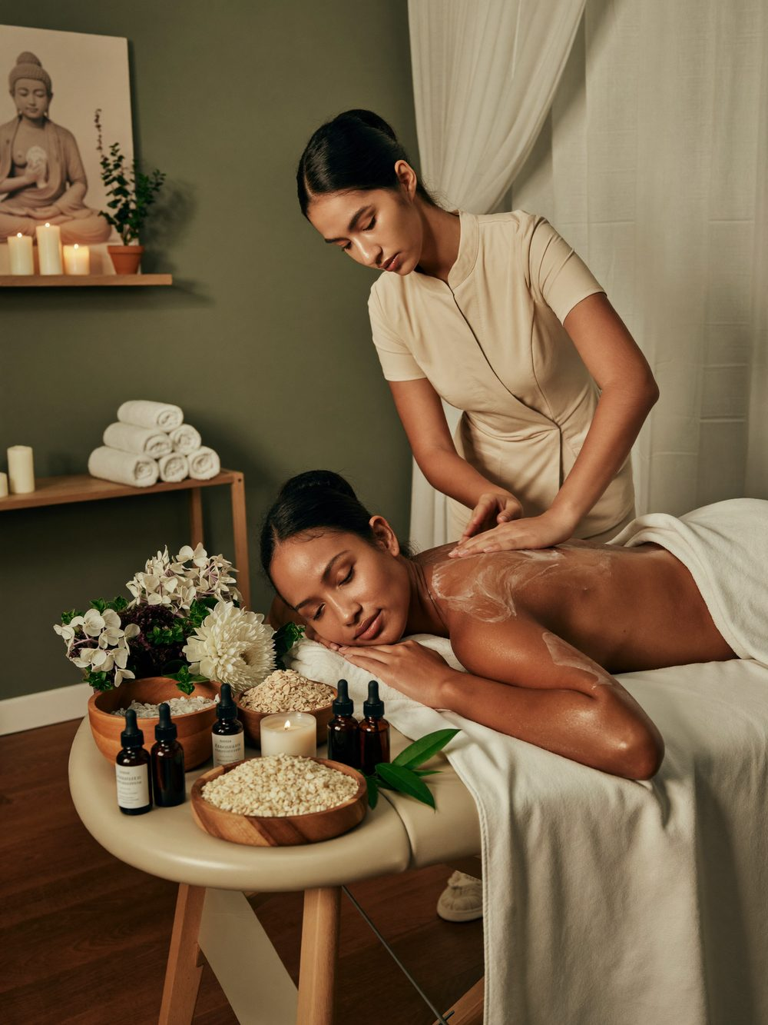
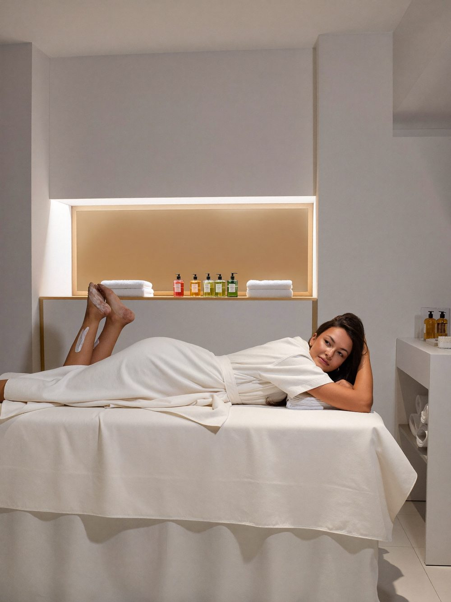
Kuenphen Beauty Spa
Relax, Renew and Reconnect with Yourself
Tucked on the second floor of Oli Building in Gelephu, Kuenphen Beauty Spa is where you come to slow down. Every treatment in this catalog is performed by trained hands in a space built for quiet — browse the pages ahead and book whichever one speaks to you.
SERVICE CATALOG
Massage from Nu. 500
Facial from Nu. 600
Body Spa from Nu. 1,500
Waxing from Nu. 100
Manicure from Nu. 600
Pedicure from Nu. 700
Oli Building, 2nd Floor, near NNC Sales, Gelephu, Bhutan · kuenphenbeautyspa.com

Slide 2
Massage
BEST SELLER
SPA MENU
Therapeutic bodywork to release tension and restore balance.
From firm, focused deep-tissue work to the slower glide of a classic Swedish massage, every session is shaped around how your body feels that day. Tell your therapist where you're holding tension and how much pressure you like.
Deep Tissue Massage
SIGNATURE
60 min Nu. 1,500 90 min Nu. 2,000
Swedish Massage
60 min Nu. 1,300 90 min Nu. 1,800
Aromatherapy Massage
60 min Nu. 1,300 90 min Nu. 1,800
Head, Neck & Back Massage (30 min)
Nu. 950
Head Massage (30 min)
Nu. 500
Feet Massage (30 min)
Nu. 500

Slide 3
Facial
SPA MENU
BEST SELLER
Deep-cleansing and brightening treatments for every skin type.
Whether your skin needs a quick reset or a dedicated plan for acne, dullness or uneven tone, our facials pair hands-on technique with results-driven care — from a straightforward cleanse to BB Glow and Vitamin C hydration.
BB Glow
SIGNATURE
Nu. 3,000
Vitamin C Hydra Facial
Nu. 2,500
Twacha Hydra Facial
Nu. 1,500
Acne Treatment
Nu. 1,050
Manual Vitamin C Facial
Nu. 1,000
Rich Feel Facial
Nu. 950
Cleansing Facial
Nu. 600

Slide 4
Body Spa
SPA MENU
Full-body rituals, scrubs and wraps.
One unhurried ritual for the whole body: a full exfoliation that leaves skin visibly smoother, followed by a calming massage to finish. A good choice before a special occasion, or simply when your skin needs the attention.
Body Scrub (45 min)
Nu. 1,500
Full-body exfoliation · Smoother, softer skin · Finishing massage

Slide 5
Waxing
SPA MENU
BEST SELLER
Gentle, precise hair removal.
Smooth, lasting results with care taken at every step. Come in for a quick underarm appointment, or set aside time for a full-body session — either way, it's performed privately and at your pace.
Full Body Waxing
SIGNATURE
Nu. 3,500
Bikini Waxing
Nu. 1,800
Leg Waxing
From Nu. 150
Arm Waxing
From Nu. 150
Under Arm Waxing
Nu. 100

Slide 6
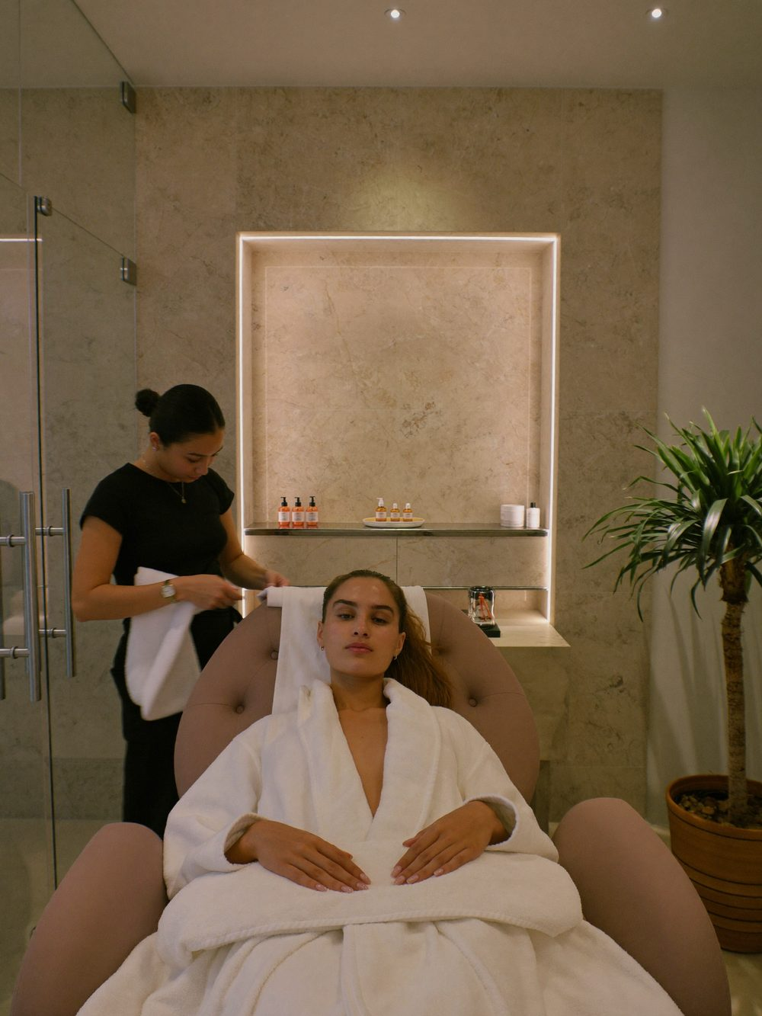
Manicure
SPA MENU
Hand and nail grooming.
Shaped, buffed and polished by hand, finished with a relaxing massage. Simple, unhurried care for hands that do a lot of work — book it on its own or pair it with a pedicure.
Manicure (45 min)
Nu. 600
Shape & cuticle care · Hand massage · Polish

Slide 7
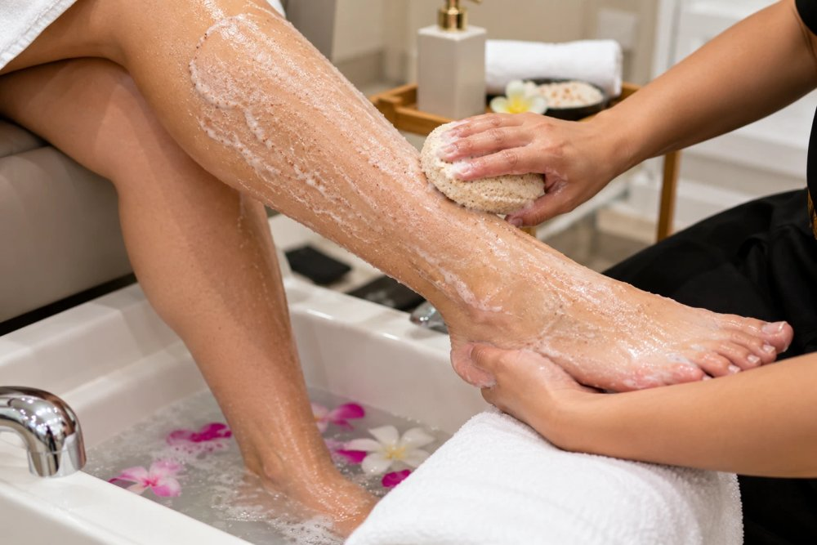
Pedicure
SPA MENU
Restorative foot and nail treatments.
A proper reset for tired feet — a warm soak, careful callus care, massage and polish, done at a pace that actually lets you relax instead of rushing you out the door.
Pedicure (45 min)
Nu. 700
Soak · Callus care · Massage · Polish

Slide 8
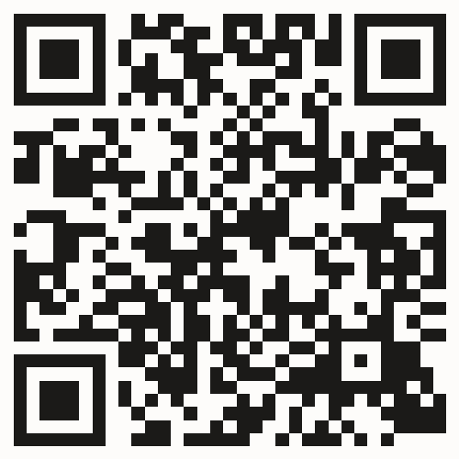
Visit Us
Walk in, call ahead, or scan the code to book online — we look forward to welcoming you.
Scan to book online
LOCATION
Oli Building, 2nd Floor, near NNC Sales, Gelephu, Bhutan
CONTACT
+975 7770 6348 / +975 1780 7066
hello@kuenphenbeautyspa.com
OPENING HOURS
Open Every Day
10:00 AM – 8:00 PM
STARTING PRICES
Massage from Nu. 500
Facial from Nu. 600
Body Spa from Nu. 1,500
Waxing from Nu. 100
Manicure from Nu. 600
Pedicure from Nu. 700

