Slide 1
Employee Management System Developed in PHP & MySQL

Slide 2
Abstract
The main objective of this project is to build a employee database system that will store records of employees. It is purposed to reduce time spent on administrative tasks. The system is intended to accept process, generate employee.
The system is also intended to provide better services to users, provide meaningful, consistent, and timely data and information and finally promotes efficiency by converting paper processes to electronic form.
The system was developed using basic technologies such as MySQL database and PHP. The system is free of errors and very efficient and less time consuming due to the care taken to develop it.
All the phases of software development cycle are employed and it is worthwhile to state that the system is user friendly and strong. Provision is made for future development in the system.

Slide 3
Purpose of the Project
The objective of Employee Management System is to allow the administrator of any organization to edit and find out the personal details of a employee and allows the employee to keep up to date his profile .It’ll also facilitate keeping all the records of employee, such as their id, name, mailing address, phone number, DOB etc. So all the information about an employee will be available in a few seconds.
Overall, it’ll make Employee Information Management an easier job for the administrator and the employee of any organization.

Slide 4
Advantage and Disadvantage
It helps the companies administrator to handle and manage employee records.
It helps companies administrator to generate report.
It brings transparency and efficiency in the working of organization.
Disadvantages:
The system can only handle single organization.
The system does not include bank payment, dd, cheque status.

Slide 5
Introduction
Employee Management System is software which is helpful for employees as well as the companies or organizations. In the current system all the activities are done manually. It is very time consuming and costly. Our Employee Management System deals with the various activities related to the employees in the company.
The two main users involved in this system are
Employee
Admin
In the Software admin can add a employee by the authentication code i.e empid and password with help of empid and password employee can login his/her account and employee can view and request for leave and view salary details which is maintain by admin.

Slide 6
Project Modules
The proposed system will affect or interface with the user (employee) and companies administrator. The system works and fulfills all the functionalities as per the proposed system. It will provide reduced response time against the queries made by different users. This project is based on PHP language with MYSQL database which manage the details of the employee because it is a tedious job for any organization. Employee Management system will store all the details of the employee including their background information.
All possible features such as verification, validation, security, user friendliness etc. have been considered.
The different types of modules present in this project are
Admin
Employee

Slide 7
Admin Module
Dashboard: In this section, admin can see all detail in brief like Total Registered Employee , Total Listed Department, Total Leave Type, Total Applied Leave, New Leave Request, Approved Leave Request and Rejected Leave Request.
Department In this section, admin can manage department (Add/Update/Delete).
Leave Type In this section, admin can manage leave type (Add/Update/Delete).
Employee: In this section, admin can manage the employee (Add/Update/Delete).
Salary: In this section, the admin can manage salary (Add/Update/Delete).
Leave Request: In this section, the admin can manage leave request and update the leave request.
Reports: In this section admin, can view how much employee has been register in particular period.
Admin can also update his profile, change the password and recover the password

Slide 8
User Module
Dashboard: It is welcome page for employee.
My Profile: In this section, employee can view and update his/her profile.
Leave: In this section, employee can apply for leave and view leave history.
Salary History: In this section, employee can view history of his/her salaries.
Employee can also view his profile, change the password and recover the password.

Slide 9
Requirement Specification
Hardware Configuration:
Client Side
Server Side
RAM | 512 MB
Hard Disk | 10GB
Processor | 1.0 GHz
RAM | 1 GB
Hard Disk | 20GB
Processor | 2.0GHz

Slide 10
Continue.....
Software Requirement:
Client Side
Server Side
Web Browser | Google Chrome or any compatible browser
Operating System | Windows or any equivalent OS
Web Server | APACHE
Server side Language | PHP5.6 or above version
Database Server | MySQL
Web Browser | Google Chrome or any compatible browser
Operating System | Windows or any equivalent OS

Slide 11
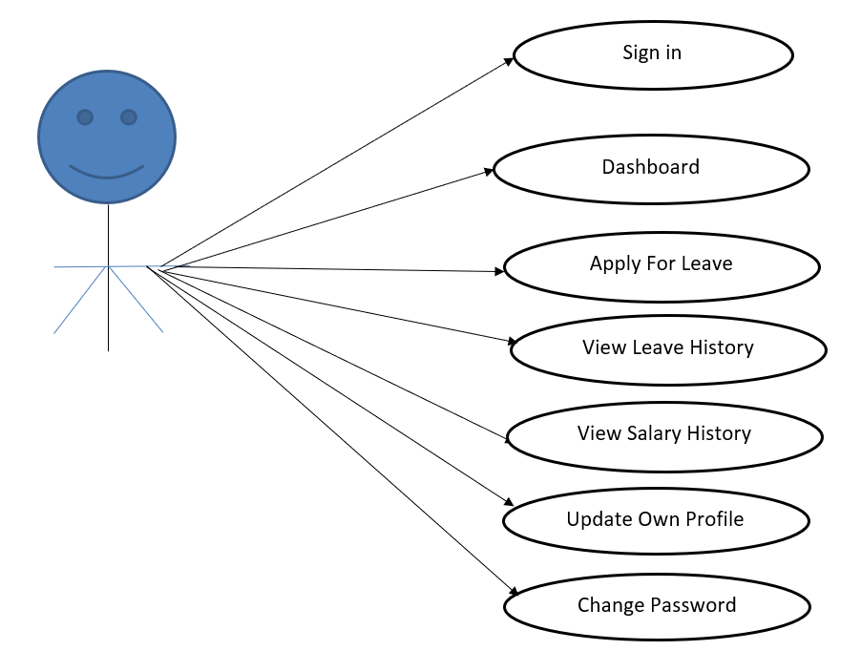
Use Case Diagram
Employee Use Case Diagram
Notes:
USECASE DIAGRAM: A Use case is a description of set of sequence of actions. Graphically it is rendered as an ellipse with solid line including only its name. Use case diagram is a behavioral diagram that shows a set of use cases and actors and their relationship. It is an association between the use cases and actors. An actor represents a real-world object. Primary Actor – Sender, Secondary Actor Receiver.

Slide 12
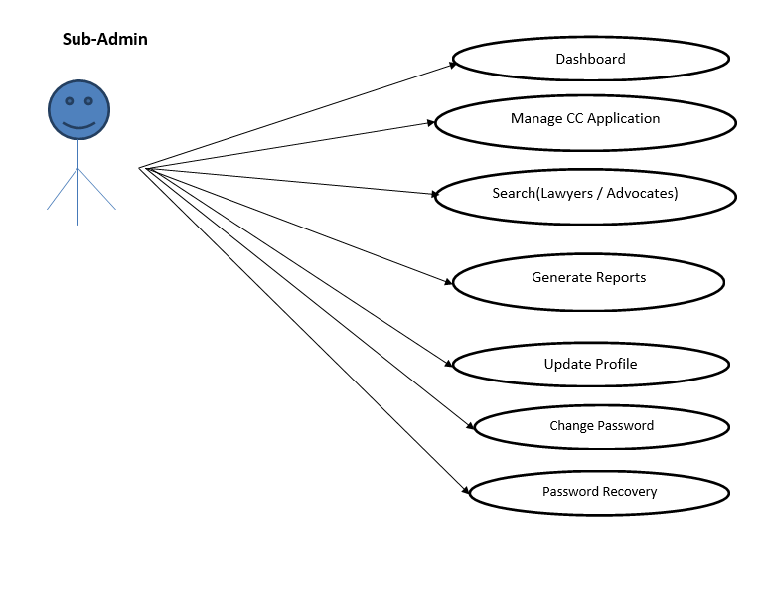
Continue…

Slide 13
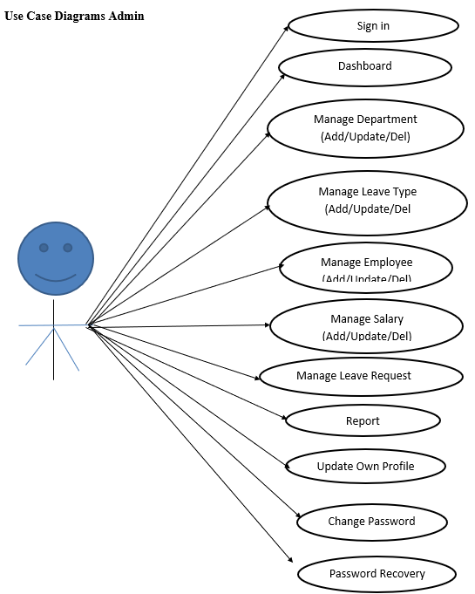
Continue…

Slide 14
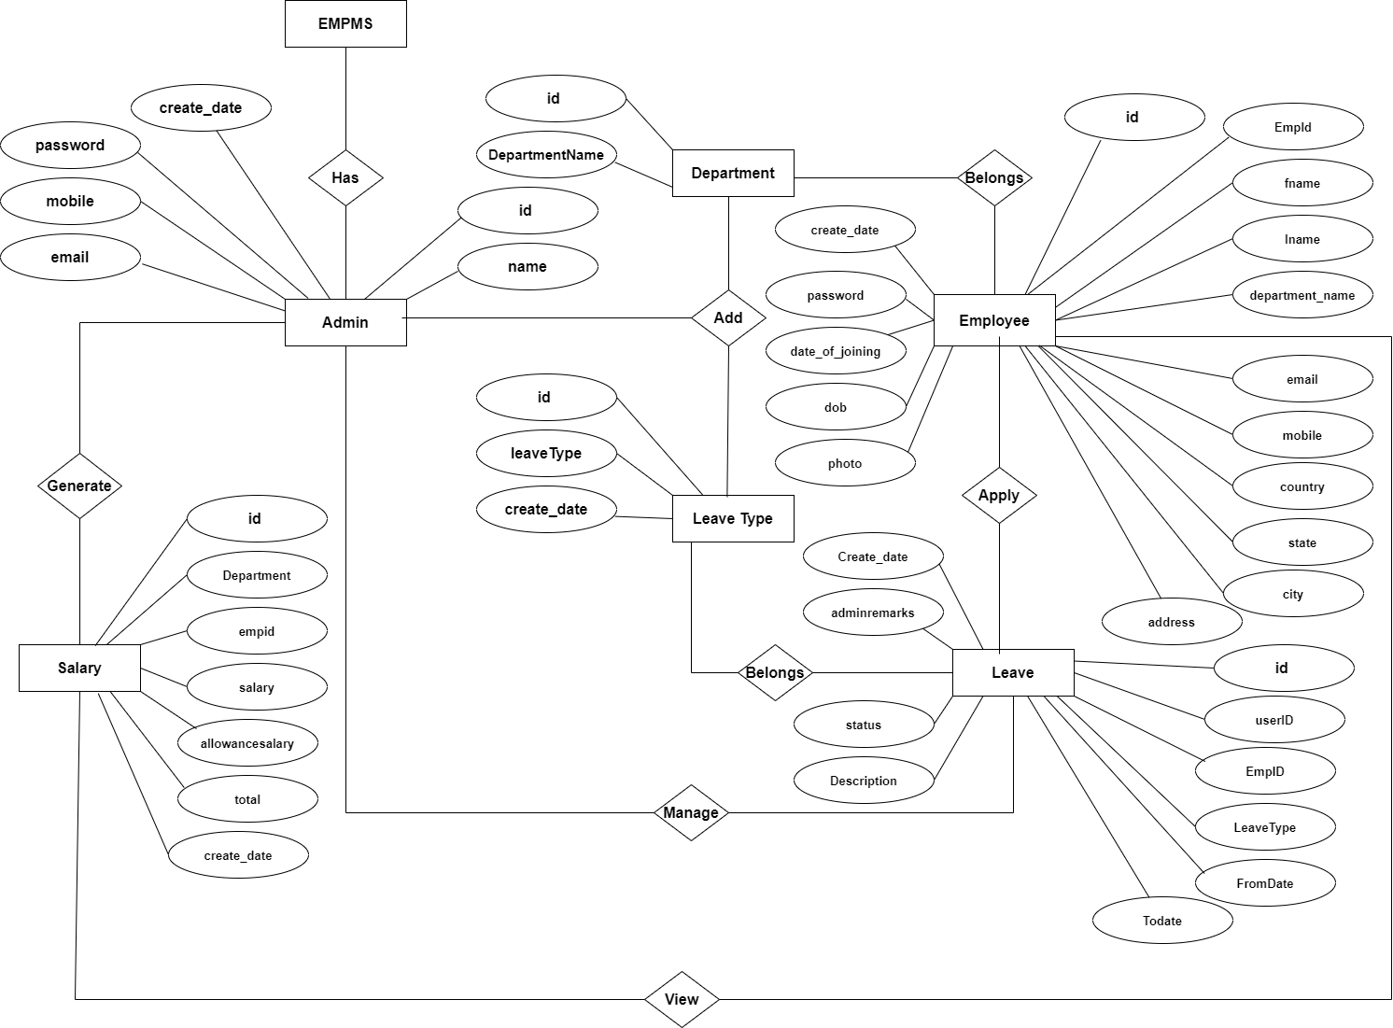
ER Diagram

Slide 15
Dataflow Diagrams (DFDs)
A Data Flow Diagram (DFD) is a traditional visual representation of the information flows within a system. A neat and clear DFD can depict the right amount of the system requirement graphically. It can be manual, automated, or a combination of both.
It shows how data enters and leaves the system, what changes the information, and where data is stored.
The objective of a DFD is to show the scope and boundaries of a system as a whole. It may be used as a communication tool between a system analyst and any person who plays a part in the order that acts as a starting point for redesigning a system. The DFD is also called as a data flow graph or bubble chart.

Slide 16
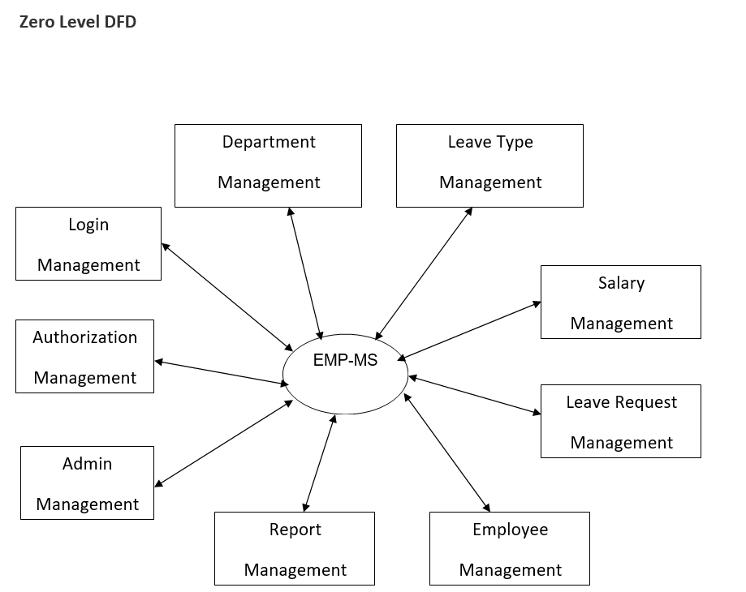

Slide 17
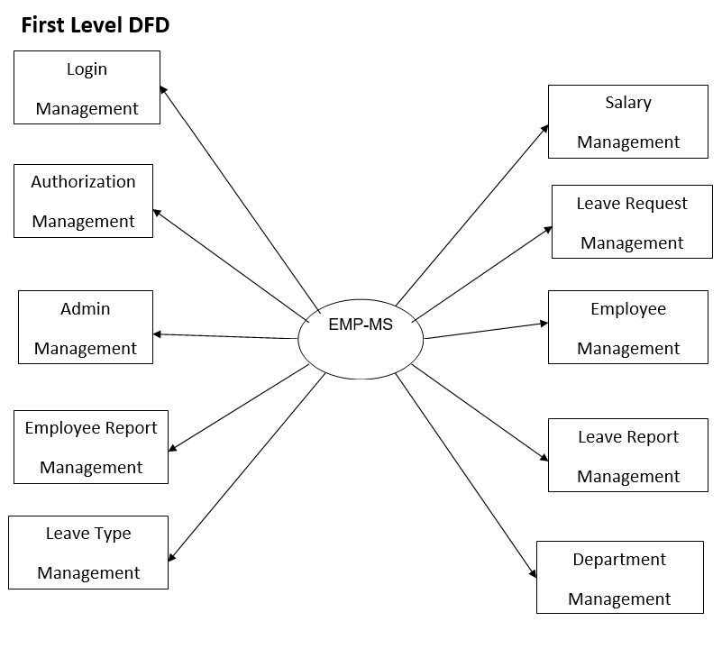

Slide 18
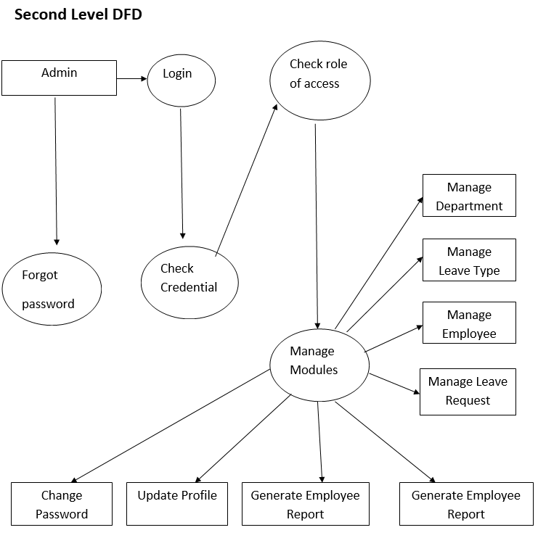

Slide 19
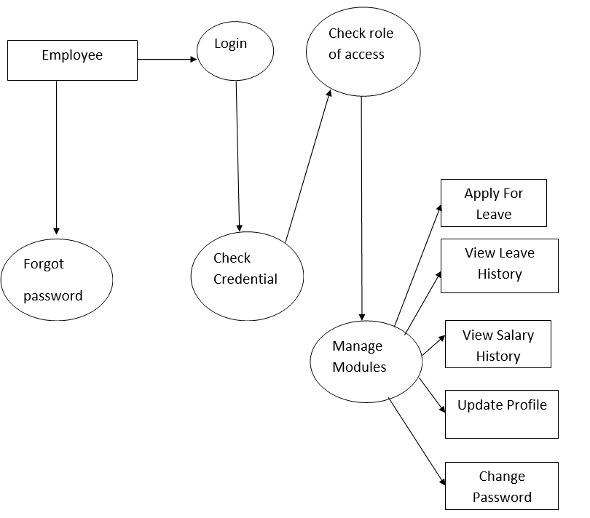

Slide 20
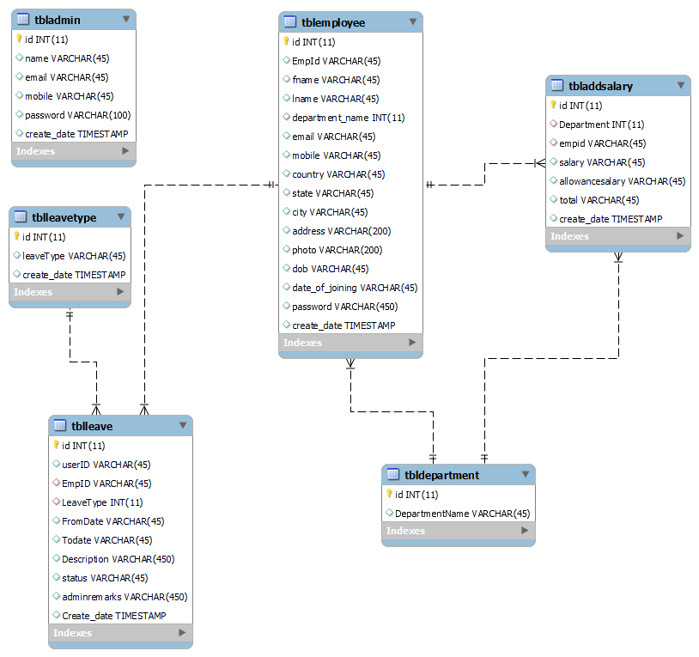
Class Diagram
Notes:
The class diagram shows a set of classes, interfaces, collaborations and their relationships.

Slide 21
Implementation and System Testing
After all phase have been perfectly done, the system will be implemented to the server and the system can be used.
System Testing
The goal of the system testing process was to determine all faults in our project .The program was subjected to a set of test inputs and many explanations were made and based on these explanations it will be decided whether the program behaves as expected or not. Our Project went through two levels of testing
Unit testing
Integration testing

Slide 22
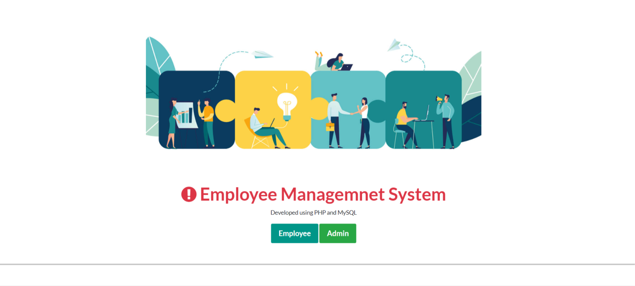
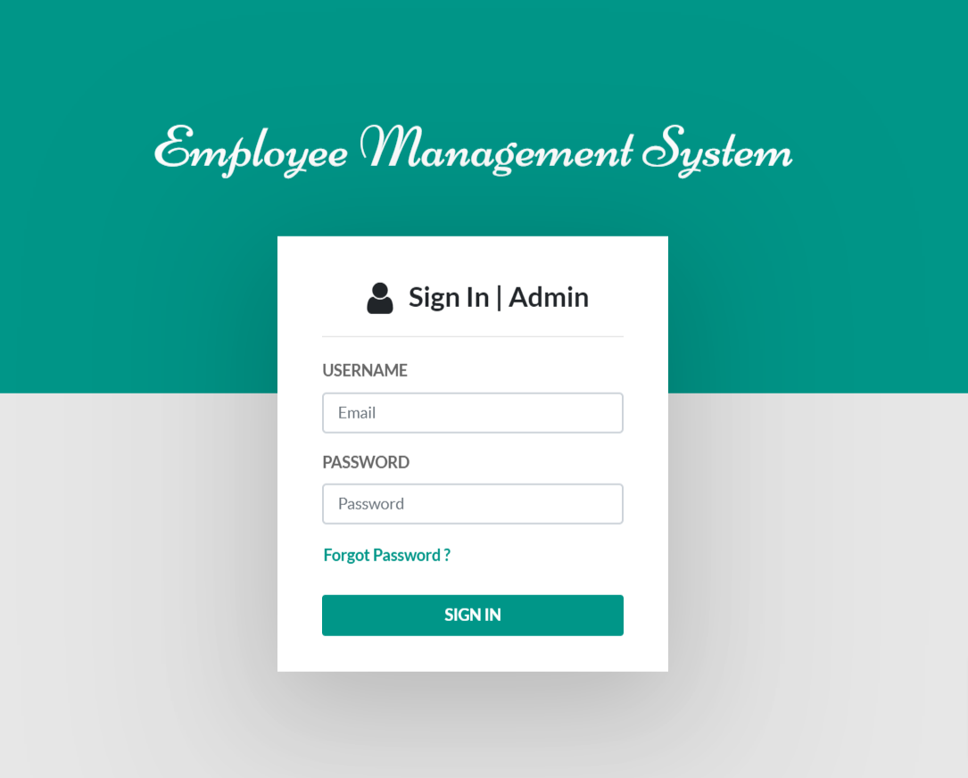
Project Screens

Slide 23
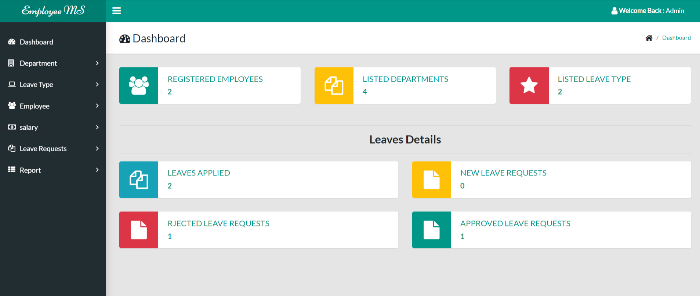
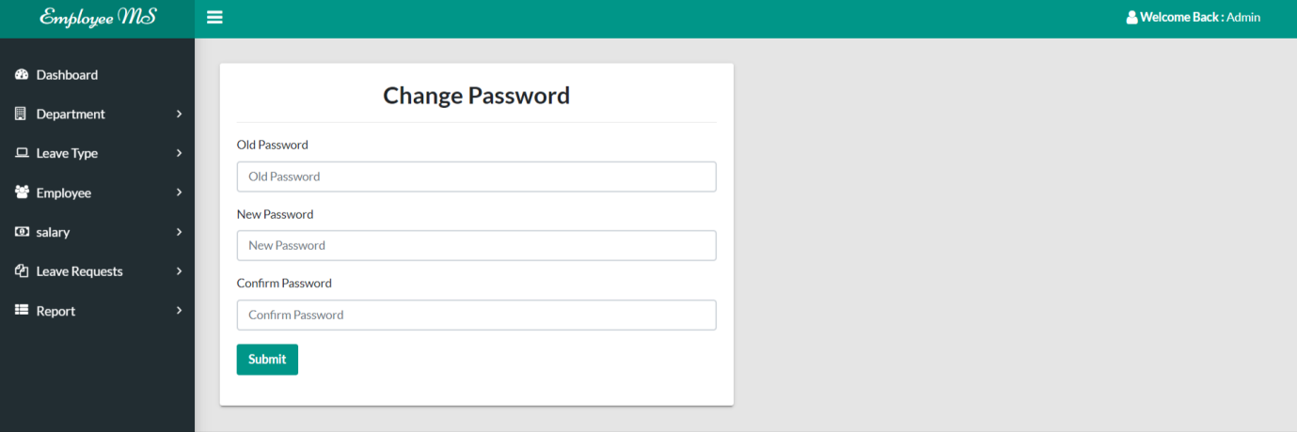

Slide 24
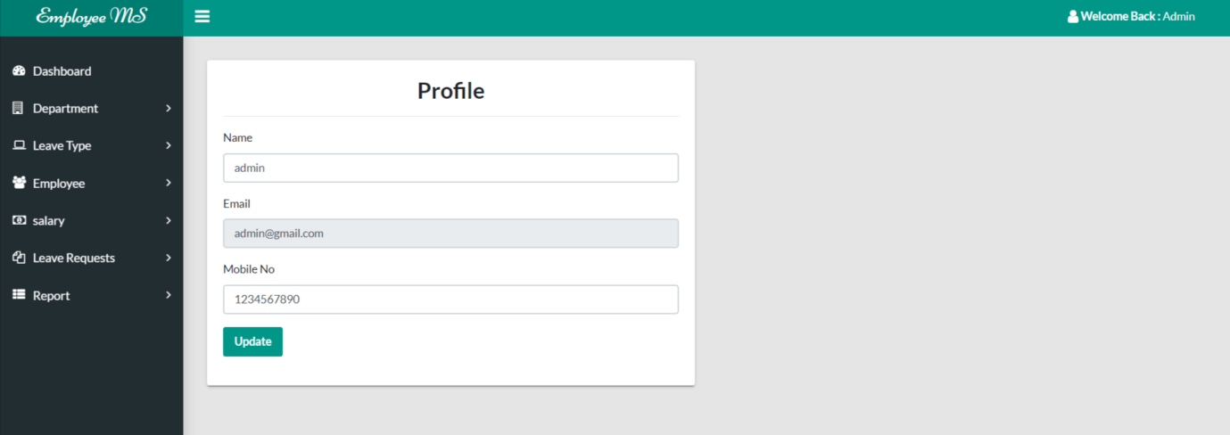
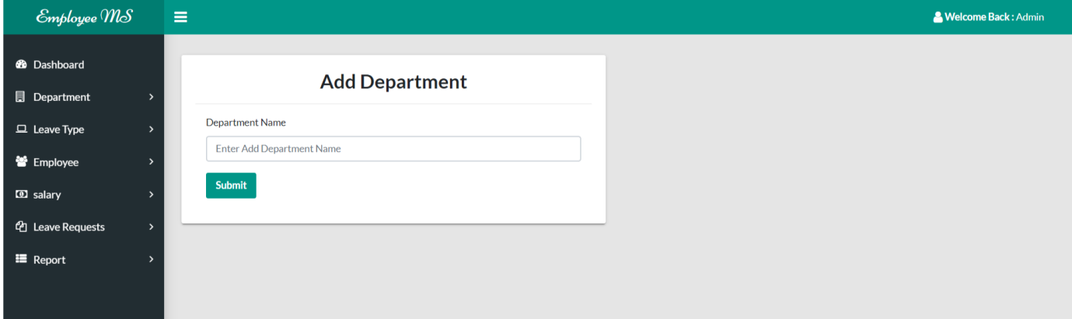
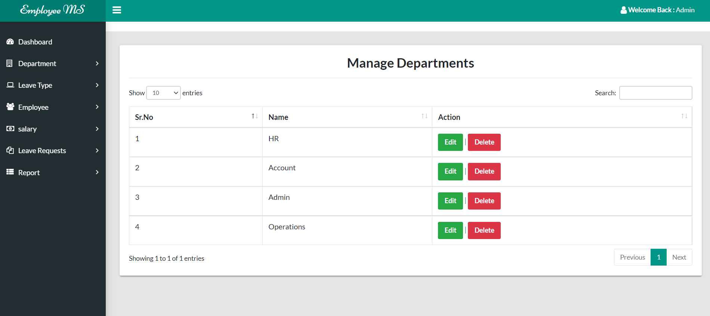

Slide 25
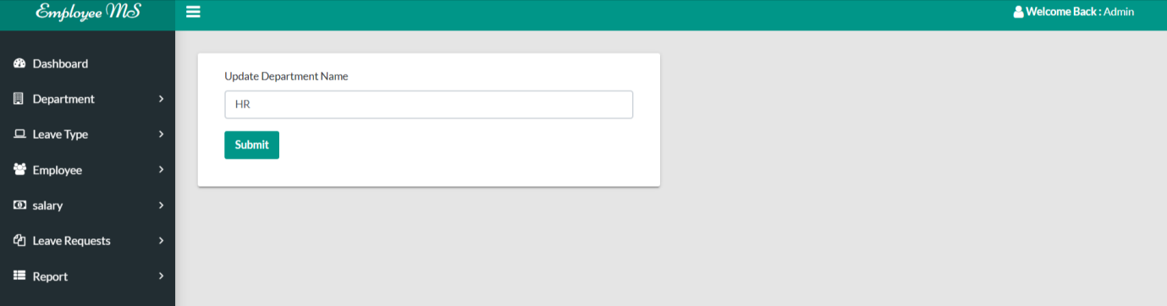
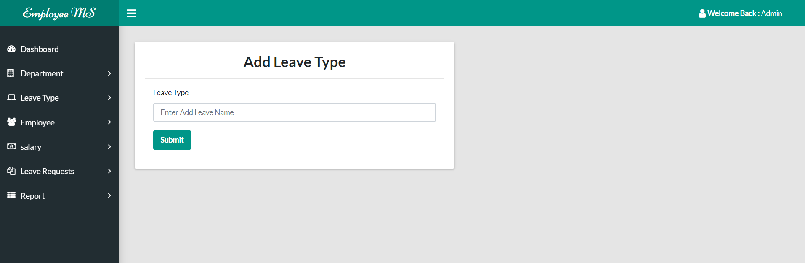
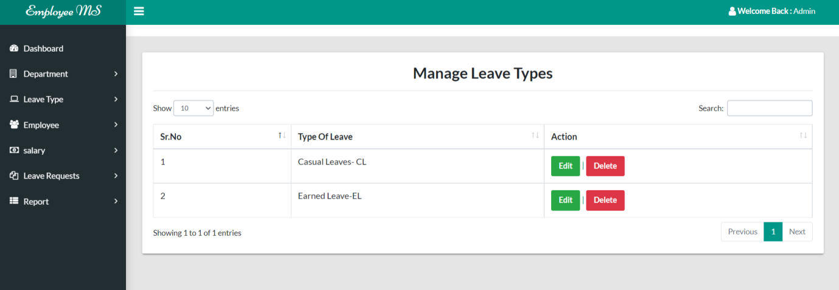

Slide 26
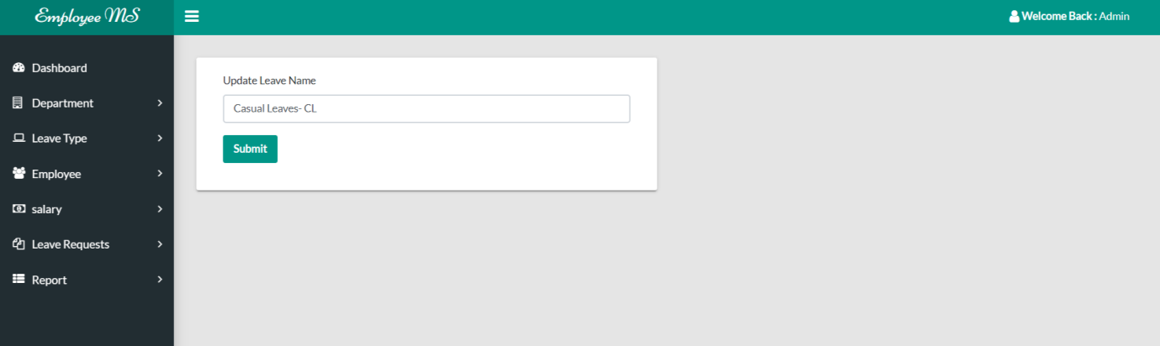

Slide 27
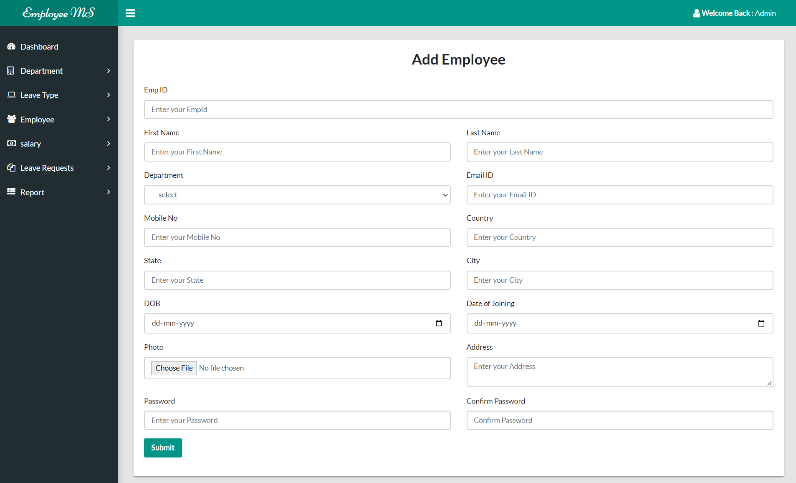

Slide 28
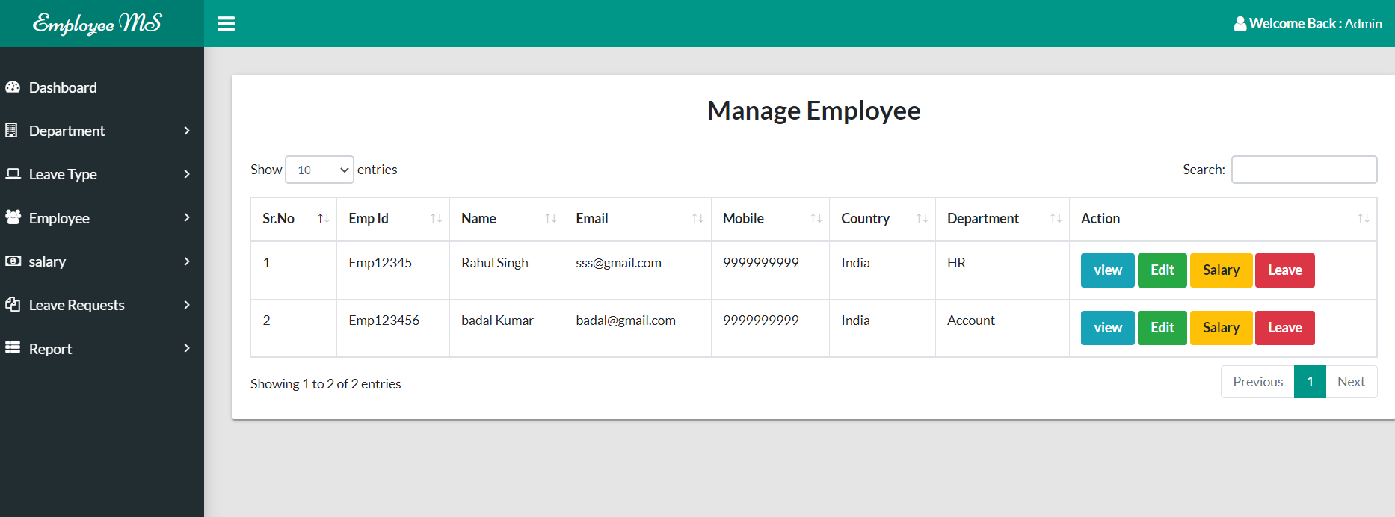
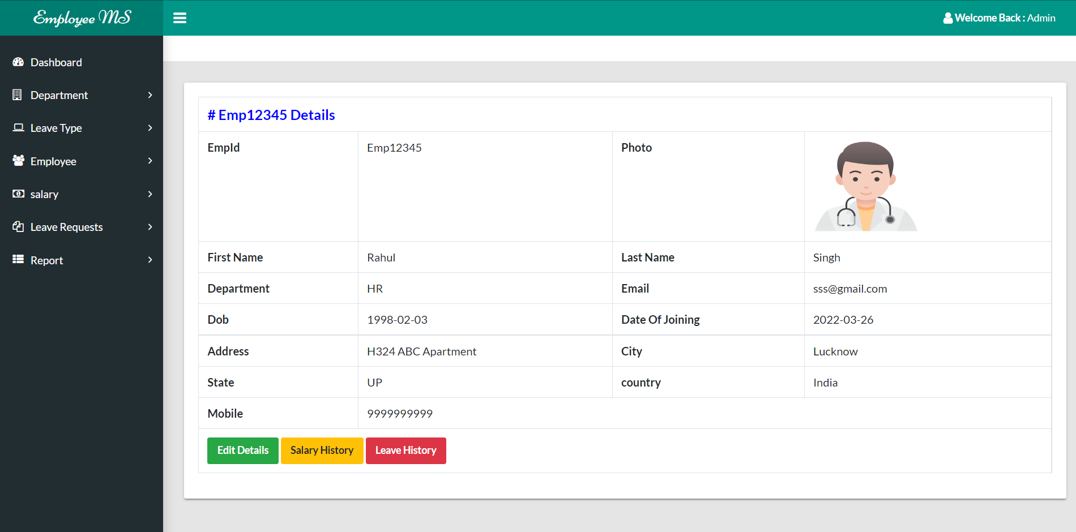

Slide 29
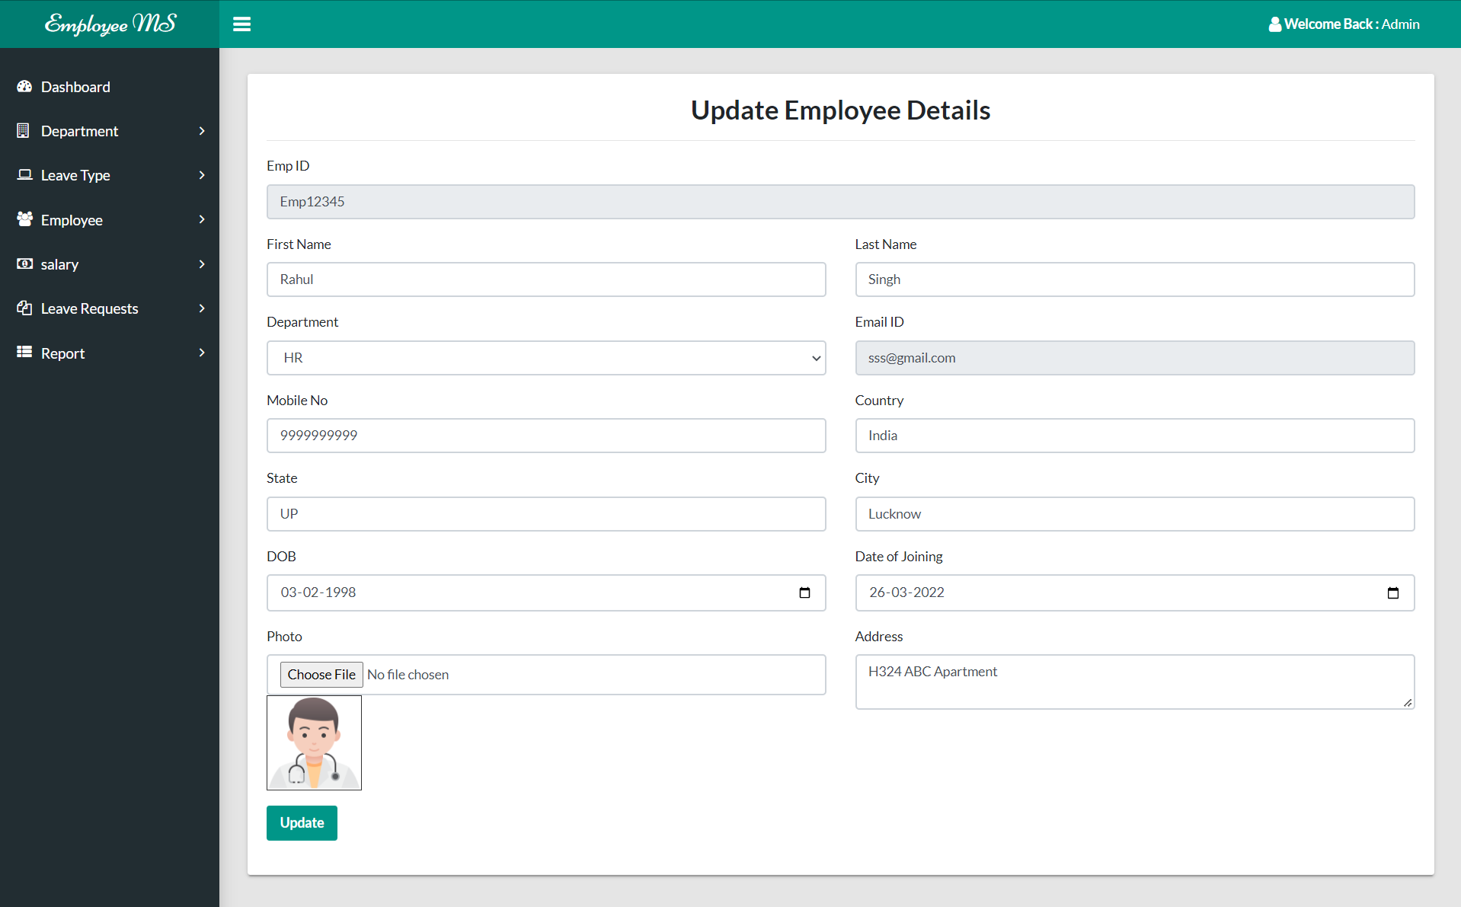
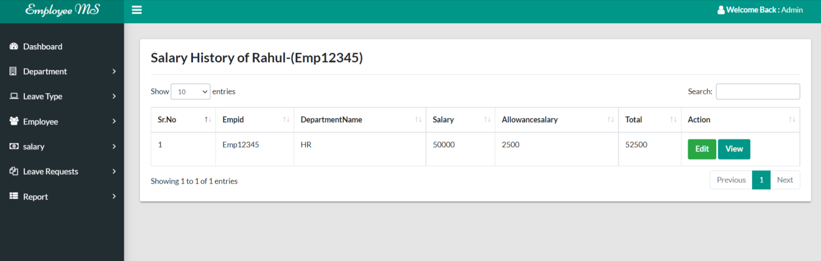

Slide 30
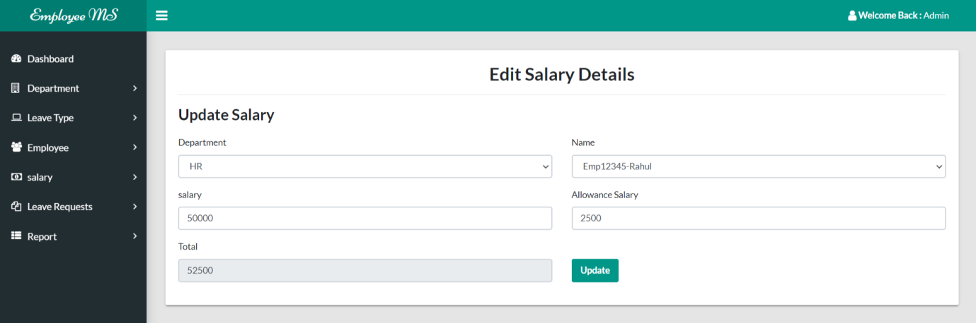
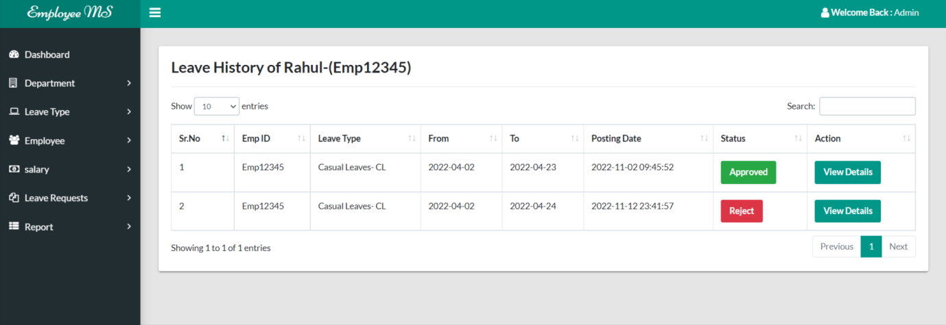
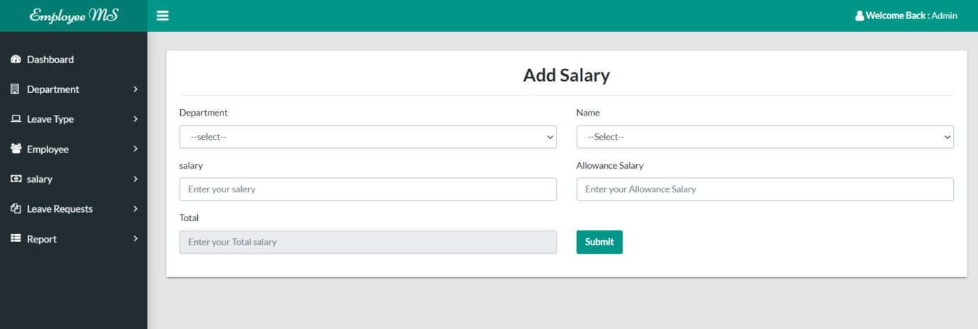

Slide 31
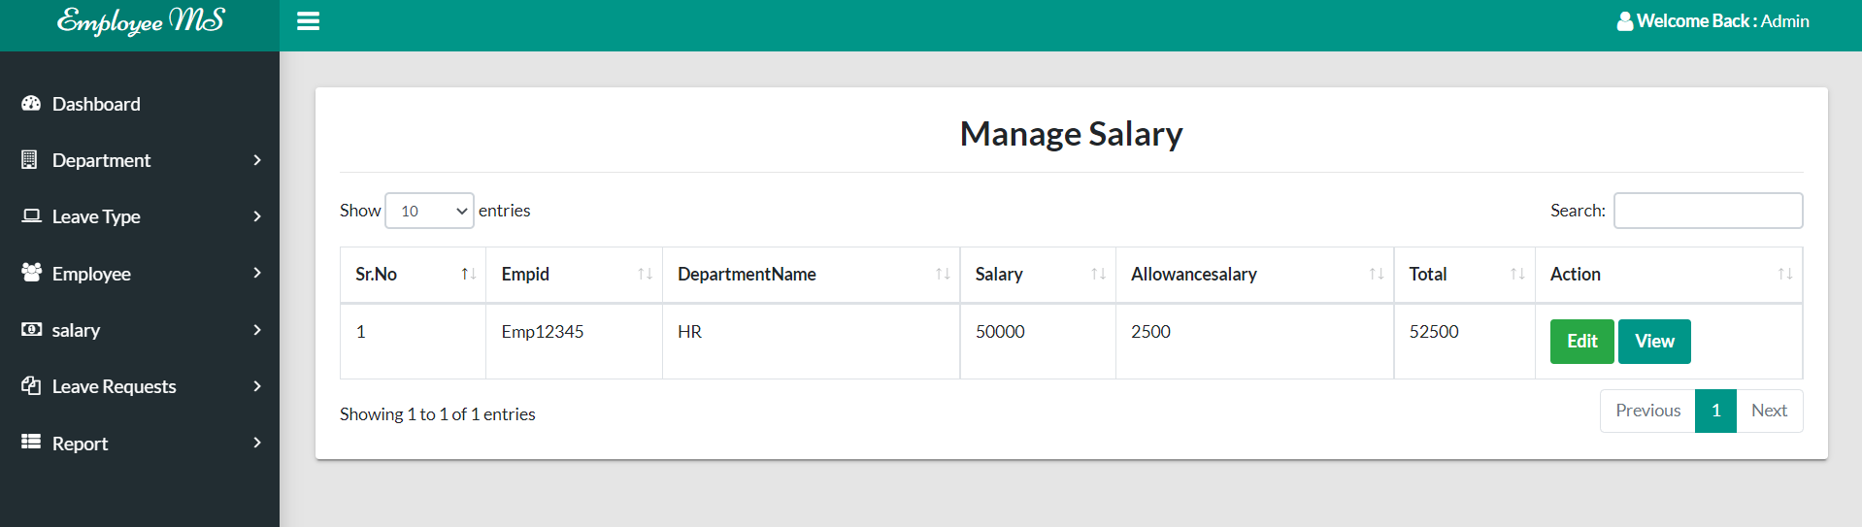
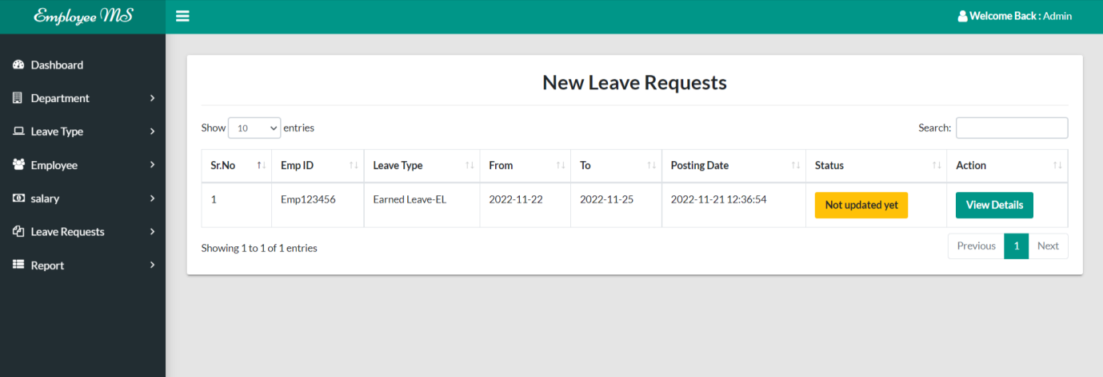
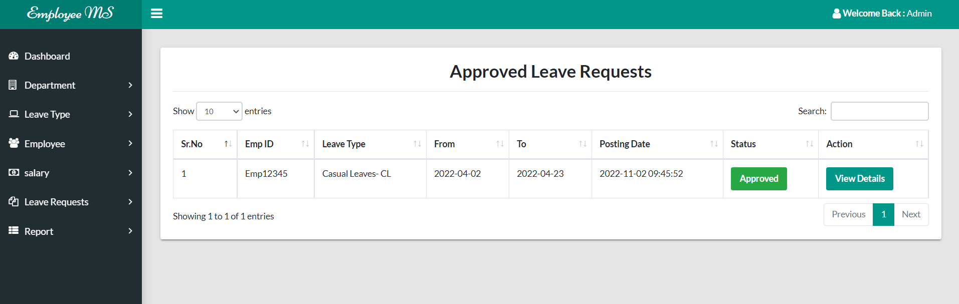

Slide 32
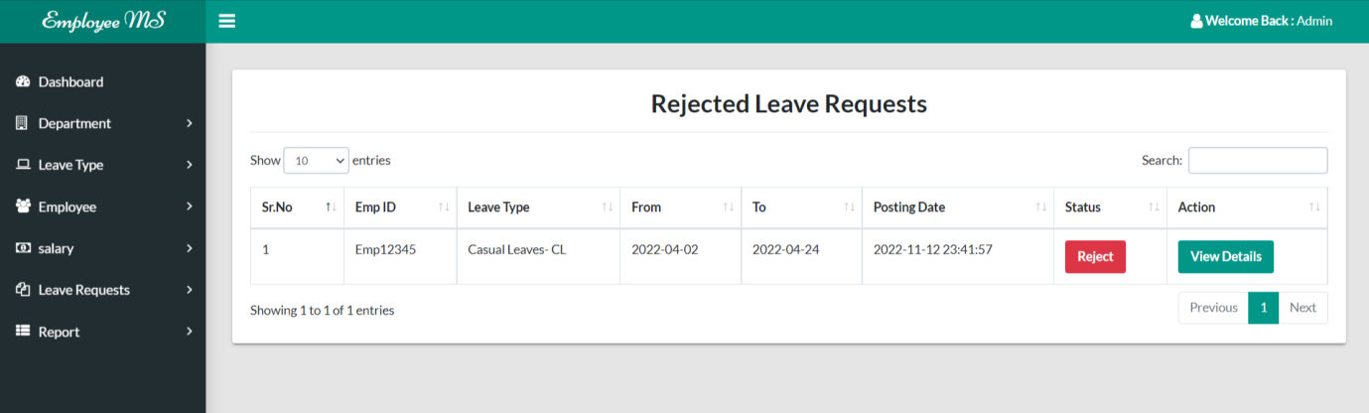
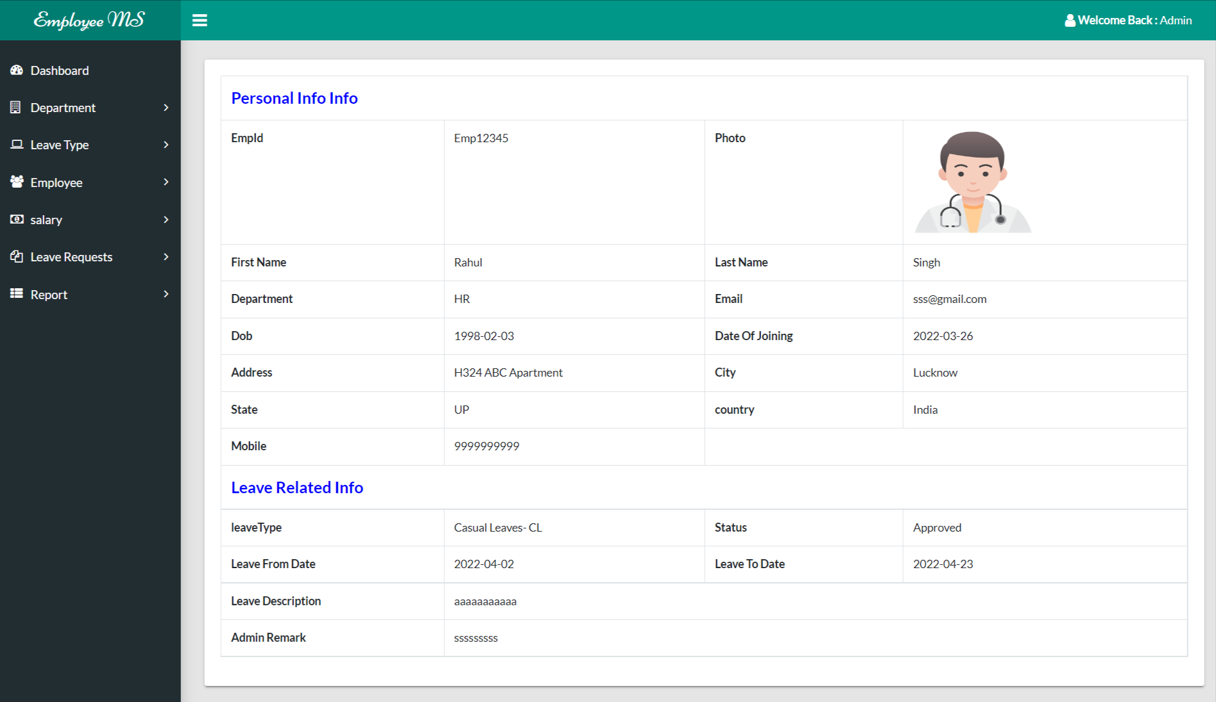

Slide 33
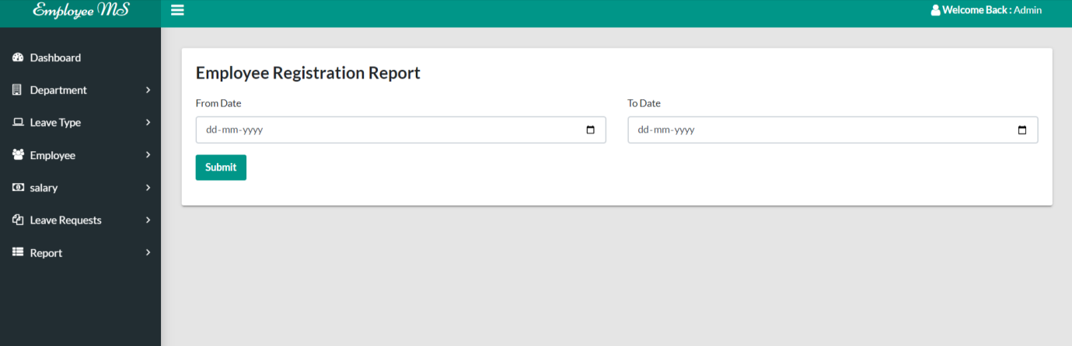
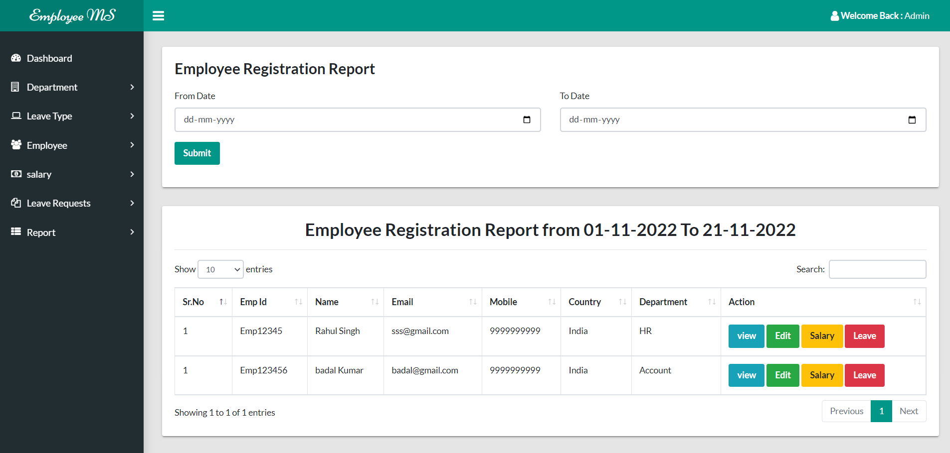

Slide 34
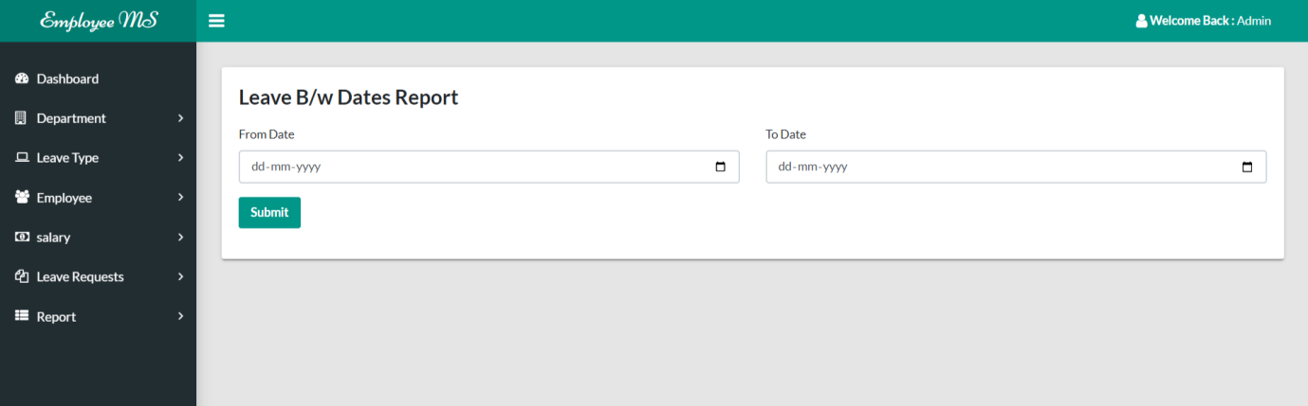
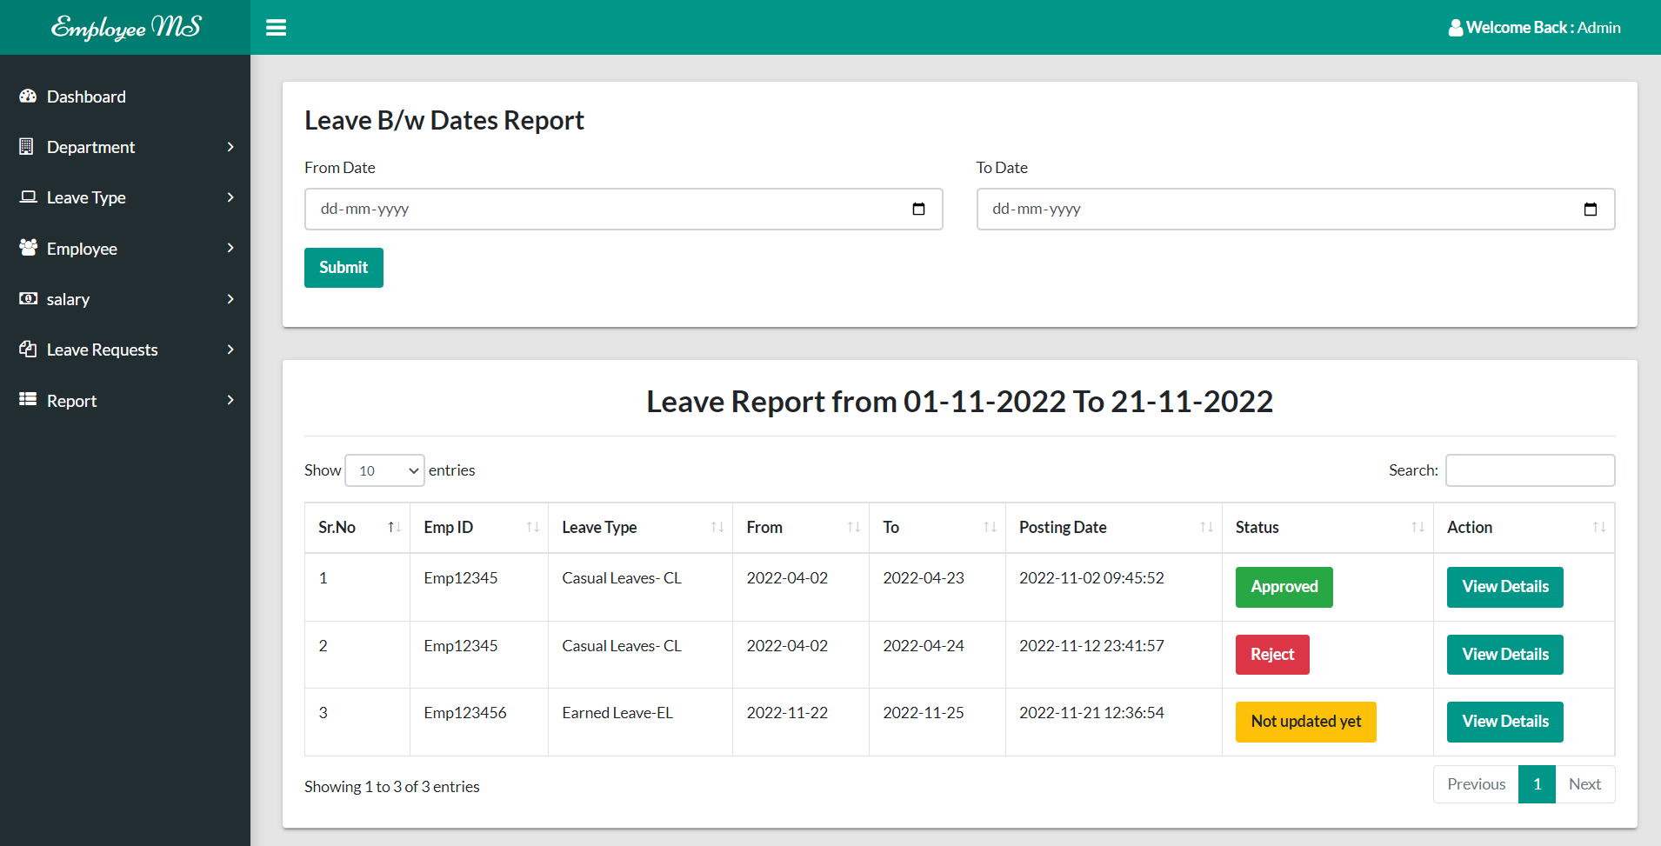

Slide 35
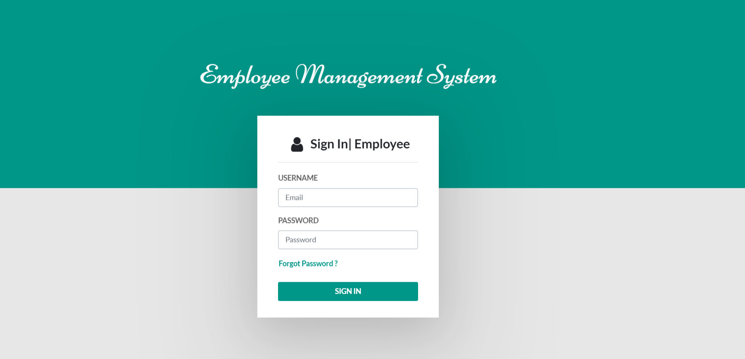
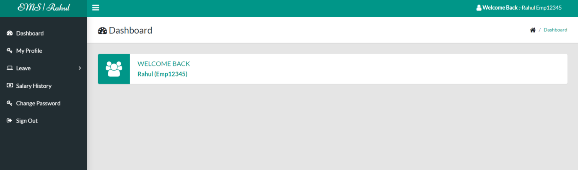

Slide 36
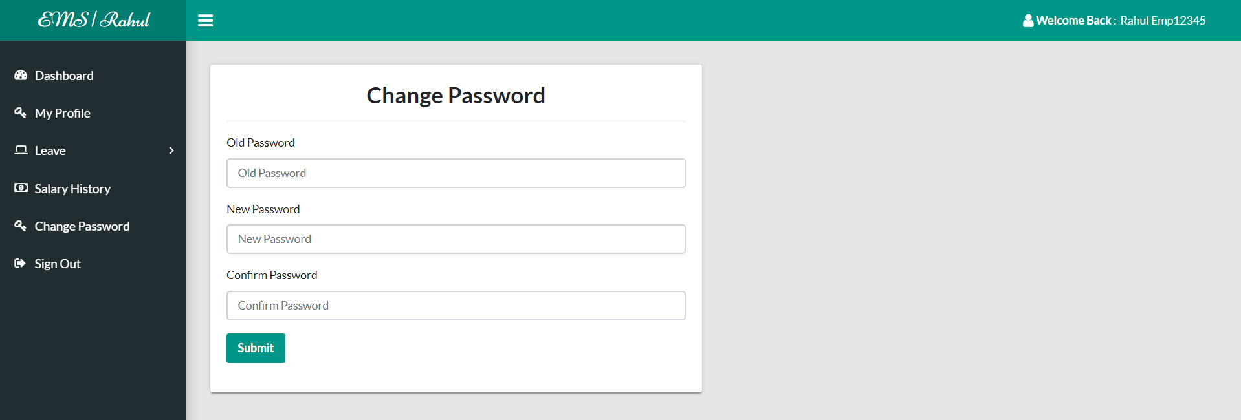
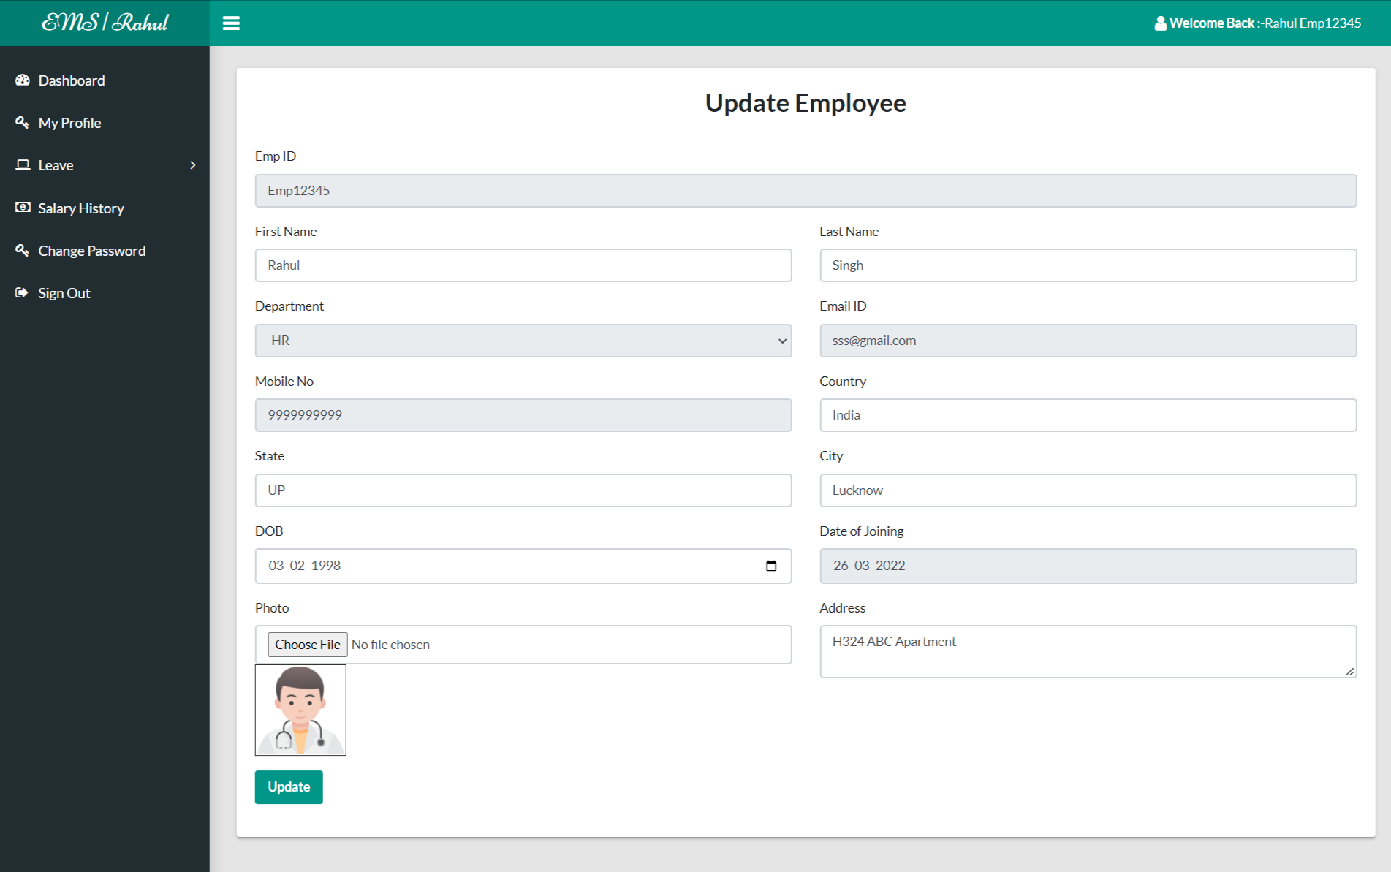

Slide 37
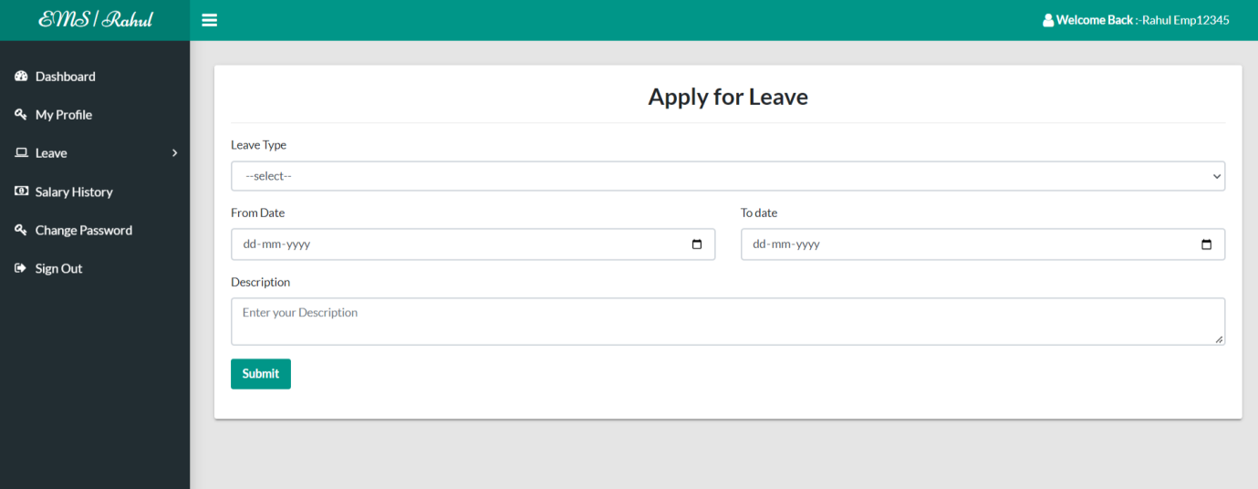
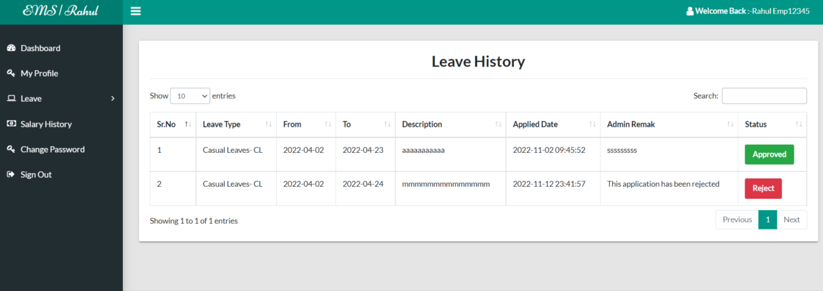

Slide 38
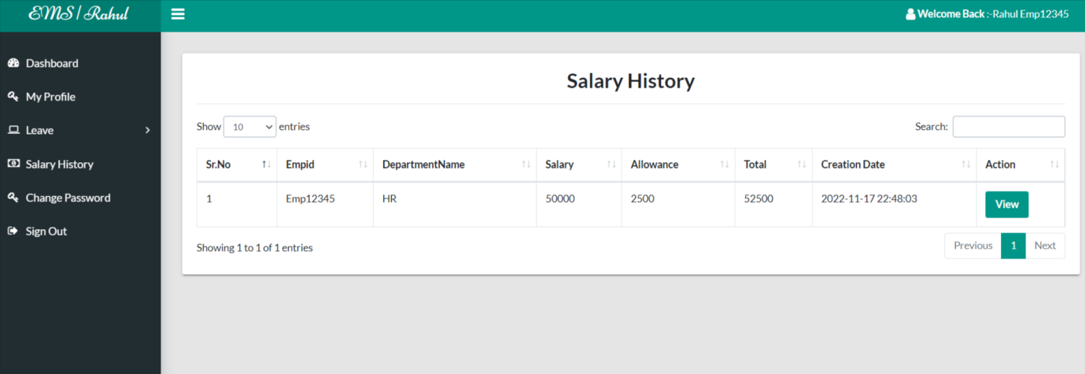
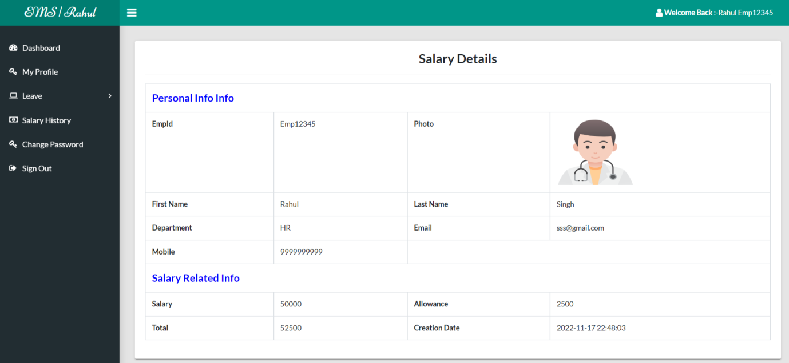

Slide 39
Conclusion
The project titled as Employee Management System was deeply studied and analyzed to design the code and implement. It was done under the guidance of the experienced project guide. All the current requirements and possibilities have been taken care during the project time.
Employee Management System can be used by companies to maintain the records of employee easily. Achieving this objective is difficult using a manual system as the information is scattered, can be redundant and collecting relevant information may be very time consuming. All these problems are solved using this project

Slide 40
References
For PHP
https://www.w3schools.com/php/default.asp
https://www.sitepoint.com/php/
https://www.php.net/
For MySQL
https://www.mysql.com/
http://www.mysqltutorial.org
For XAMPP
https://www.apachefriends.org/download.html

Slide 41
Thank You

