Slide 1

Gated Networks
Natural Language Processing Lecture Oct 31, 2022
Duke University, Pratt School of Engineering
Patrick Wang, Zachary C. Brown, Zexin Cai

Slide 2
House-keeping:
Assignment 7: details released on Wednesday
Final Project: due Dec. 19th (~7 weeks)

Slide 3
Introduction
Theoretical Details
LSTMs and Related Methods
Next Steps
References
Introduction
(Motivation and Overview)

Slide 4
Introduction
Theoretical Details
LSTMs and Related Methods
Next Steps
References
Introduction: Motivation
Observation: fully-connected RNNs are bad at long-range dependencies
Example: language modeling (auto-complete)
“The flights that the airline was cancelling were full.”
Guessing “were” instead of, e.g., “was” requires remembering that “flights” was plural (even though “airline” was singular).
See [1]

Slide 5
Introduction
Theoretical Details
LSTMs and Related Methods
Next Steps
References
Theoretical Details
(Analyses of Memory-Deficient RNNs)

Slide 6
Introduction
Theoretical Details
LSTMs and Related Methods
Next Steps
References
Theoretical Details: Analyses
Why?
In theory, each iteration of the RNN can receive information from anywhere in the past.
However, in practice:
The “message” passed between iterations is of finite size, and we may need to pass unbounded amounts of information!
“Remembering” the distant past requires a lot of work
More layers/nodes/weights/data/time is required to learn to compact the necessary information into the message vector
The vanishing gradient problem …
See [1]

Slide 7
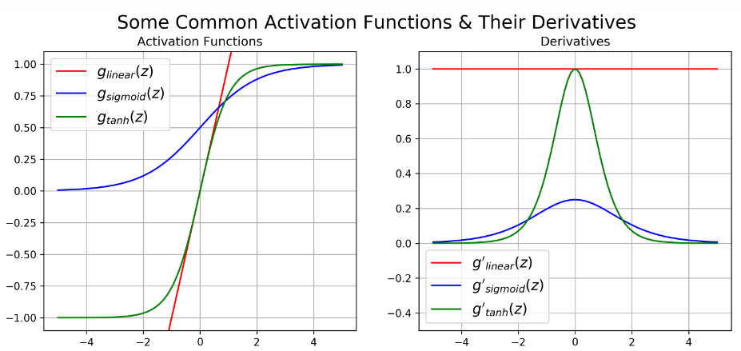
Introduction
Theoretical Details
LSTMs and Related Methods
Next Steps
References
Theoretical Details: Vanishing Gradient
Classical activation functions:
Many have derivatives strictly <1
E.g. sigmoid, tanh
In backpropagation, errors are multiplied by these derivatives
See [1, 2]

Slide 8
Introduction
Theoretical Details
LSTMs and Related Methods
Next Steps
References
Theoretical Details: Vanishing Gradient
Classical activation functions:
Many have derivatives strictly <1
E.g. sigmoid, tanh
In backpropagation, errors are multiplied by these derivatives
In “deep” neural networks and/or RNNs
Successive derivatives for each layer/iteration compound errors
Gradients from the output become very small (i.e. “vanishing”)
For other activation functions, e.g. ReLU, the opposite can happen (i.e. “exploding” gradients)
(Stochastic) Gradient descent then stalls
See [1, 2]

Slide 9
Introduction
Theoretical Details
LSTMs and Related Methods
Next Steps
References
Theoretical Details: Solutions
More data, processing power (expensive)
Non-saturating activation function, e.g. ReLU
Oh yeah, exploding gradients …
Effectively “shallower” network structure
Residual connections in “deep” neural networks
Gated networks for RNNs
See [1]

Slide 10
Introduction
Theoretical Details
LSTMs and Related Methods
Next Steps
References
LSTMs and Related Methods
(Addressing Memory-Deficiency in RNNs)

Slide 11
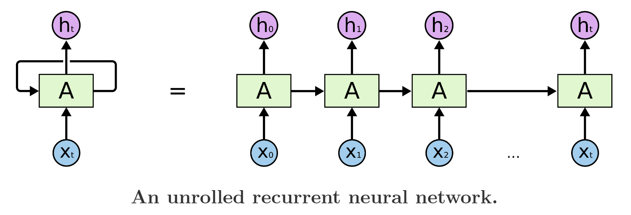
Introduction
Theoretical Details
LSTMs and Related Methods
Next Steps
References
LSTMs: Reviewing ‘Vanilla’ RNNs
See [1, 3]

Slide 12
Introduction
Theoretical Details
LSTMs and Related Methods
Next Steps
References
LSTMs: Reviewing ‘Vanilla’ RNNs
See [1, 3]

Slide 13
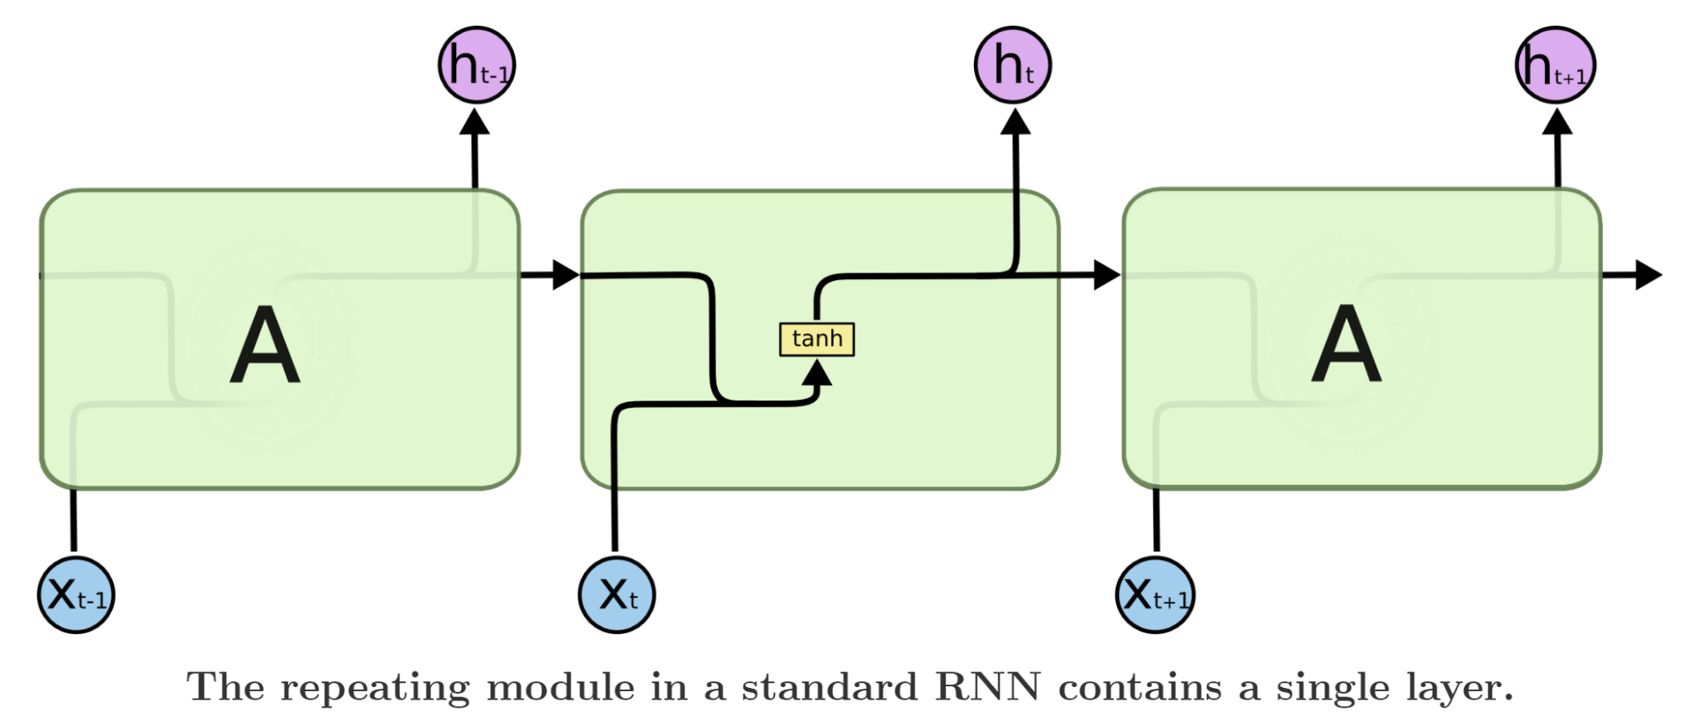
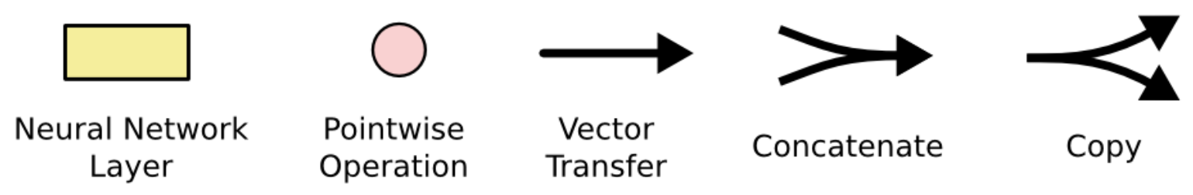
Introduction
Theoretical Details
LSTMs and Related Methods
Next Steps
References
LSTMs: Reviewing ‘Vanilla’ RNNs
See [1, 3]

Slide 14
Introduction
Theoretical Details
LSTMs and Related Methods
Next Steps
References
LSTMs: Reviewing ‘Vanilla’ RNNs
Memory Bottleneck
See [1, 3]

Slide 15
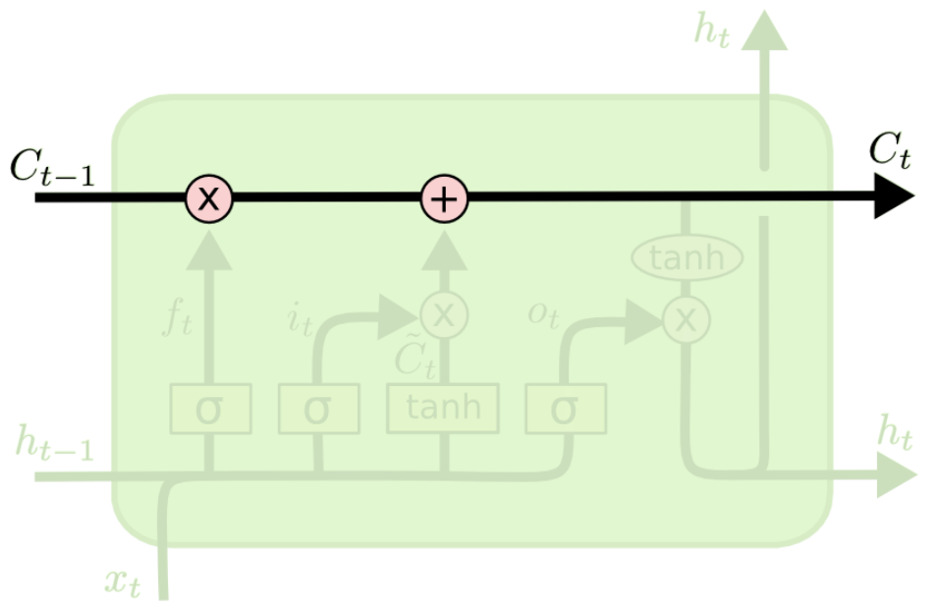
Introduction
Theoretical Details
LSTMs and Related Methods
Next Steps
References
LSTMs: Long-term Memory Mechanism
See [1, 3]

Slide 16
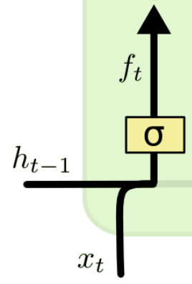

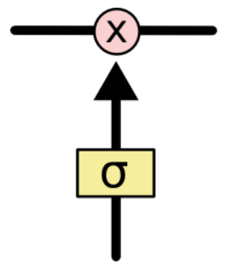
Introduction
Theoretical Details
LSTMs and Related Methods
Next Steps
References
LSTMs: ‘Forgetting’ Long-term Memory
Gates
See [1, 3]

Slide 17
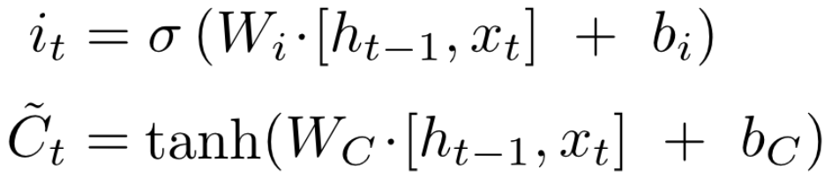
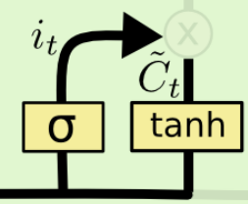
Introduction
Theoretical Details
LSTMs and Related Methods
Next Steps
References
LSTMs: ‘Updating’ Long-term Memory
Identify values to update
Generate new candidate values
See [1, 3]

Slide 18


Introduction
Theoretical Details
LSTMs and Related Methods
Next Steps
References
LSTMs: ‘Updating’ Long-term Memory
Update long-term memory
See [1, 3]

Slide 19
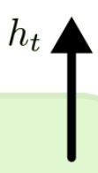
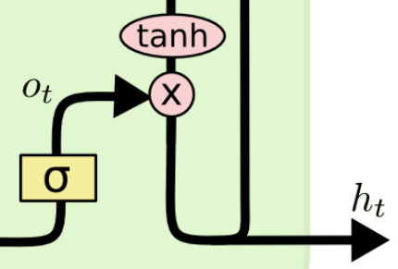
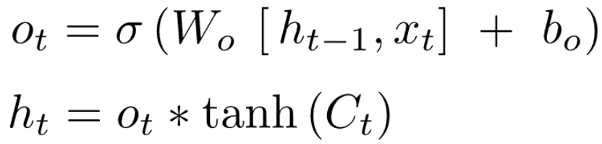
Introduction
Theoretical Details
LSTMs and Related Methods
Next Steps
References
LSTMs: Generating Output
See [1, 3]

Slide 20

Introduction
Theoretical Details
LSTMs and Related Methods
Next Steps
References
5 Minute Break
https://me.me/i/moch-mucch-much-later-2-hours-later-spongebob-download-80498-d7a0e90deb1e409a90d03e44f25508f2

Slide 21
Introduction
Theoretical Details
LSTMs and Related Methods
Next Steps
References
5 Minute Break

Slide 22
Introduction
Theoretical Details
LSTMs and Related Methods
Next Steps
References
Ex: Sentiment Analysis
(Gated Networks for NLP)

Slide 23
Introduction
Theoretical Details
LSTMs and Related Methods
Next Steps
References
Sentiment Analysis: Intro
Goal: design an RNN that outputs the cumulative net sentiment at each position in a word sequence
Vocabulary: [“good”, “bad”, “uh”, “not”]
See [1]

Slide 24
Introduction
Theoretical Details
LSTMs and Related Methods
Next Steps
References
Sentiment Analysis: Example Details
You can find the solution in l18_sentiment_analyzer.pdf
This contrived example illustrates the need for:
a long-term memory (the cumulative sum)
undergoes (relatively) few modifications
a short-term memory (the “not” flag)
undergoes a lot of processing
See [1]

Slide 25
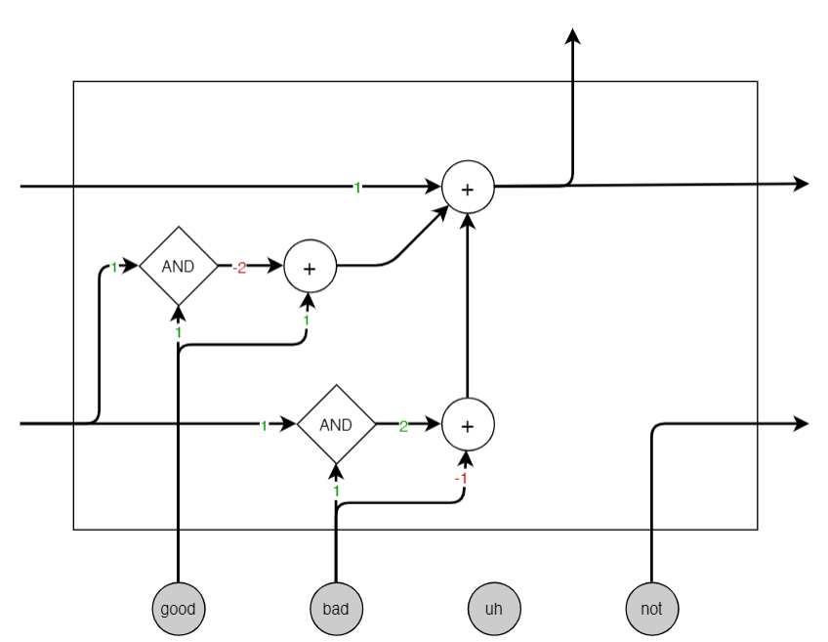
Introduction
Theoretical Details
LSTMs and Related Methods
Next Steps
References
Sentiment Analysis: Recording “good”
Long-term Memory
See [1]

Slide 26
Introduction
Theoretical Details
LSTMs and Related Methods
Next Steps
References
Sentiment Analysis: Recognizing “bad”
See [1]

Slide 27
Introduction
Theoretical Details
LSTMs and Related Methods
Next Steps
References
Sentiment Analysis: “not good”
Short-term Memory
See [1]
Notes:
A negation impact the next word
Instead of being stored in long term memory
We are going to feed it onto the next cell to worry about because really we don’t know what’s being negated yet

Slide 28
Introduction
Theoretical Details
LSTMs and Related Methods
Next Steps
References
Sentiment Analysis: “not good”
See [1]
Notes:
If there is a negation, whatever this good word that’s being fed in is not actually good, it’s bad
So the output of the ‘AND’ is going to be negative
But it added here with one because we did see a good word --- goes back to negative one
[all the weights are idealized version]

Slide 29
Introduction
Theoretical Details
LSTMs and Related Methods
Next Steps
References
Sentiment Analysis: Full model
See [1]

Slide 30
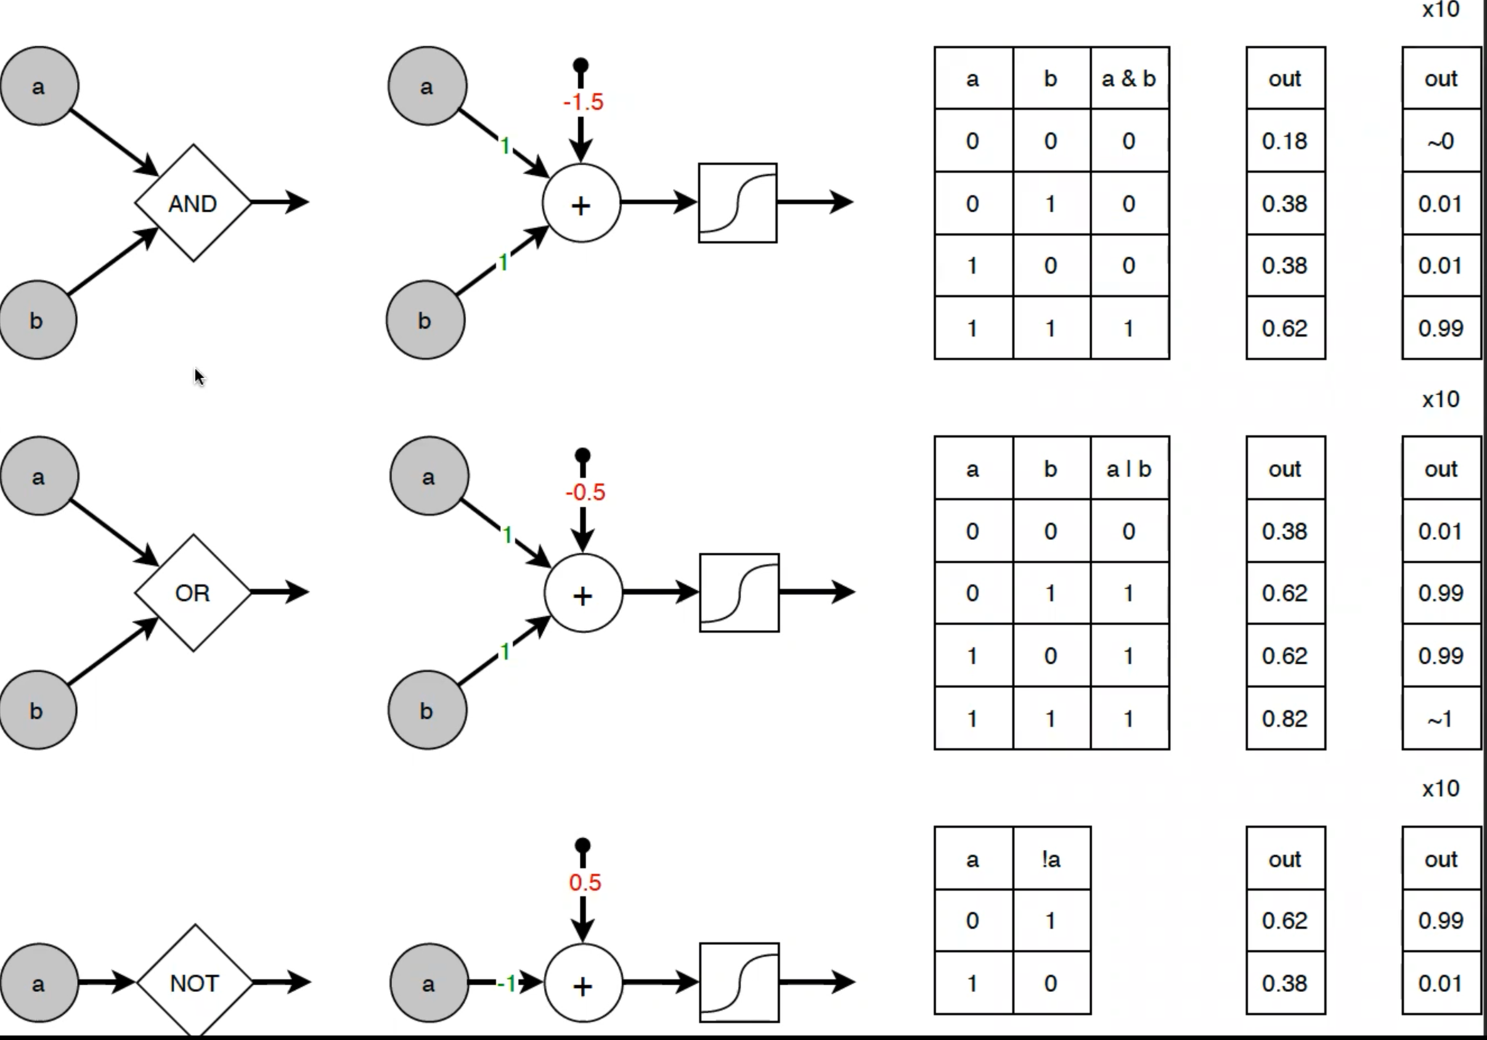
Introduction
Theoretical Details
LSTMs and Related Methods
Next Steps
References
Sentiment Analysis: Alternative Gates
See [1]

Slide 31
Introduction
Theoretical Details
LSTMs and Related Methods
Next Steps
References
Next Steps
(Beyond Gated Networks)

Slide 32
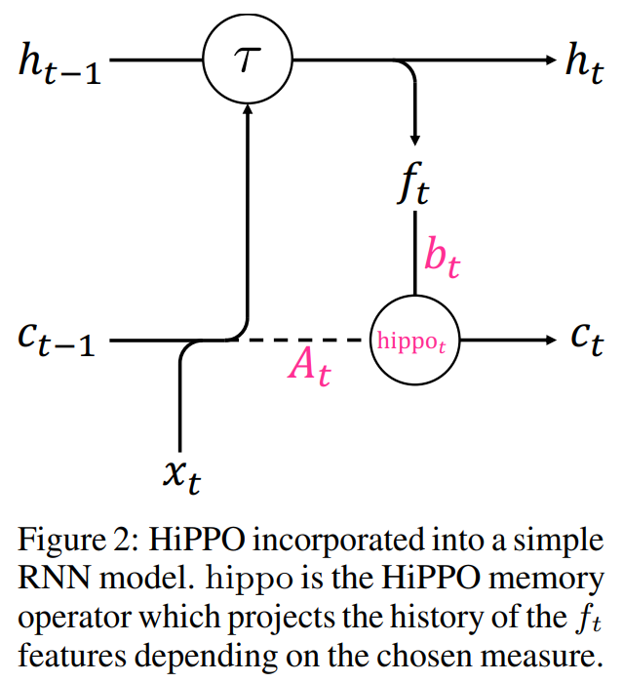
Introduction
Theoretical Details
LSTMs and Related Methods
Next Steps
References
Next Steps:
Gated networks:
Make long-range dependencies easier to handle
Do not solve the (distant memory) problem entirely
The “message” passed between iterations is still of finite size and we may need to pass unbounded amounts of information
Attention networks will provide a better solution …
Other interesting work (not covered in scope of course) related to gated networks:
HiPPO [4]
See [1, 4]

Slide 33
Introduction
Theoretical Details
LSTMs and Related Methods
Next Steps
References
References:
[1] “Gated Networks” slides, Patrick Wang, 10/29/2022
[2] https://dustinstansbury.github.io/theclevermachine/derivation-common-neural-network-activation-functions
[3] https://colah.github.io/posts/2015-08-Understanding-LSTMs/
[4] https://proceedings.neurips.cc/paper/2020/file/102f0bb6efb3a6128a3c750dd16729be-Paper.pdf

