Slide 1
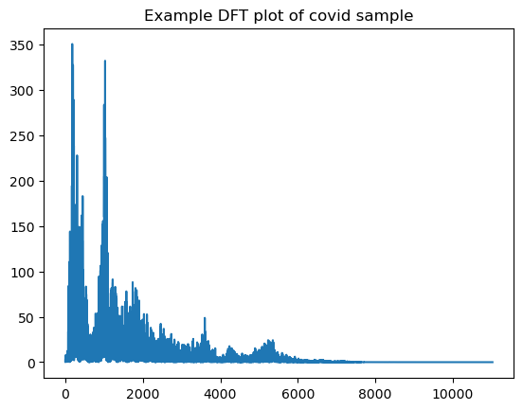
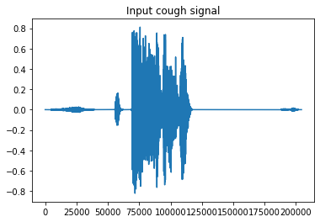
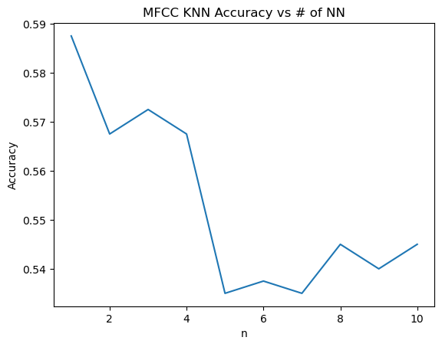
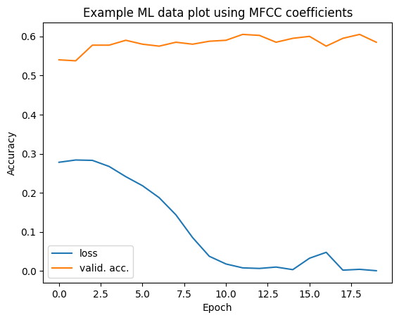
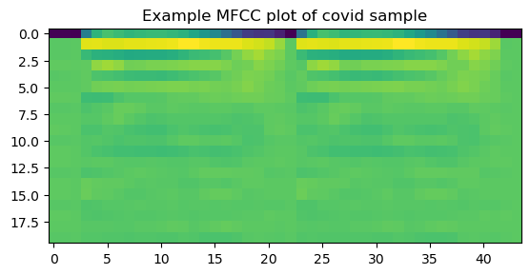
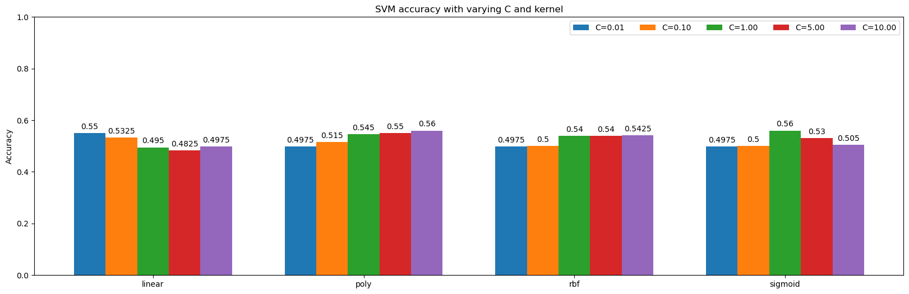
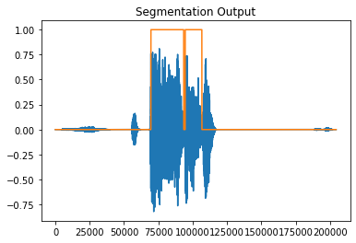
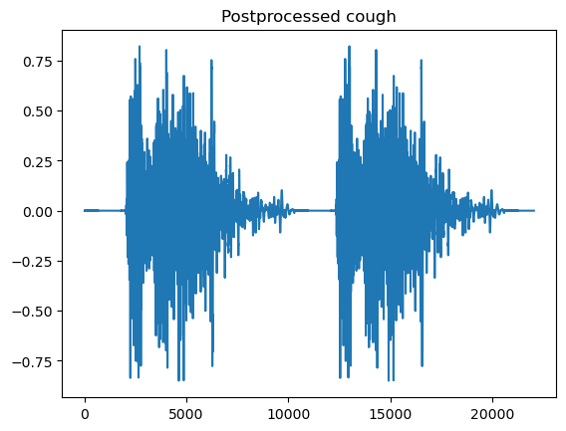
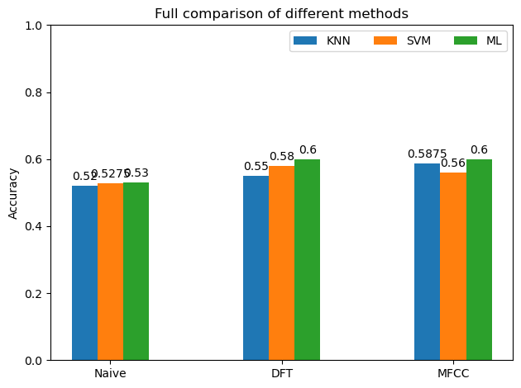
The Role of Processing Cough Audio to Detect Covid-19
Stephen Zhu, srzhu3@stanford.edu
Electrical Engineering
Abstract
Dataset
Data Preprocessing (Cont.)
Results and Plots
This project aims to examine the role of signal processing in aiding audio classification, specifically detecting Covid-19 in cough audio files. During the pandemic, it took some time before the first accessible covid tests were released, posing a global health issue. If we were to collect data early on and use machine learning in the future, we would potentially be able to deploy these accessible tests at a much faster rate, and at significantly less cost.
This project compares the accuracies of different classification techniques, namely KNN, SVM, and ML, combined with different forms of signal processing on the COUGHVID dataset [1]. The types of processing used are: no processing, DFT, and MFCC. As shown in this project, adding even one layer of signal processing can boost classification accuracy.
COUGHVID dataset
Healthy, (symptomatic,) covid
Varying lengths, background noise, etc.
NN structure: Input -> Linear -> ReLU -> Linear -> ReLU -> Softmax -> Output
20 epochs, batch size 4, MSE loss, Adam Optimizer (learning rate varied)
Data Preprocessing
Sample rate, segmentation , resizing, normalization
Discussion
In general, KNN worst, ML best
For KNN, 1 neighbor performed best
For SVM, depended on method
Future Work
References
Accuracy
Use rest of dataset
Combining types of processing
Fine-tuning of classifiers and hyperparameters
Different techniques (wavelets, etc.)
Other Applications
Flu detection
[1] Orlandic, L., Teijeiro, T. & Atienza, D. The COUGHVID crowdsourcing dataset, a corpus for the study of large-scale cough analysis algorithms. *Sci Data* 8, 156 (2021). https://doi.org/10.1038/s41597-021-00937-4

