Slide 1
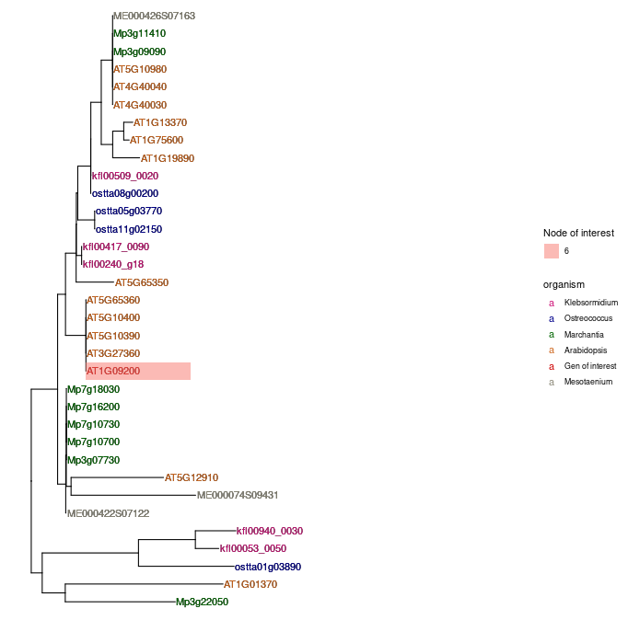

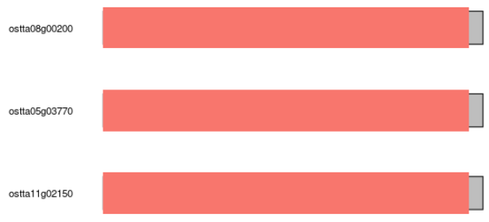


Histone
H3.3
H3.1
Centromeric H3

Slide 2
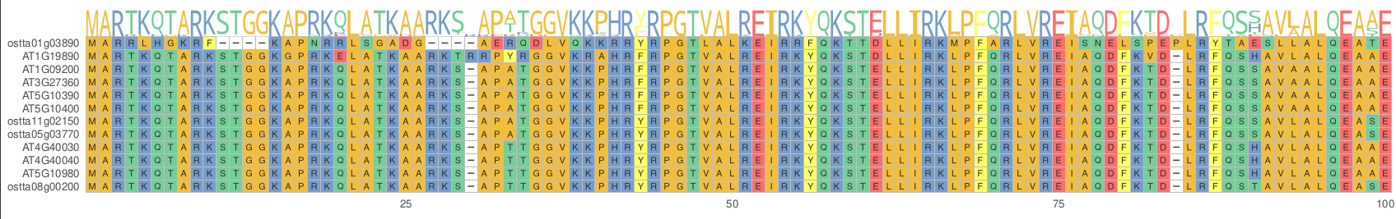
K4
K27
31,32
41

Slide 3
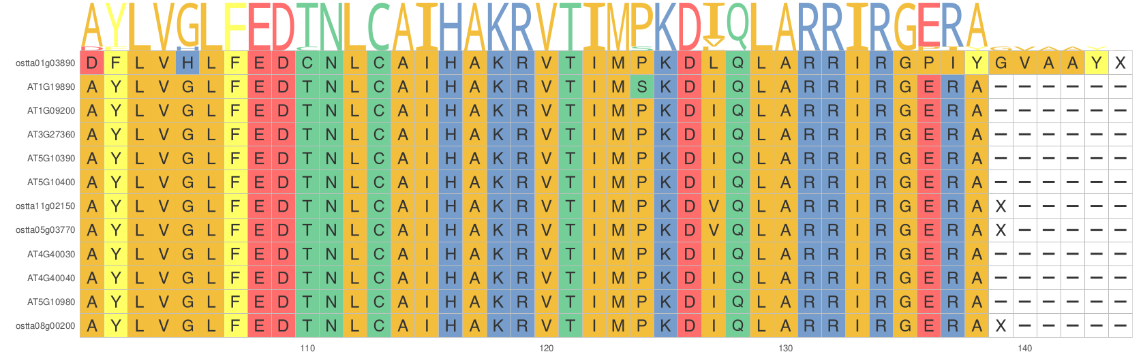

Slide 4
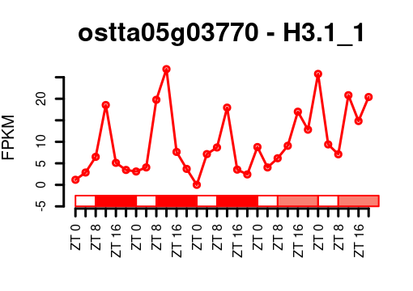
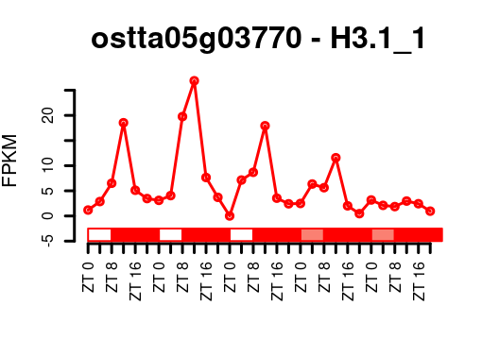
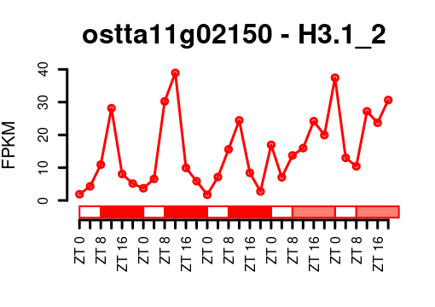
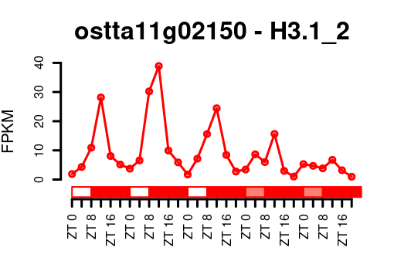
G1
S
G2
OsttaH3.1 (ostta05g03770 and ostta11g02150) are co-expressed and light regulated, being activated by light and repressed by dark. Expressed only during the S phase of the cell cycle.

Slide 5
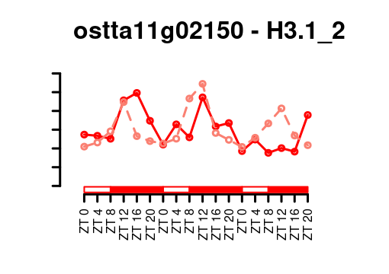
OsttaH3.1 (ostta11g02150) no offset between transcript and protein abundance profiles. Protein peak of abundance reached during the S phase of the cell cycle.

Slide 6
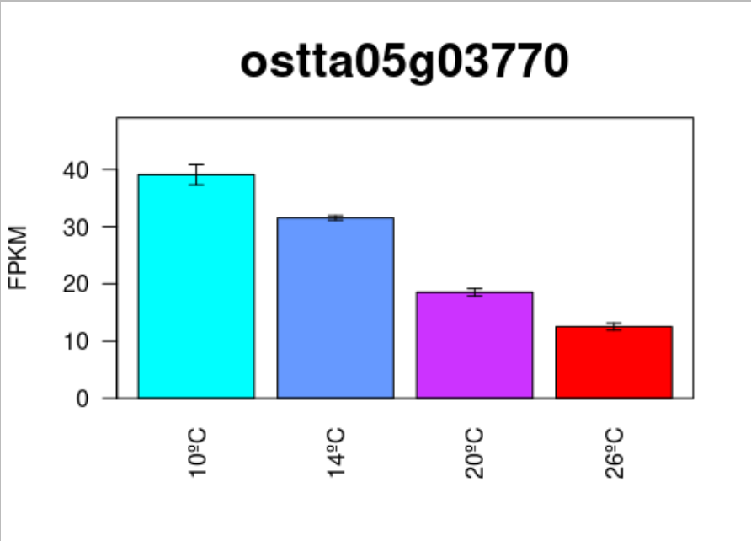
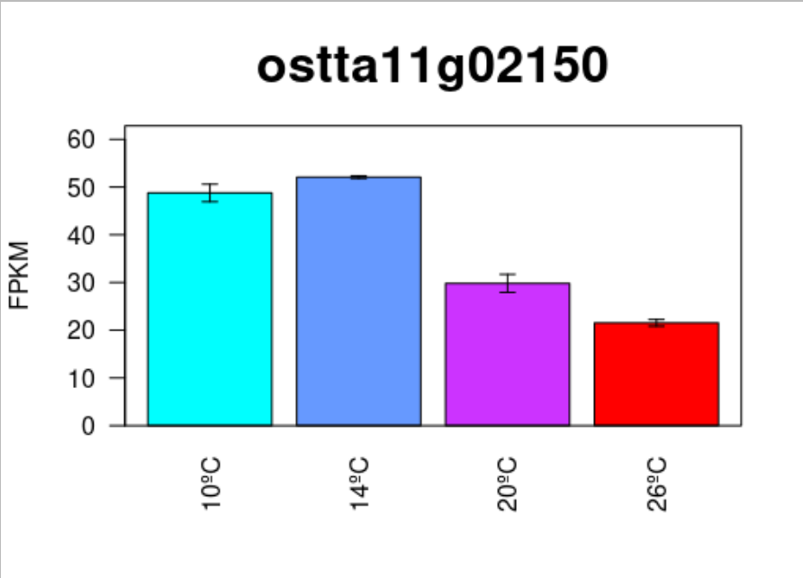

Slide 7
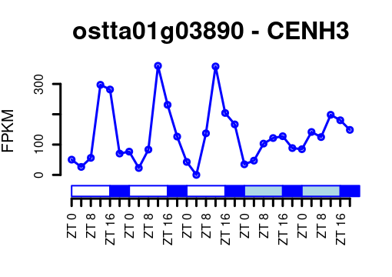
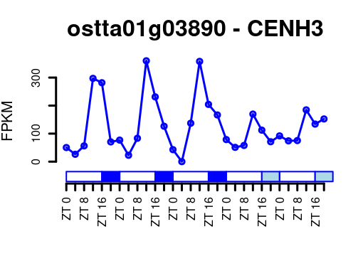
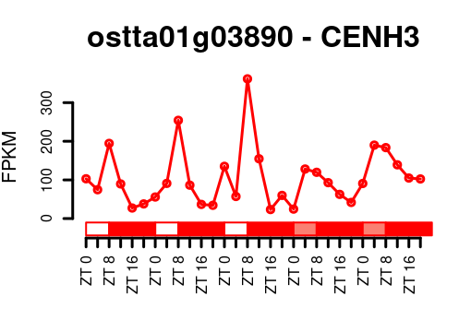
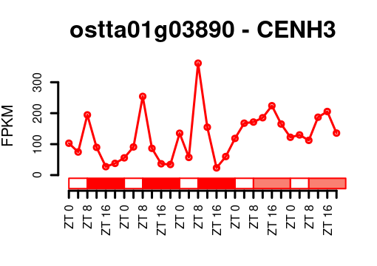

Slide 8
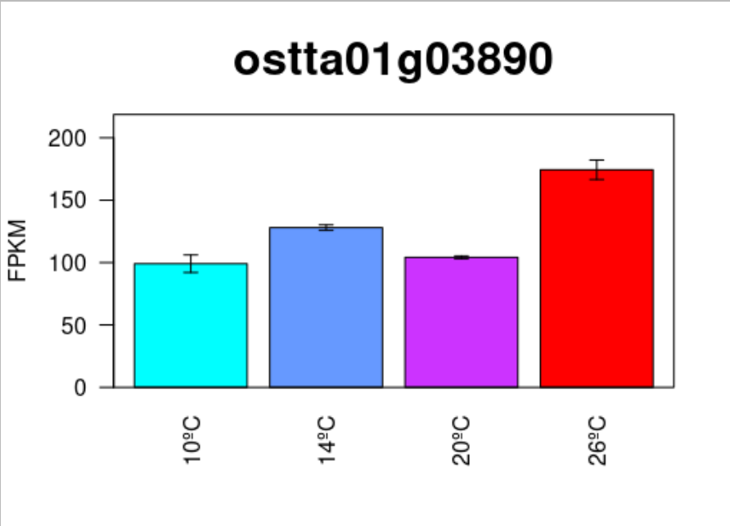

Slide 9
H3.1 profile is similar to DNA replication genes including PCNA

Slide 10
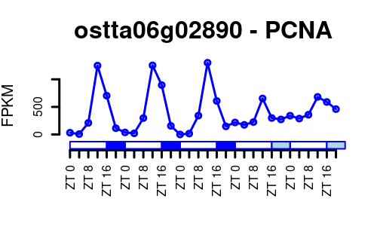
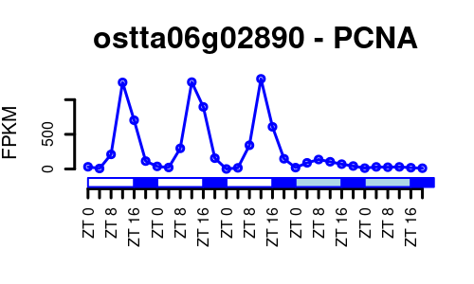
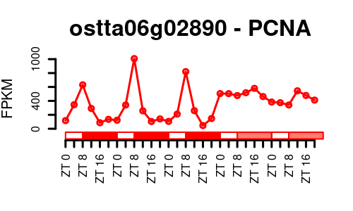
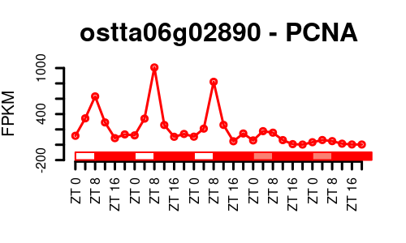

Slide 11
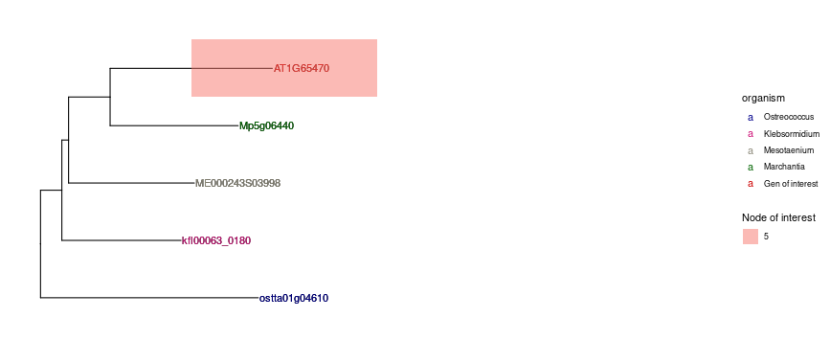
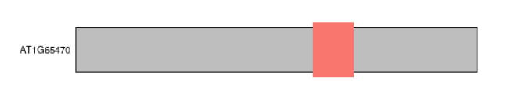
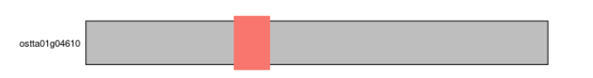
CAF1A
CAF1A

Slide 12
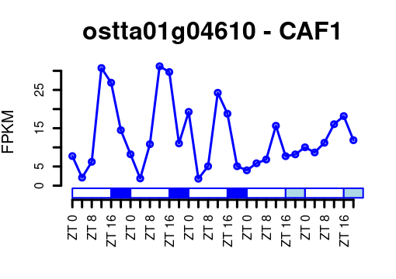
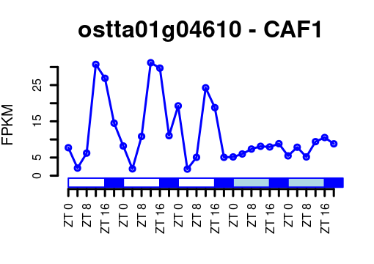
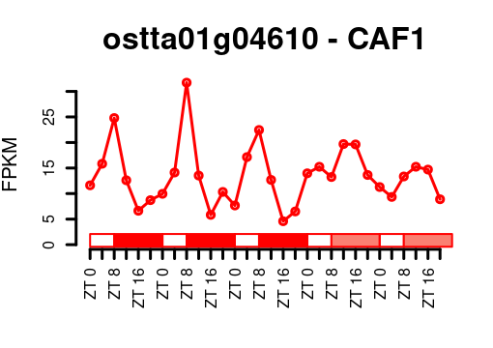
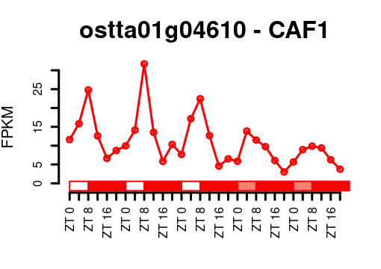

Slide 13
Ostta03g03390 (H3K4me3), ostta13g02150?, ostta08g01150 (H3K27me3, ELF6)
Ostta01g04710, Ostta07g01330, Ostta07g03750, Ostta01g04890, AT3G20810 (histone demethylase involved in circadian regulation)
Ostta02g02900, AT3G45880 (histone demethylase involved in vernalization and FLC regulation)
Ostta03g03890, ostta18g01660, AT5G06550 (histone demethylase involved in light response)
Ostta04g02310?? AT3G26135 AT5G19840
Ostta05g03250 only in Ostreococcus
Ostta05g03920 only in Ostreococcus
Ostta08g03390?? AT4G04670
Ostta15g00920 only in Ostreococcus
Ostta10g00180 only in Ostreococcus
Ostta13g02410 only in Ostreococcus
Ostta01g03270 only a potential ortholog in klebs kfl00508_0060

Slide 14

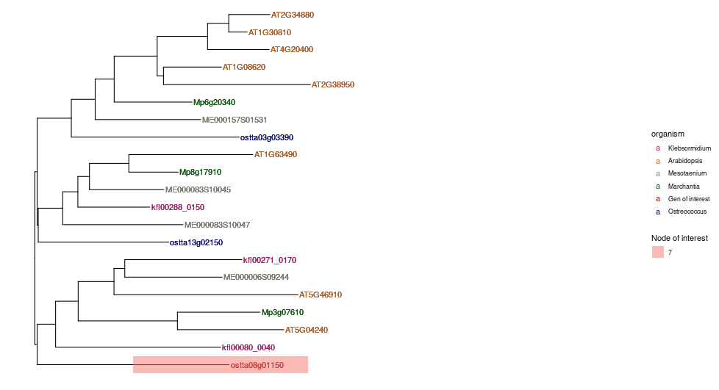






JMJ15 H3K4me3
JMJ18 H3K4me3
JMJ14 H3K4me3 Ser290, Trp296, and Tyr298 contribute to the recognition of H3K4me3
JMJ16 H3K4me3 H3K9me3
KDM5/JARID1
JMJ17 H3K4me3
JMJ13 H3K27me3 demethylase involved in temperature and photoperiod dependent repressing of flowering.
ELF6 H3K27me3
KDM4/JHDM3

Slide 15
JmjC
JmjN
zf-C5HC2
PHD
JmjC
PLU-1
PHD
PHD
ARID
zf-C5HC2

Slide 16
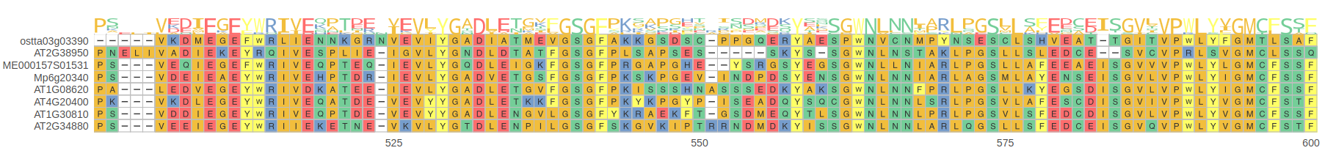
MSA of histone demethylases recognizing H3K4me3
Ser290
Trp296
Tyr298

Slide 17
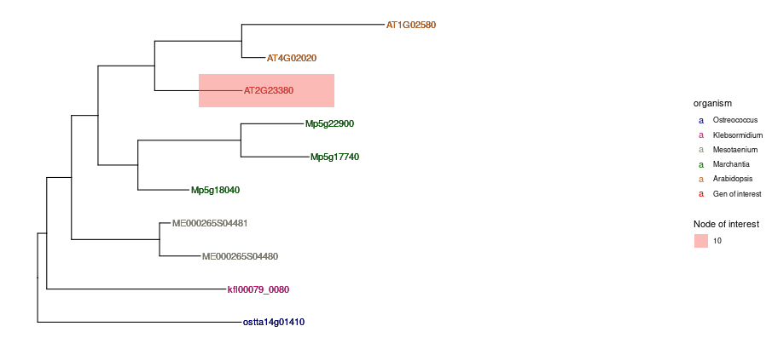
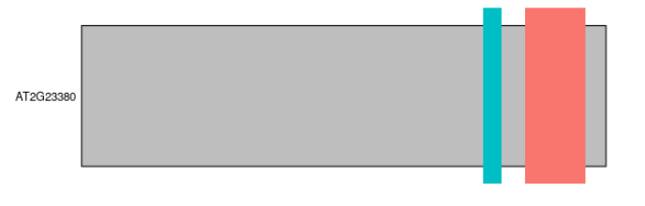
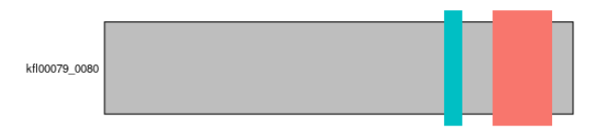
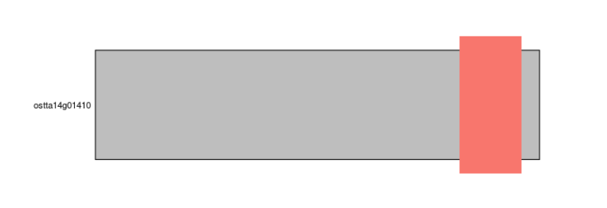
MEA
SWN
preSET_CXC
SET
CLF (E(z))
preSET_CXC
SET
SET

Slide 18
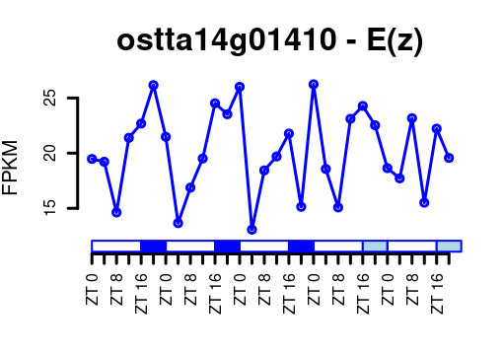
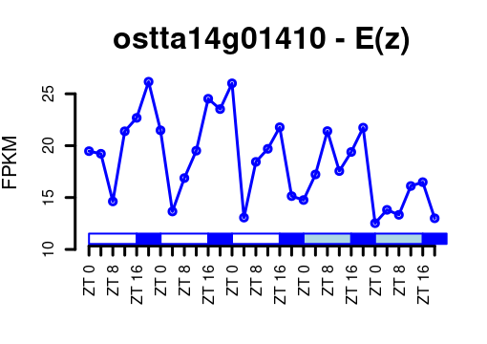
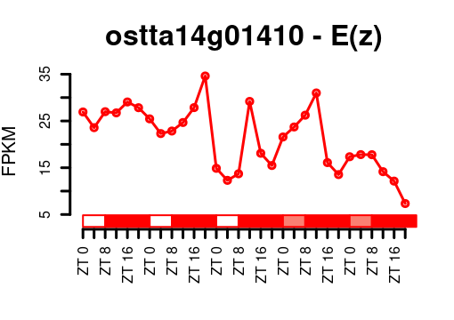
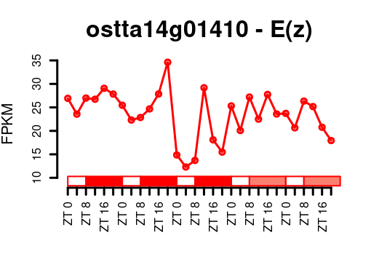
Light regulated, being activated by light and repressed by dark.

Slide 19
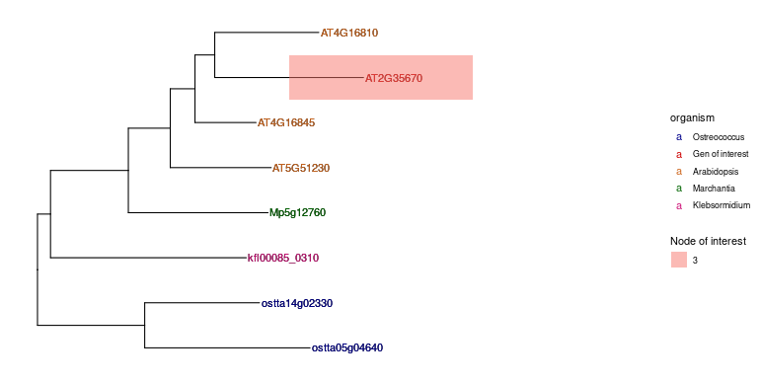
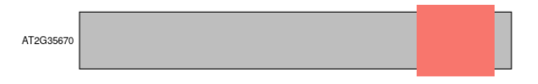
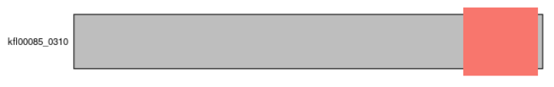
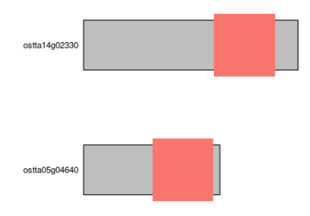
VEFS-Box
FIS2
VRN2
VEFS-Box
EMF2
VEFS-Box
VEFS-Box
VEFS-Box

Slide 20
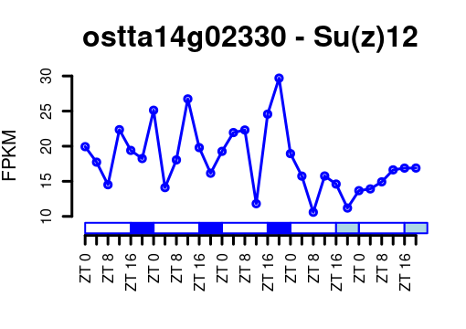
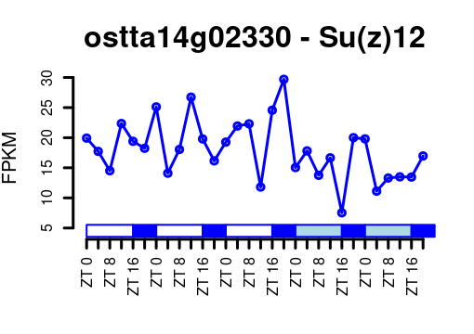
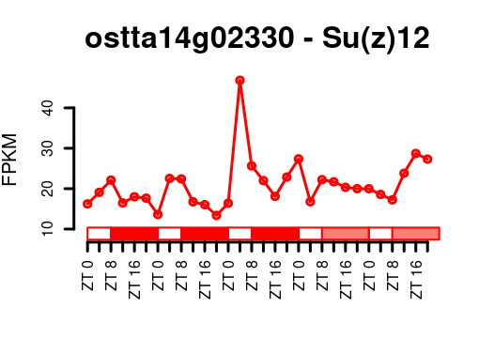
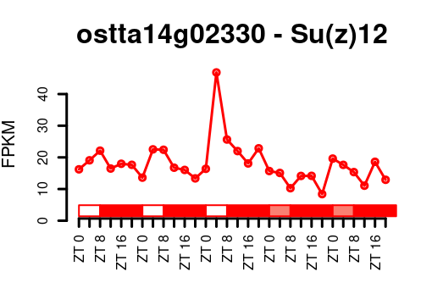

Slide 21
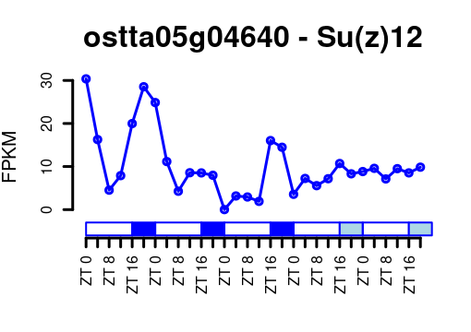
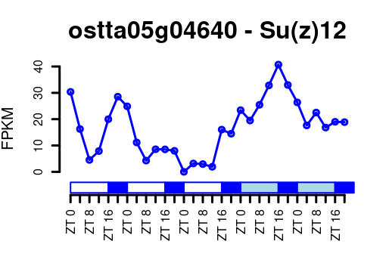
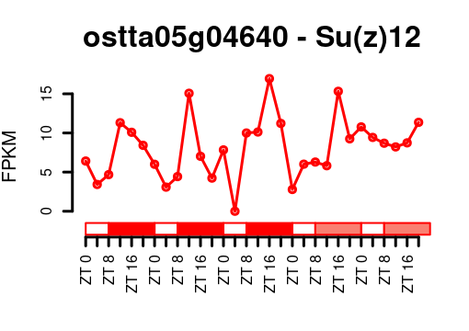
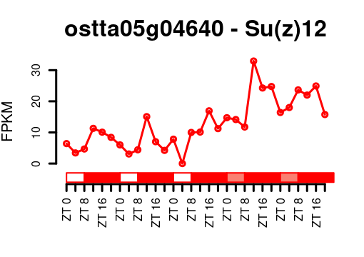

Slide 22
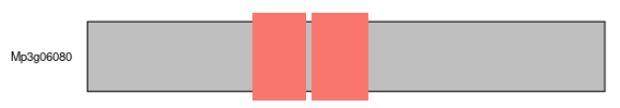




WD40
WD40
WD40
WD40
FIE (Esc)
WD40
WD40
WD40

Slide 23





Slide 24





ATX5
ATX4
ATX3
PWWP
PHD
PHD
zf-HC5HC2H
SET
PWWP
PHD
HMG_box
PHD
zf-CW
SET
SAND
zf-HC5HC2H
HMG_box_2
SET
PWWP
zf-HC5HC2H
ATXR7
SET

Slide 25





Slide 26



zf-MYND
SET
ATXR2
SET
No clear rhythmicity

Slide 27




GYF_2
SET
SDG2_C
ATXR3
zf-CW
zf-CW
SET
SDG2_C
SET
SDG2_C

Slide 28




Dark repressed

Slide 29





Slide 30




SPRY
ASH2R/TRO
SPRY
SPRY

Slide 31


Slide 32



WD40
WD40
WD40
WD40
RBL
WD40

Slide 33


Slide 34

S2Lb

Slide 35


Slide 36


Slide 37


