Slide 1
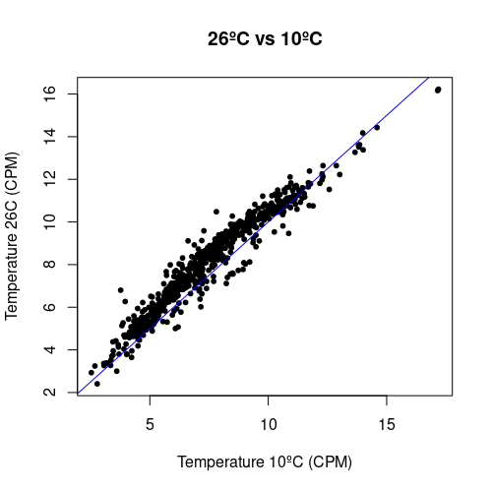
142 peaks (20.7%) significantly gain H3K27me3 as temperature rises from 10ºC to 26ºC according to a fold-change of 2 and a q-value of 0.05

Slide 2
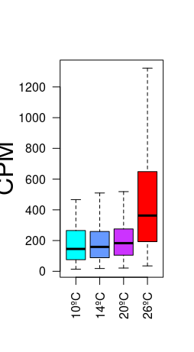
H3K27me3 levels in peaks
responding to temperature
CPM

Slide 3
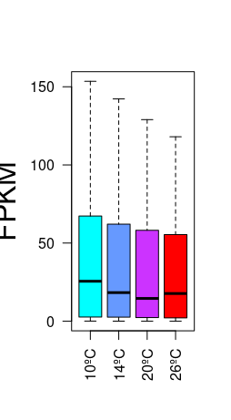
H3K27me3 levels in peaks
responding to temperature
Expression levels in genes marked by H3K27me3 peaks responding to temperature
CPM
FPKM

Slide 4
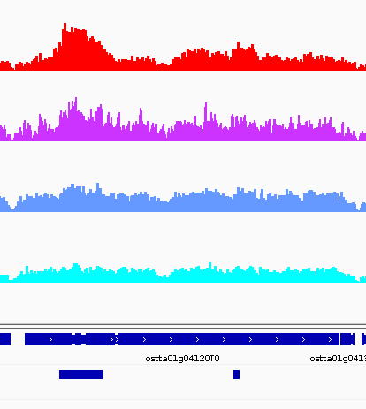
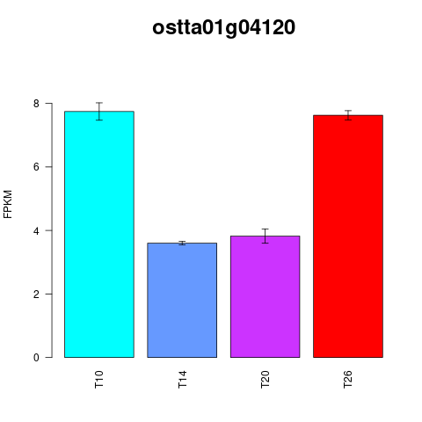
Ribosome biogenesis, protein translation
ostta01g04120 a homolog of the yeast MDN gene, which encodes a non-ribosomal protein involved in the maturation and assembly of the 60S ribosomal subunit

Slide 5
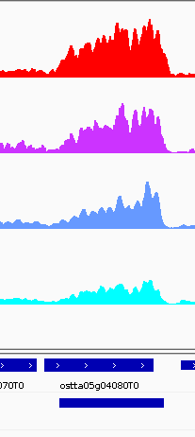
Ribosome biogenesis, protein translation
ostta05g04180 RNA helicase family

Slide 6
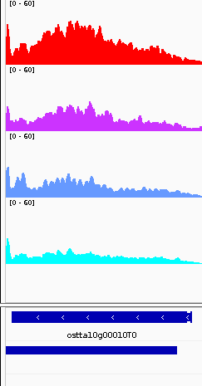
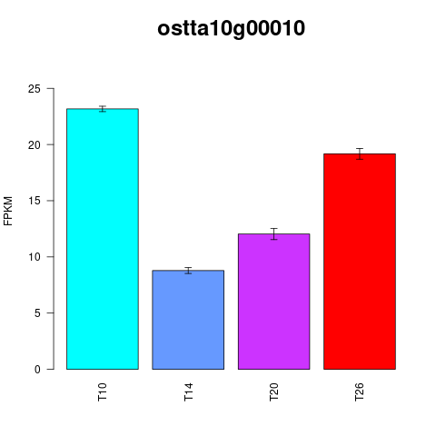
Ribosome biogenesis, protein translation
ostta10g00010 Encodes a nucleolar protein that is a ribosome biogenesis co-factor.

Slide 7
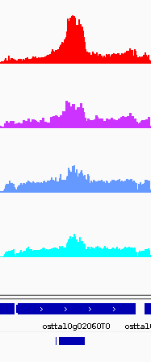
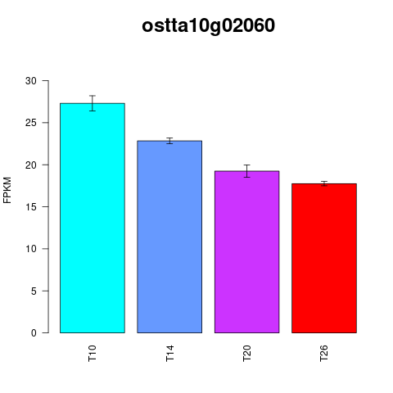
ostta10g02060 AT5G49150 Encodes a transmembrane domain containing protein expressed in sperm cells. Mutants are defective in gamete fusion.

Slide 8
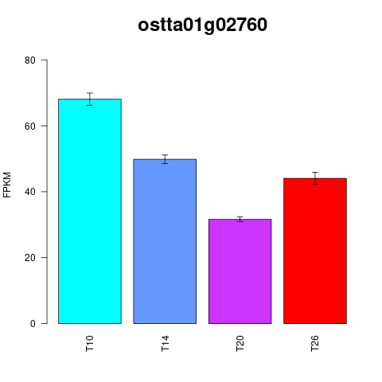
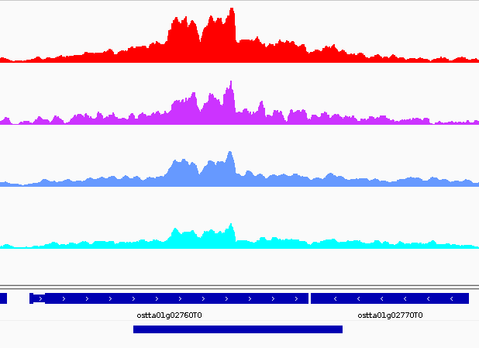
ostta01g02760 Carbohydrate binding module family 20

Slide 9
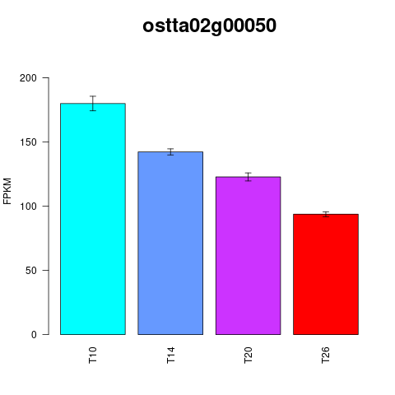
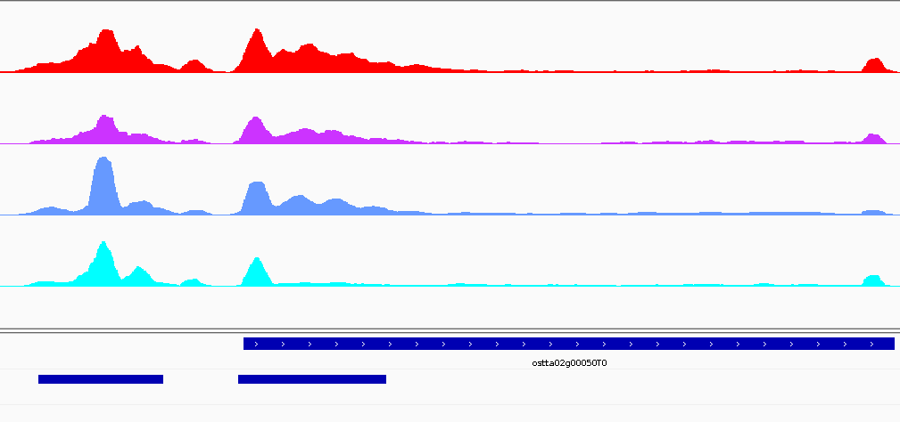
ostta02g00050 Ribonuclease H-like domain

Slide 10
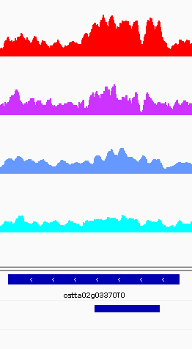
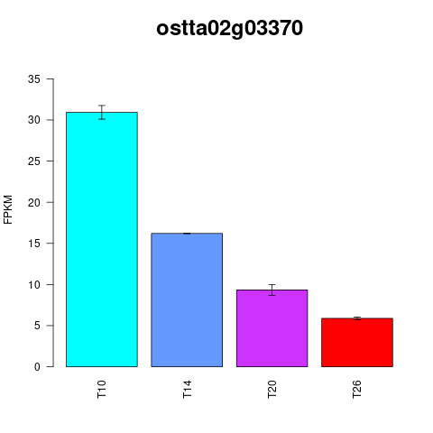
Ribosome biogenesis, protein translation
AT3G08730 - Encodes a protein-serine kinase that phosphorylates ribosomal protein in vitro. Involved in translational up-regulation of ribosomal proteins.

Slide 11
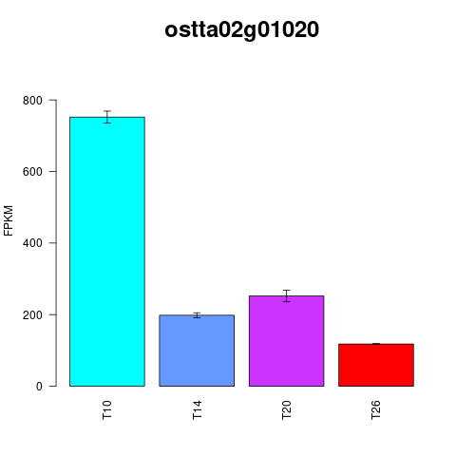
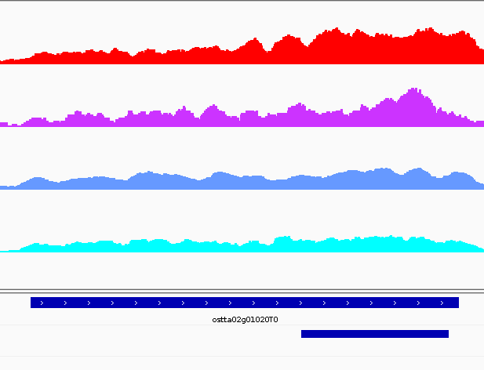
Cell cycle, Cellular organization
ostta02g01020 – AT5G42020 HSP70 Luminal binding protein (BiP2) involved in polar nuclei fusion during proliferation of endosperm nuclei. https://www.ncbi.nlm.nih.gov/pmc/articles/PMC2824368/

Slide 12
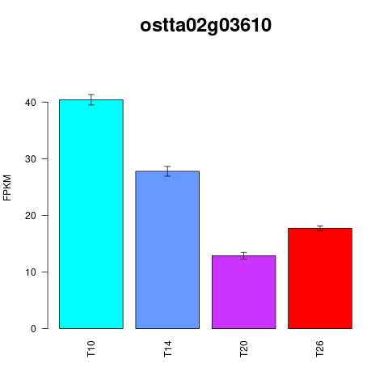
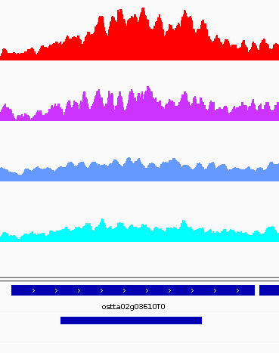
Cell cycle, Cellular organization
AT3G57060 - Similar to mamalian condensin. Mutants have reduced fertility.

Slide 13
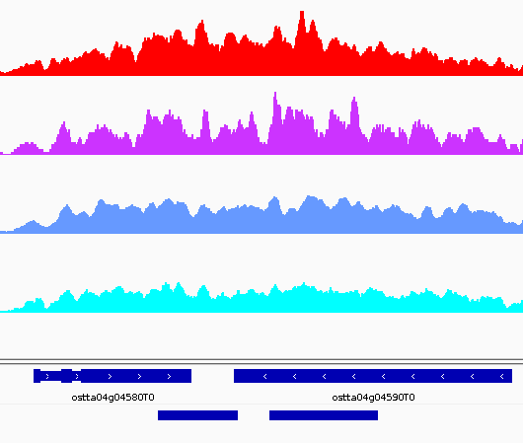
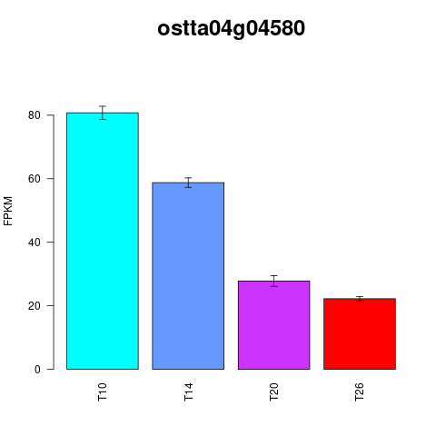
Cell cycle, Cellular organization
AT4G33270 - Encodes a CDC20 protein that interacts with APC subunits

Slide 14
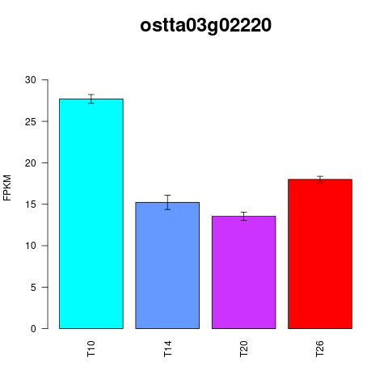
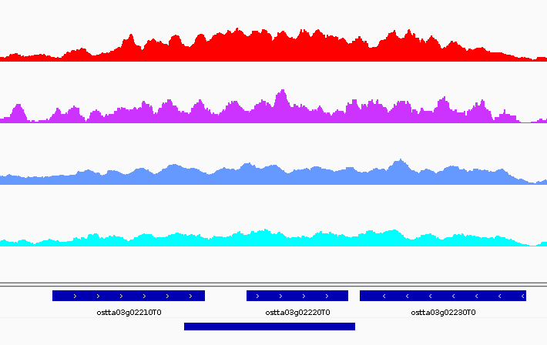
Cell cycle, Cellular organization
AT5G57390 AINTEGUMENTA-LIKE 5 EMBRYOMAKER Encodes a member of the AP2 family of transcriptional regulators. May be involved in germination and seedling growth. Essential for the developmental transition between the embryonic and vegetative phases in plants. Overexpression results in the formation of somatic embryos on cotyledons.

Slide 15
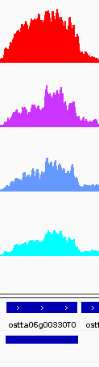
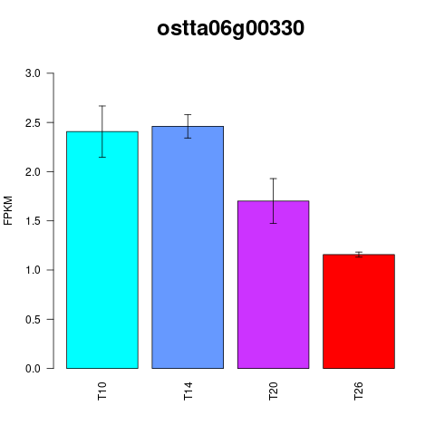
Cell cycle, Cellular organization
AT3G18524 Encodes a DNA mismatch repair homolog of human MutS gene, MSH6. MSH2 is involved in maintaining genome stability and repressing recombination of mismatched heteroduplexes

Slide 16
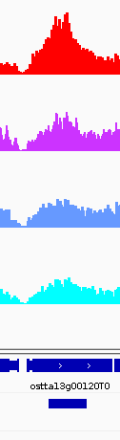
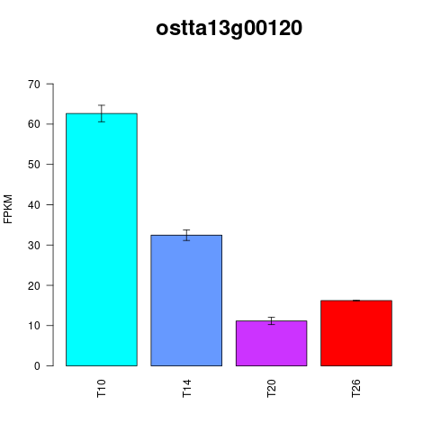
Cell cycle, Cellular organization
AT3G23890 - Encodes a topoisomerase II that is highly expressed in young seedlings. The protein is localized in the nucleus and gene expression levels are increased in proliferative tissues.

Slide 17
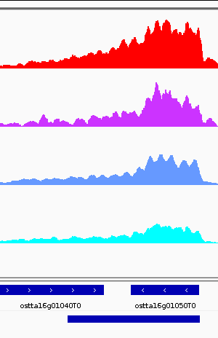
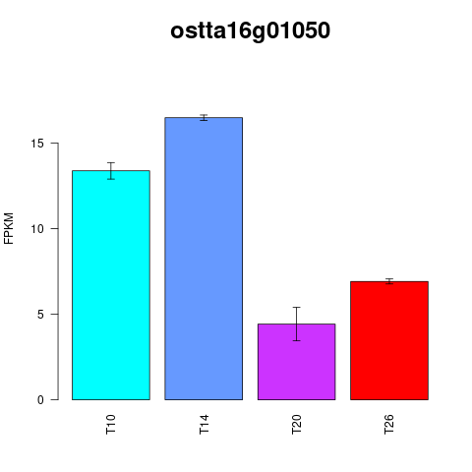
Cell cycle, Cellular organization
AT5G40440 - Encodes a mitogen-activated protein kinase kinase. Activates MPK8 and is a target of MPKKK20. Mutant root growth is sensitive oryzalin and suggestive of a role in signaling during microtubule organization.

Slide 18
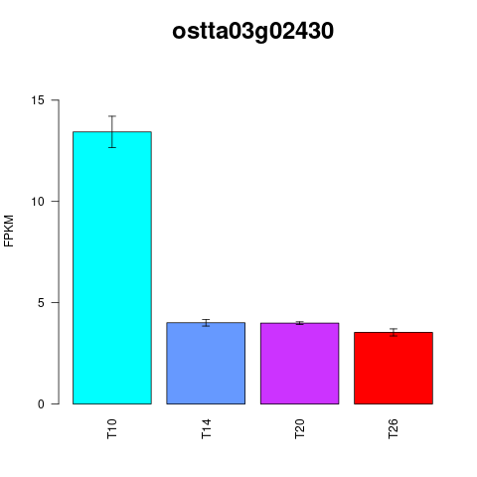
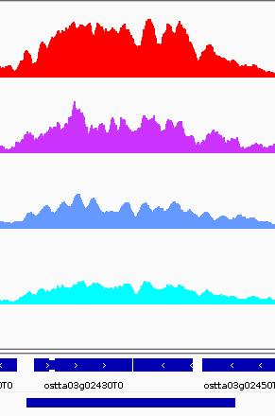
AT5G19680 PP1 Regulatory Subunit3.

Slide 19
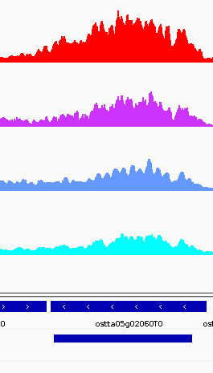
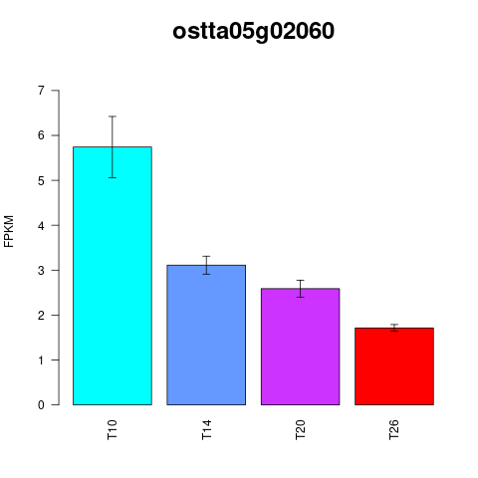
AT2G43770 - Transducin/WD40 repeat-like superfamily protein

Slide 20
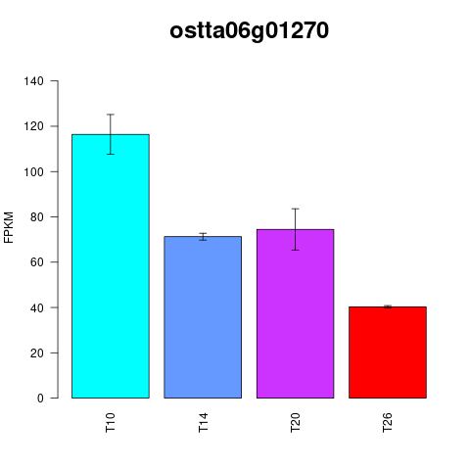
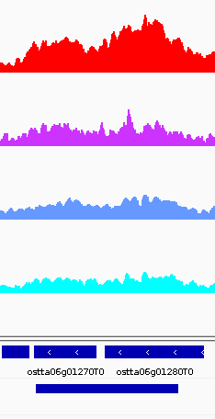

Slide 21
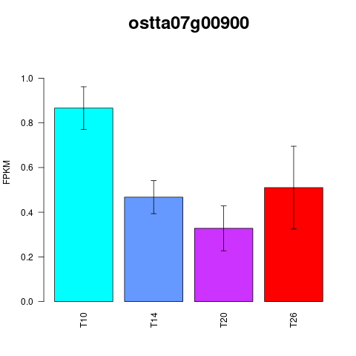
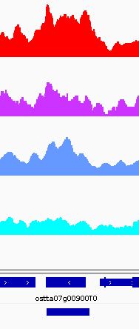

Slide 22
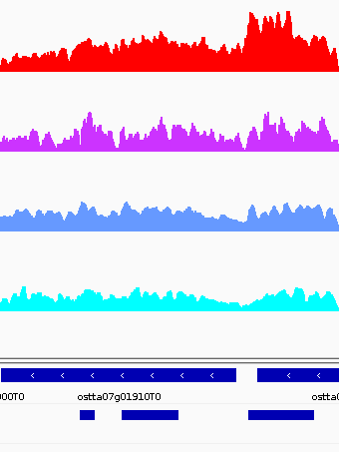
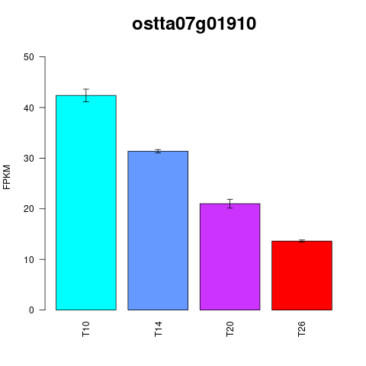
AT3G06270 Protein phosphatase 2C family protein

Slide 23
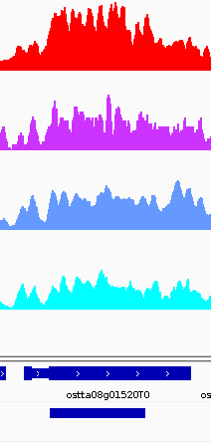
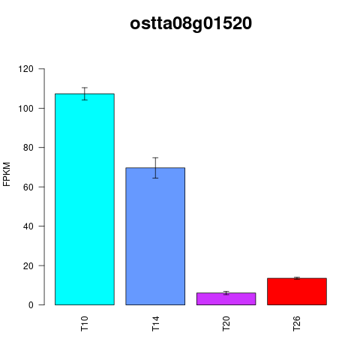

Slide 24
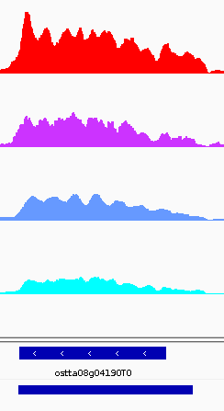
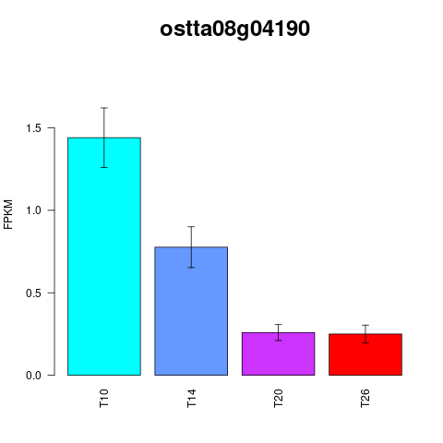
AT3G49660 WD40 repeat Encodes a structural core component of a COMPASS-like H3K4 histone methylation complex.

Slide 25
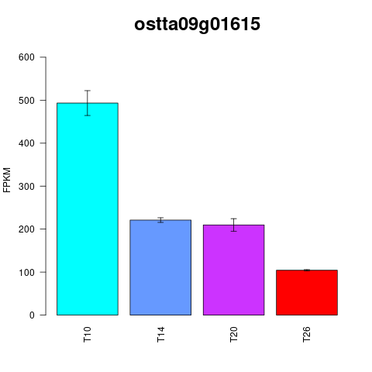
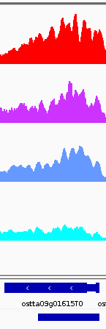
AT3G55100 ABC-2 type transporter family protein

Slide 26
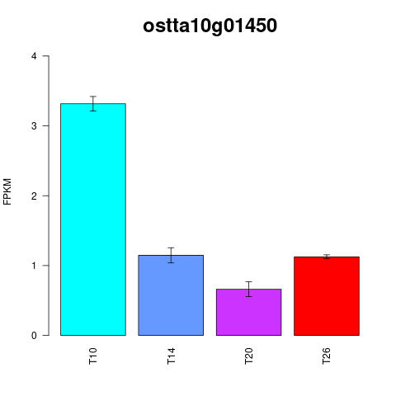
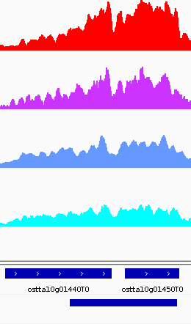
AT2G20030 ARABIDOPSIS TOXICOS EN LEVADURA 12, ATL12

Slide 27
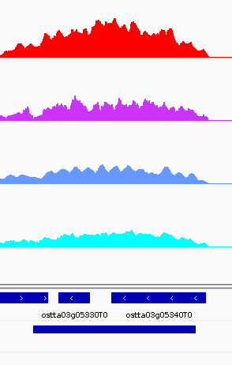
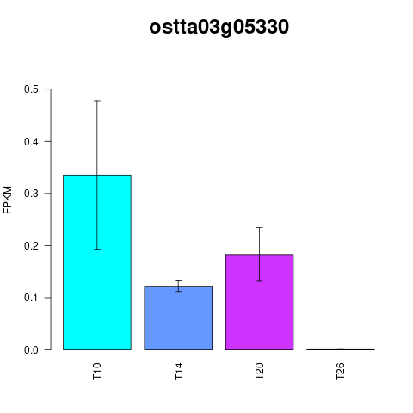
AT2G21860 - Violaxanthin de-epoxidase located in chloroplast.

Slide 28


AT1G21840 - Encodes a urease accessory protein which is essential for the activation of plant urease.

Slide 29



Slide 30



Slide 31



Slide 32


AT4G21090 MITOCHONDRIAL FERREDOXIN 2

Slide 33


AT3G45770 Encodes a mitochondrial enoyl-ACP reductase, a component of the fatty acid synthase complex.

Slide 34



Slide 35


AT2G30200 - Malonyl-ACP expressed in developing seeds

