Slide 1
SUGAR-SWEETENED BEVERAGE TAXES
Do they reduce the burden of disease?
A cross-country study covering 2000 to 2023, when countries adopted the tax at different times
Empirical project – Causal inference and impact evaluation
Student M.Tavella, mat. 712246
Professor R.Miniaci

Slide 2
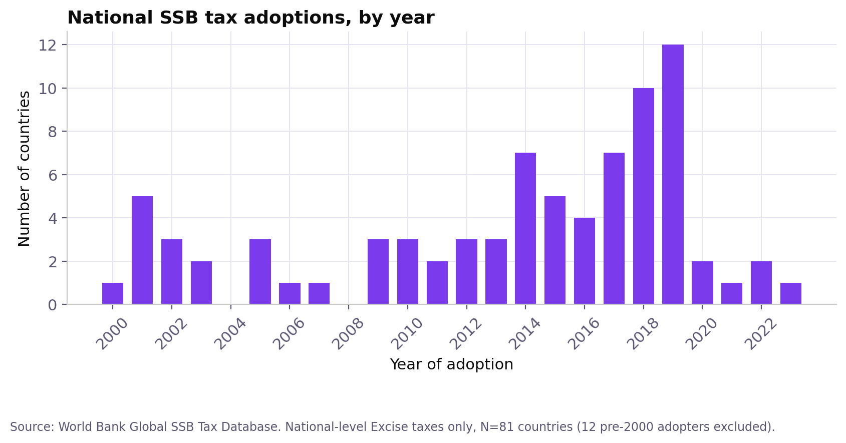
MOTIVATION
A global health problem, a common policy tool
A high body mass index (BMI) is one of the biggest health risks in the world today, and it is something people can change.
Sugar-sweetened beverages (SSBs) are one of the easiest targets for a health tax.
Since 2000, over 80 countries have taxed SSBs. Because they did not all do it at the same time, we can compare them and estimate the tax's effect.
Source: World Bank Global SSB Tax Database.
2

Slide 3
MOTIVATION
What we already know, and what is missing
Colchero et al. (2017); Teng et al. (2019)
In Mexico, people still bought fewer sugary drinks two years after the tax started. A review of many countries found the same average effect on purchases.
Stacey et al. (2021); Cobiac et al. (2024)
South Africa: beverage purchases dropped sharply after the tax. UK: a simulation model predicts a large drop in childhood overweight.
The gap and the closest match
None of these studies check whether lower consumption actually improves health outcomes across many countries. The closest match (Villani et al., 2024; 43 countries) finds mixed, mostly non-significant results, like we do.
3

Slide 4
RESEARCH QUESTION
Main question
Does a national tax on sugar-sweetened beverages reduce the population's burden of disease from high BMI?
Follow-up questions
Does the effect reach type 2 diabetes as well?
Does it depend on how the tax is designed (fixed amount vs. percentage of price, tiered or not)?
Does a country's own sugar production change the effect, for example through lobbying or substitution?

Slide 5
SPECIFICATION
Why not the standard TWFE model
The problem: staggered adoption
The fix: Callaway-Sant'Anna
When countries adopt a tax at different times, the standard two-way fixed effects (TWFE) model compares already-treated countries to newly-treated ones, and some of these comparisons get negative weight.
If the tax's effect builds up over time (likely here), TWFE gives a biased result.
Goodman-Bacon (2021), Journal of Econometrics.
Estimates a separate effect for each group of countries that adopted in the same year, for each time period, using a doubly-robust approach.
Compares each group to countries that never adopted the tax, then combines everything into one overall effect and an event-study graph.
Callaway & Sant'Anna (2021), Journal of Econometrics.
5

Slide 6
SPECIFICATION
The two models written out
TWFE (robustness check)
Callaway & Sant'Anna (2021)
Y_{it} = α_{i} + λ_{t} + β·SSBtax_{it} + X_{it}′γ + ε_{it}
Y = BMI DALYs rate; αi, λt = country and year fixed effects
Xit = log GDP p.c., school enrollment, log sugar production
Estimated by OLS with two fixed effects, SE clustered by country
β = one common effect for all countries - biased under staggered adoption (Goodman-Bacon, 2021)
ATT(g,t) = E[Y_{t} − Y_{g−1} | G=g] - E[Y_{t} − Y_{g−1} | C]
g = year a country first adopts the tax (its cohort); C = never-treated group
Estimated separately for every (g,t) pair, doubly robust (doubly robust, inverse probability weighted): outcome regression + propensity score model of adoption
Consistent if at least one of the two models is correctly specified
Aggregated into one overall ATT (estat simple) and an event-study ATT(e), e = t−g (estat event)
6

Slide 7
SPECIFICATION
Main threats, and how we handle them
Differences between countries that do not change over time
Removed with country fixed effects
Shocks that hit all countries the same year (2008 crisis, pandemic)
Removed with year fixed effects
Richer or more educated countries adopting first
We control for GDP per capita and school enrollment
Reverse causality (rising obesity pushing faster adoption)
Checked: pre-trends are flat and not significant
Key assumption: without the tax, treated and never-treated countries would follow the same trend. We can only test this before the tax starts (Pre_avg = -2.29; p=0.663 for BMI DALYs).
7

Slide 8
DATA
Four sources, one key: ISO3
WB SSB Tax Database
IHME GBD 2023
World Bank WDI
FAOSTAT
When taxes started, how they are designed
BMI DALYs, diabetes rates
GDP per capita, school enrollment
Sugar production
We merge everything using each country's ISO3 code, never the country name - different sources spell names differently, which causes silent errors.
160
24
81 / 79
3,840
countries in the panel
years (2000-2023)
treated / never-treated
country-year observations
8

Slide 9
DATA
Descriptive statistics
Variable | N | Mean | SD | Min | Max
BMI DALYs rate (per 100,000) | 3,840 | 2,189.3 | 1,573.8 | 288.2 | 12,756.4
Diabetes prevalence (per 100,000) | 3,840 | 6,452.3 | 3,548.8 | 1,699.4 | 22,875.4
GDP per capita, PPP ($) | 3,540 | 19,235.5 | 23,463.3 | 404.0 | 180,939.4
Secondary school enrollment (%) | 2,503 | 78.4 | 30.8 | 3.4 | 164.1
Sugar production (tonnes) | 3,840 | 7,071,394.8 | 30,221,263.9 | 0.0 | 490,533,351.1
Table 1. Country-year sample, 2000-2023. GDP and school enrollment are not fully covered by the World Bank. We computed these numbers in Stata and rebuilt the chart in Python.
9

Slide 10
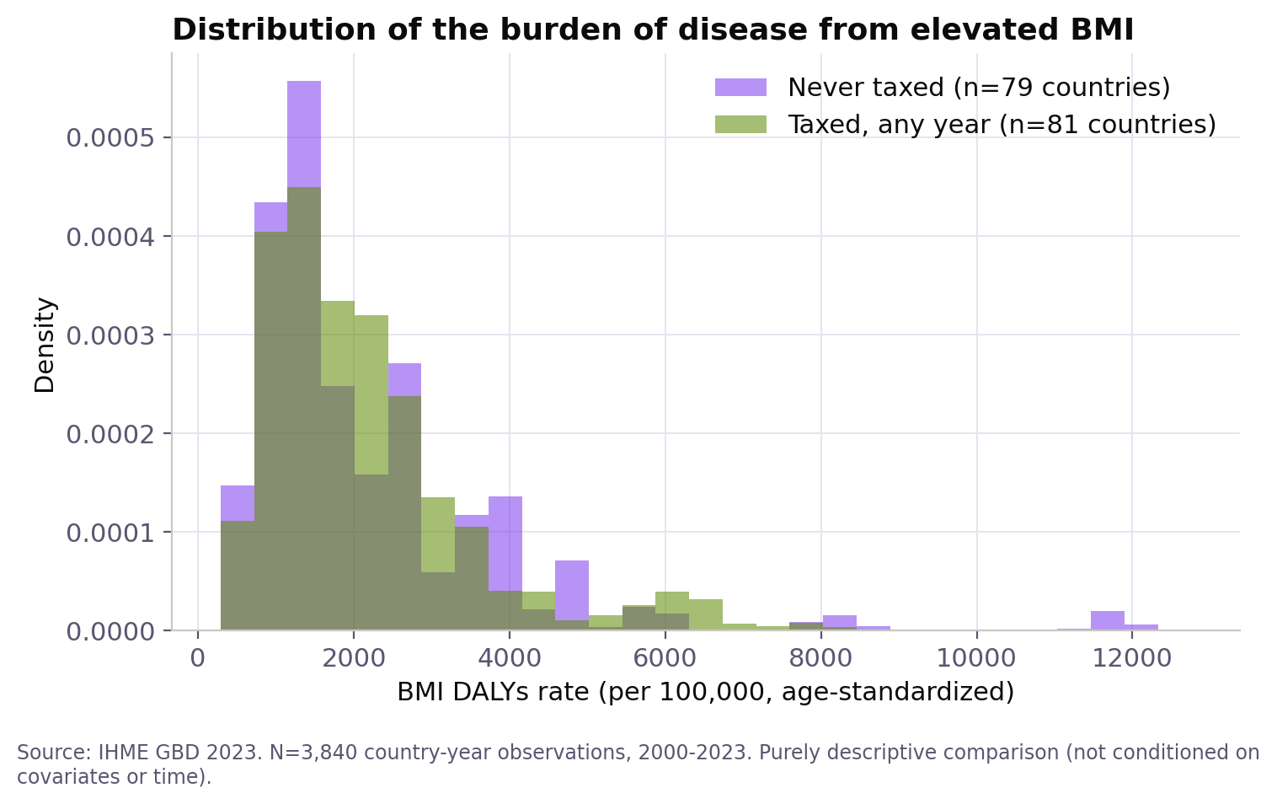
DATA
No clear difference between the two groups
10

Slide 11
RESULTS
Main estimate: no effect we can detect
34.45
p = 0.280
N = 2,226
effect on BMI DALYs (per 100,000)
not significant
observations in the estimation
The next slide shows the full event-study graph behind this number: pre-trends by year before adoption, and the effect by year after adoption.
11

Slide 12
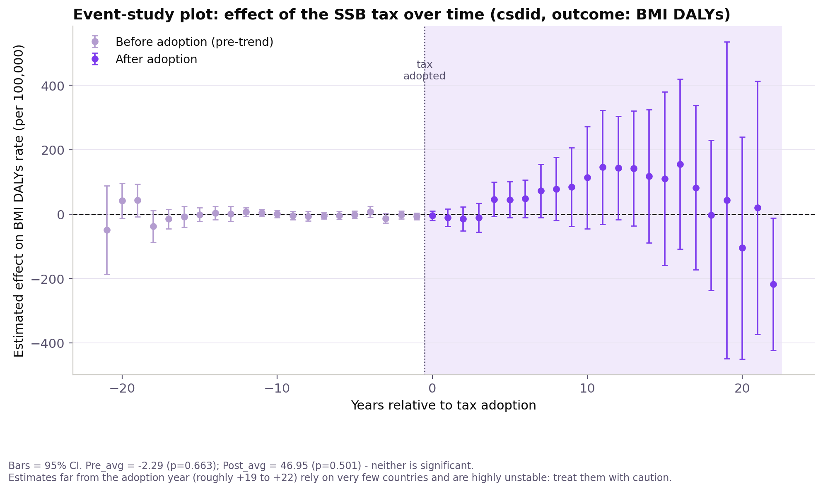
RESULTS
The full picture: effect by year, before and after
12

Slide 13
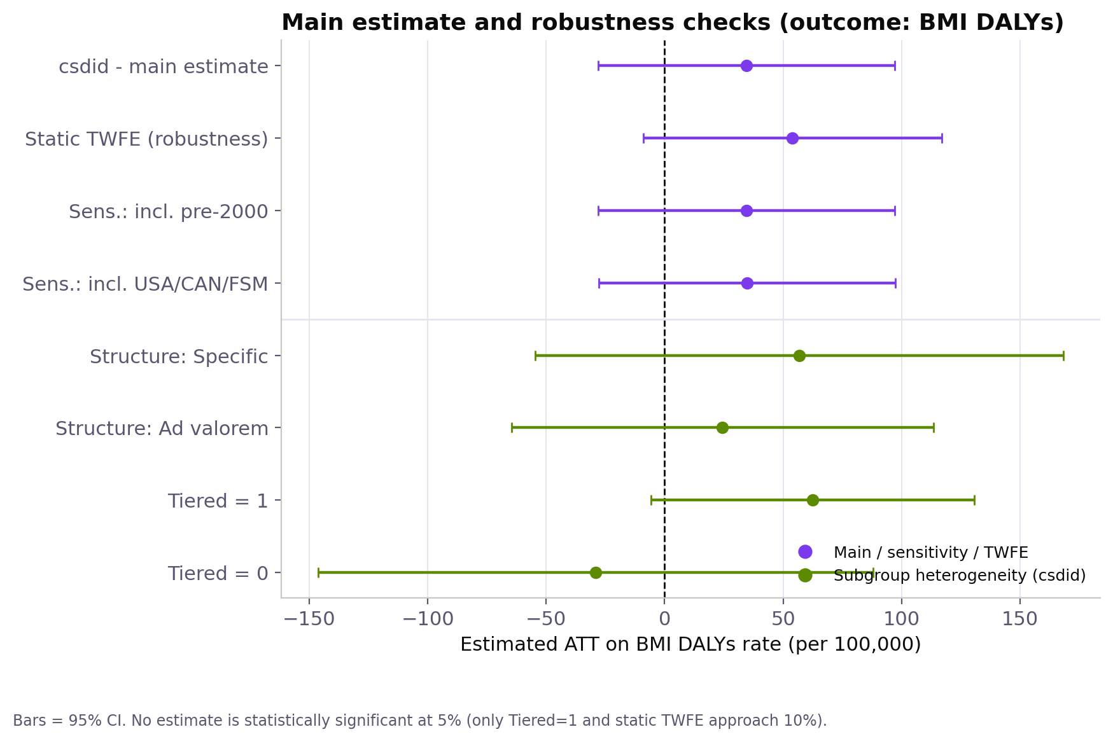
RESULTS
Robustness checks: the result barely moves
13

Slide 14
RESULTS
Does tax design matter? There is not a clear pattern
Tax structure
csdid and TWFE do not even agree on the direction of the effect (Specific vs Ad valorem). The difference is not statistically significant (p=0.378).
Tiered status
Tiered=1 comes closer to significance (p=0.073) than Tiered=0, but the difference between the two is not significant (p=0.708).
Sugar production
A continuous interaction with TWFE gives -1.96 (SE 5.40; p=0.717): no significant effect.
14

Slide 15
RESULTS
Building an instrument: two equations
Leave-one-out regional diffusion
Two regressions to test it
spatial_diff_{i,t} = Σ_{j≠i, region}SSBtax_{j,t} / (N_{region,t} − 1)
Share of OTHER countries in i's UN region that had already adopted the tax by year t (own status excluded, leave-one-out)
Idea: regional policy diffusion (imitation between neighboring governments) as a source of variation in adoption, in principle unrelated to a country's own BMI trend
Built from panel_master + a UN-region crosswalk (kountry); not the formal first stage of a 2SLS
1. Relevance
SSBtax_{it} = π·spatial_diff_{it} + α_{i} + λ_{t} + u_{it}
π > 0 and significant → the instrument predicts a country's own adoption
2. Exclusion (falsification)
BMI_{it} = ρ·spatial_diff_{it} + X_{it}′γ + α_{i} + λ_{t} + η_{it}
Estimated only on never-treated units (SSBtax≡0). ρ ≈ 0 expected if valid; ρ significant → exclusion restriction violated
15

Slide 16
RESULTS
Checking an instrument: does it hold up?
We built a leave-one-out instrument: the share of other countries in the same UN region that already tax SSBs. We use it only as a check, not as our main estimate.
First stage: strong
Falsification test: fails
coefficient 0.52 (p=0.008)
coefficient 706.6 (p=0.001)
regional diffusion predicts a country's own adoption
it also predicts BMI DALYs among the 69 countries that NEVER adopted the tax
Conclusion: the instrument is picking up shared regional trends (diet, economic development), not just policy diffusion. That is why we do not use it for a formal 2SLS estimate.
16

Slide 17
RESULTS
Does the sample choice matter?
Main estimate
ATT = 34.45
p = 0.280
+ USA / Canada / Micronesia as never-treated
ATT = 34.79
p = 0.276
+ 12 countries that adopted before 2000
ATT = 34.45
p = 0.280
Adding or removing these countries barely changes the estimate: csdid already treats them as “always treated” and ignores them.
17

Slide 18
CONCLUSION
A real null result, not a data problem
No effect we can distinguish from zero, on BMI DALYs or on diabetes prevalence.
But the design is solid: flat pre-trends, and the result barely changes across different reasonable samples.
The null mainly reflects a power problem: few early-adopting countries, and our longest-run estimates rely on very few of them.
This matches the literature: lower consumption (Colchero et al., 2017; Teng et al., 2019) does not yet show up as a measurable health effect in our time window, and a similar multi-country study (Villani et al., 2024) finds the same thing.

Slide 19
CONCLUSION
Limitations
Internal validity
External validity
DALYs and diabetes prevalence are modeled IHME estimates, not direct counts.
Not enough long-run data to detect a small effect.
Some reverse causality may be left (a pre-existing health trend).
Our treatment variable is binary: it cannot tell a 5% tax from a 20% tax.
Missing GDP/education data cuts the sample from 3,840 to 2,226 country-years; we did not check if this drop is random.
Results apply to national excise taxes only, not duties, VAT, or local taxes.
81 treated countries, mostly small or medium-sized and middle-income.
Limited relevance for large, high-income economies, since few of them adopted early.
19

Slide 20
References
Angrist, J. D., & Pischke, J.-S. (2009). Mostly Harmless Econometrics: An Empiricist's Companion. Princeton University Press.
Callaway, B., & Sant'Anna, P. H. C. (2021). Difference-in-Differences with multiple time periods. Journal of Econometrics, 225(2), 200-230.
Cobiac, L. J., et al. (2024). Impact of the UK soft drinks industry levy on health and health inequalities in children and adolescents in England. PLOS Medicine.
Colchero, M. A., Popkin, B. M., Rivera, J. A., & Ng, S. W. (2017). In Mexico, evidence of sustained consumer response two years after implementing a sugar-sweetened beverage tax. Health Affairs, 36(3), 564-571.
Goodman-Bacon, A. (2021). Difference-in-differences with variation in treatment timing. Journal of Econometrics, 225(2), 254-277.
Mozaffarian, D., et al. (2026), on behalf of the Global Dietary Database. Understanding SSB tax implementation globally: a 34-year study in 183 countries. The Lancet Global Health, 14(6).
Stacey, N., et al. (2021). Changes in beverage purchases following South Africa's Health Promotion Levy: an observational study. The Lancet Planetary Health.
Teng, A. M., Jones, A. C., Mizdrak, A., Signal, L., Genç, M., & Wilson, N. (2019). Impact of SSB taxes on purchases and dietary intake: Systematic review and meta-analysis. Obesity Reviews, 20(9), 1187-1204.
Villani, L., Sassano, M., et al. (2024). National taxation on SSBs and its association with overweight, obesity, and diabetes. American Journal of Clinical Nutrition.
20

