Slide 1

Large language models
SHENZHEN UNIVERSITY
黄昭辉
郭剑华
黄捷宇
演讲人：

Slide 2
CONTENTS
Fine-tuning Techniques for Large Language Models
The Past and Present of Language Models
01
02
The Impact of Large Language Models on Science and Technology Development
03

Slide 3
01
The Past and Present of Language Models

Slide 4
Timeline of language model development
Statistical language models
Neural language models
Pretrained language models
Large language models
1970s~1990s
2000s~2014s
2018s~2020s
2020s~ hitherto

Slide 5
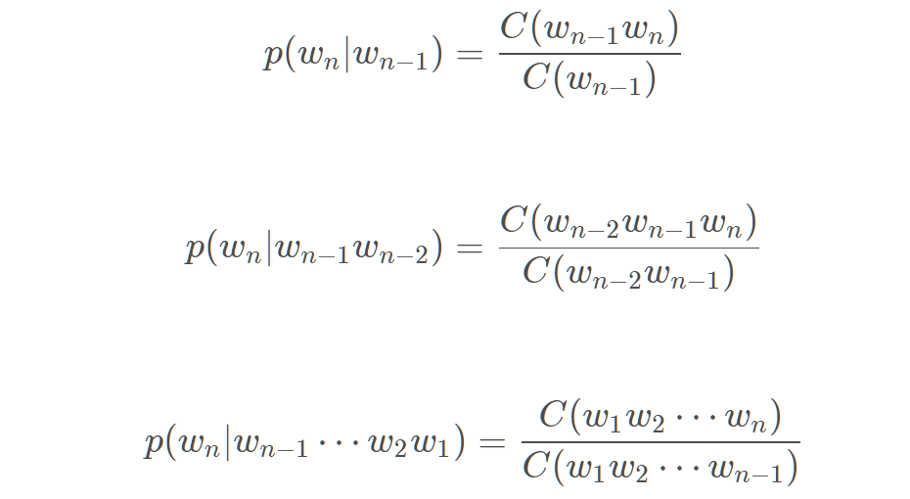
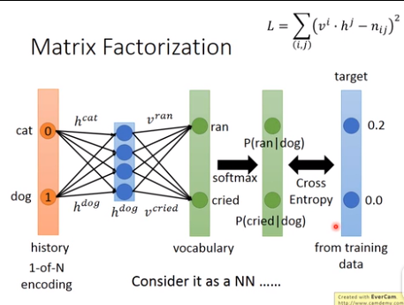
Statistical language models
Traditional statistical language models
Markov hypothesis
N-gram
Traditional statistical language models are based on the assumption that the nth word occurrence is related to the first n-1 word and not to any other word.
The probability of the occurrence of the whole sentence is equal to the product of the probability of the occurrence of each word.
The probability of each word can be statistically calculated from the corpus.
The n-gram model introduces the Markov hypothesis to establish a prediction model for language sequences, which usually predicts the probability of the occurrence of the next word based on several consecutive context words in the word sequence, that is, predicts the target word according to a fixed-length prefix.
In order to solve the second problem, statistical language models alleviate the problem of data sparsity by designing a special language model smoothing strategy.
The difference between the predicted value and the true probability value is used as the loss function.
The parameter space is too large: The probability involves n variables, and the probability of each variable is the dictionary size.
Severe data sparsity: words may not appear at the same time, especially at high combinatorial orders.
The statistical-based language model is a discrete language model, so the generalization ability is poor.
However, for higher-order statistical language models, the number of transition probability terms that need to be estimated increases exponentially as order n increases, and statistical language models are often plagued by a "dimensionality catastrophe".
Moreover, the ability of the smoothing method to characterize higher-order contexts is still weak, and it cannot accurately model complex higher-order semantic relationships.

Slide 6
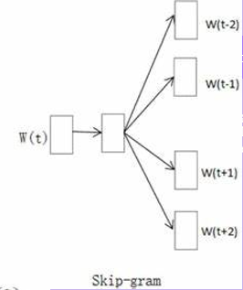
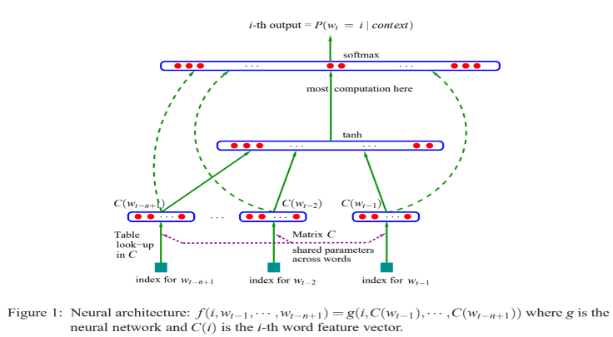
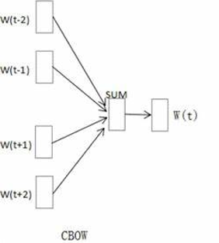
Neural language models
Neural language models
CBOW
Skip-gram
Neural language models use neural networks to model the generation of text sequences.
The concept of distributed word representation is introduced, and the target word prediction function based on aggregate context features is constructed.
CBOW calculates the probability of the occurrence of a word based on the C words in front of it and the C consecutive words in front of it.
Skip-gram is based on a certain word, and then calculates the probability of a certain number of words before and after it.
Distributed word representation uses low-dimensional dense vectors to represent the semantics of words, which is fundamentally different from the sparse word vector representation based on dictionary space, and can describe richer implicit semantic features.
The non-zero representation of dense vectors is very friendly to the construction of complex language models, and can effectively overcome the problem of data sparsity in statistical language models.
At the same time, the training speed and computational efficiency of the model are significantly improved by negative sampling and hierarchical soft maximization technology.

Slide 7
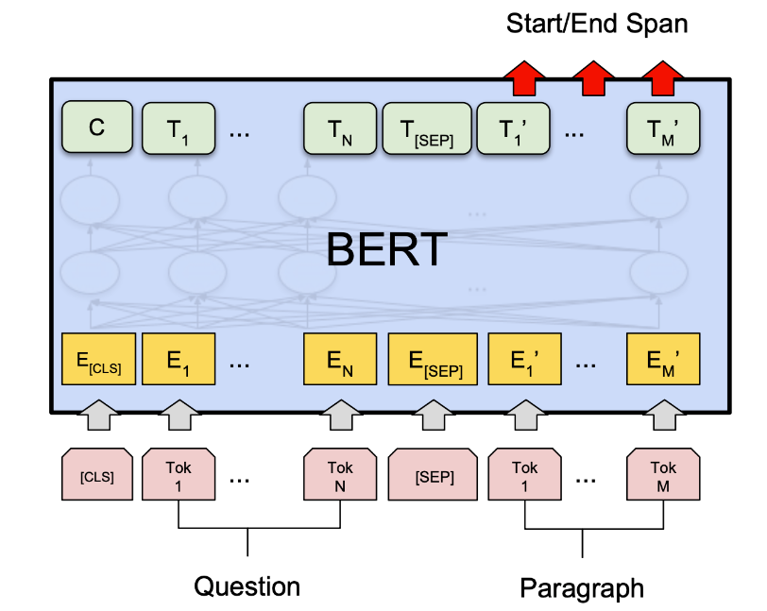
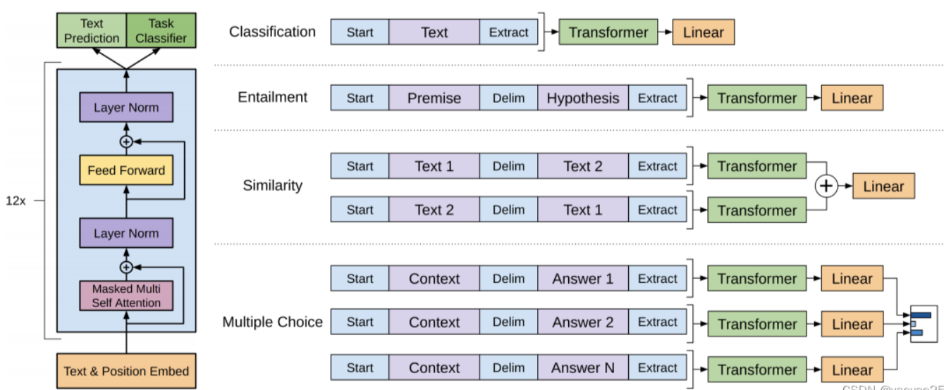
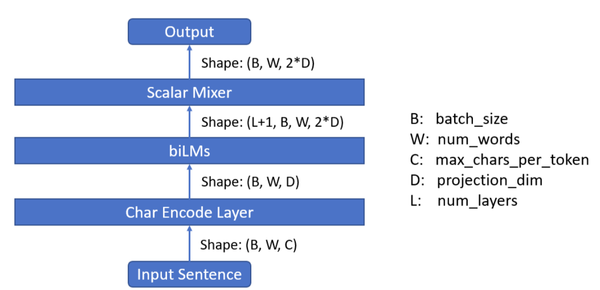
Pretrained language models
ELMO
BERT
GPT-1
ELMo uses a large amount of unlabeled data to train a bidirectional LSTM network, and the biLSTM obtained after the pre-training is completed can be used to learn context-aware word representations
Furthermore, ELMo can fine-tune the biLSTM network based on downstream task data, so as to achieve task-specific model optimization.
BERT is based on the Transformer architecture and models long program column relationships through a self-attention mechanism.
An encoder-only Transformer architecture is used.
Use specially designed pre-trained tasks to learn bidirectional language models on large-scale, unlabeled data.
GPT-1 uses a decoder-only Transformer architecture and a pre-trained task based on the next token prediction for model training.
Compared with the earlier word embedding model, the pre-trained language model has been improved and innovated in two aspects: training architecture and training data.
Pre-trained language models represented by ELMo, BERT, and GPT-1 have established the task solving paradigm of "pre-training-fine-tuning".
The pre-training phase aims to build the basic capabilities of the model through large-scale unlabeled text, while the fine-tuning phase uses labeled data to adapt the model to specific tasks.

Slide 8
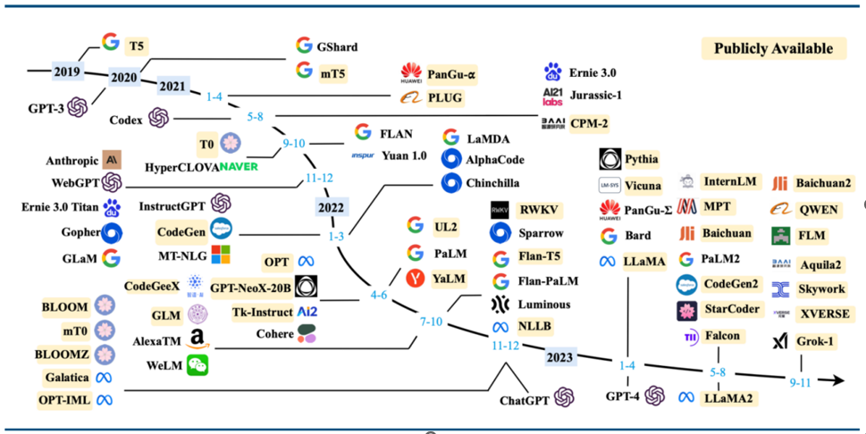
Large language models
The researchers found that scaling often leads to improved model performance for downstream tasks, a phenomenon often referred to as the "law of scaling."
Some research efforts have attempted to train larger, pre-trained language models to explore the performance limits of scaling language models. These large-scale pre-trained language models exhibit different behaviors than small pre-trained language models when solving complex tasks.
In order to distinguish this difference in capabilities, the academic community has named these large pre-trained language models "large language models".

Slide 9
02
Fine-tuning Techniques for Large Language Models

Slide 10
Introduction
A basic explanation is that fine-tuning involves targeted optimization of a pre-trained model using domain-specific data to enhance its performance on specific tasks.
Here is a question: What is fine-tuning technology?
So why incorporate fine-tuning techniques into large language models?
The core reason is to provide the model with more customized functionalities. While general large models are powerful, they may perform poorly in specific domains. Fine-tuning allows the model to better adapt to the needs and characteristics of a particular domain.

Slide 11
Content Architecture
To gain a deeper understanding of the specifics of fine-tuning techniques, I will introduce them in the following sections.
Representative Fine-tuning Techniques
Technical Development
Technical Summary
01
02
03
Among them, representative fine-tuning techniques can be further divided into the following four specific fine-tuning methods.
Classic Parameter Fine-tuning
Prompt Tuning
Parameter Efficient Fine-tuning
Reinforcement Learning Fine-Tuning

Slide 12
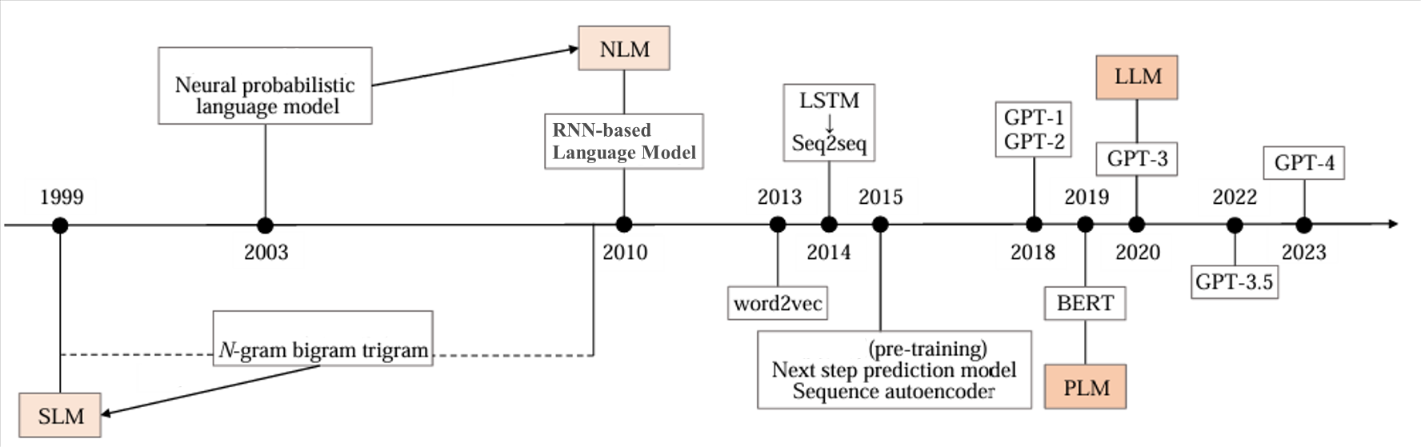
Technical Development
This is a diagram that summarizes the development process of large language models and fine-tuning techniques.

Slide 13


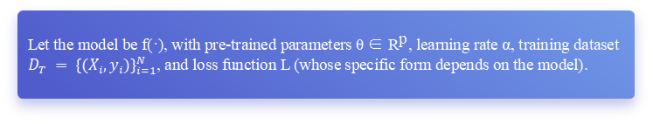
Representative Fine-tuning Techniques
Classic Parameter Fine-tuning
Classic parameter fine-tuning, often referred to as full parameter tuning, is a model optimization technique in deep learning, especially used in transfer learning or domain adaptation scenarios. It involves fine-tuning all the parameters of a pre-trained model to adapt it to a specific task or dataset.
Let the model be f(·), with pre-trained parameters θ ∈ ${\text{R}}^{\text{p}}$, learning rate α, training dataset $D_{T} = {\{(X_{i},y_{i})\}}_{i=1}^{N}$, and loss function L (whose specific form depends on the model).
To minimize the loss function for the new task, fine-tuning can be performed based on the original pre-trained parameters. Optimization algorithms, such as gradient descent, are typically used, with a small or dynamically changing learning rate, to update the f ine-tuning parameters:

Slide 14

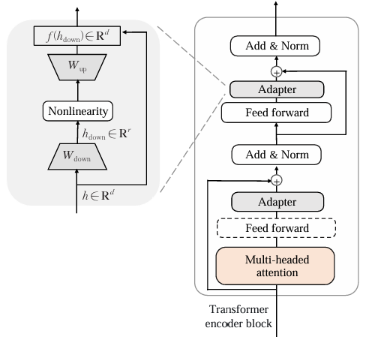

Representative Fine-tuning Techniques
Parameter Efficient Fine-Tuning
Parameter Efficient Fine-Tuning (PEFT) is a technique used to enhance the perfor mance of pre-trained language models on specific downstream tasks.
As an example of addition-based fine-tuning, the addition-based fine-tuning method in volves adding extra parameters by introducing adapter mod ules to each layer of the pre-trained model.
By only fine-tuning the newly added adapter structures and the layer norm layers
The process can be expressed as
Classic Parameter Fine-tuning
Parameter Efficient Fine-Tuning
same effect

Slide 15
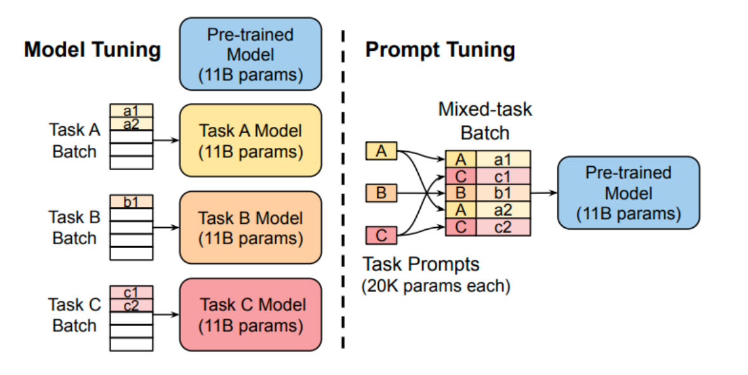
Representative Fine-tuning Techniques
Prompt Tuning mainly addresses two issues
Bridging the Gap between Pre-training and Fine-tuning: Pre-training tasks primarily focus on Masked Language Modeling (MLM), while downstream tasks introduce new training parameters, resulting in significant differences between the objectives of the two stages.
Avoiding Overfitting of the Head: During the Fine-tuning stage, additional parameters are introduced to adapt to specific task requirements, which can easily lead to overfitting when the number of training samples is limited, thereby reducing the model's generalization ability.

Slide 16
Representative Fine-tuning Techniques
Reinforcement Learning Basics
Policy Optimization
1
The agent takes actions (generates text), and based on the feedback or reward it receives, it adjusts its behavior to maximize the cumulative reward.
The language model's parameters are adjusted through policy optimization algorithms, such as Proximal Policy Optimization (PPO).
3
Reinforcement Learning Fine-Tuning
2
Human-in-the-loop Approach
Reward Signal and Feedback
RL Fine-tuning often involves a human-in-the-loop component, where human evaluators provide feedback on the quality of the model's responses.
The reward serves as a signal that encourages the model to generate responses that align with human preferences or task-specific objectives.
4

Slide 17
Technical Summary
Fine-tuning techniques, such as full parameter tuning, parameter-efficient fine-tuning , prompt tuning, and reinforcement learning-based approaches, have shown significant promise in optimizing the balance between computational resource demands and model accuracy.
Future research should focus on developing more efficient fine-tuning strategies that minimize resource consumption while maintaining high levels of performance.

Slide 18
03
The Impact of Large Language Models on Science and Technology Development

Slide 19
Four different areas of application
Natural language processing
Information retrieval
Natural Language Processing (NLP) enables computers to understand and respond to human language.
Information retrieval is the process of finding relevant information from a large dataset.
Computer vision
AI4Science
Computer vision enables computers to interpret and understand visual information from the world.
AI4Science leverages artificial intelligence to advance scientific research and discoveries.

Slide 20
Natural language processing
×
Traditional natural language processing
Large language models
Deep learning
Large language models
Task flexibilit
Traditional natural language processing methods often rely on specific algorithms and rules, which often struggle to capture the deep meaning and contextual relationships of text.
The large language model is trained by deep learning and using massive text data, demonstrating stronger language understanding and generation capabilities.
Task flexibility is one of the great advantages of large language models. Users can easily complete different language tasks, such as writing articles, writing code, and more, by simply adjusting the input prompts.
With the rise of large language models, the research paradigm is also quietly changing. Traditional research tasks are gradually being re-examined, and researchers have begun to focus on improving the overall performance of models. This change not only affects the direction of research, but also drives the innovation of new algorithms and frameworks.

Slide 21
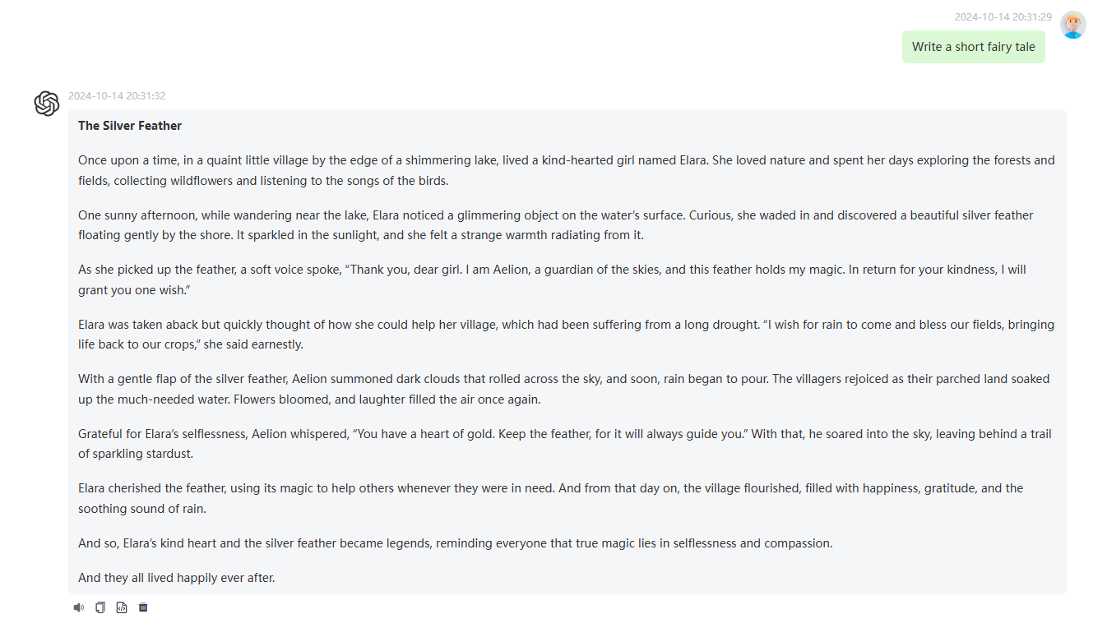
Natural language processing
The success of large language models marks the rise of language intelligence and has become an important path for the development of artificial intelligence. More and more companies and research institutes are using this technology to develop a variety of language-based applications, from chatbots to intelligent assistants, which show great potential.
添加标题文本
根据自己的需要添加适当的文字，此处添加详细文本描述，建议与标题相关尽量简洁... ...
添加标题文本
根据自己的需要添加适当的文字，此处添加详细文本描述，建议与标题相关尽量简洁... ...
intelligent assistants
chatbots

Slide 22
Natural language processing
Traditional information
retrieval
Large language models
Traditional search engines are mainly based on the working principle of keyword matching, and its core idea is to index a large number of web documents through an indexing system, and then match them in the index according to the keywords entered by users, and finally return document links or information related to keywords.
Today, information retrieval systems based on large language models allow users to ask questions in natural language, greatly improving the user experience. Users no longer need to focus on keyword selection, but can directly ask. The system is able to understand the context and provide accurate information.
Development

Slide 23

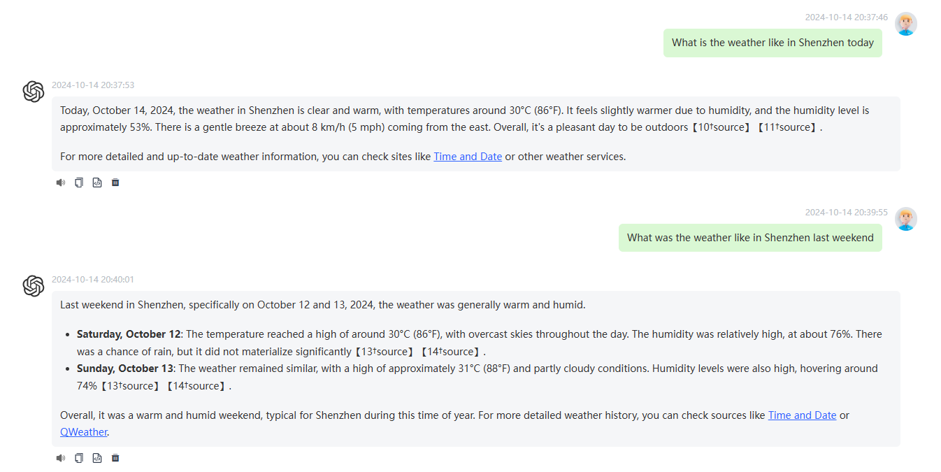
Information retrieval
.
One success story is Microsoft's launch of New Bing, a search engine based on large language model enhancements. It combines the advantages of large language models with traditional search engines to provide users with a more intelligent and personalized search experience, which greatly improves the efficiency of information retrieval.

Slide 24
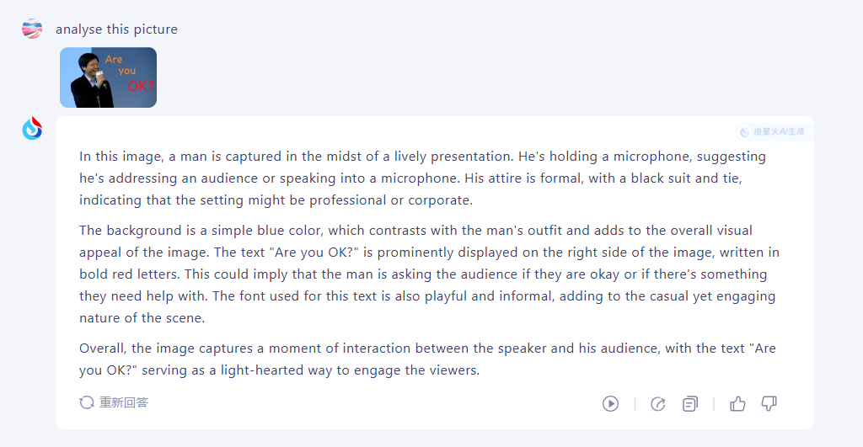
Computer vision
Large language models have the ability to process multimodal information of images and texts. This allows them to not only understand texts but also analyze images and videos. This cross-modality capability improves the model's performance in understanding complex scenarios and generating descriptions.

Slide 25
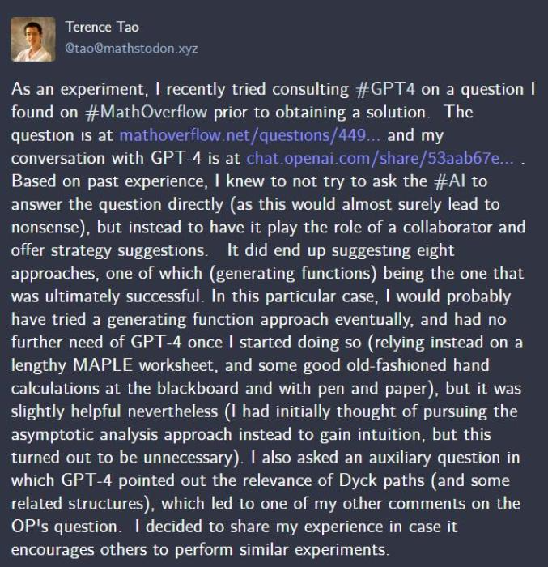
AI4Science
Famous mathematician Tao Zhexuan
Large language models are widely used in a variety of disciplines such as mathematics, chemistry, physics, and biology. Tao Zhexuan, a well-known mathematician, has said that he has widely used large language models in his research to get inspiration for solving problems and write papers.
In areas such as new material discovery and biopharmaceuticals, large language models show great potential. Researchers use models to analyze literature, formulate hypotheses, and even generate experimental designs to accelerate scientific discovery.

Slide 26
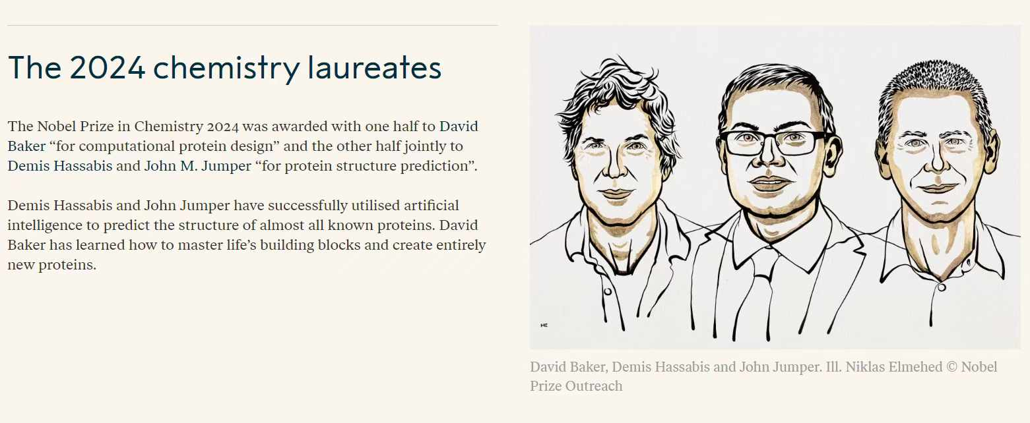
AI4Science
添加标题文本
根据自己的需要添加适当的文字，此处添加详细文本描述，建议与标题相关尽量简洁... ...
The 2024 Nobel Prize in Chemistry illustrates the synergy between computational methods in protein research and large language models. LLMs enhance data processing and pattern recognition, which can improve predictive models in chemistry, facilitate interdisciplinary collaboration, and support drug discovery by analyzing molecular interactions and synthesizing relevant scientific knowledge.

Slide 27
Thanks for listening
黄昭辉
郭剑华
黄捷宇
演讲人：

