Slide 1

Recovering Structures of Complex Dynamical Networks
Jianhua Guo
Visual Computing Research Center
October 6，2024

Slide 2
Content
Background
Methods
Contribution

Slide 3
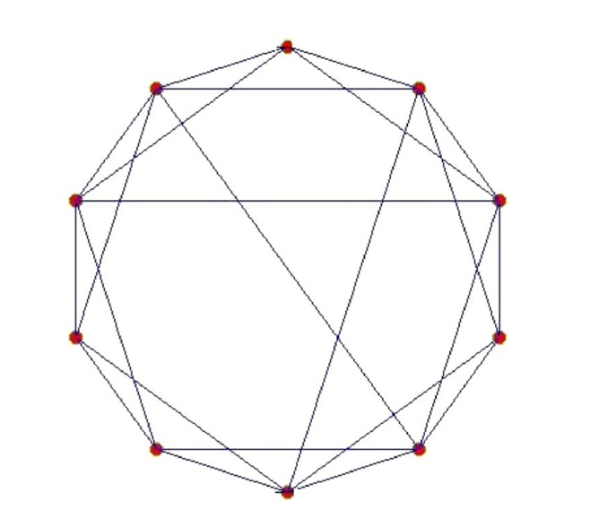
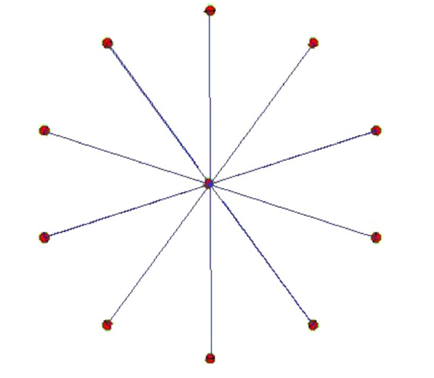
Background
Since the 20th century, the exploration of complex net works has been substantially extended from pure mathe matical analysis to various scientific fields, such as physical sci ences, engineering sciences, life sciences, biology sciences and so on . People began to investigate the basic characteris tics of complex networks which have a huge number of nodes andlinks, and practically complicated structures. In every scien tific discipline, complex networks have attracted wide research interest.

Slide 4
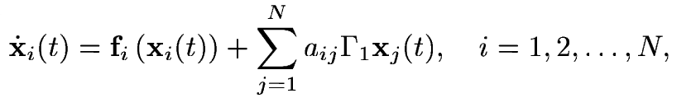
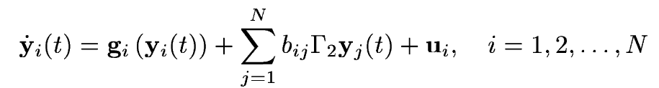
Methods
Consider a general weighted complex dynamical network Consisting of dynamical nodes with linear couplings
To recover the underlying topology of network,one can construct an auxiliary complex dynamical network containing N dynamical nodes as follows:

Slide 5
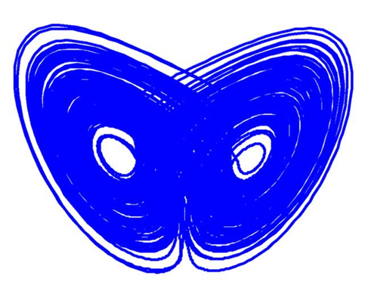
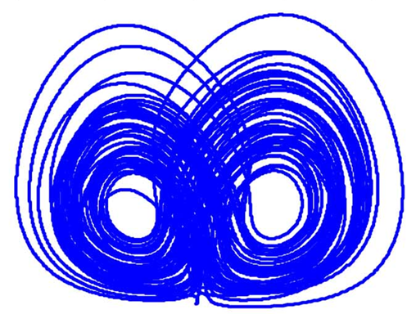
Methods
The Lyapunov function is determined by calculating the error, and then the Lyapunov function related to the conclusion equation is proved to have positive definite properties, so as to show that the complex network system has the characteristics of asymptotic stability, so as to judge the topology of the network.

Slide 6
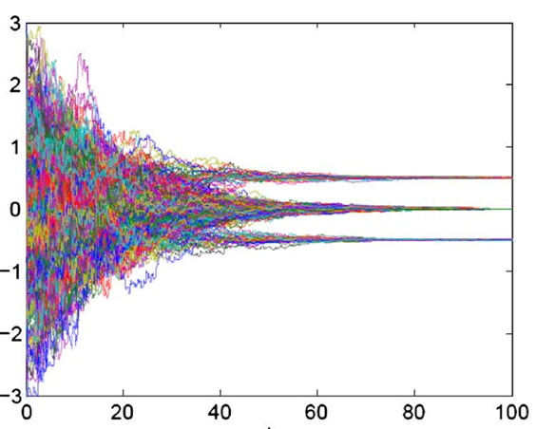
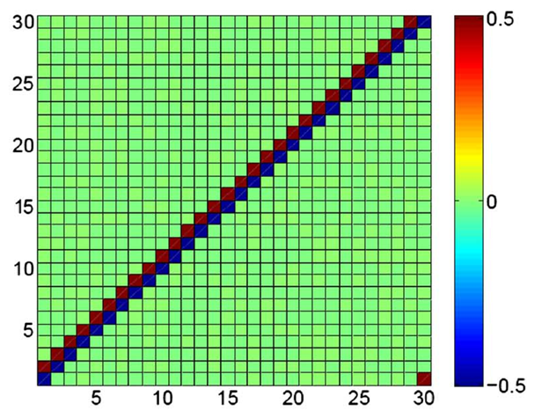
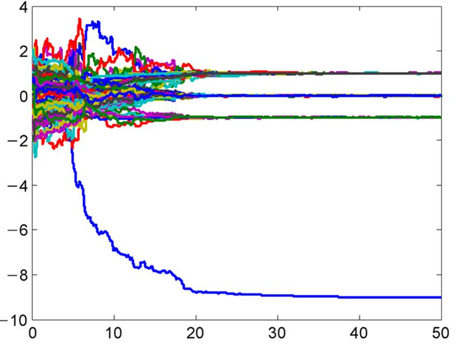
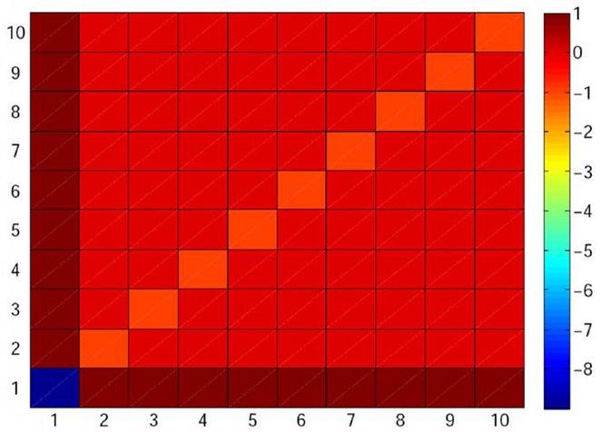
Methods

Slide 7
Contribution
The effectiveness of the theoretical f indings has been illustrated by three numerical examples. This work provides a convenient approach to recovering network topology, which can facilitate the selection of practical circuits and reduce application costs.

Slide 8
Thanks

