Slide 1
Physical Properties of Aldehydes and Ketones
States, boiling points, solubility and odour

Slide 2
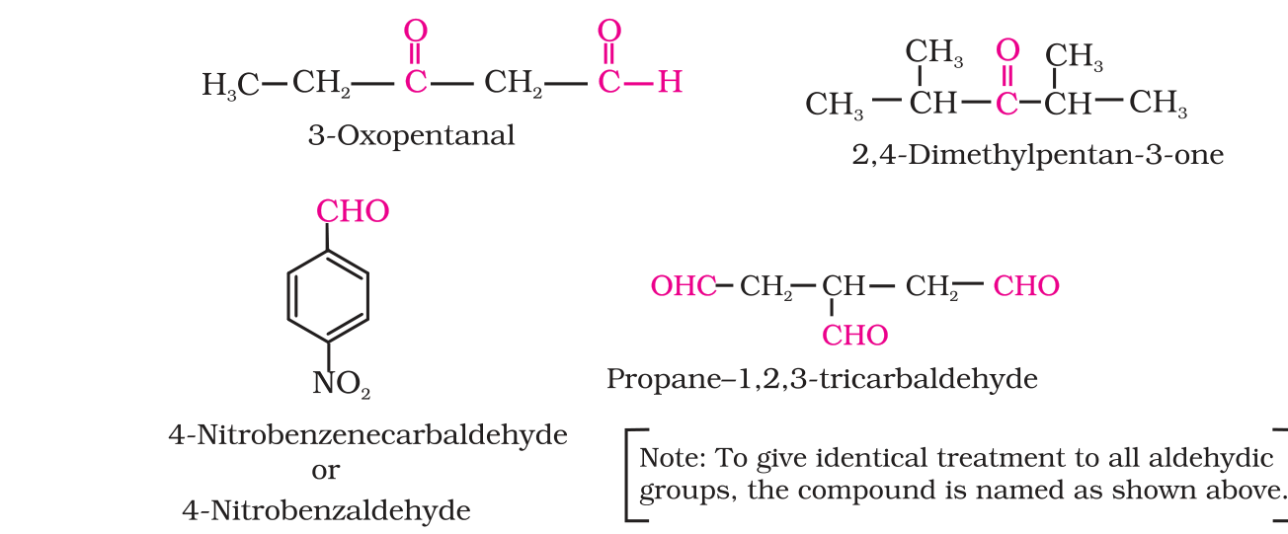
Meet Aldehydes and Ketones: Their Structures
Structures from NCERT page 230.
Every one has a carbonyl group, C=O (in pink).
Aldehydes: C=O at the end of the chain, as -CHO (3-Oxopentanal, 4-Nitrobenzaldehyde).
Ketones: C=O inside the chain (2,4-Dimethylpentan-3-one).

Slide 3
Meet Aldehydes and Ketones: States at Room Temperature
Methanal (HCHO) is a gas.
Ethanal (CH3CHO) is a volatile liquid.
Other aldehydes and ketones are liquids or solids.

Slide 4
Boiling Points: Why They Sit in the Middle
Higher than hydrocarbons and ethers of similar molecular mass: the polar C=O group gives dipole-dipole attraction.
Lower than alcohols of similar molecular mass: aldehydes and ketones cannot hydrogen bond with each other.
Compare molecules of similar molecular mass, so size does not decide the order.

Slide 5
Boiling Points: The Numbers
Hydrocarbon and ether lowest, aldehyde and ketone in the middle, alcohol highest.

Slide 6
Solubility and Odour
Methanal, ethanal and propanone mix with water in all proportions: they form hydrogen bonds with water.
Solubility in water falls quickly as the alkyl chain gets longer.
All are fairly soluble in benzene, ether, methanol and chloroform.
Lower aldehydes smell sharp and pungent; bigger molecules smell more fragrant, so many are used in perfumes and flavours.

Slide 7
Ranking Boiling Points (NCERT Example 8.2)
1. Check that the molecular masses are similar
2. Find the molecules that hydrogen bond with each other: they boil highest
3. Compare polarity: more polar means stronger dipole-dipole attraction
4. Molecules with only van der Waals forces boil lowest
5. Write the order from lowest to highest

Slide 8
Remember
Hydrocarbons and ethers < aldehydes and ketones < alcohols (similar mass).
Dipole-dipole attraction raises the boiling point; hydrogen bonding raises it most.
Small aldehydes and ketones dissolve in water; long-chain ones do not.

