Slide 1
French Society Before the Revolution
The Old Regime, its taxes and the struggle to survive

Slide 2
France in 1774
Louis XVI became king at the age of 20.
He found an empty treasury: long wars and a costly court at Versailles.
Helping the American colonies added more than 1 billion livres to a debt of over 2 billion livres.
Lenders now charged 10 per cent interest on loans.
To meet its expenses, the state had to raise taxes.

Slide 3
The Society of Estates: Who Was Who
First estate: the clergy.
Second estate: the nobility.
Third estate: merchants, lawyers and officials, peasants, artisans, labourers and servants.
Peasants were about 90 per cent of the population, but few owned the land they farmed.
Nobles, the Church and rich members of the third estate owned about 60 per cent of the land.
Only the third estate paid taxes to the state.

Slide 4
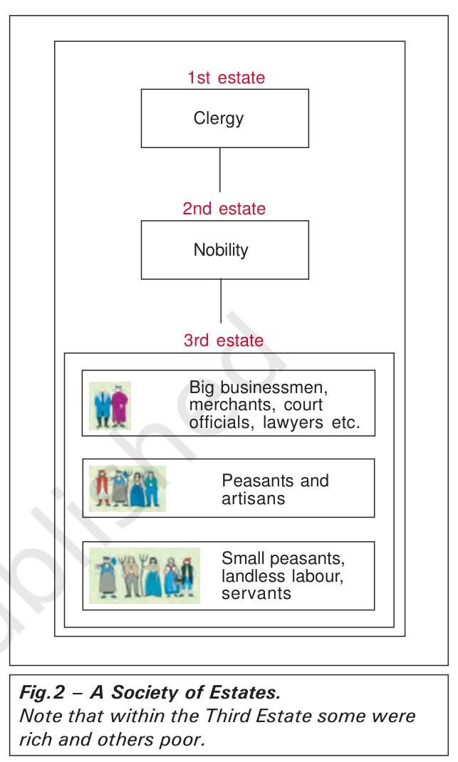
The Society of Estates: Fig. 2 in Your Book
Fig. 2, NCERT page 4.
1st estate: clergy.
2nd estate: nobility.
3rd estate: three groups, from rich businessmen and lawyers down to landless labourers and servants.
Within the third estate, some were rich and others poor.

Slide 5
The Society of Estates: Who Paid What
Tithes: a tax paid to the Church.
Taille: a direct tax paid to the state.
Indirect taxes: on everyday things like salt and tobacco.
Feudal dues and services: owed to the lord, such as work in his house and fields.
The clergy and nobles were exempt from taxes to the state, by birth.

Slide 6
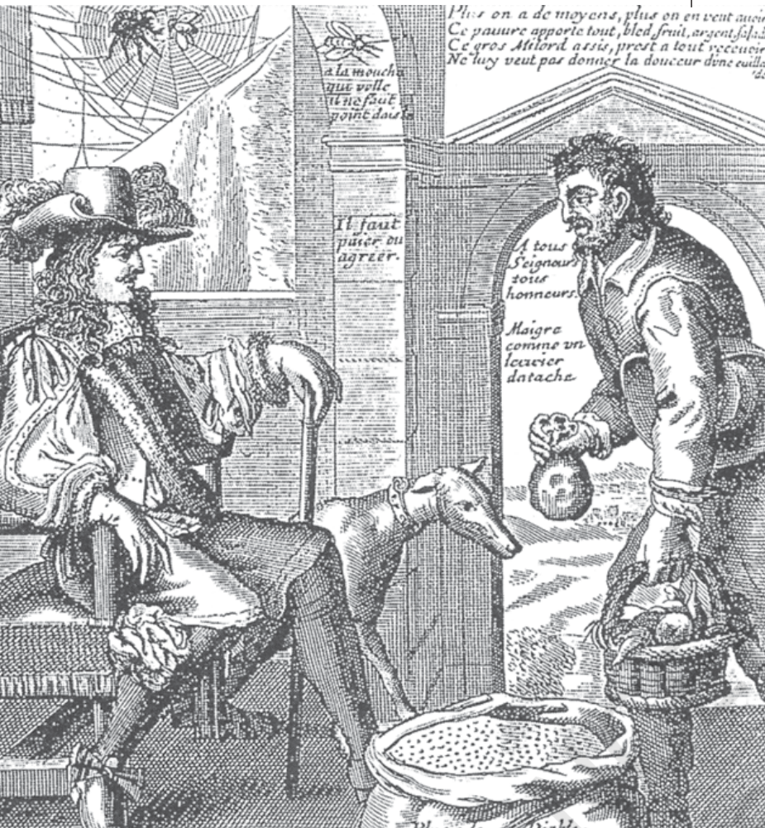
The Society of Estates: The Spider and the Fly
Fig. 3, NCERT page 5: an anonymous etching.
The nobleman sits; the peasant brings grain, fruit and money.
'The nobleman is the spider, the peasant the fly.'
Why did the artist draw the noble as a spider and the peasant as a fly?

Slide 7
The Struggle to Survive
The population of France grew from about 23 million in 1715 to 28 million in 1789.
Grain production could not keep pace with the demand for food.
The price of bread, the staple food, rose rapidly.
Wages did not keep pace with prices, so the gap between rich and poor widened.
A drought or hail that cut the harvest made things worse.

Slide 8
How a Subsistence Crisis Happens
1. Bad harvest
2. Scarcity of grain
3. Rising food prices
4. The poorest can no longer buy bread
5. Weaker bodies and disease epidemics
6. More deaths and food riots

Slide 9
Remember
Three estates, but only the third estate paid taxes to the state.
Peasants paid tithes, taille, indirect taxes and feudal dues.
More people, too little grain and low wages led to subsistence crises.
Anger at unfair taxes and hunger set the stage for 1789.

