Slide 1
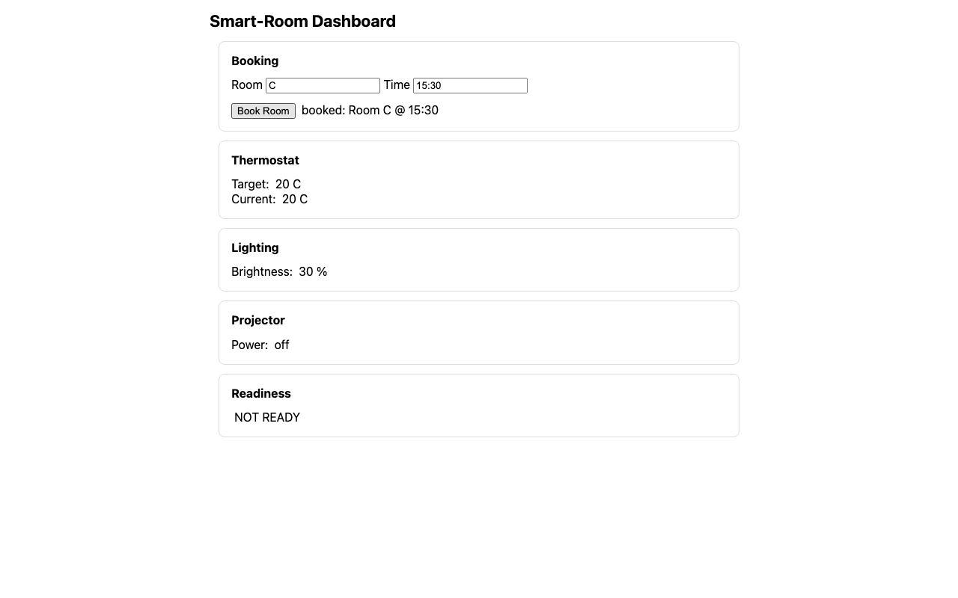
Supervised smart-room sessions
WEEKLY UPDATE
One shared path from a user request to safe, reversible execution.
GoalSpec → Skill → DOM + WoT actions
Human pause → verification → cleanup
Fadi Ferjani • 5–7 minutes
Live dashboard evidence • DOM + WoT
1
Notes:
Today I will show one small integrated update.
It gives every task a clean session and a safe pause point.
The same run uses the smart-room dashboard and the WoT devices.
I will first explain the idea, then run the demo, then show a few code files.

Slide 2
The ideal PiP and this milestone are different
Ideal: UFO2 Windows PiP
Implemented: supervised session isolation
A separate Windows child desktop
User mouse and keyboard cannot disturb the agent
The child desktop appears inside an RDP window
Needs Windows-specific C# and system setup
A fresh browser context for each episode
A WoT checkpoint that is restored at the end
Tier-4 pause, approve, reject, cancel, or takeover
Software input ownership between agent and operator
Uses the shared runtime pipeline
Source: src/isolation/episode.py; src/isolation/input_lease.py; UFO2 paper used as the target design
2
Notes:
The paper describes the ideal version on the left.
That version gives the agent its own Windows desktop.
Our project is web-based and runs on different systems, so this milestone is smaller.
I renamed it so I do not claim full PiP.
The current input gate protects software executors; it does not block a physical mouse at operating-system level.
A Windows RDP child session remains future work.

Slide 3
What happens in one supervised episode
1 UNDERSTAND
2 ACT
3 SUPERVISE
GoalSpec → Skill
DOM + WoT
Pause → verify → restore
One request becomes a stable goal. The Skill Library validates all values and policies.
The shared runner creates typed actions for the booking form, lights, projector, and thermostat.
The risky click pauses. After a decision, the runtime verifies fresh state and always cleans up.
Source: scripts/run_supervised_smartroom_demo.py; src/runtime/episode_runner.py; src/runtime/continuous_interaction_manager.py
3
Notes:
First, one normal sentence becomes a GoalSpec.
The stable goal selects the reusable prepare-and-confirm-room Skill.
The Skill checks its parameters, allowed backends, safety level, and final condition.
The shared episode runner creates a fresh browser and a room checkpoint.
The agent types the room and time through DOM actions and controls three devices through WoT.
The final booking click is high risk, so the runtime pauses.
If a human takes over, the old plan is discarded and the runtime observes and plans again.
At the end, the browser closes and the original device state is restored.

Slide 4
Evidence from the implementation
The test and demo results below were produced from the same repository path used in the live walkthrough.
758
16
6
fast tests passed
smart-room tests passed
verified demo actions
Contracts, planning, runtime, takeover, cleanup
Real Chromium + running WoT services
2 DOM inputs + 3 WoT calls + 1 protected click
Source: local test runs; artifacts/supervised_smartroom/episode.json (completed, DOM + WoT, restored=true)
4
Notes:
These are the checks I ran after the implementation.
The fast suite passed 758 tests.
The Docker smart-room suite passed 16 tests with a real browser and WoT services.
The live episode produced six verified primitive actions.
The episode artifact records the selected Skill, every primitive, the human decision, and the cleanup result.
I will open that JSON file after the live demo if we want to inspect the evidence.

Slide 5
How I will show it in the meeting
Live demo • about 3 minutes
Small code walkthrough • about 2 minutes
.venv/bin/python scripts/
run_supervised_smartroom_demo.py
Intent + stable GoalSpec: intent_planner.py
GoalSpec → Skill: goal_skill_selector.py
Shared path: episode_runner.py
Session + input lease: src/isolation/
One trace: supervised_smartroom/episode.json
Watch the clean browser open
See room, time, and devices change
At the pause: approve or take control
Finish on completed + state restored
Honest limit: this is not a separate Windows/RDP desktop.
Runbook: SUPERVISED_SMARTROOM_WALKTHROUGH.md
5
Notes:
Before the meeting, start Docker and keep the code files already open.
Run the command on the left without --auto-approve so the pause is visible.
The agent fills Room C and 15:30; they are not prefilled by the page.
It also changes the lights, projector, and thermostat through WoT.
At the pause, choose a to approve, or t to take control and click Book Room yourself.
Then show completed, both backends used, and state restored true in the terminal.
For code, open only the four places on the right and explain one sentence for each.
Finish by saying this is supervised session isolation, while full Windows PiP is future work.

