Slide 1
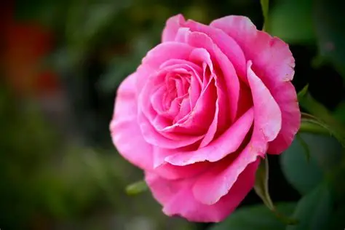

rose
This is a rose

