Slide 1
Dr. Riddhi S. Gupta Senior Research Fellow, SMP
Brief Tour of Quantum Computing

Slide 2
Agenda
Today
High level overview of quantum computing
Quantum ‘rules’ (words)
Quantum `rules’ (maths)
Dirac notation
Single Qubit
Two Qubits
What can we do with this?
Entanglement (not really covered)
Phase kickback
Tomorrow
Recap
Audience questions
Phase kickback
Deutsch-Josza Algorithm
Optional extras:
Complexity of classical vs. quantum comparisons
Challenges in quantum computing

Slide 3
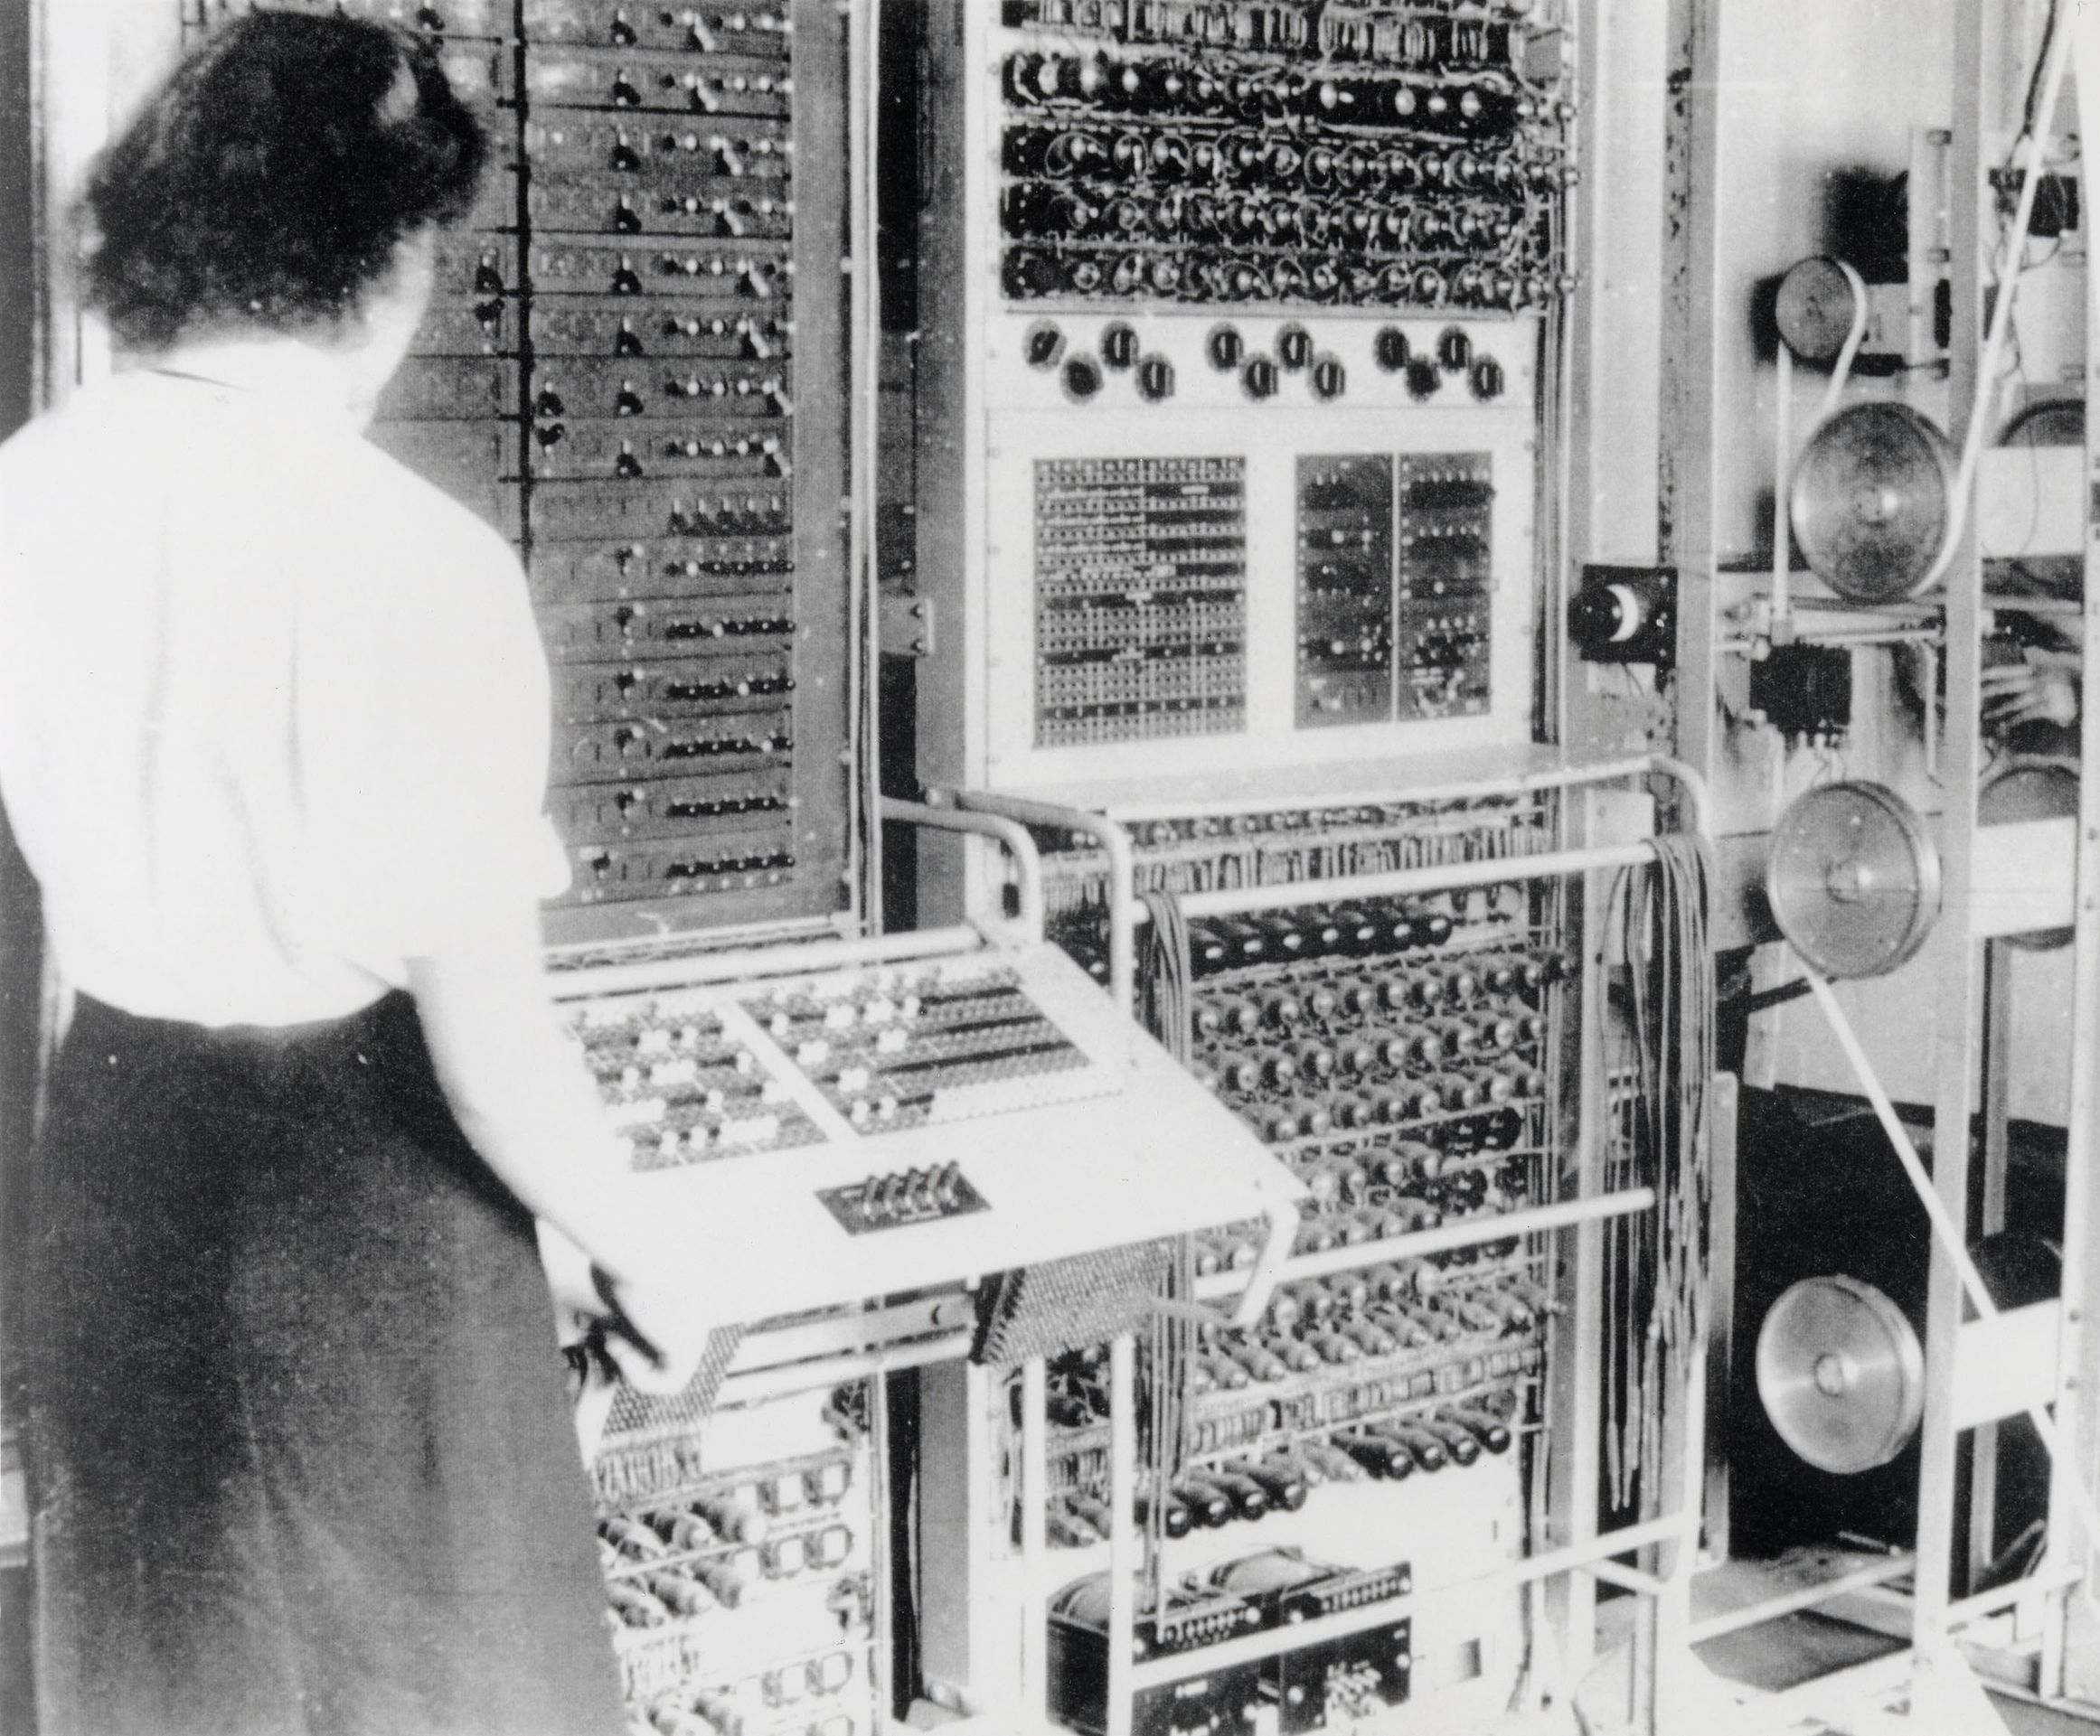
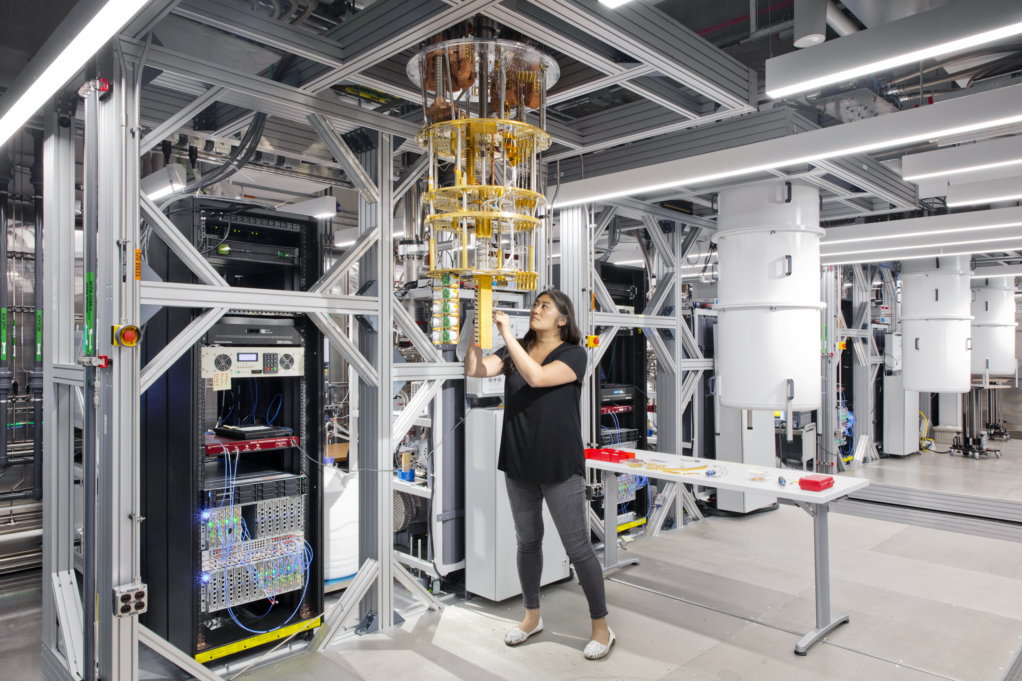

From classical to quantum computing
1943
First computer
2025
Current computer
2025
Quantum computer
01010101010101
01110000111000
0 = ON
1 = OFF
Uses “quantum” rules instead of switches
Millions of switches
Notes:
Ask: what is a computer?
What does it run on?
How does it do calculations?

Slide 4
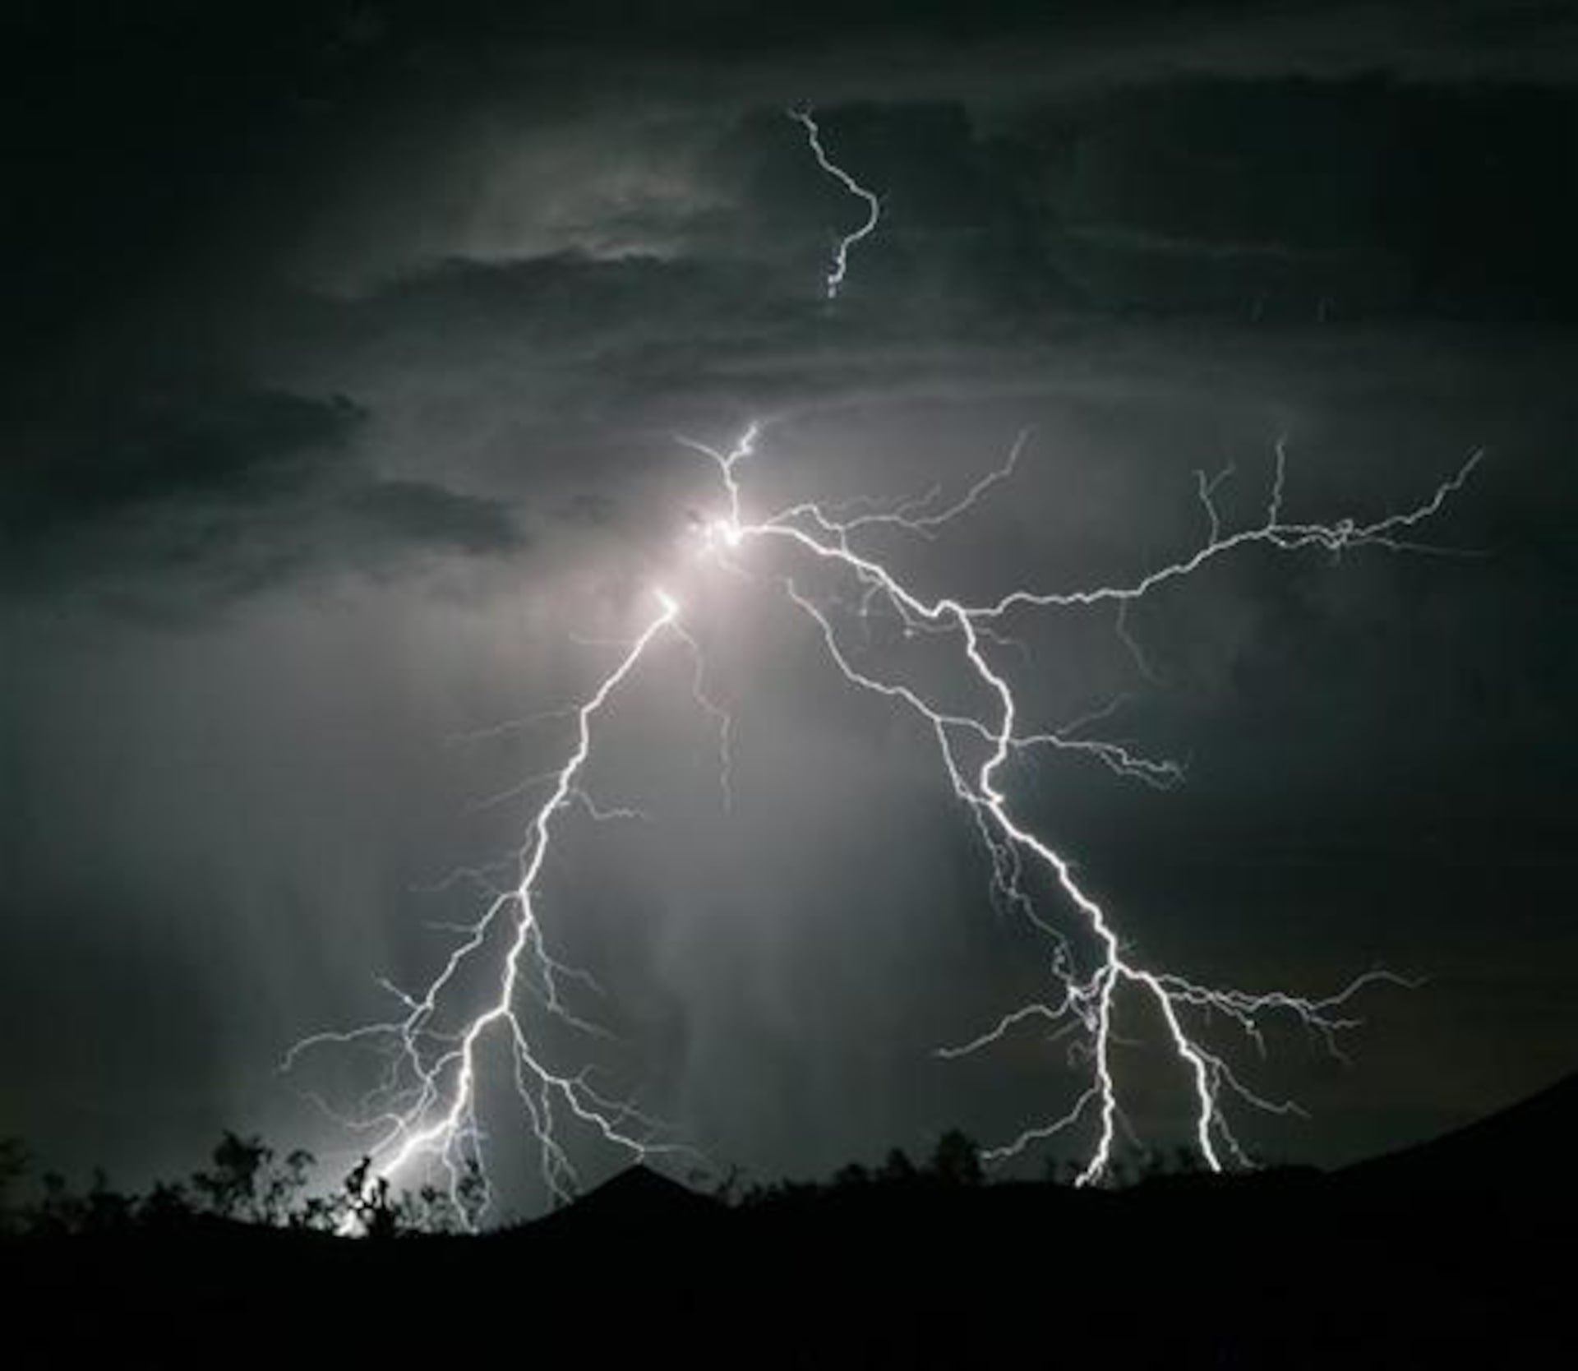
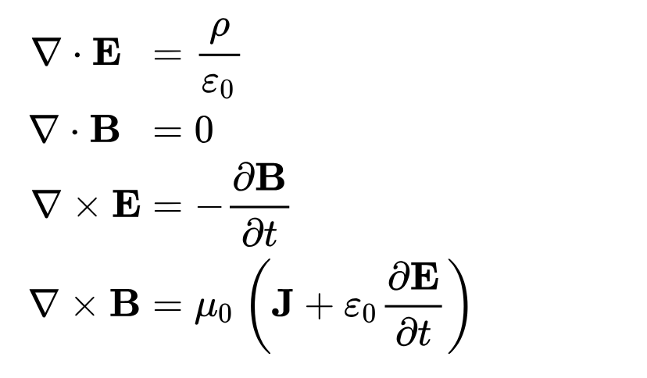
How did we make a computer from electricity?
1752: Benjamin Franklin
We see things in nature
1861: Maxwell Equations
We describe things via mathematics
1943: First electronic computer
We build the hardware
Source: https://www.reuters.com/news/picture/idUSRTR24K3J/undefined
Source: https://en.wikipedia.org/wiki/Computer#/media/File:Colossus.jpg
It took us 200 years to control electricity to make computers
Notes:
192 years

Slide 5
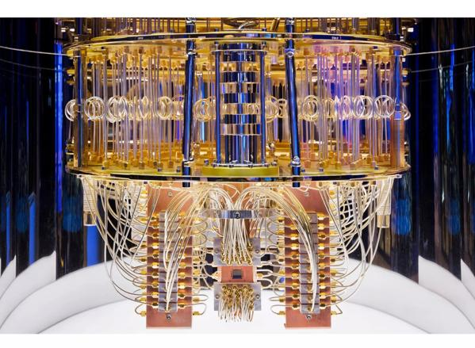
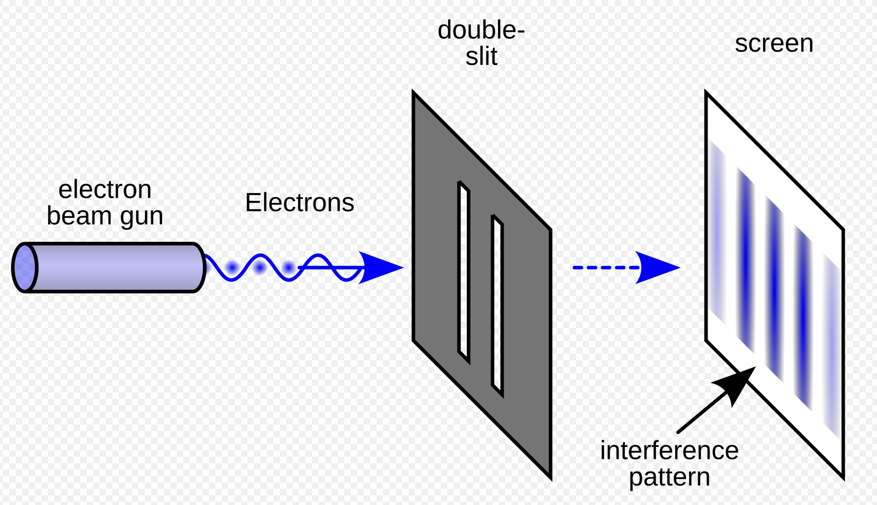
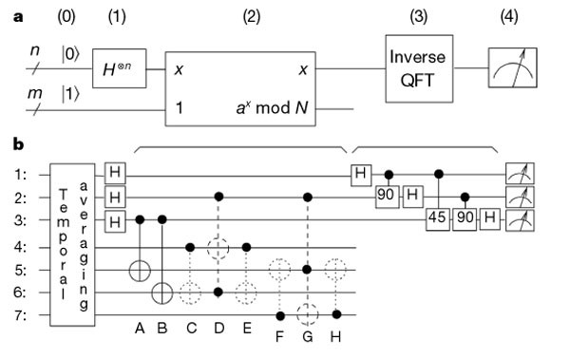
How will we make a computer from quantum rules?
1920s: Quantum mechanics confirmed in experiments
1970s – 1990s
Quantum algorithms proposed
2010 - 2016
Quantum computers
https://www.nature.com/articles/414883a
We see strange things in nature when things become very small
We describe quantum computing via mathematics
We build the hardware
Notes:
192 years
Who has done double split experiment with light?

Slide 6









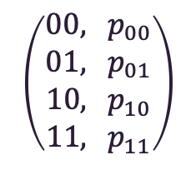
Classical vs. quantum computing
Classical computer
Quantum computer
$$f$$
$$f$$
$$\left(\begin{matrix}00, { p}_{00} \\ 01, { p}_{01} \\ \begin{aligned}10, { p}_{10} \\ 11,{ p}_{11}\end{aligned}\end{matrix}\right)$$
$$x= \left(\begin{aligned}x_{1} \\ x_{2}\end{aligned}\right)$$
$$f(x)$$
$$x= \left(\begin{aligned}x_{1} \\ x_{2}\end{aligned}\right)$$
$$x_{1},x_{2}∈\{0,1\}$$
$$x_{1},x_{2}∈\{0,1\}$$
Deterministic outcome $f(x)$
Random outcomes $i$ with prob $p_{i}$
Quantum Algorithms: Probability of finding (optimal) solutions maximized (near 1)

Slide 7
When do “Quantum” rules in Nature apply?

Slide 8
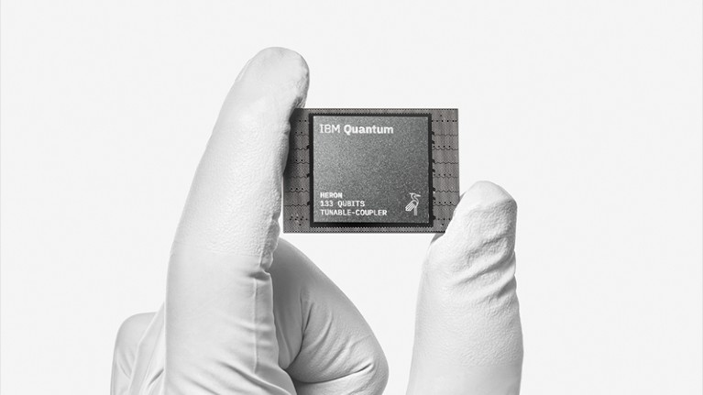
Today’s quantum computer
Very, very small
Very, very cold

Slide 9

Today’s quantum computer

Slide 10
“Quantum” rules

Slide 11
But first, a bad classical analogy….
What is a ‘system’?
What is a ‘state’ of a system?
What is a ‘measurement’ / ‘outcome’?
SYSTEM collapses to a state
DETECTOR gets measurements
Quantum
entanglement

Slide 12
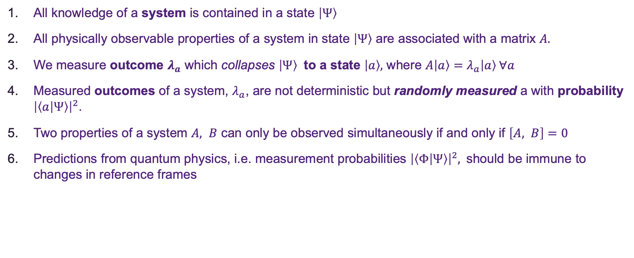
Quantum rules (words)
All knowledge of a system is contained in a state $\left|Ψ\right\rangle$
All physically observable properties of a system in state $\left|Ψ\right\rangle$ are associated with a matrix $A.$
We measure outcome $λ_{a}$ which collapses $\left|Ψ\right\rangle$ to a state $\left|a\right\rangle ,$ where $A\left|a\right\rangle =λ_{a}\left|a\right\rangle ∀a$
Measured outcomes of a system, $λ_{a}$, are not deterministic but randomly measured a with probability ${\left|\left\langle a | Ψ\right\rangle \right|}^{2}$.
Two properties of a system $A, B$ can only be observed simultaneously if and only if $\left[A, B\right]=0$
Predictions from quantum physics, i.e. measurement probabilities ${\left|\left\langle Φ | Ψ\right\rangle \right|}^{2},$should be immune to changes in reference frames

Slide 13
(math)

Slide 14
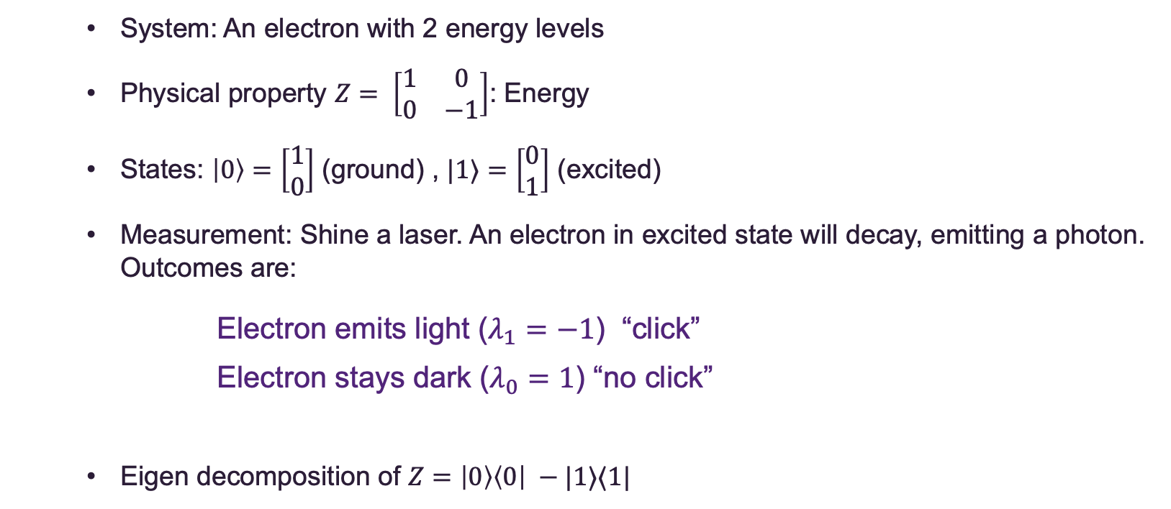
Two level system (qubit)
System: An electron with 2 energy levels
Physical property $Z= \left[\begin{matrix}1 & 0 \\ 0 & −1\end{matrix}\right]$: Energy
States: $\left|0\right\rangle =\left[\begin{aligned}1 \\ 0\end{aligned}\right]$ (ground) , $|1⟩$ $=\left[\begin{aligned}0 \\ 1\end{aligned}\right]$ (excited)
Measurement: Shine a laser. An electron in excited state will decay, emitting a photon. Outcomes are:
Electron emits light ($λ_{1}=−1$) “click”
Electron stays dark ($λ_{0}=1$) “no click”
Eigen decomposition of $Z=\left|0\right\rangle \left\langle 0\right| −|1⟩⟨1|$

Slide 15
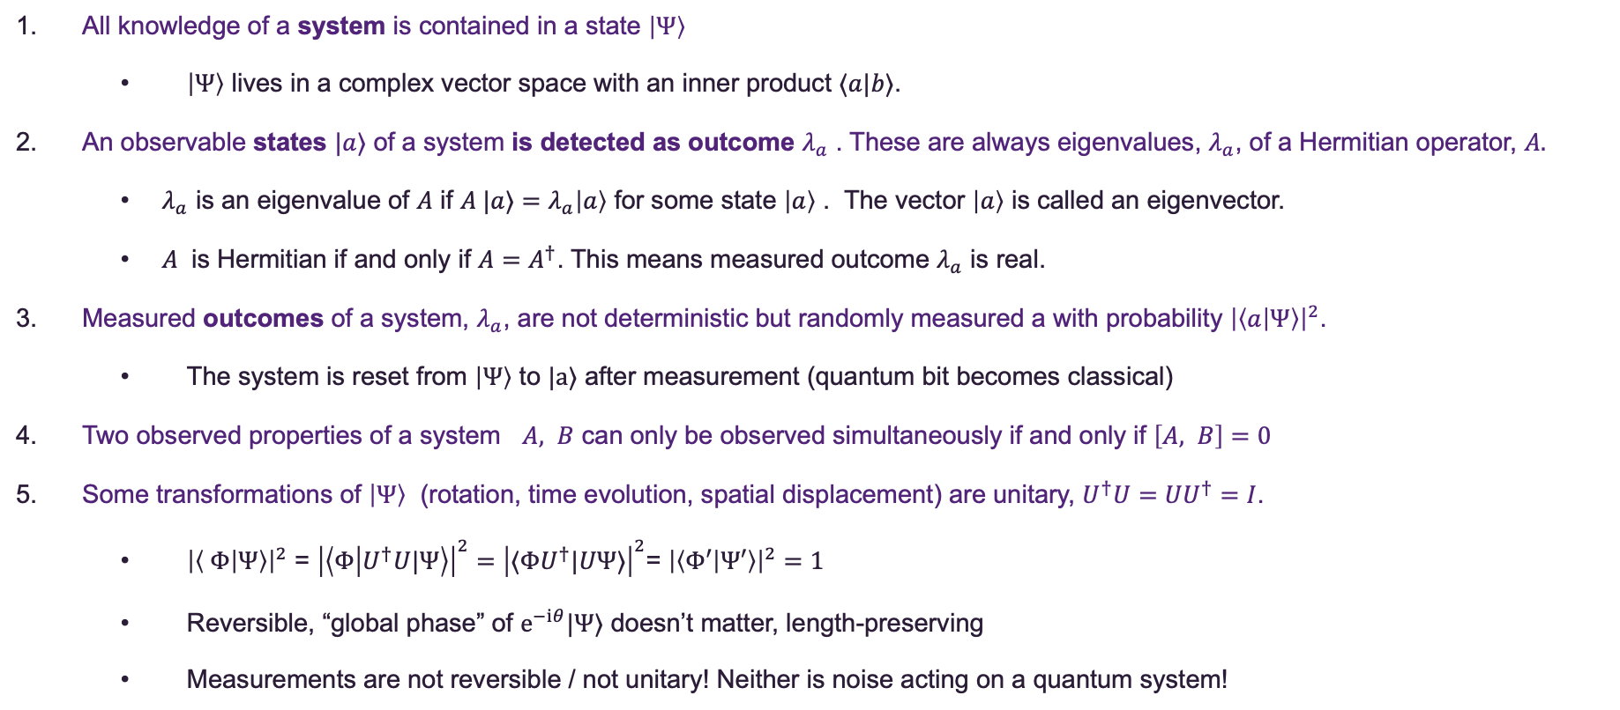
Summary of quantum rules in maths
All knowledge of a system is contained in a state $\left|Ψ\right\rangle$
$\left|Ψ\right\rangle$ lives in a complex vector space with an inner product $⟨a|b⟩$.
An observable states $|a⟩$ of a system is detected as outcome $λ_{a}$ . These are always eigenvalues, $λ_{a}$, of a Hermitian operator, $A.$
$λ_{a}$ is an eigenvalue of $A$ if $A |a⟩=λ_{a}\left|a\right\rangle$ for some state $\left|a\right\rangle$ . The vector $\left|a\right\rangle$ is called an eigenvector.
$A$ is Hermitian if and only if $A=A^{†}$. This means measured outcome $λ_{a}$ is real.
Measured outcomes of a system, $λ_{a}$, are not deterministic but randomly measured a with probability ${\left|\left\langle a | Ψ\right\rangle \right|}^{2}$.
The system is reset from $\left|Ψ\right\rangle$ to $|a⟩$ after measurement (quantum bit becomes classical)
Two observed properties of a system $A, B$ can only be observed simultaneously if and only if $\left[A, B\right]=0$
Some transformations of $\left|Ψ\right\rangle$ (rotation, time evolution, spatial displacement) are unitary, $U^{†}U={UU}^{†}=I$.
${\left|\left\langle Φ | Ψ\right\rangle \right|}^{2}$ = ${\left|\left\langle Φ | U^{†}U|Ψ\right\rangle \right|}^{2}={\left|⟨ΦU^{†}|UΨ⟩\right|}^{2}$= ${\left|\left\langle Φ′ | Ψ′\right\rangle \right|}^{2}=1$
Reversible, “global phase” of $e^{−iθ}|Ψ⟩$ doesn’t matter, length-preserving
Measurements are not reversible / not unitary! Neither is noise acting on a quantum system!

