Slide 1
Temus - Case study financial report QA Agent
XU SHIHAO
2024-05-12

Slide 2
Overview of the case study
Objective:
Develop a generative Q&A chatbot that can provide factual answers to user questions, by referring to a knowledge base created from the PDF files of financial reports of big listed public companies.
Problem Statement
Develop a generative Q&A chatbot to answer questions related to financial reports of large public companies.
The chatbot must refer to a knowledge base generated from the provided PDF files of financial reports.
The chatbot should be grounded in the knowledge base, minimize hallucination, and provide accurate information.
Data
Use PDF files of financial reports from big listed public companies.
Requirements
Use any open-source language models, frameworks, and coding languages.
Use cloud-based SaaS offerings as necessary for powering the chatbot.
Minimize hallucination with proper grounding techniques.

Slide 3
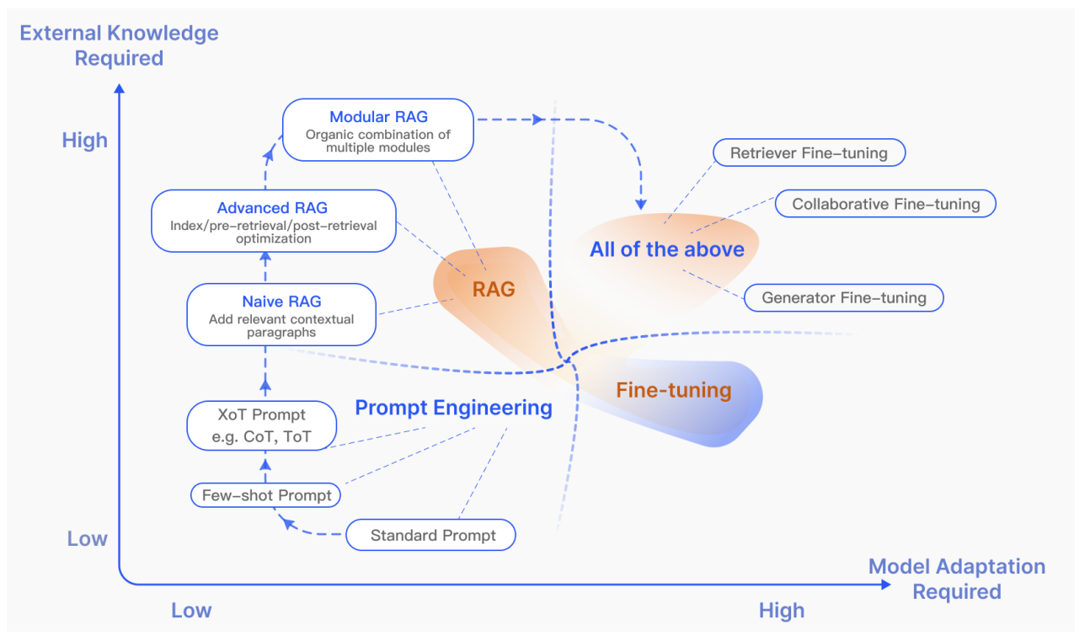
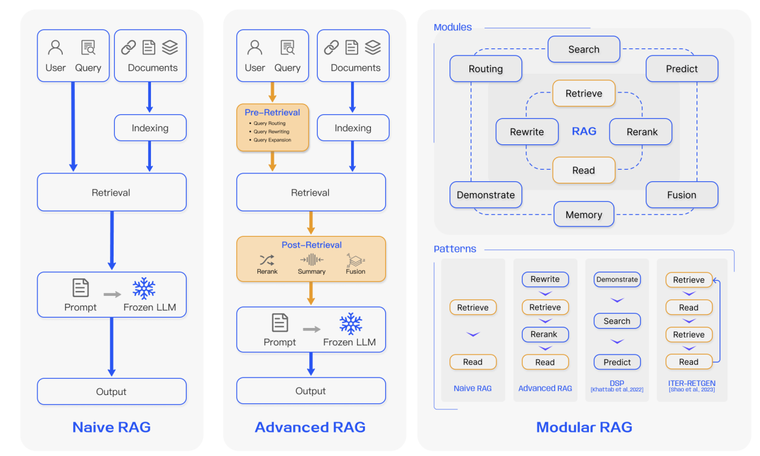
Background of using RAG for LLM QA system
Gao, Y., Xiong, Y., Gao, X., Jia, K., Pan, J., Bi, Y., ... & Wang, H. (2023). Retrieval-augmented generation for large language models: A survey. arXiv preprint arXiv:2312.10997.

Slide 4
Dataset
Collect 16 annual financial reports from 7 companies (e.g., Apple, Amazon, OCBC, Shell, etc.)
Automatic question answer generation using GPT4
2 test datasets (Simple & Hard)
42 relatively simple question-answer pairs
Example
{
"question_1": "What were Amazon's total advertising and other promotional costs in 2023?",
"answer_1": "$20.3 billion",
"question_2": "How much was Amazon's income from equity warrant valuation gains in 2023?",
"answer_2": "$26 million",
"question_3": "What was the fair value of Amazon's equity investment in Rivian Automotive, Inc. as of December 31, 2023?",
"answer_3": "$3.7 billion",
"filename": "./docs\\Amazon-com-Inc-2023-Annual-Report.pdf“
}
40 relatively hard question-answer pairs
Example
{
"question_1": "What was McDonald's global comparable sales growth rate in 2023 compared to 2022?",
"answer_1": "Nearly 11%",
"question_2": "By how much did McDonald's systemwide sales increase since 2020 by the end of 2022?",
"answer_2": "Nearly $20 billion",
"question_3": "How many active loyalty users did McDonald\u2019s have in its top six markets by the end of 2022?",
"answer_3": "Almost 50 million",
"filename": "./docs\\McDonald*.pdf“
}

Slide 5
Overall Pipeline
Advanced technique for performance boosting
Ensemble Retriever
Leveraging the strengths of different retrievers can achieve better performance than single retriever. The sparse retriever (e.g., BM25) is good at finding relevant documents based on keywords, while the dense retriever (e.g., embeddings from alignment pretrain model) is good at finding relevant documents based on semantic similarity.
Hypothetical Document Embeddings (HyDE)
It is a method used to enhance retrieval by generating a hypothetical document for an incoming query. In our case, I first generated the potential answer, and use the answer to look up the financial document segments.
Query paraphrasing
Query paraphrasing in document retrieval refers to the process of reformulating or rephrasing a user's search query with the intent to improve the search results by either expanding the range of retrieved documents or by more accurately capturing the user's information need.
Loading PDFs using PdfReader to pain text
Query paraphrasing
Hypothetical Document Embeddings (HyDE)
mxbai-embed-large-v1
bge-large-en-v1.5
BM25
Faiss retrieval library for sematic indexing
Ensemble Retriever
GPT4-Turbo for QA
A verifier Agent to calculate the accuracy automatically
https://github.com/langchain-ai/langchain

Slide 6
Results
Naïve RAG
Ensemble retriever (ER)
Hypothetical Document Embeddings (HyDE)
Query paraphrasing (QP)
Pipeline | Indexing Method | Simple QA data |  |  | Hard QA data |  |  | Overall (cs=500)
 |  | Text splitter chunk size |  |  | Text splitter chunk size
 |  | 500 | 1000 | 1500 | 500 | 1000 | 1500
Naïve RAG | BM25 | 76.2% | 76.2% | 83.3% | 52.5% | 55.0% | 47.5% | 64.3%
Naïve RAG | mxbai-embed-large-v1 | 76.2% | 81.0% | 81.0% | 60.0% | 62.5% | 62.5% | 68.1%
Naïve RAG | bge-large-en-v1.5 | 85.7% | 85.7% | 85.7% | 70.0% | 65.0% | 57.5% | 77.9%
Naïve RAG + ER | Fused | 95.2% | 95.2% | 92.9% | 85.0% | 75.0% | 75.0% | 90.1%
Naïve RAG + ER + QP | Fused | 85.7% | 90.5% | 88.1% | 70.0% | 72.5% | 60.0% | 77.9%
Naïve RAG + ER + HyDE | Fused | 100.0% | 97.6% | 97.6% | 77.5% | 77.5% | 80.0% | 88.8%
Naïve RAG + ER + HyDE + QP | Fused | 92.9% | 95.2% | 92.9% | 67.5% | 72.5% | 75.0% | 80.2%
Conclusion: RAG + ER with chunk size of 500 achieves best results

Slide 7
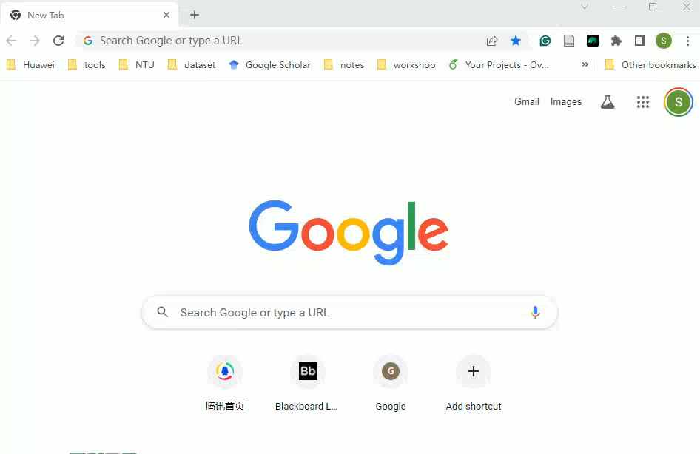
Demo
https://financial-report-app-xushihao.streamlit.app/
https://github.com/Xu-Shihao/financial_report_QA

Slide 8
Thanks for your listening

