Slide 1

Tribhuvan University Institute Of Engineering Kathmandu Engineering College Kalimati, Kathmandu
Stock Market Analysis and Prediction (S-MAP)
SUBMITTED BY:
Prasanna Dangol (73053)
Shreejal K. Gupta (73073)
Shreyanshu D. Kunwar (73075)
Sujan Manandhar (73083)
Date: 2076/04/23

Slide 2
OVERVIEW
Introduction
Objectives of Project
Problem Statement
Block Diagram
Flowchart
Methodology
Application and Scope
Conclusion/Future Enhancements
References

Slide 3
1. INTRODUCTION
Stock analysis: analyse the market value of companies.
Share Market prediction: determine the future value of market.
Use of Artificial Neural Network for market analysis.
Assists traders to find a profitable stock.

Slide 4
2. OBJECTIVES OF PROJECT
To provide reliable analysis about stock to the user.
To recognize a pattern in stock market for financial investors.

Slide 5
3. PROBLEM STATEMENT
Some methods used for stock prediction in past:
Linear Regression and Multiple Discriminant Analysis
These methods were proved to be unreliable
Use of ANN for the proper prediction of the stock.
Ability to model non-linear and complex relationships.
No restrictions to input variables.

Slide 6




4. BLOCK DIAGRAM
Retrieving
Data
Data
Data from
Filtering
Normalization
Artificial
Predicted
source
Neural
Output
Network
Fig: Block Diagram of Proposed System
Creation of dataset.
Data is filtered and structured for the model.
Analysed output shown through the trained model.

Slide 7
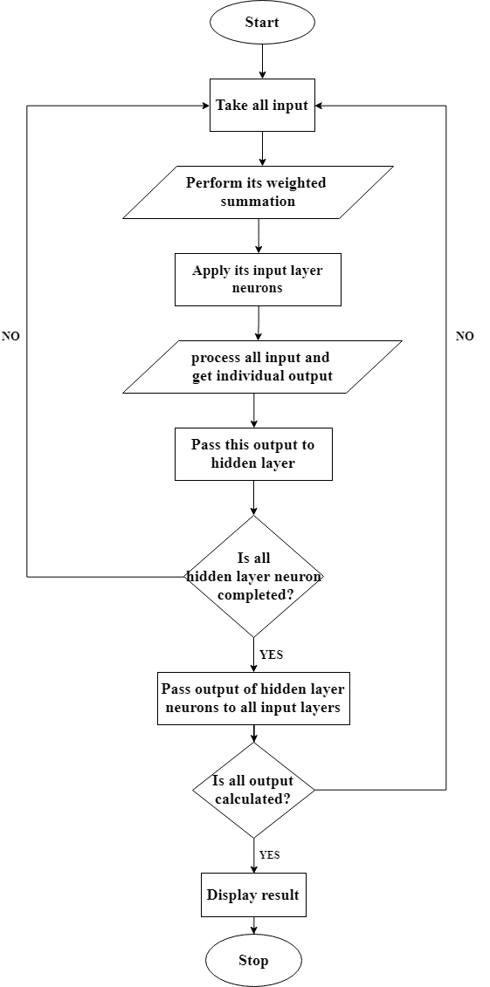
5. FLOWCHART

Slide 8
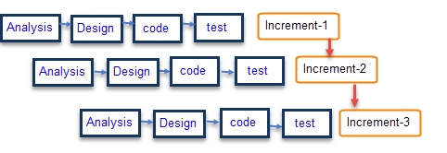
6. METHODOLOGY
6.1. Incremental Process Model

Slide 9
Incremental Process Model
Combination of sequential and prototyping model.
Application is divided into components.
For each component waterfall model is applied.
Features are improved and added in different increments.

Slide 10
6.2. Tools Used
Python 3 for software development.
Keras library for model training.
Matplotlib module for embedding plots.
Sklearn for data pre-processing and scaling.
Numpy library for operating mathematical functions.
User Interface of the software was designed using Tkinter toolkit.

Slide 11
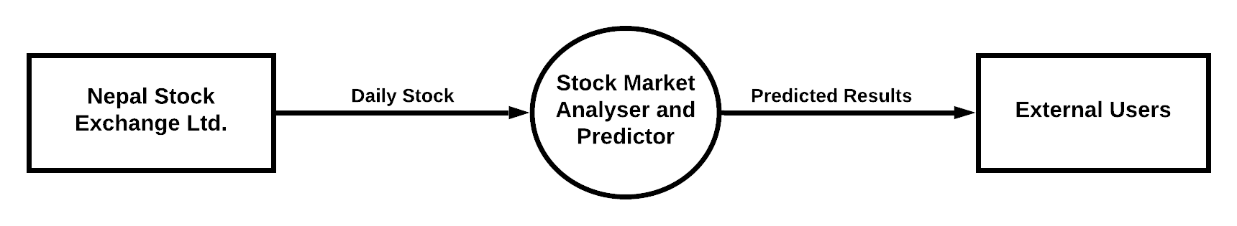
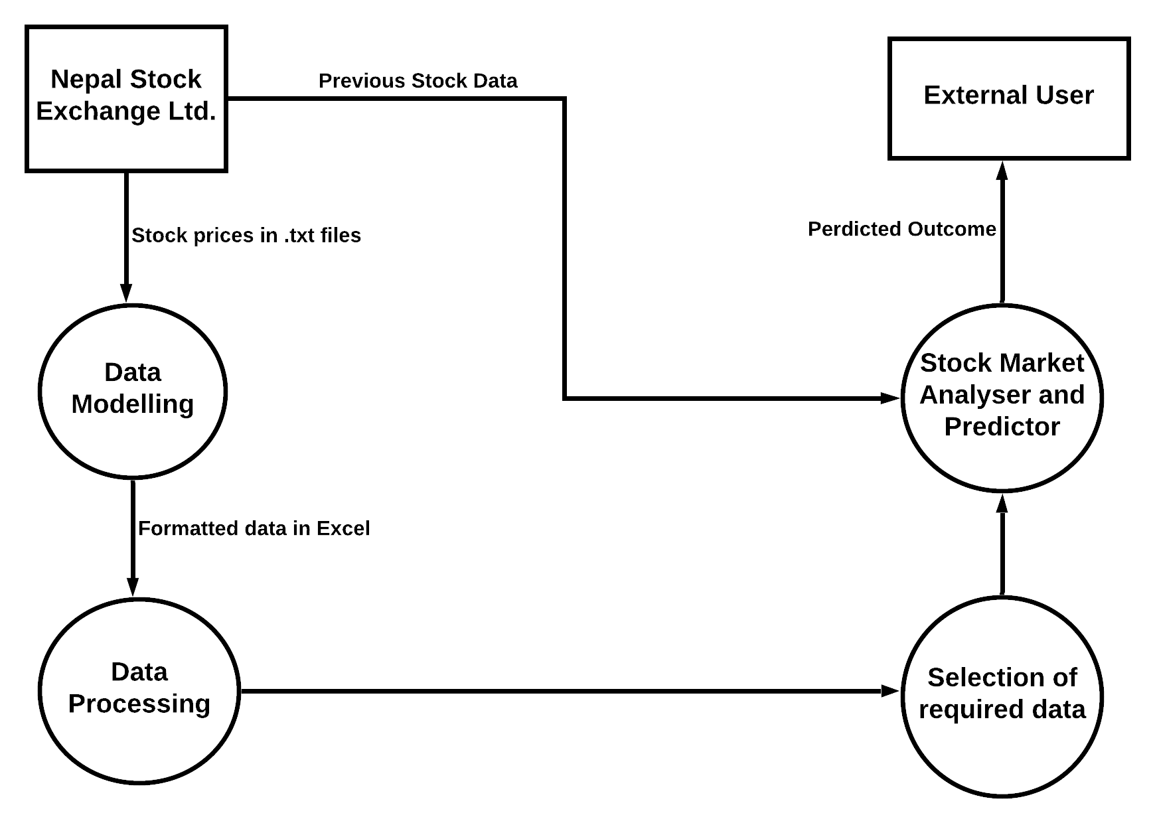
6.3. Pictorial Representations
6.3.1. Multilevel DFD’s
Level 0
Level 1

Slide 12
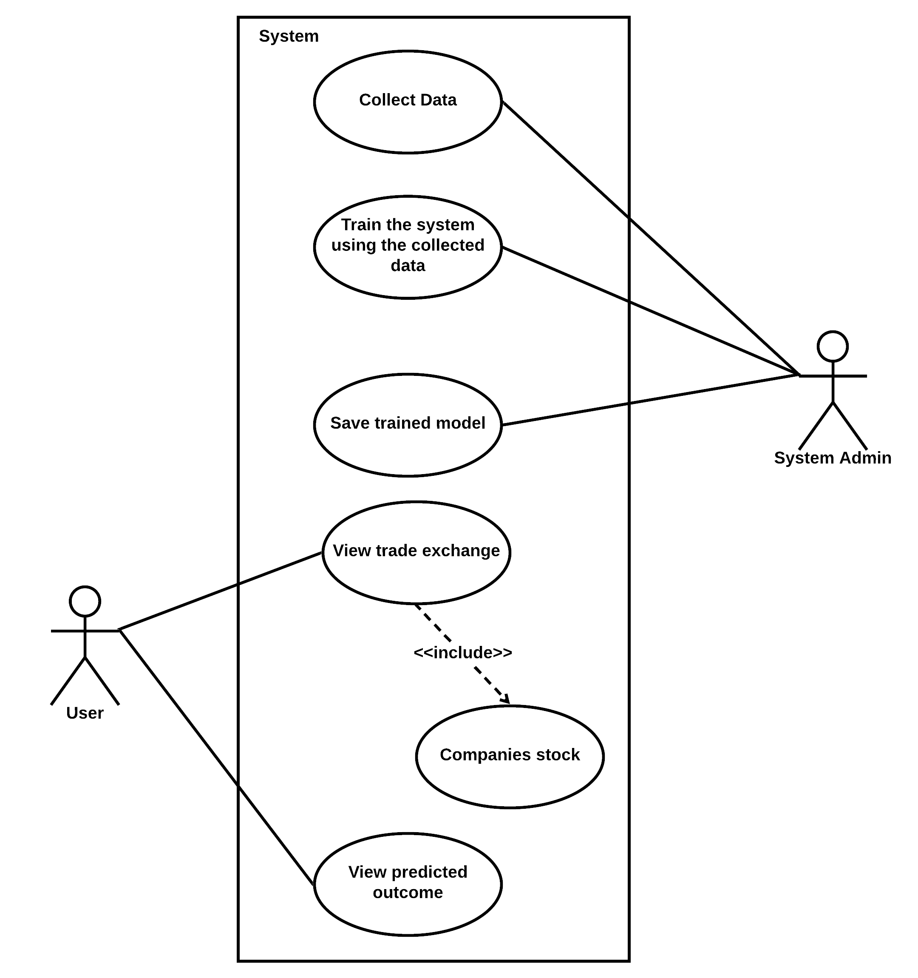
6.3.2. Use-Case Diagram

Slide 13
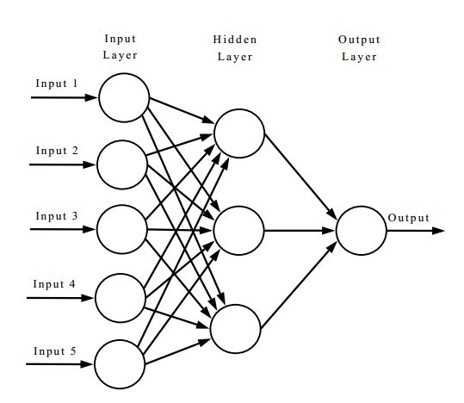
6.4. Artificial Neural Network

Slide 14
7. APPLICATION AND SCOPE
Studying the stock market.
Provide supportive future market directions.
Observing market behavior.
Analyze market trends.
Promote data digitization.

Slide 15
8.1. Conclusion
Investment in stock is made easier.
Gives direction of stock market.
Unbiased towards any individual or company.
Integrates Machine Learning into the business scene.

Slide 16
8.2. Future Enhancements
Sentiment Analysis for event-driven analysis.
Improvements on user experience.
Increase in the number of companies.

Slide 17
9. REFERENCES
R. L. Wilson and S. Ramesh, "Bankruptcy Prediction using Neural Networks," Elsevier, June, 1994.
J. Min and Y. Lee, "The Prediction Model of Financial Crisis Based on the Combination Principle Component Analysis and Support Vector Machines," Open Journal of Social Sciences,Vol.2, 2014.
K.-H. Tsai and J.-C. Wang, "External technology sourcing and innovation performance in LMT sectors: An analysis based on the Taiwanese Technological Innovation Survey," Elsevier, vol. 38, no. 3, 2009.
K.-H. Han and J.-H. Kim, "Genetic Quantum Algorithm and its Application to Combinational Optimization Problem".

Slide 18
Thank You!!!

